Slide 1
Public Economics (2450B)
Topic 7: The EITC
Nathaniel Hendren*
Spring, 2023

Slide 2
EITC Papers
Lots of papers on the EITC. In class, we will discuss:
Kleven (2021)
Bastian and Jones (2021)
Bastian (2020) (not assigned reading – slides follow)

Slide 3
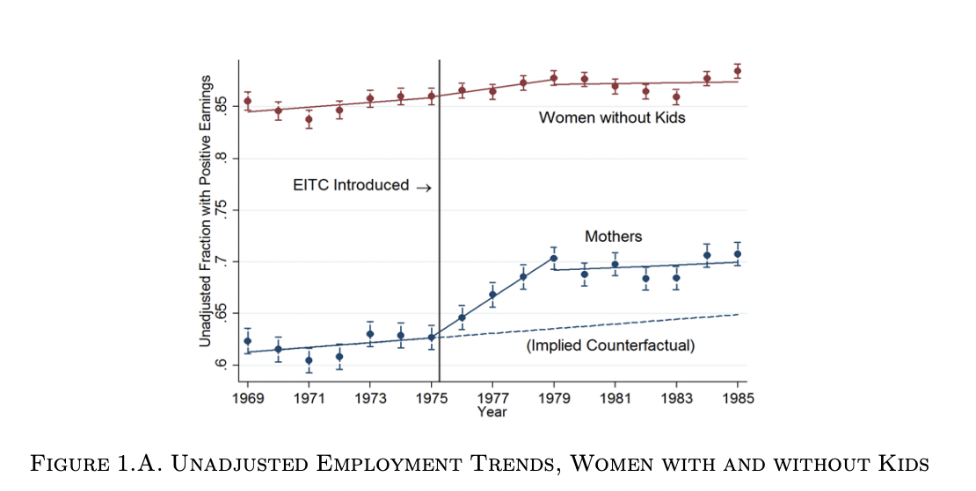
EITC Papers

Slide 4
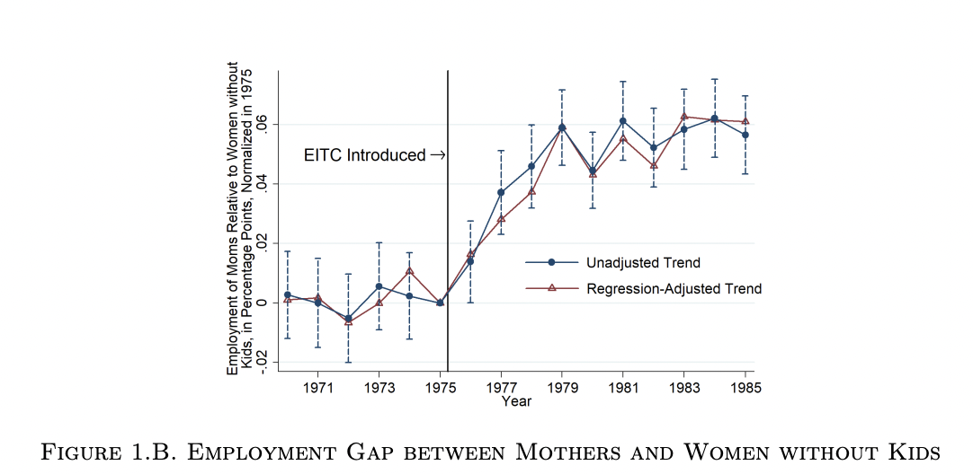

Slide 5
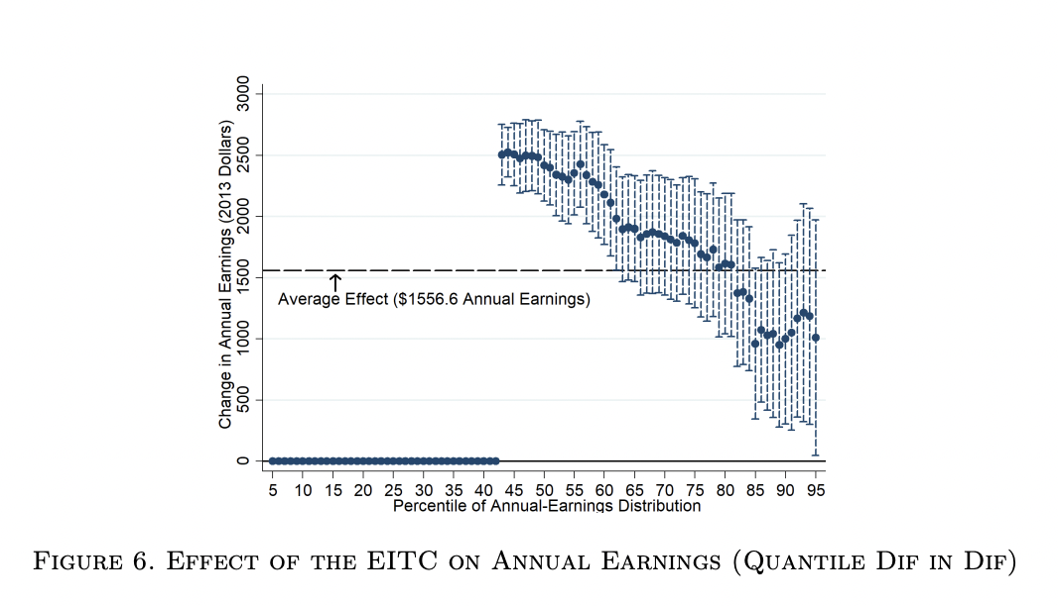

Slide 6
Chetty et al 2013
Chetty et al (2013) study variation in knowledge about the EITC to estimate its impact on labor supply

Slide 8
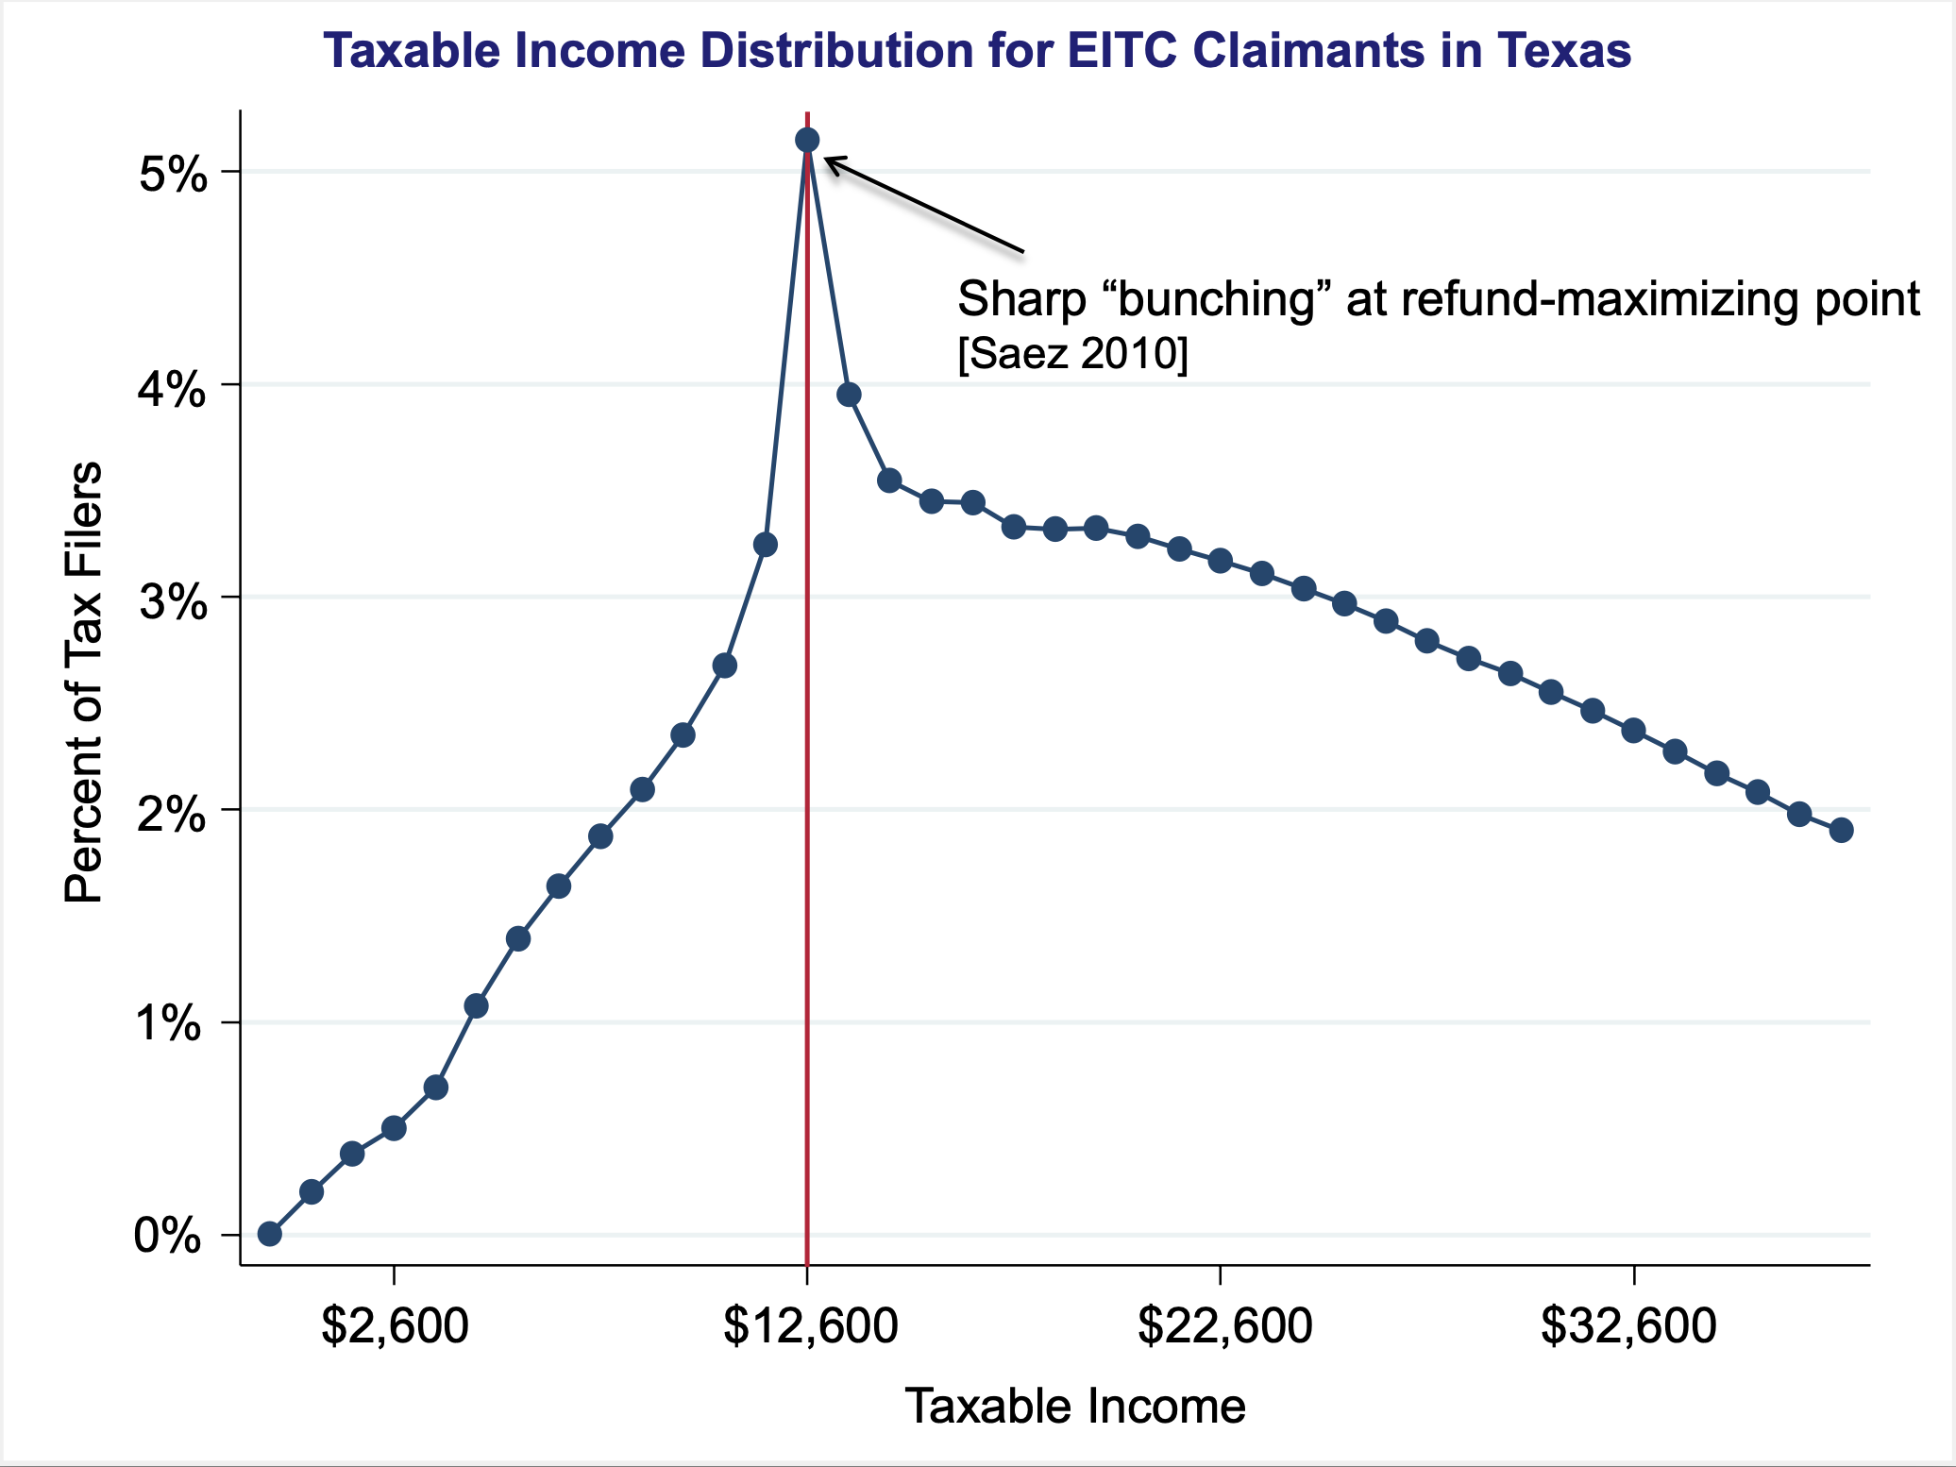

Slide 9
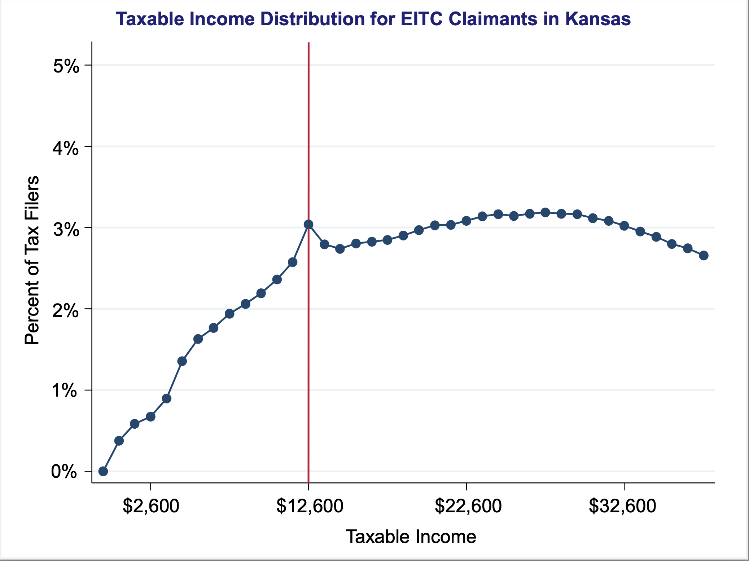

Slide 10
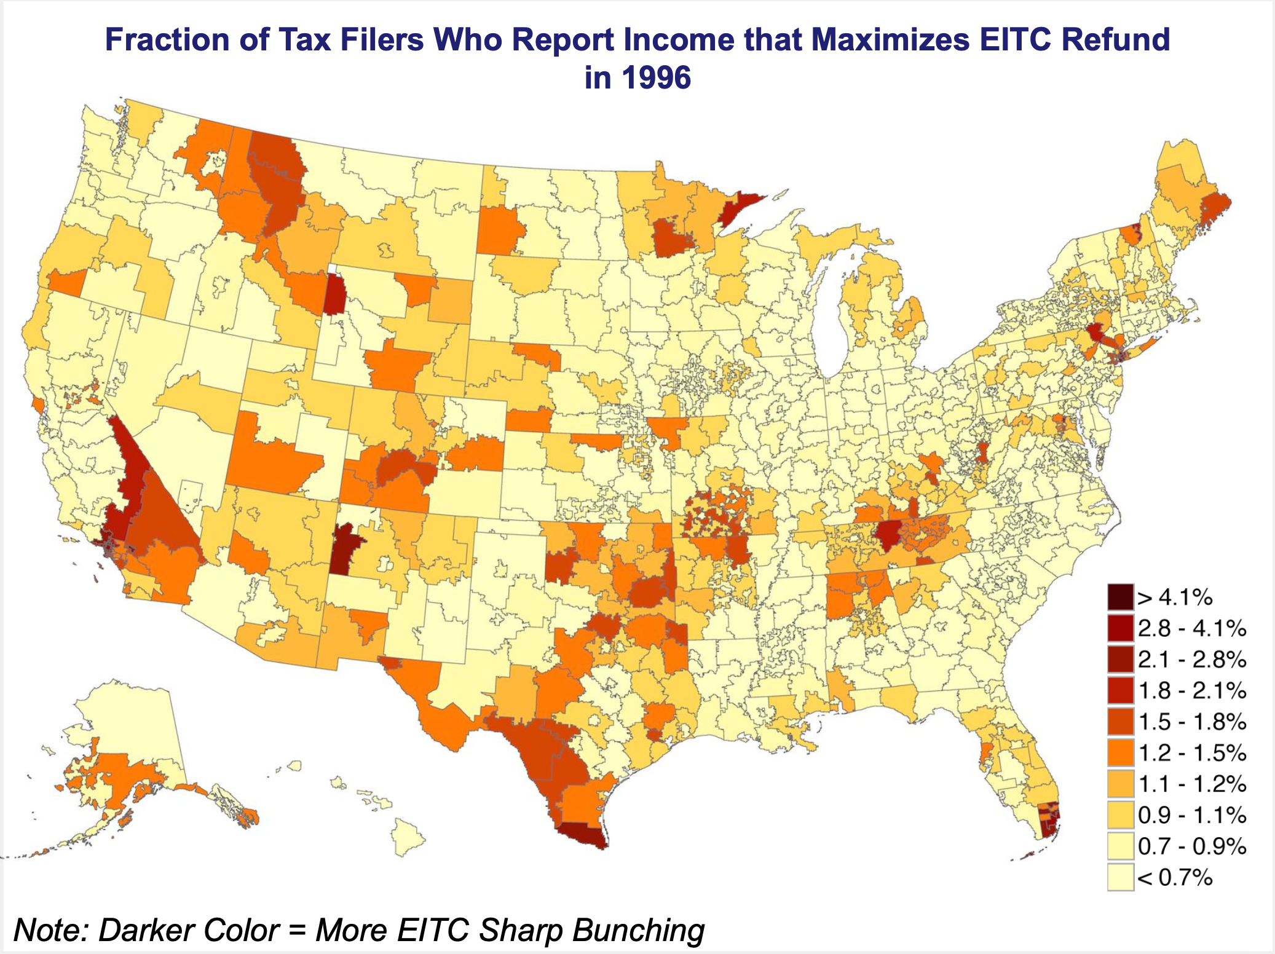

Slide 11
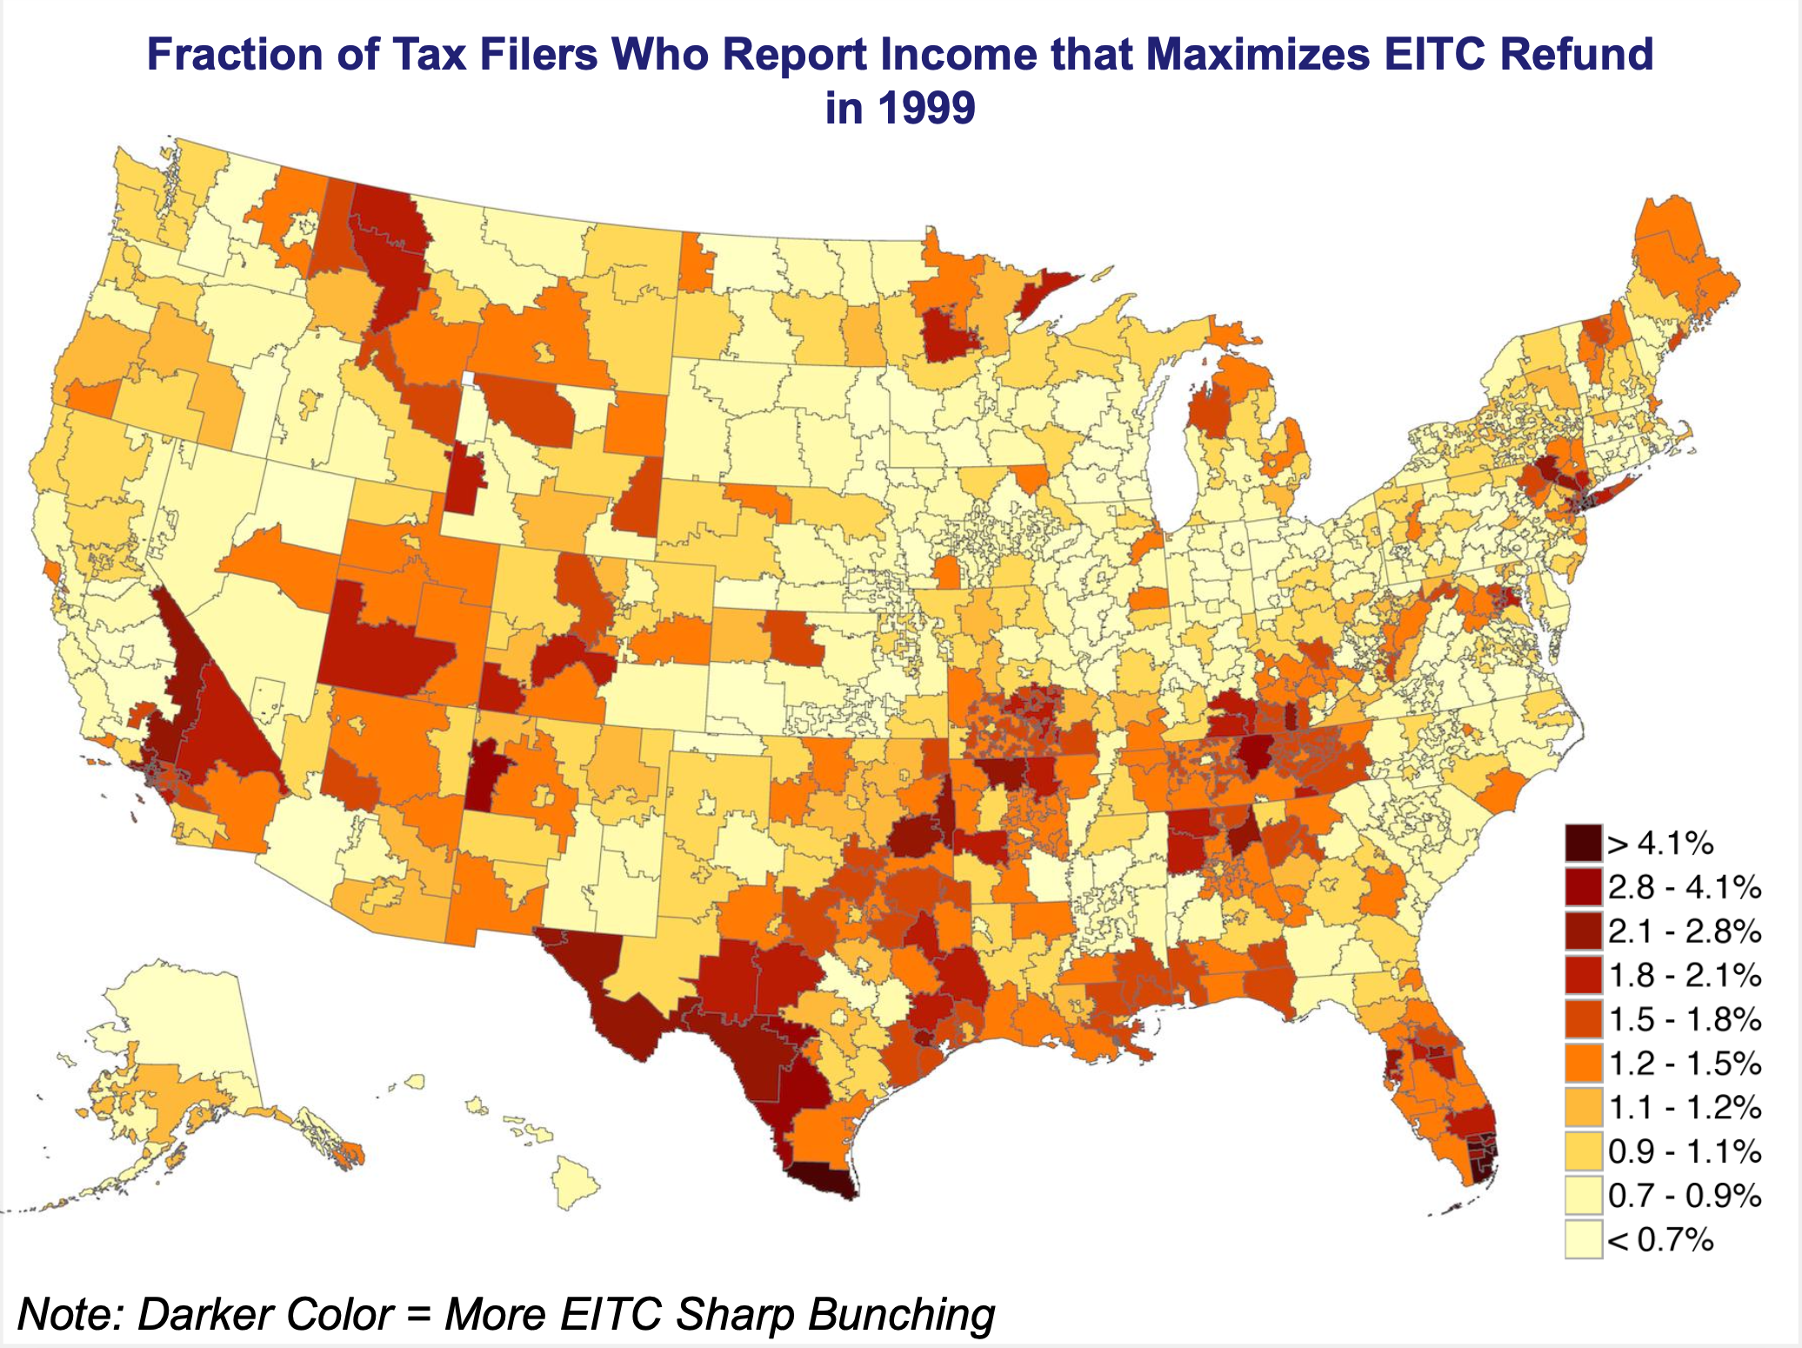

Slide 12
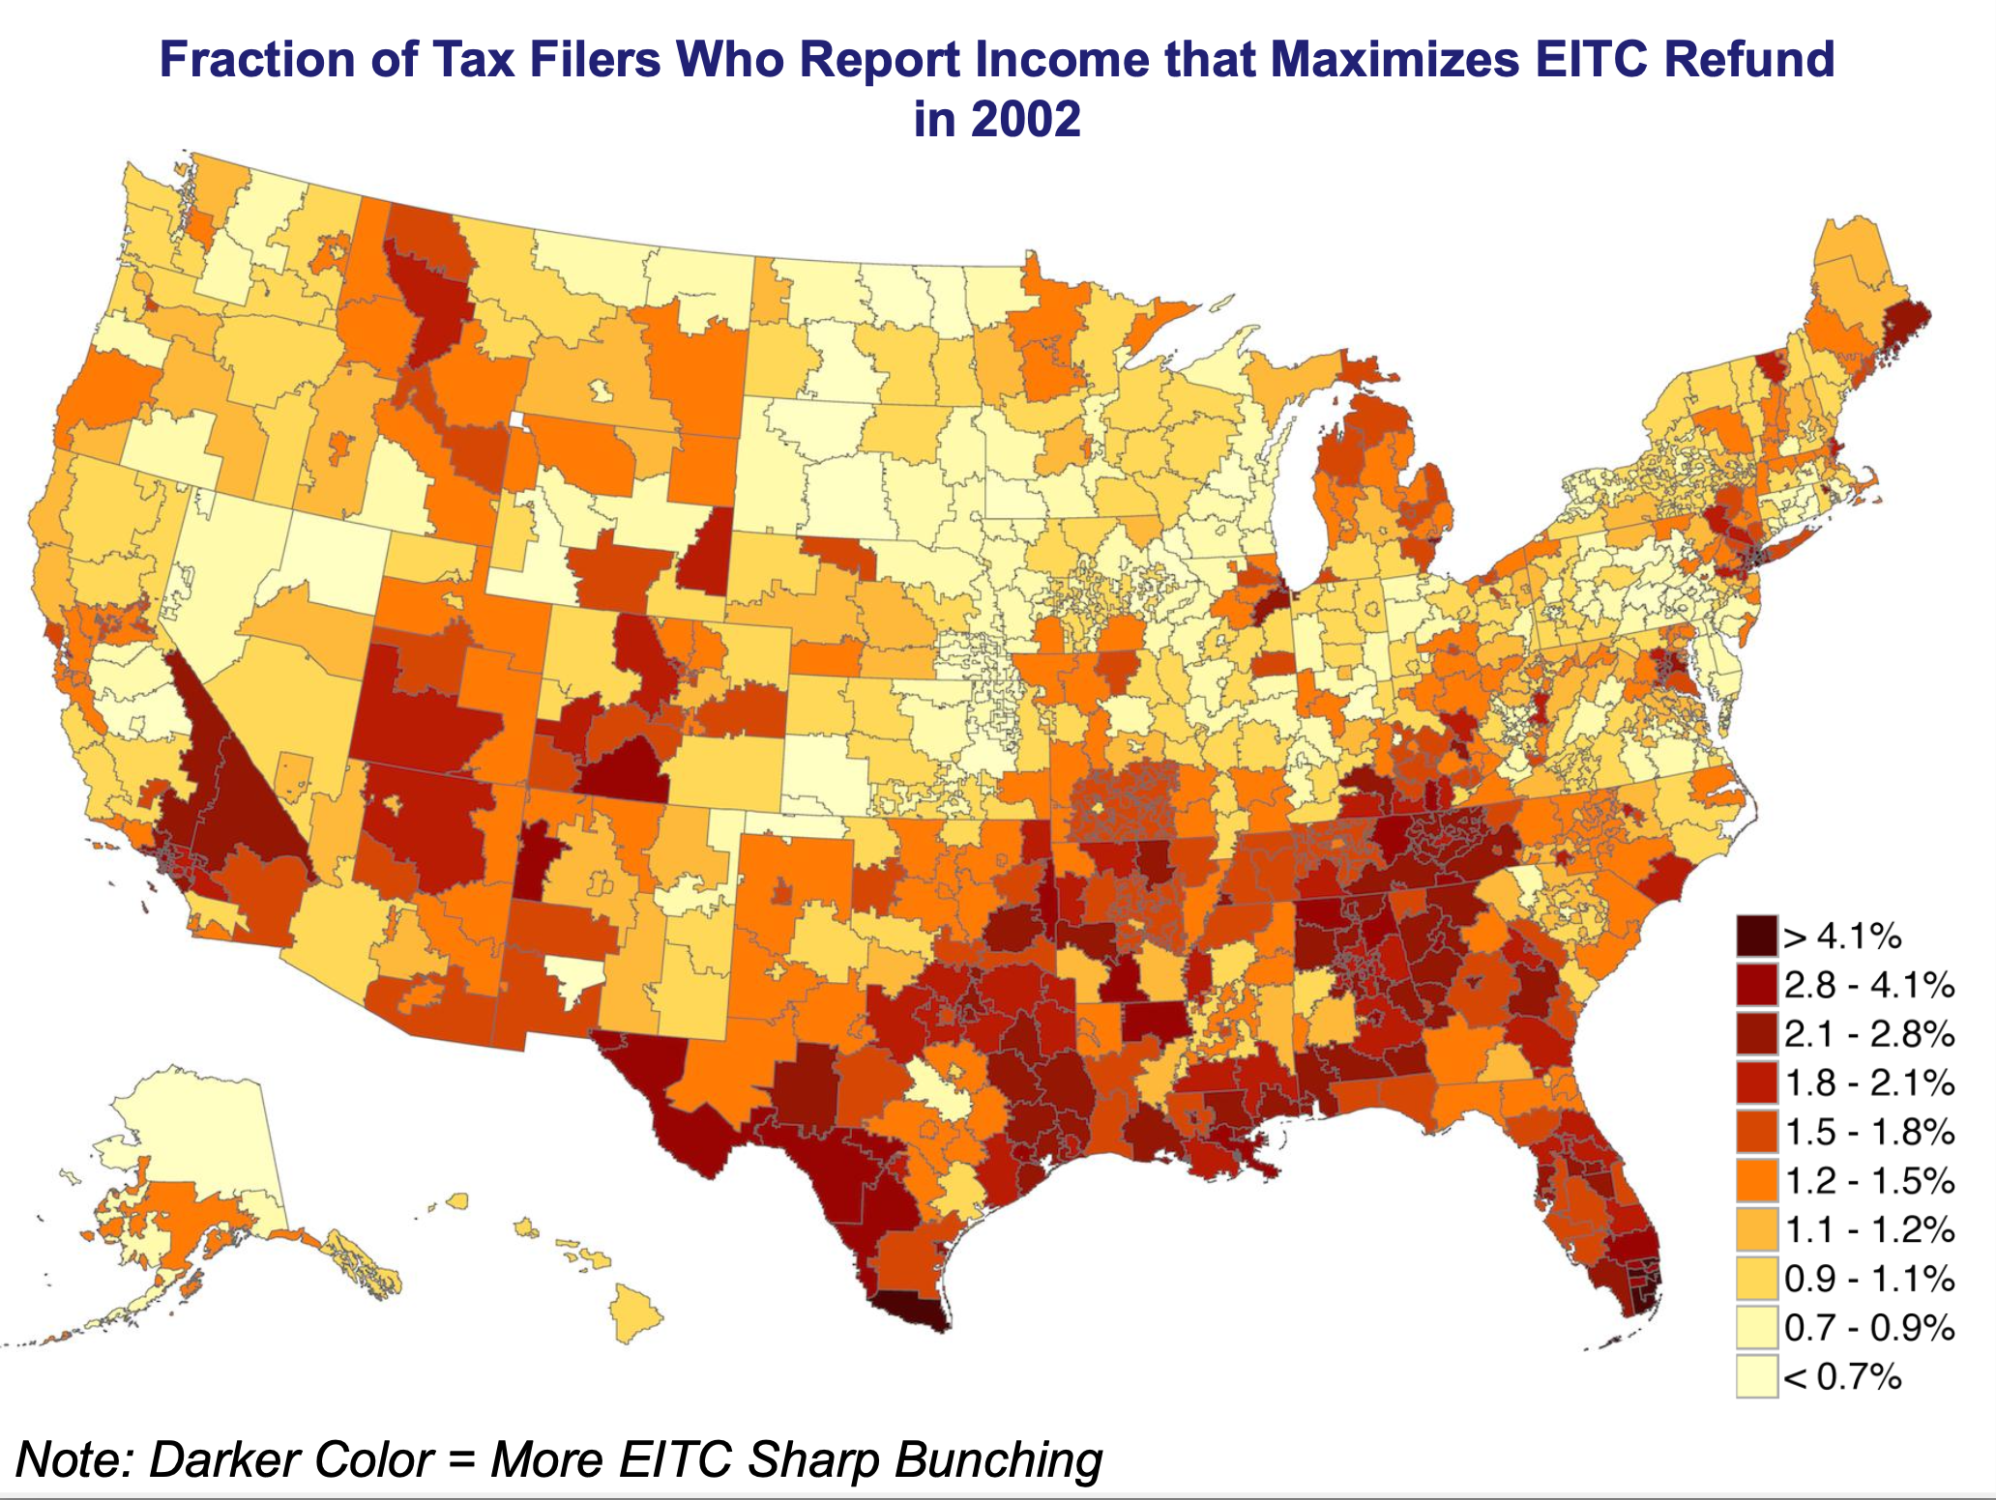

Slide 13
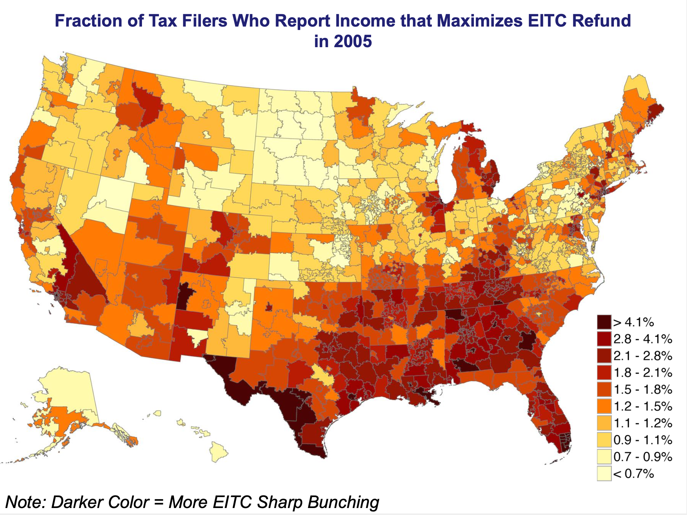

Slide 14
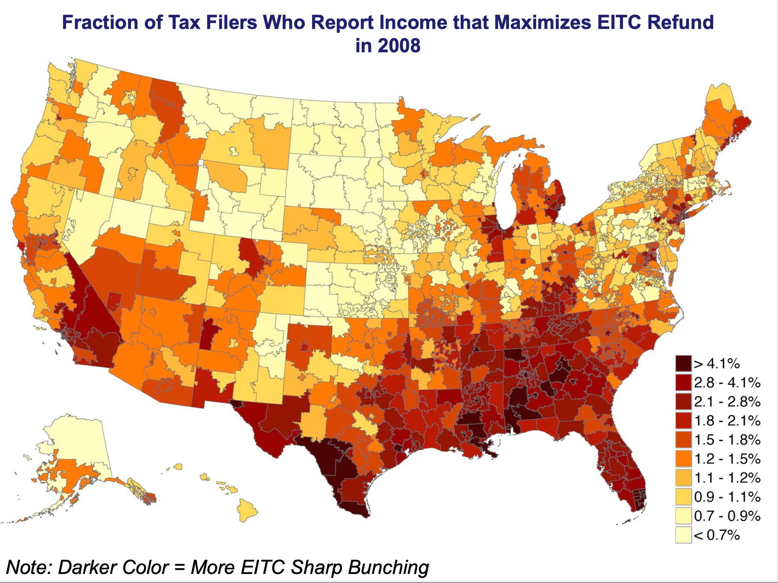

Slide 15
Differences in Knowledge about the EITC?
Why does impact of EITC on income vary so much across areas?
Plausible behavioral model: differences in knowledge about EITC To test this explanation, consider individuals who move
Knowledge model predicts asymmetric impact of moving:
  Moving to a higher-bunching area should raise EITC refund
  Moving to a lower-bunching area should not affect EITC refund

Slide 16
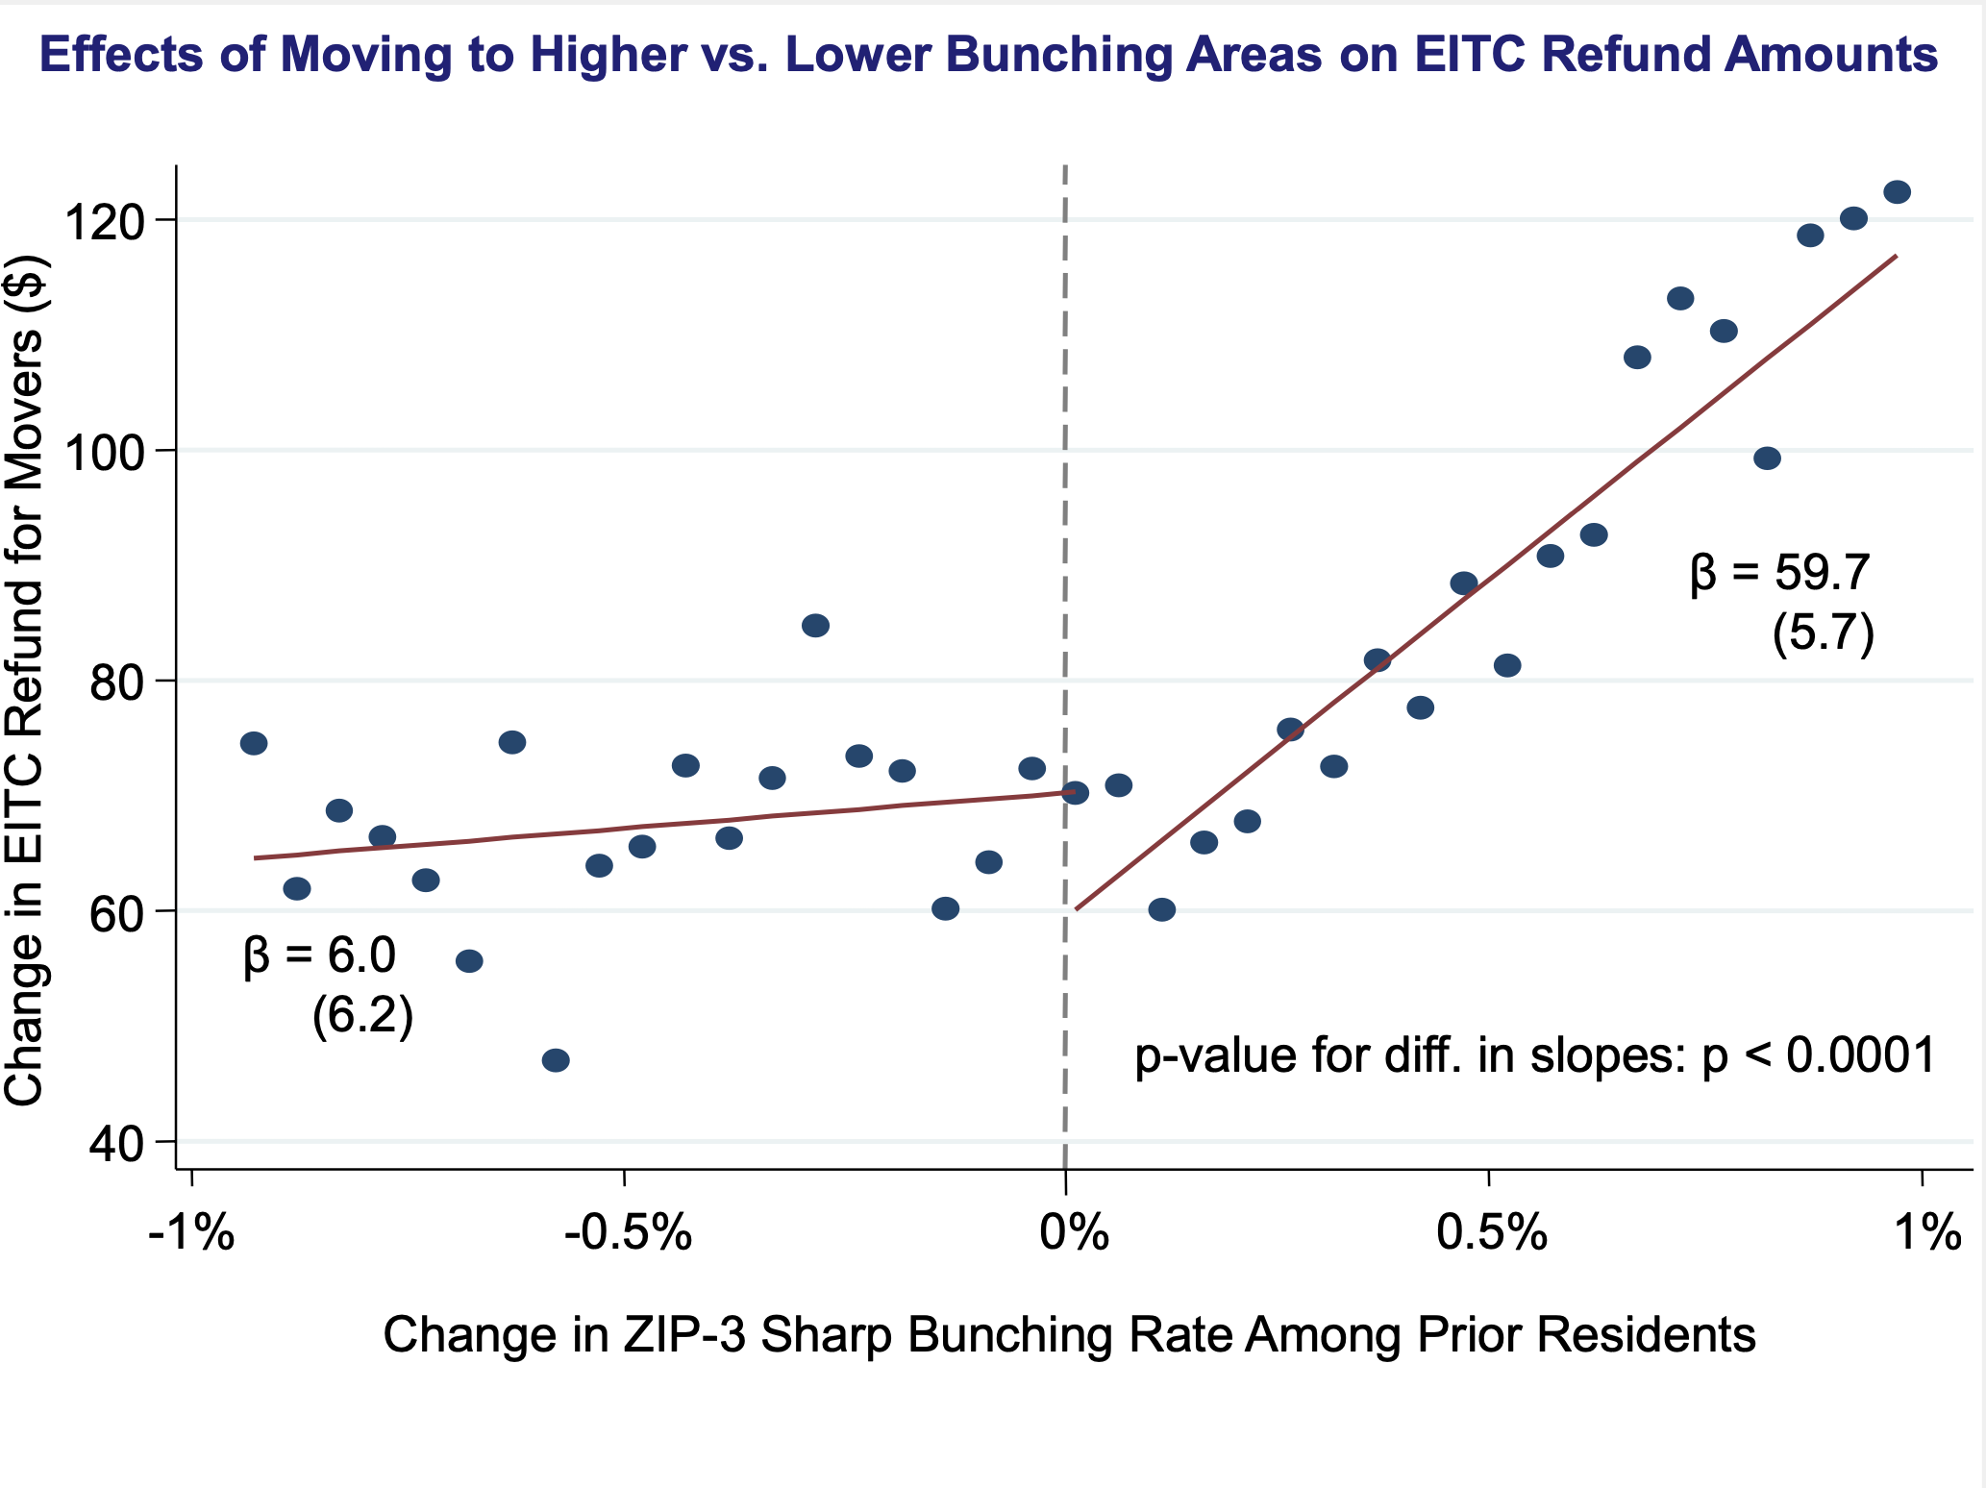

Slide 17
Differences in Knowledge about the EITC?
Paper documents clear evidence of heterogeneous bunching across areas
  Driven mainly by self-employed (Saez 2010)
  Easy to manipulate income
Paper goes on to exploit bunching variation to ask a much deeper (more difficult) question:
How does EITC affect real labor supply?

Slide 18
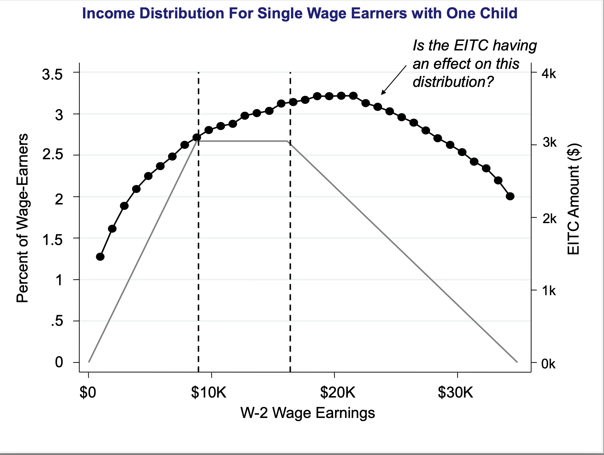

Slide 19
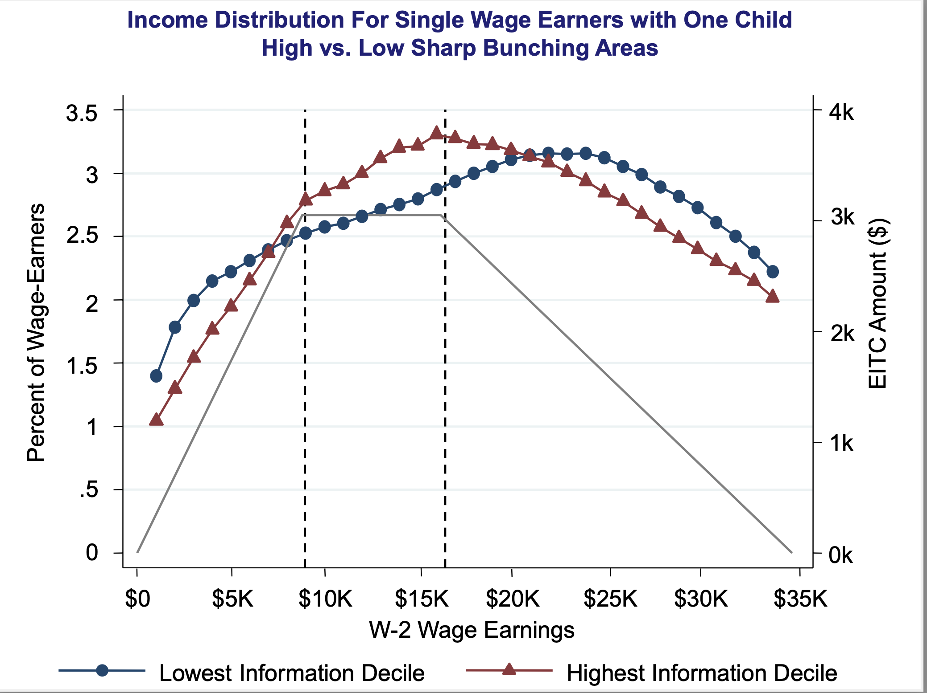

Slide 20
Child Birth Research Design
Comparisons across areas could be biased by omitted variables
Study changes in earnings around childbirth to address this concern
  Individuals without children are essentially ineligible for the EITC
  Birth of a child generates sharp variation in marginal incentives

Slide 21
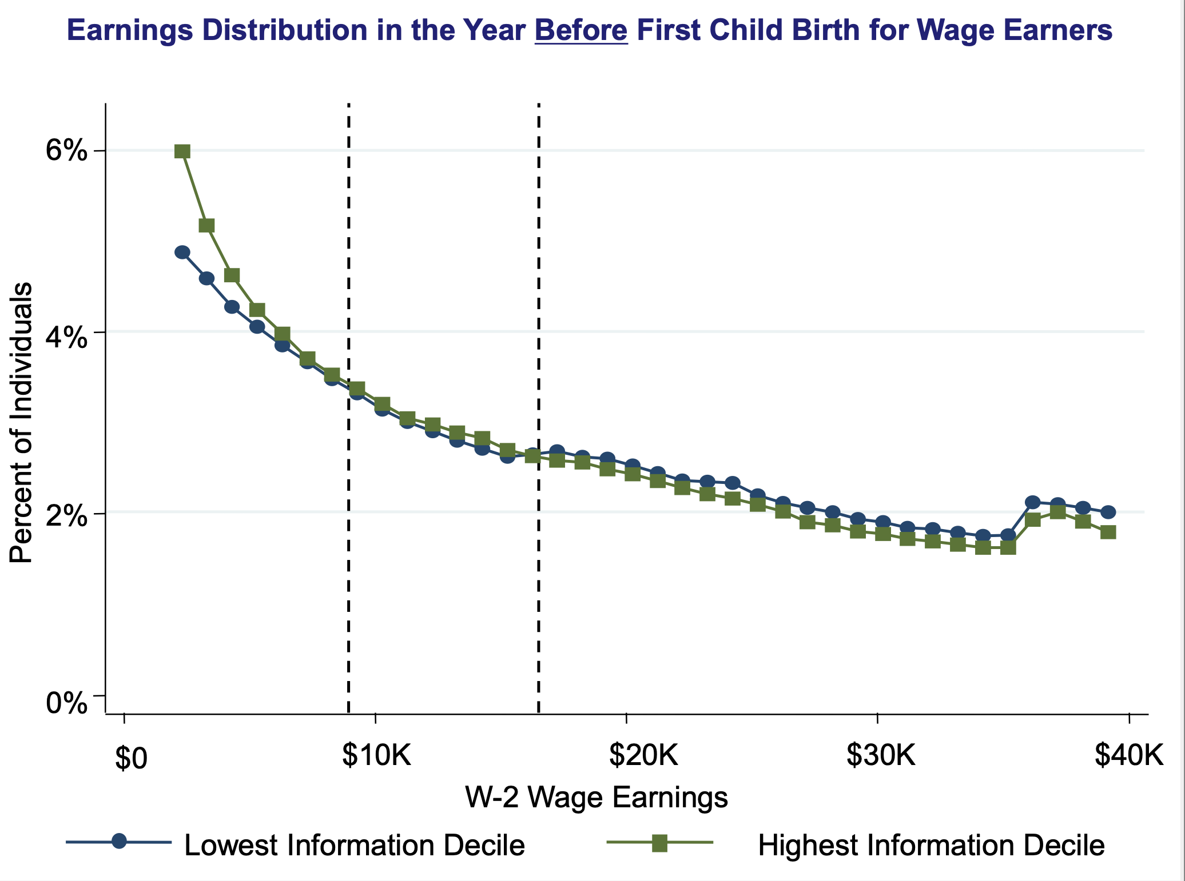

Slide 22
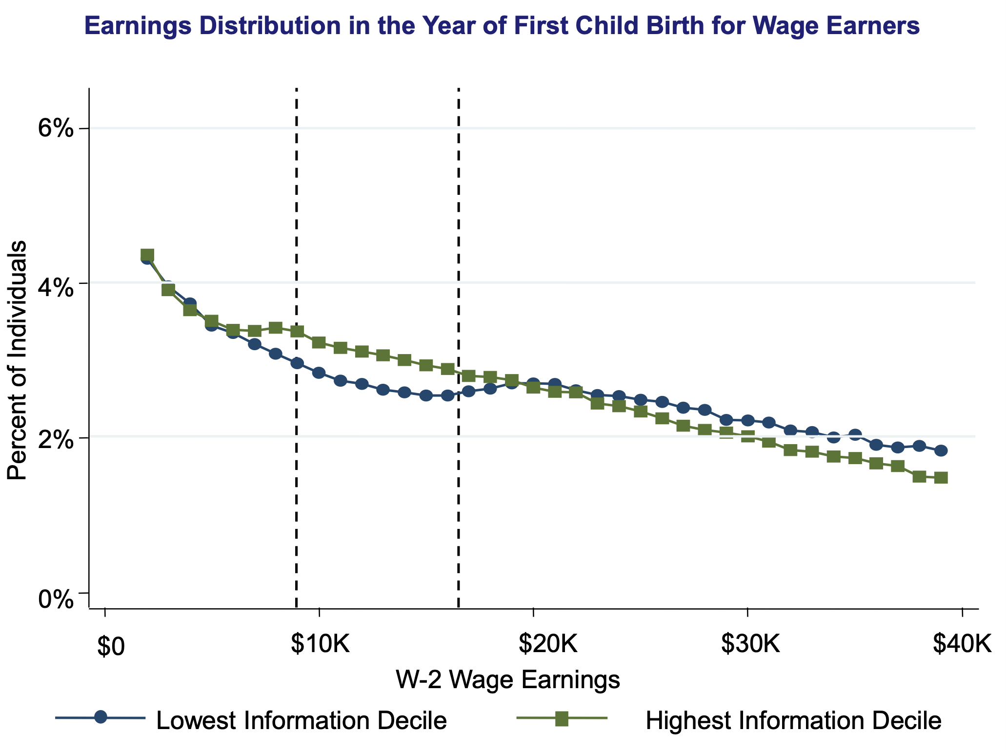

Slide 23
Paycheck Plus
Paycheck Plus provides RCT-like incentives to singles without children

Slide 24
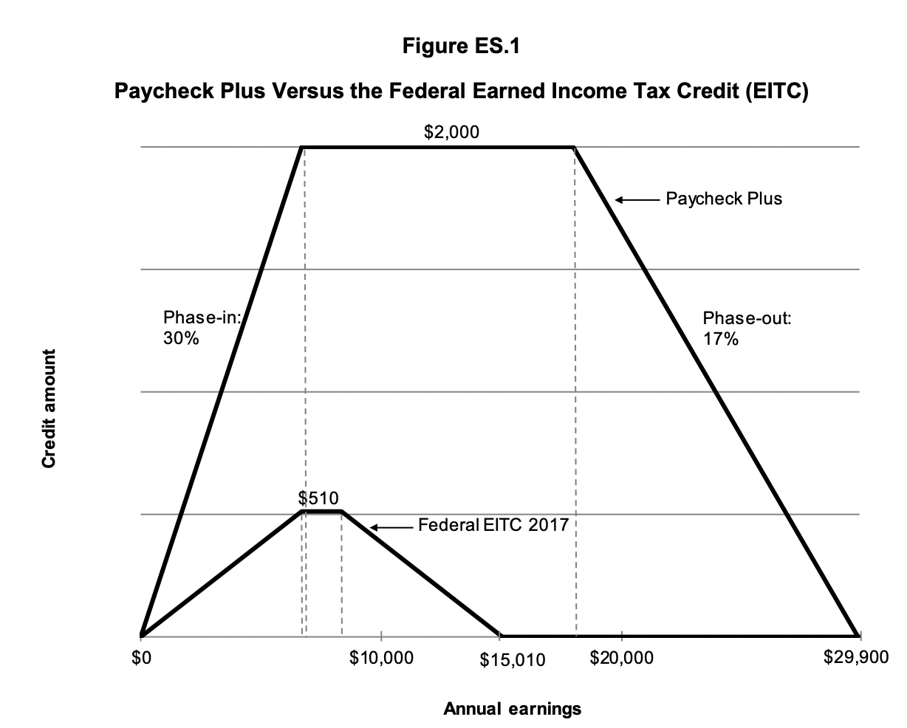
Paycheck Plus

Slide 25
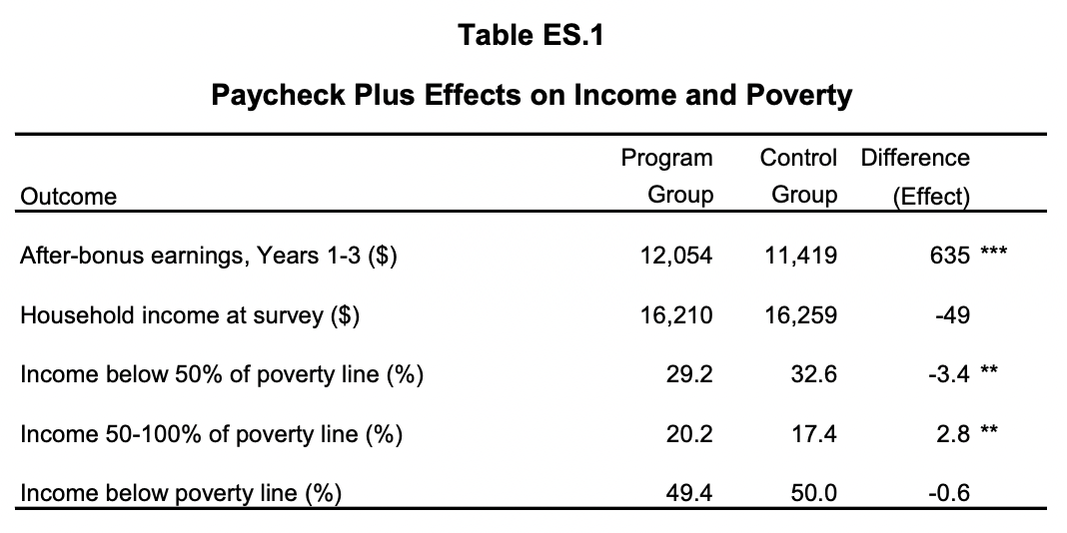

Slide 26
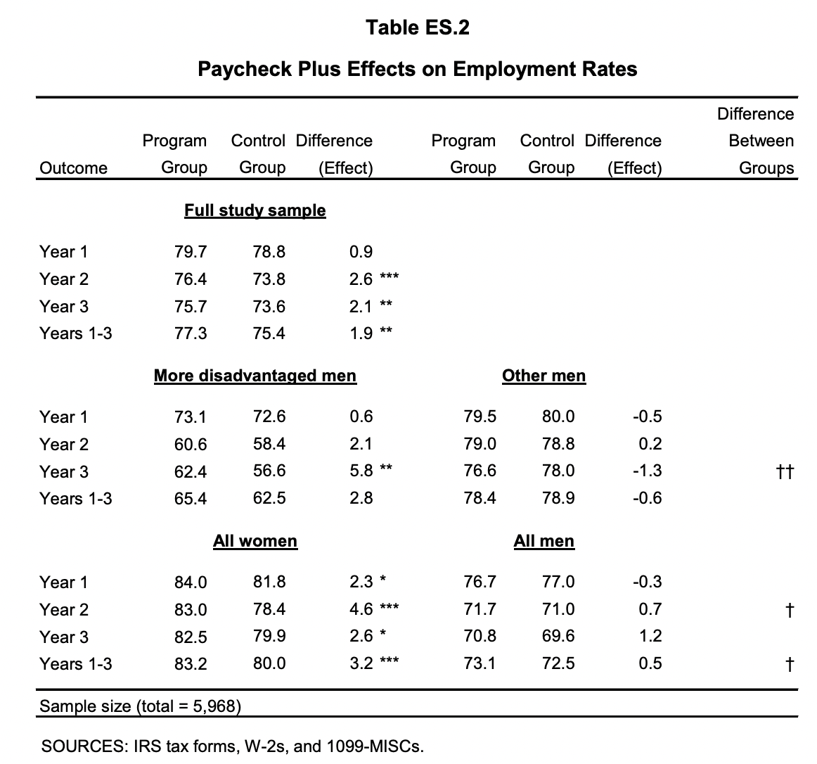

Slide 27
Impact on Kids
What is the impact of EITC on kids?
Crucial for thinking about the MVPF of the EITC

Slide 28
MVPF Estimates
With and Without Spillovers on Children
∞
No Kid Impacts
>5
With Kid Impacts
4
3
MVPF
2
1
0
<-1
AFDC
Housing
Housing
Negative
WIC
Vouchers
Vouchers
Income
AFDC
Chicago
Tax
Theory Back
Back

Slide 29
EITC OBRA 1993 MVPF Estimates
Incorporating Different Estimates of Spillovers on Children
∞
>5
4
3
MVPF
2
1
0
<-1
No
Bastian and
Bastian and
Michelmore
Manoli and
Dahl and
CFR
Maxfield
Impact
Michelmore
Michelmore
(2018)
Turner (2018)
Lochner
(2011)
(2013)
(2018)
(2018)
[College]
[College]
(2018)
[Test scores]
[Test scores]
[Earnings]
[College]
[Test scores]

Slide 30
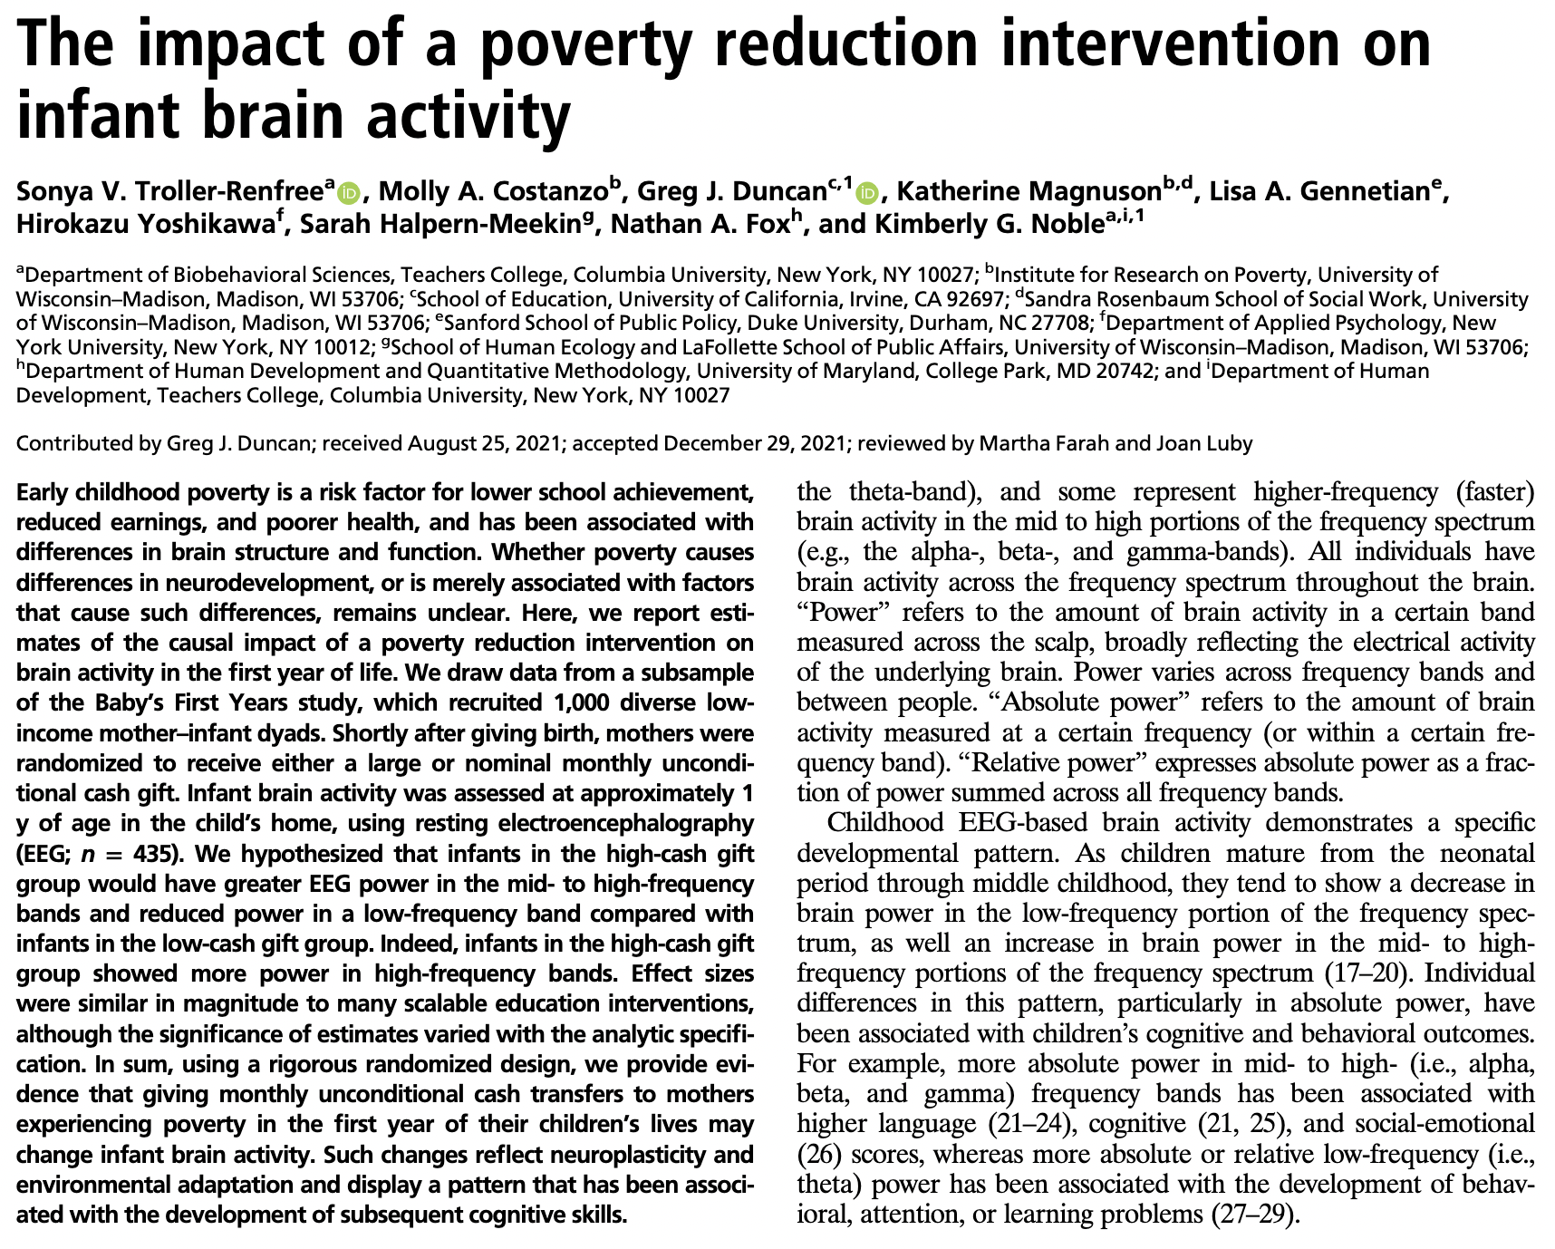

Slide 31
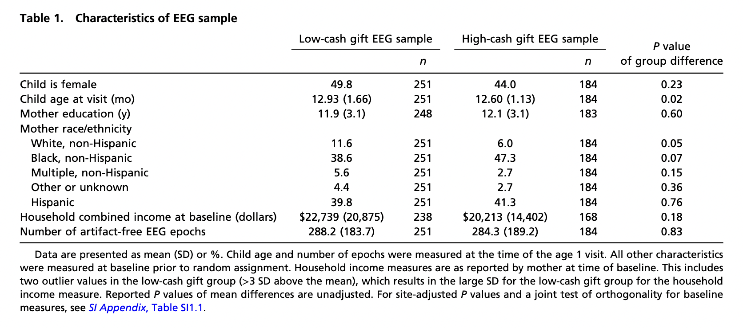

Slide 32
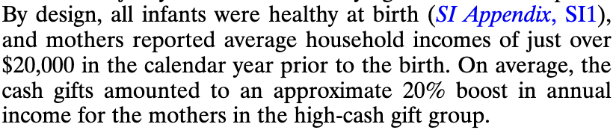

Slide 33
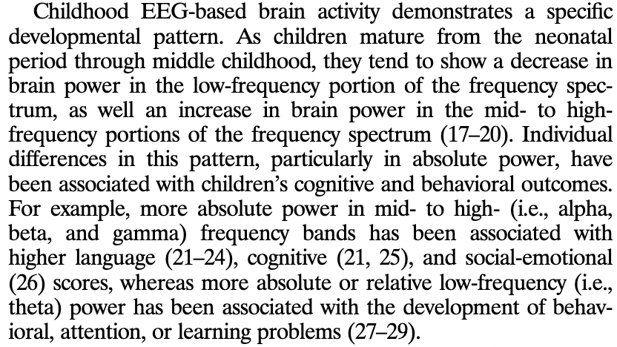

Slide 34
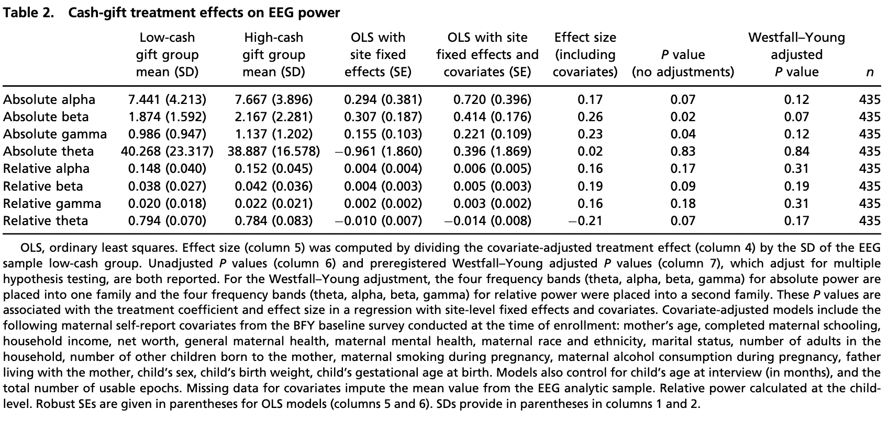

Slide 35
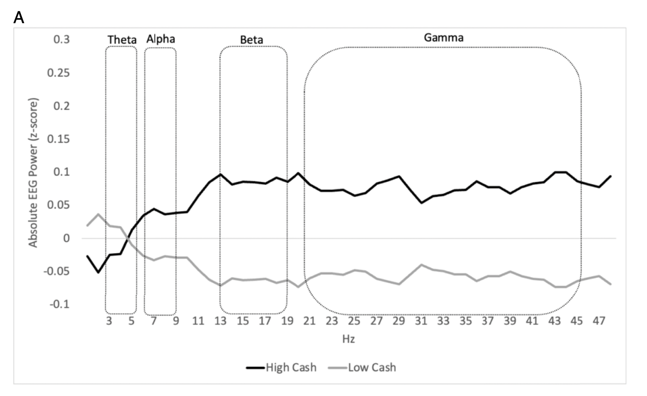

Slide 36
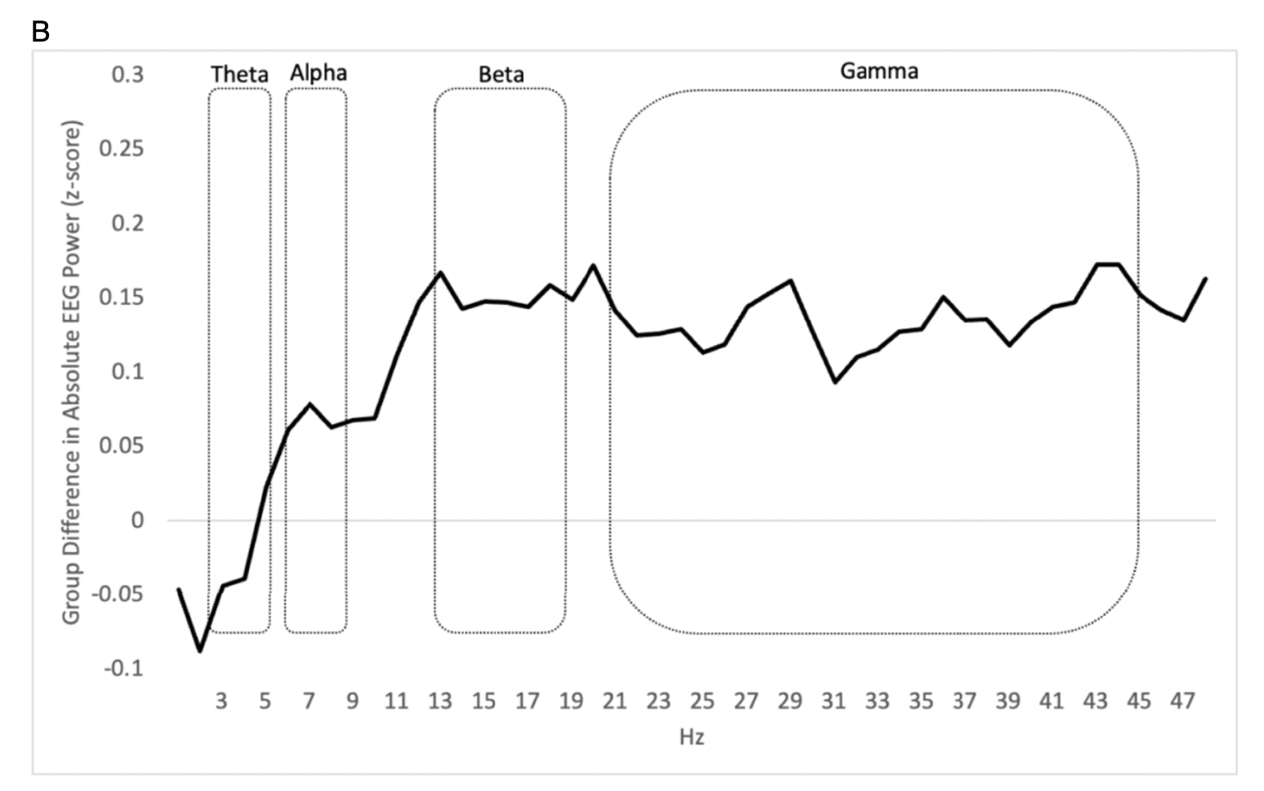

Slide 37
Tax Compliance
This deserves a much longer lecture
Here, focus on the most puzzling angle: people not taking up EITC benefits.

Slide 44
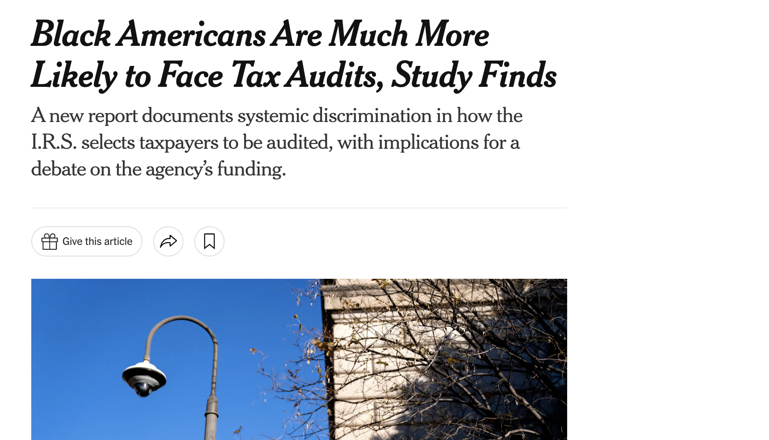
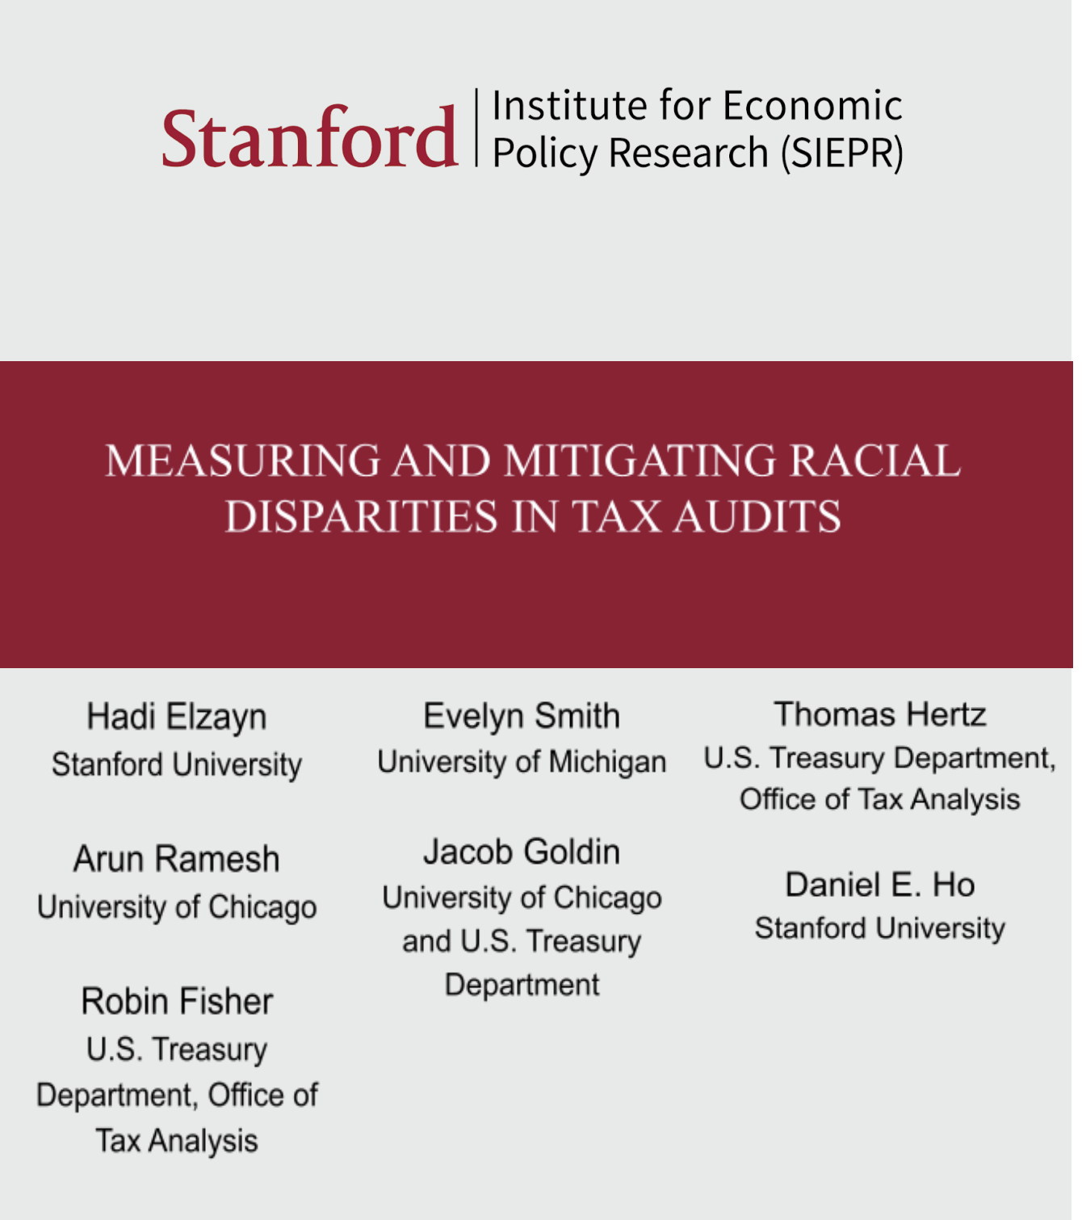

Slide 45
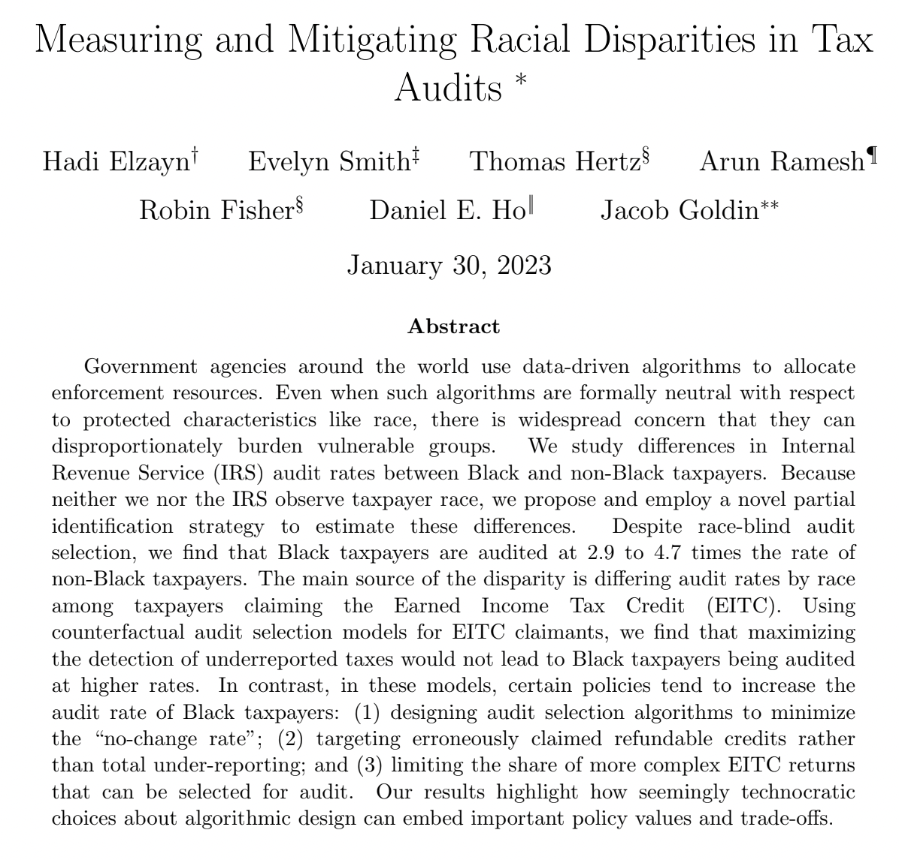

Slide 46
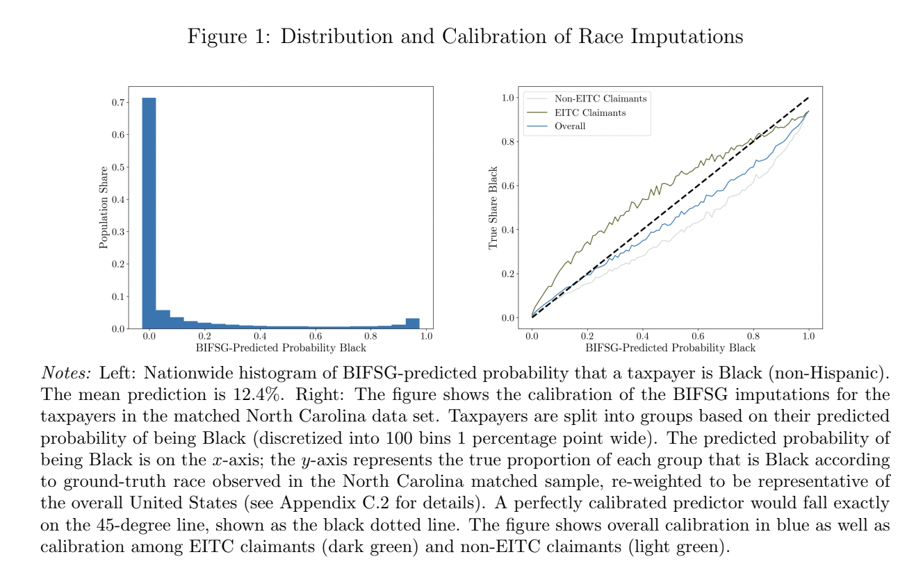

Slide 47
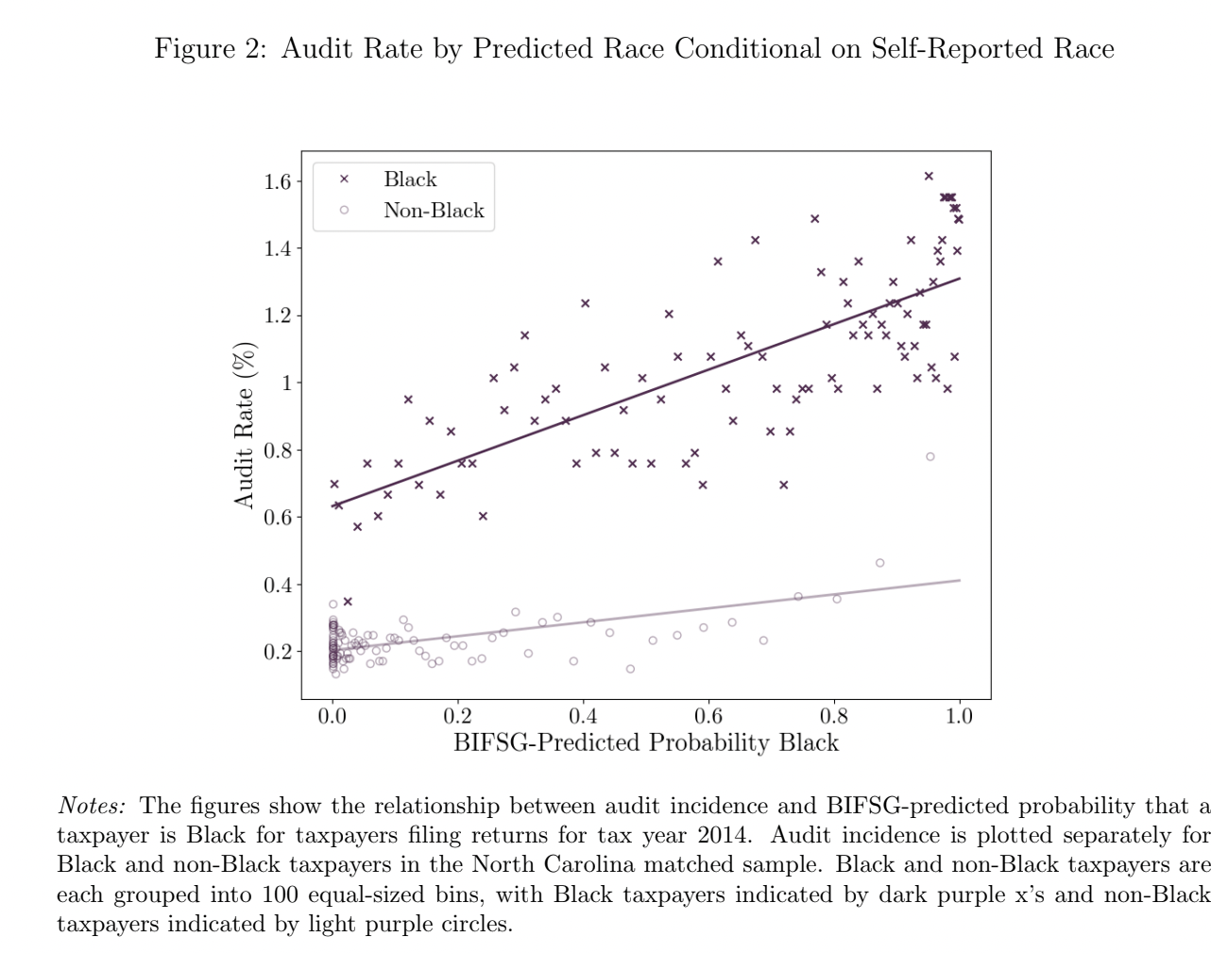

Slide 48
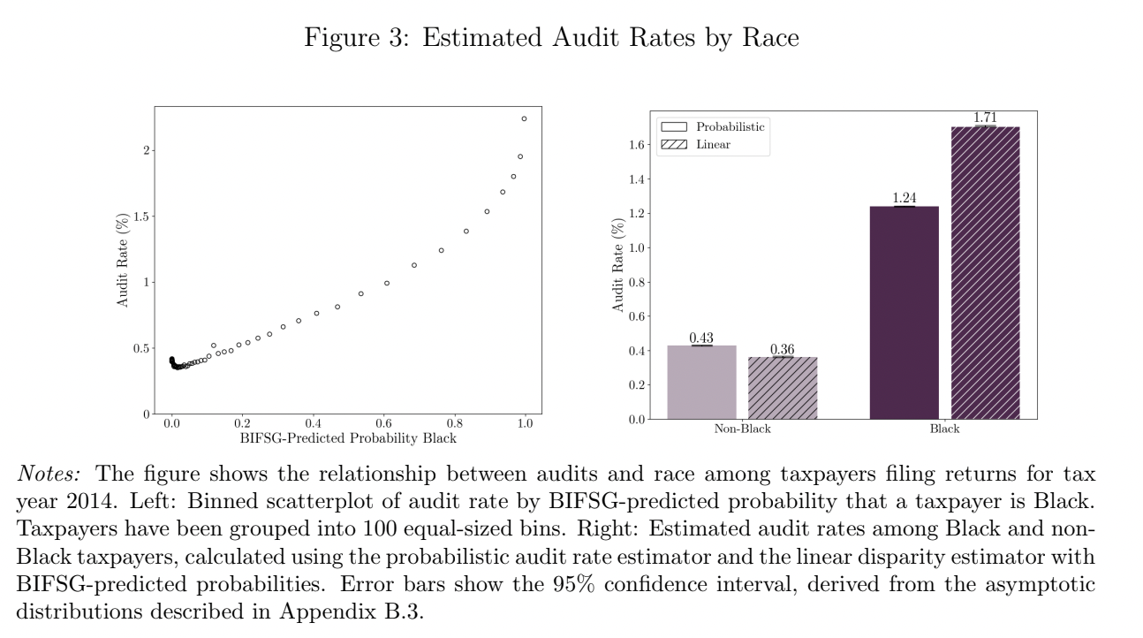

Slide 49
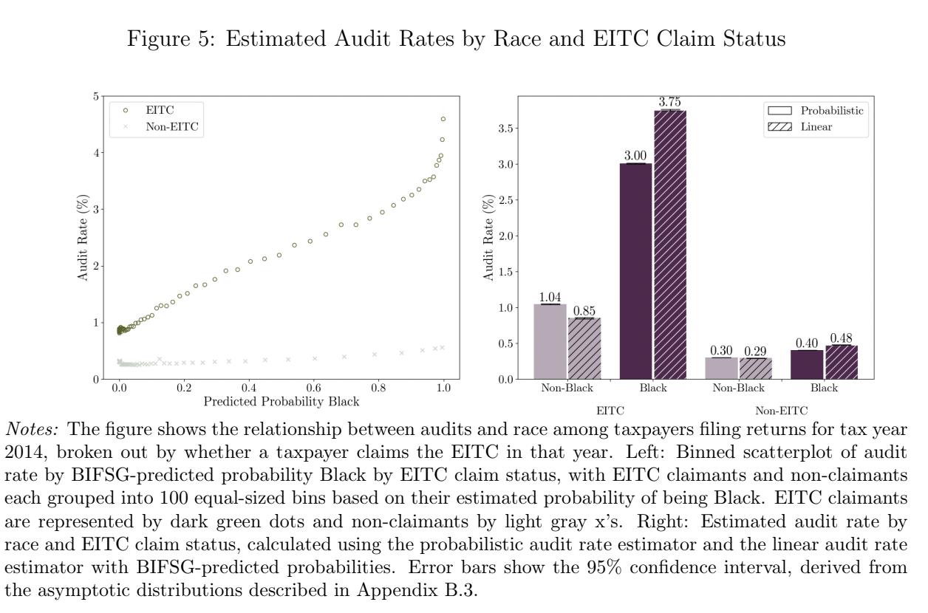

Slide 50
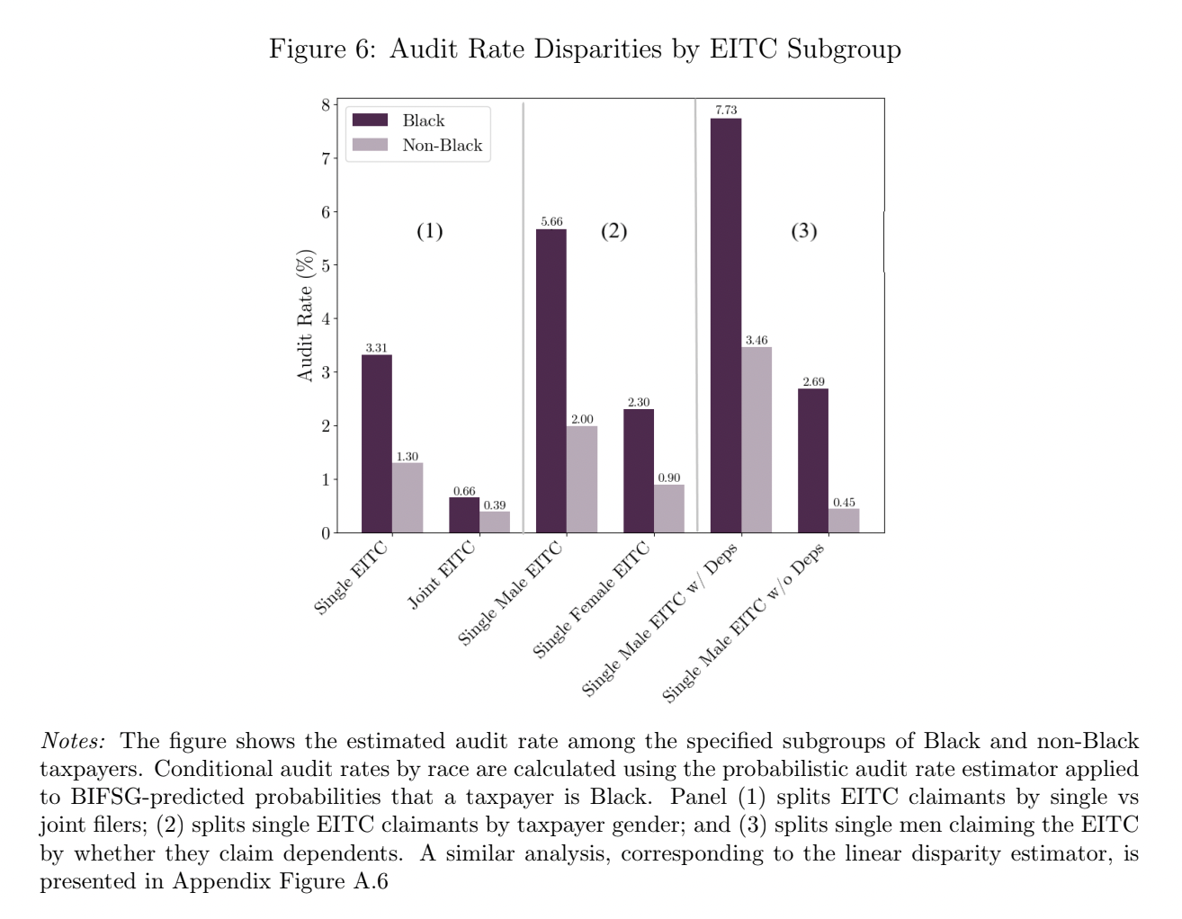

Slide 51
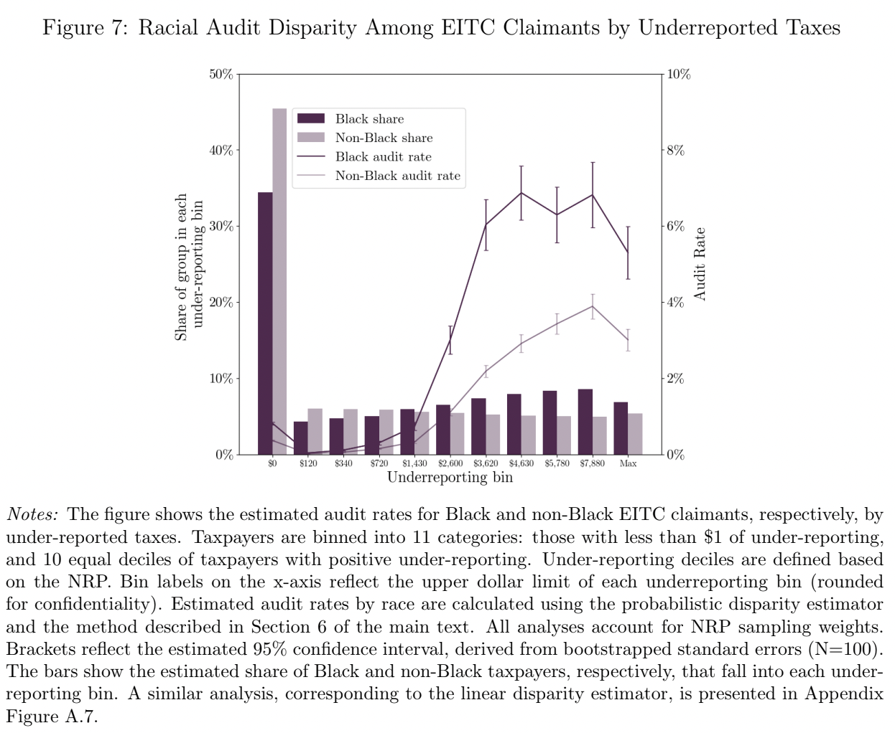

Slide 52
