Slide 1
Public Economics (2450B)
Topic 6: Place-Based Policy
Nathaniel Hendren*
Spring, 2020
*Much of these slides are based on wonderful lectures prepared by Owen Zidar, which are in turn based on lectures from Pat Kline and Juan Carlos Suarrez Serrato.

Slide 2
Place–Based Policy
Many policies are implemented at the local level
Taxes (Property, sales, and corporate)
Spending (Education, Health, UI, …)
Regulations (e.g. zoning)
Many national policies have local implications (e.g. Section 8 / Housing Choice Vouchers, LIHTC, etc.)
How should layers of government be organized? How should local and fed govt interact? These are questions about ”Fiscal Federalism”:
Should the federal government or local government set property taxes?
Who should pay for schools?
Should local or federal governments redistribute?

Slide 3
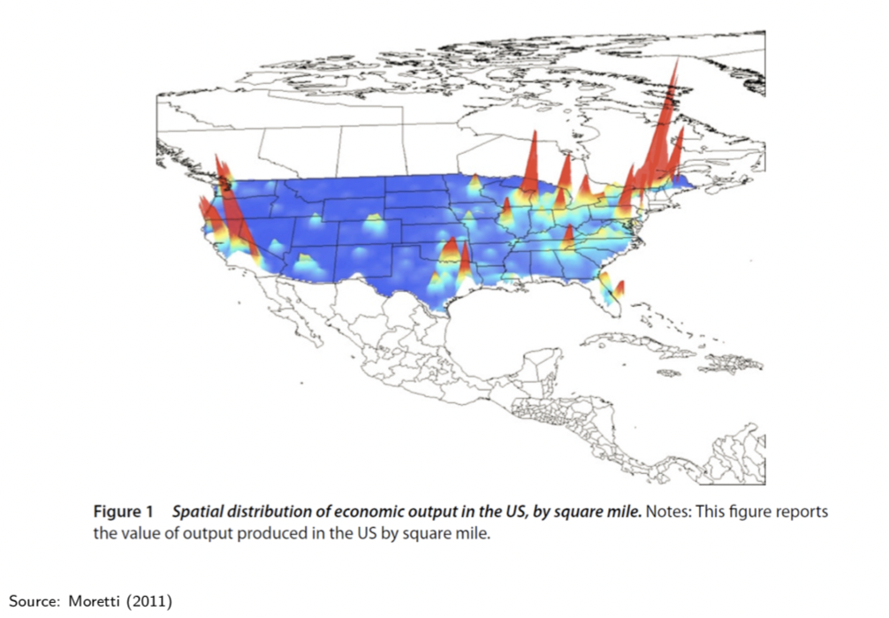
Economic Activity is Geographically Concentrated (Moretti 2011)

Slide 4
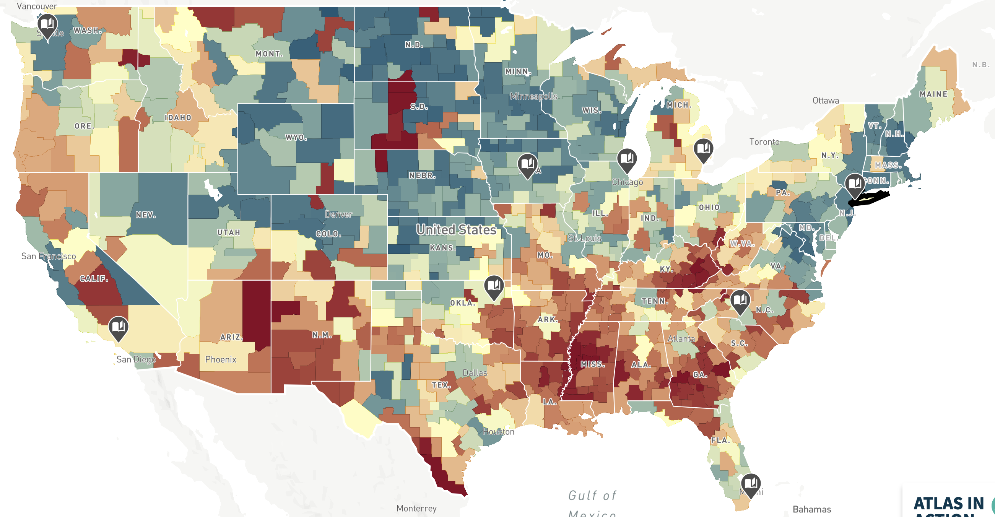
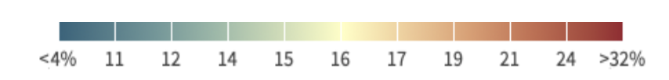
Poverty is Geographically Concentrated (2012-2016 Poverty Rates from ACS)

Slide 5
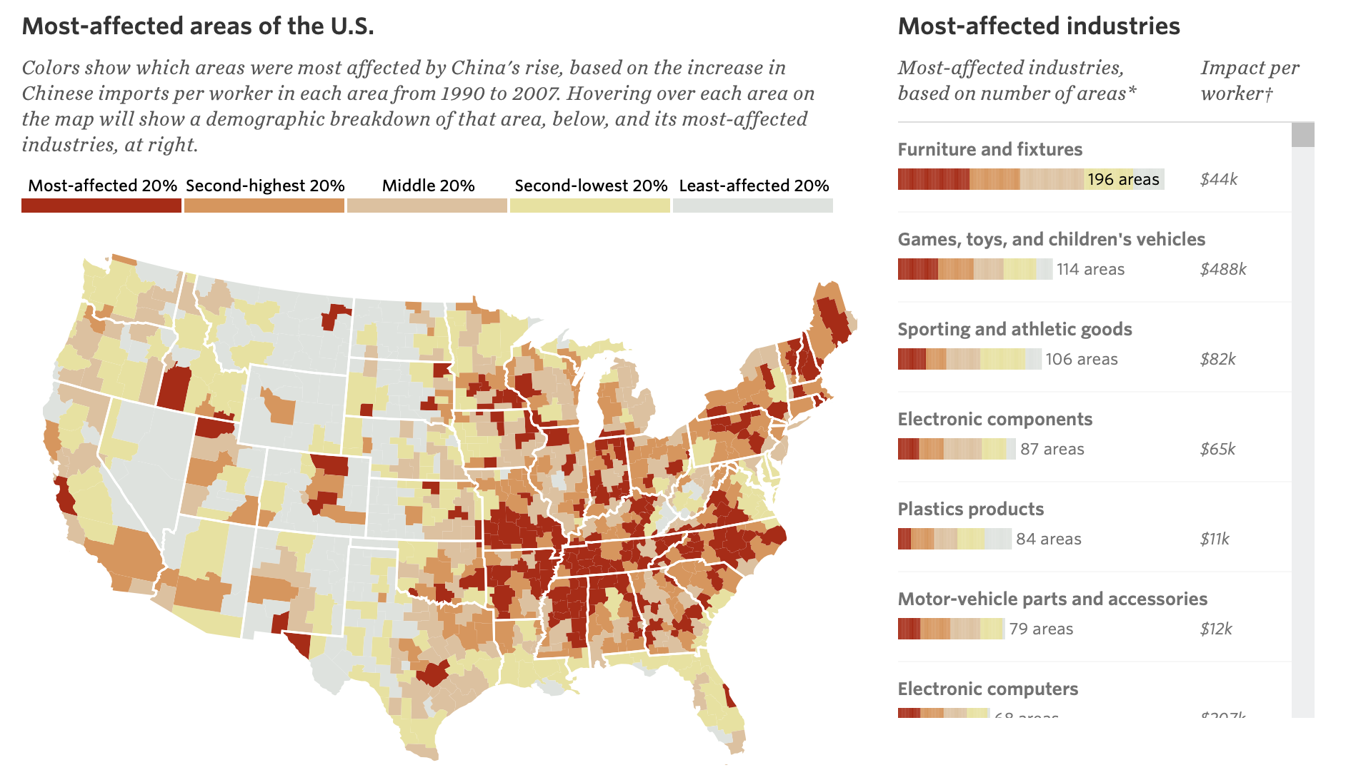
Exposure to Trade Competition from China is Geographically Concentrated
Source: chinashock.info

Slide 6
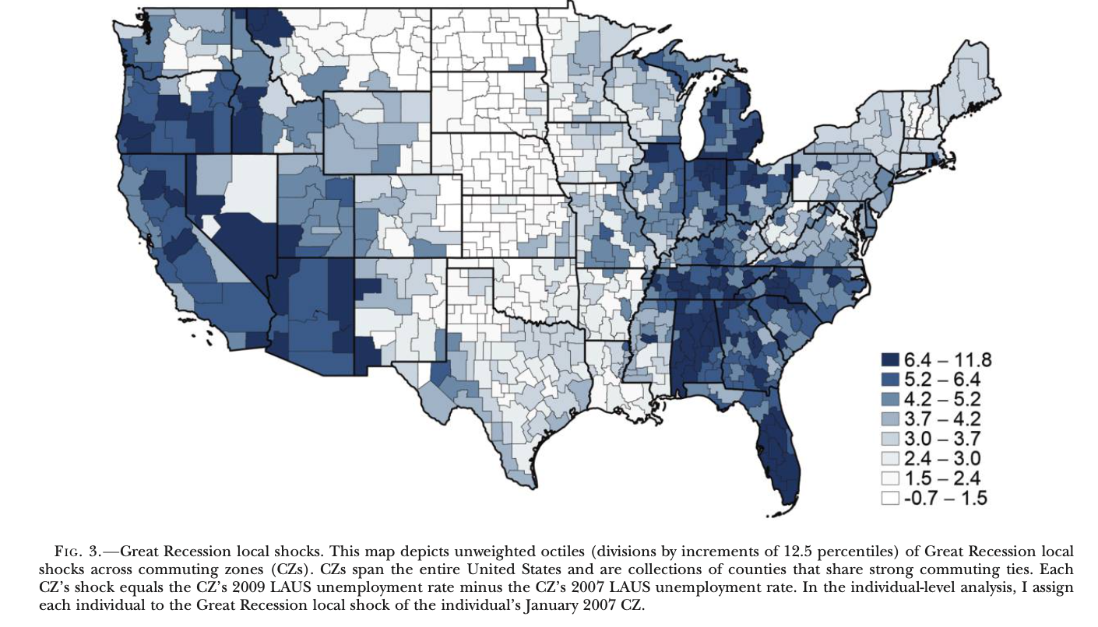
Recovery from Recession varies by Geography (Yagan 2019 JPE)

Slide 7
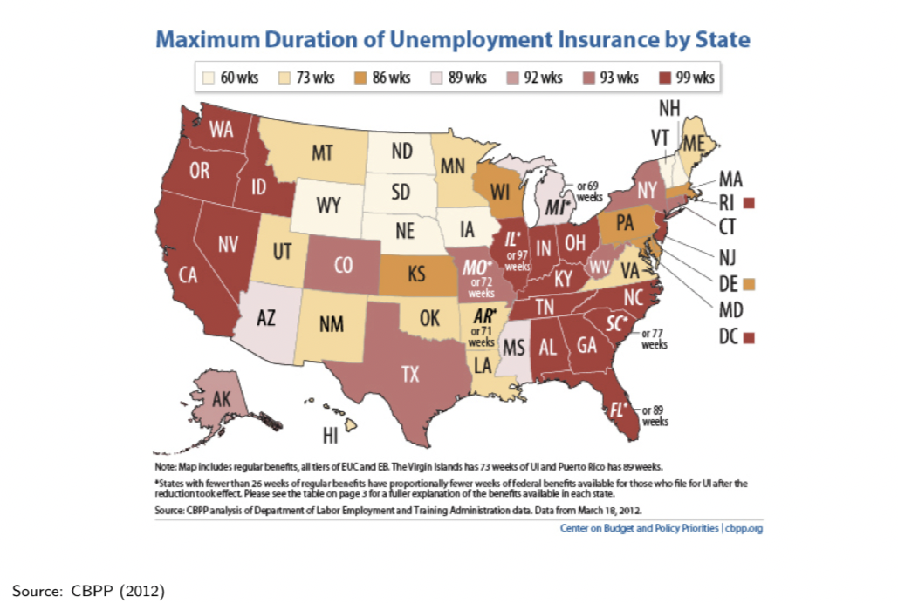
UI Expansion During the Recession Responded Heterogeneously

Slide 8
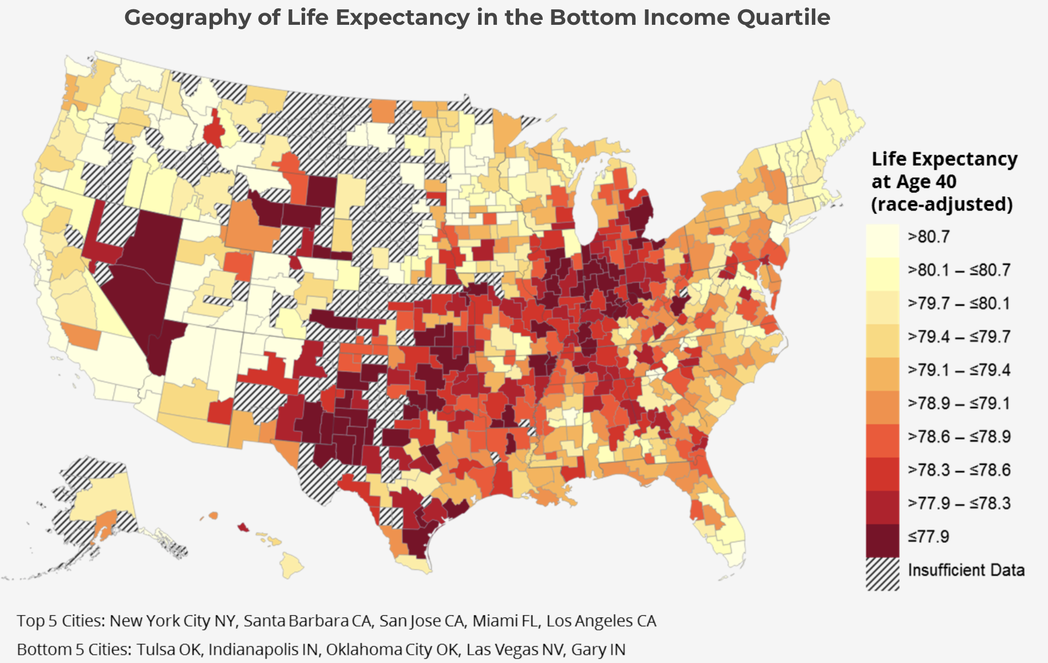
Life Expectancy varies by Geography (Chetty et al. (2016))
Source: Heathinequality.org

Slide 9
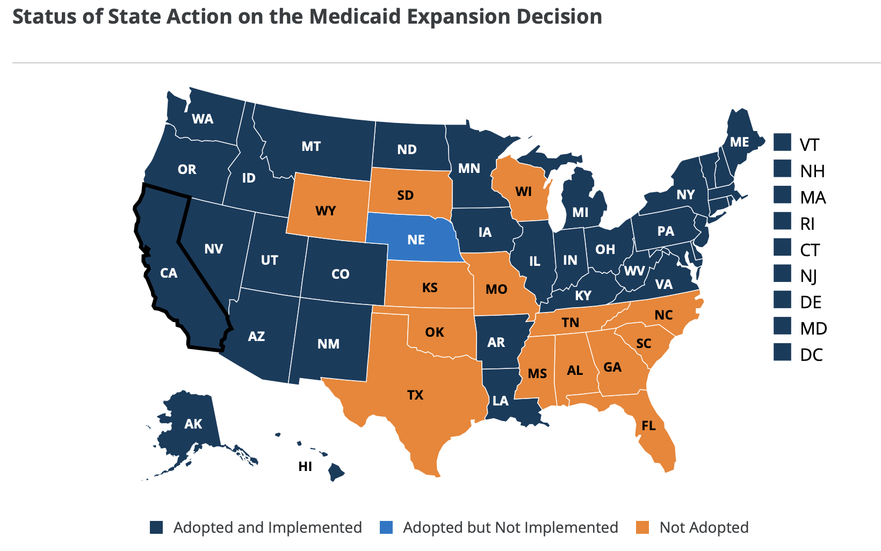
ACA Medicaid Expansions Varied Across States
Source: https://www.kff.org/medicaid/issue-brief/status-of-state-medicaid-expansion-decisions-interactive-map/

Slide 10
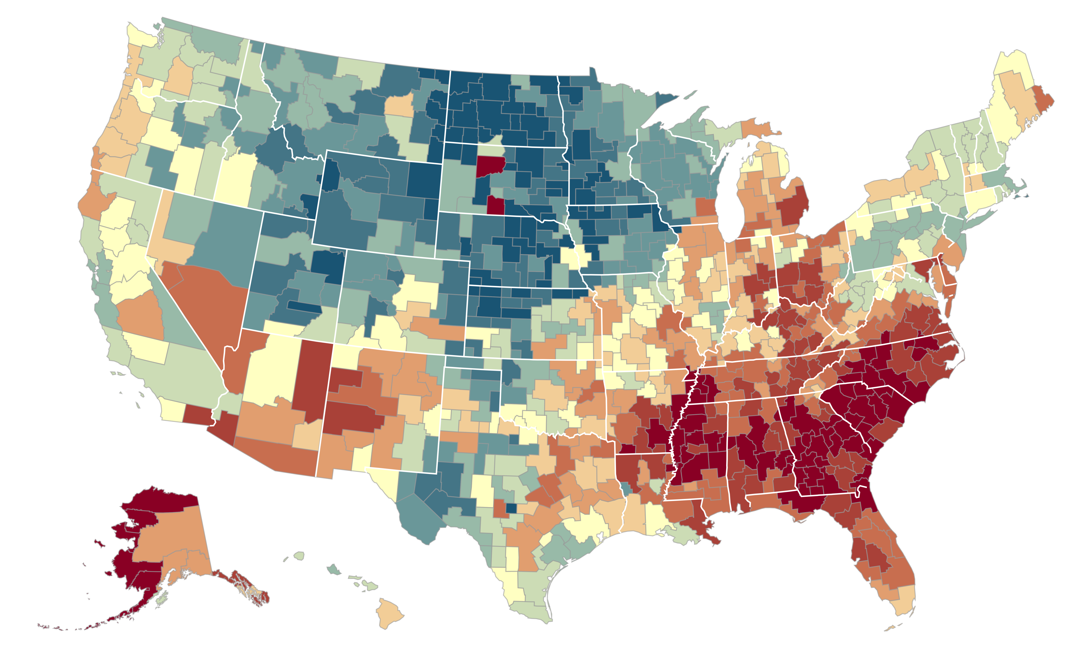

Upward Mobility Varies Across the US
Average Income at Age 35 for Children whose Parents Earned $27,000 (25th percentile)
Seattle
$35.8k
Salt Lake
City $37.9k
Dubuque
$46.1k
Cincinnati
$27.8k
Cleveland
$30.0k
Boston
$37.1k
New York City
$36.6k
San Francisco
Bay Area
$37.9k
Washington DC
$34.5k
Los Angeles
$34.8k
Charlotte
$26.3k
<$27.3k
$33.8k
>$45.7k
Note: Blue = More Upward Mobility, Red = Less Upward Mobility
Source: Chetty, Friedman, Hendren, Jones, Porter 2018

Slide 11
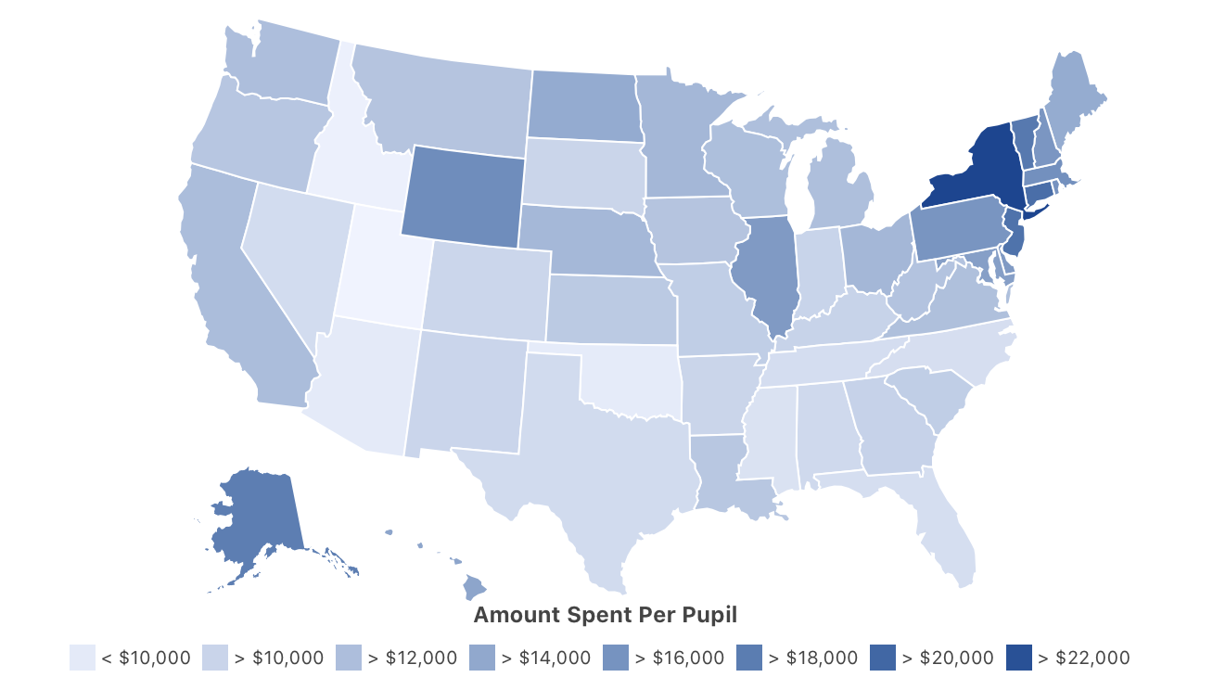
Education Spending Varies Across States
Per Pupil Spending by State (2020)
US Census Data from http://worldpopulationreview.com/states/per-pupil-spending-by-state/

Slide 12
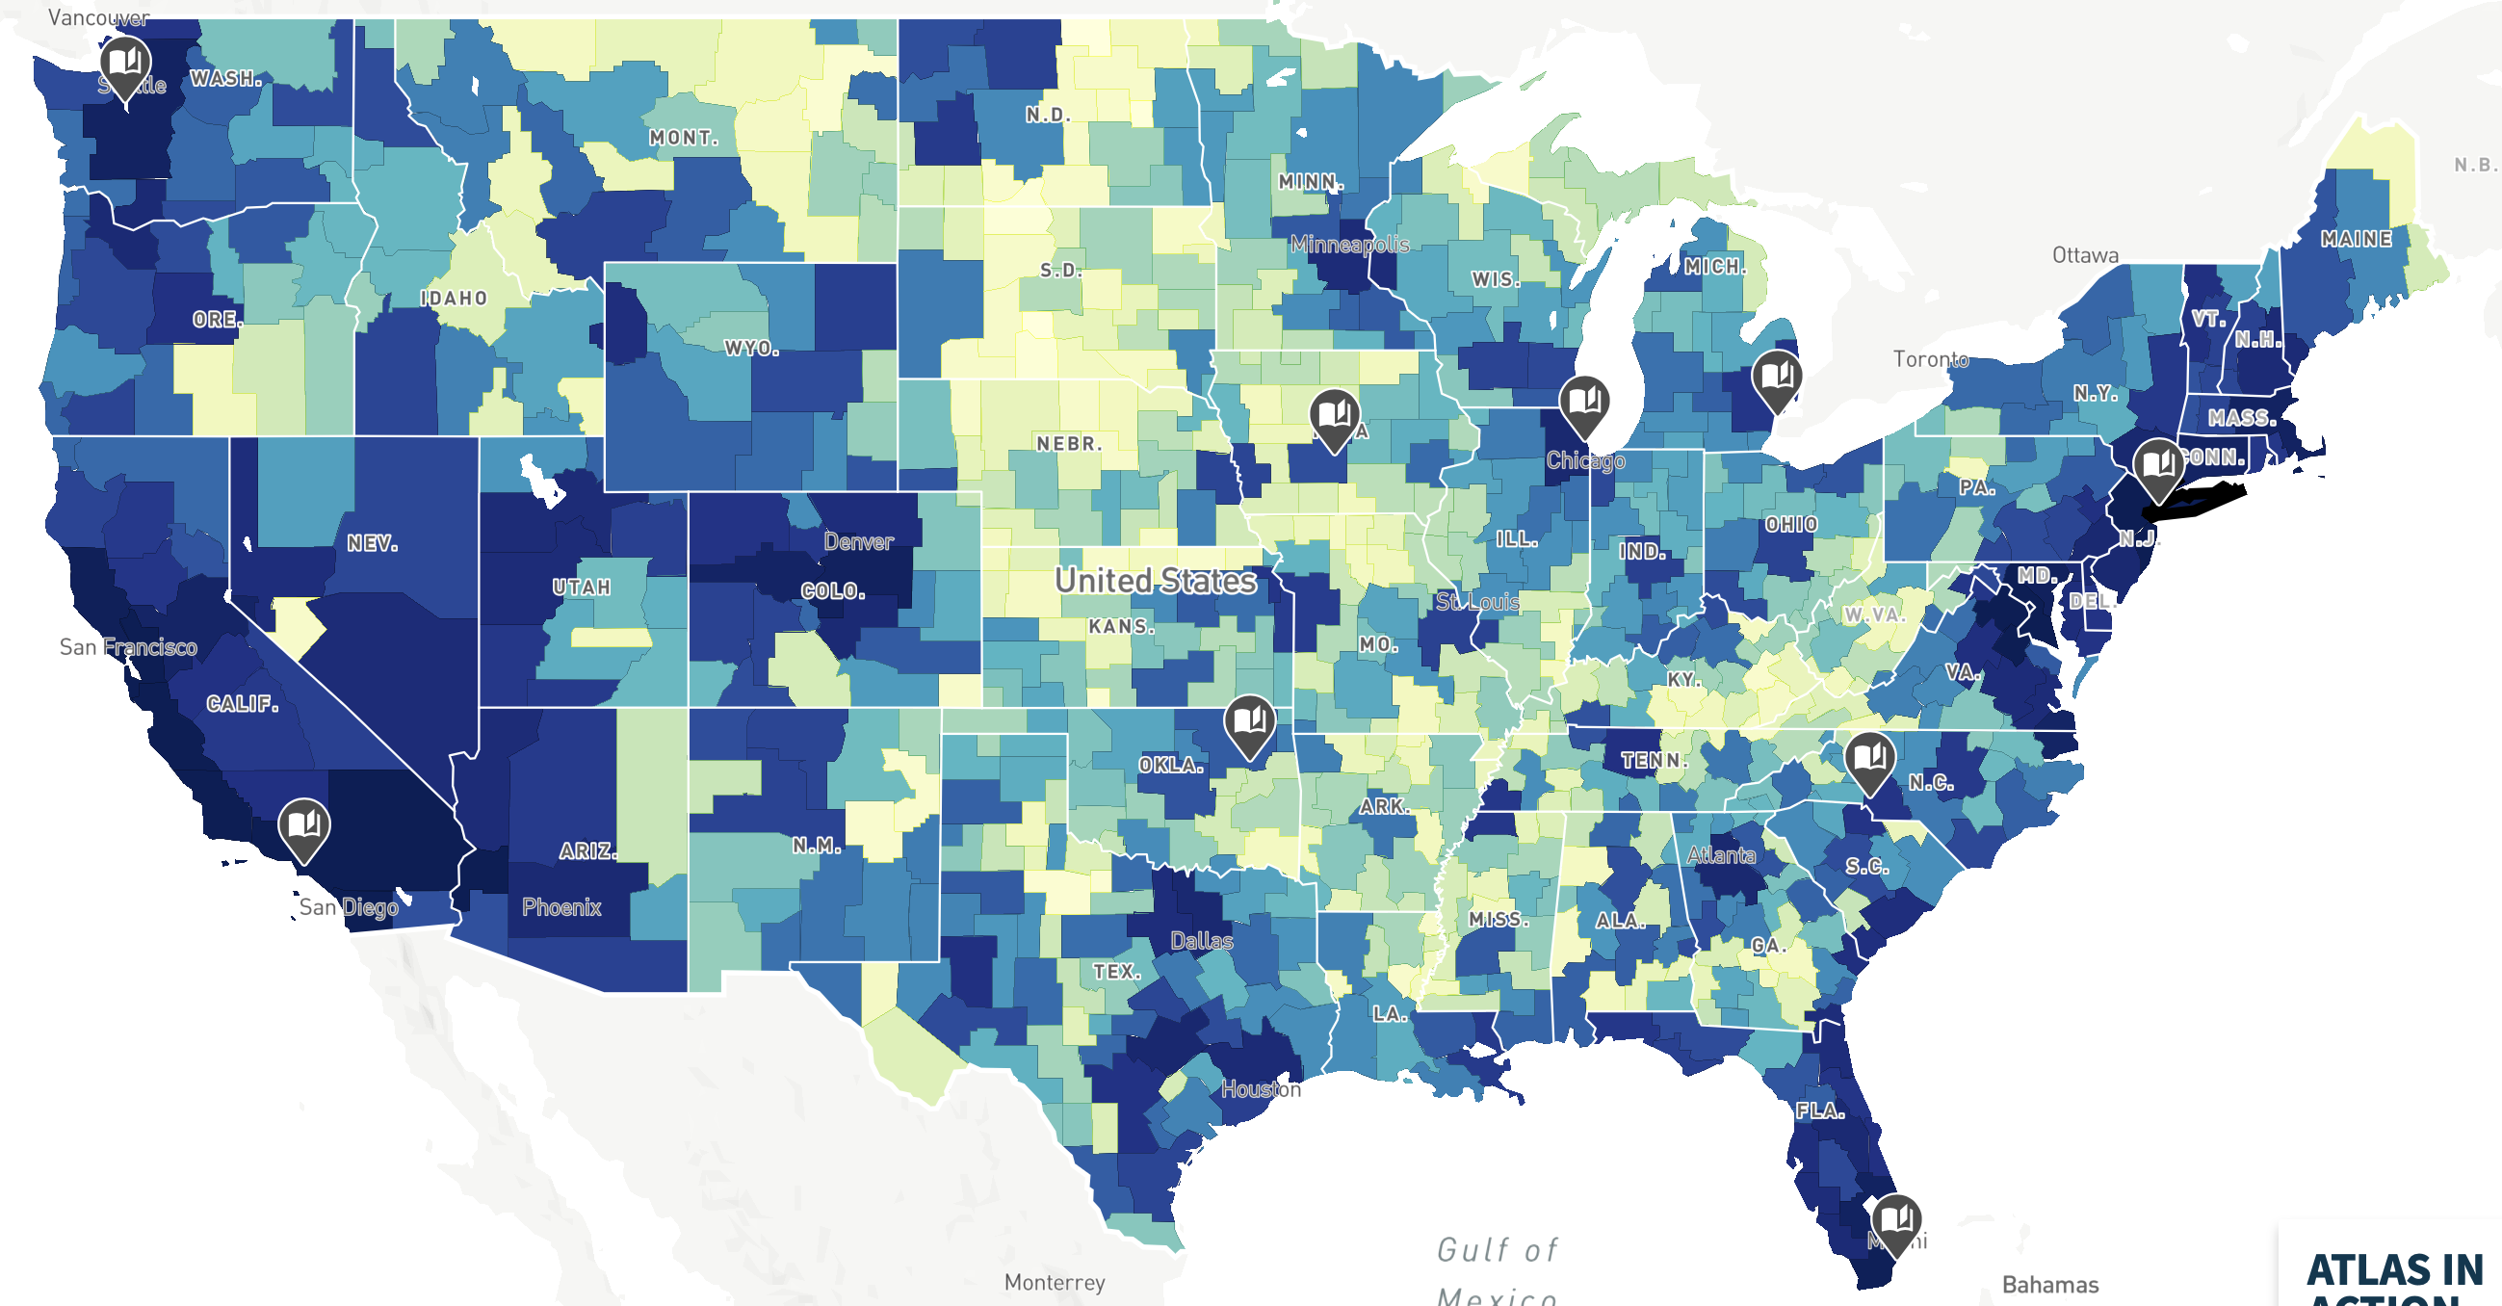

Median Rent Varies Across the US (2012-2016 ACS)

Slide 13
This lecture
Develop models that think about space and use them to think about optimal policy
Key thing we need to incorporate into models: (endogenous) price of location
Begin with simple “Rosen Roback” model
  Extend to case with infra-marginal residents (Kline and Moretti 2013)
  Discuss optimal policy / fiscal federalism: Oates and Tiebout
Discuss empirical evidence on impact of place-based policies

Slide 14
Outline
Models Spatial Sorting and Optimal Policy
1
2
Empirical Evidence on Impact of Place-Based Policies

Slide 15
Rosen and Roback
Rosen and Roback model outlines increased amenities in an area translate into incidence on land owners and workers
  In class, I will Owen Zidar’s 14.472 MIT Lectures for discussion of Rosen-Roback model and derive the pass through of changes in amenities on prices of labor and land
Given people respond to differences in local policies, how should optimal policy respond?
Tiebout JPE 1956 provides an answer:

Slide 16
Tiebout (1954)
Local government j provides a non-rival local public good available only to those in the locality
  Good is potentially non-rival but excludable via location (e.g. need to live in the place to benefit)
  Individuals are perfectly mobile
Governments cover the cost of spending through uniform, jurisdiction-based lump-sum taxes on residents
There is a large # of jurisdictions relative to # of individuals with different preferences for gov spending so that everyone can find a place on the frontier of amenities and prices
Result: sorting across place leads to efficient allocation of individuals
Efficient equilibrium where everyone sorts to optimal preferred set of public goods

Slide 17
Oates (1972)
Oates (1972) considers question of fiscal federalism: what levels of government should do each activity?
Redistribution: difficult to conduct locally because people can move → tax schedule redistributes at national level
Fiscal federalism: let spending decisions happen at a local level, but raise revenue nationally (and provide national public goods like defense)

Slide 18
Outline
Models Spatial Sorting and Optimal Policy
1
2
Empirical Evidence on Impact of Place-Based Policies

Slide 19
Impact of firm taxation on place location
Focus on two classes of empirical work:
  Firm Policies
  Housing Policies
Begin with Firm Policies

Slide 20
Direct Firm Subsidies
Large firms often lobby for and receive subsidies from localities (e.g. tax cuts and credits)
  e.g. Amazon competition
Slattery and Zidar (2020 JEP) study subsidies for local firms using data on special tax deals between firms and localities
Begin with case study of 2008 Volkswagon deal

Slide 21
Direct Firm Subsidies
VW chooses Chattanooga for new assembly plant • Promises 2,000 emp and $1B investment
TN grants VW a subsidy worth $558 million
  Local property tax abatements over 30 years ($200M)
  Enhanced state job and investment tax credits over 20 years ($200M) • Property given to VW ($81M)
  Worker training ($30M)
  Highway and road construction ($43M) + Rail line upgrades ($3.5M)
Runner up: Huntsville, AL offers $386 million package

Slide 22
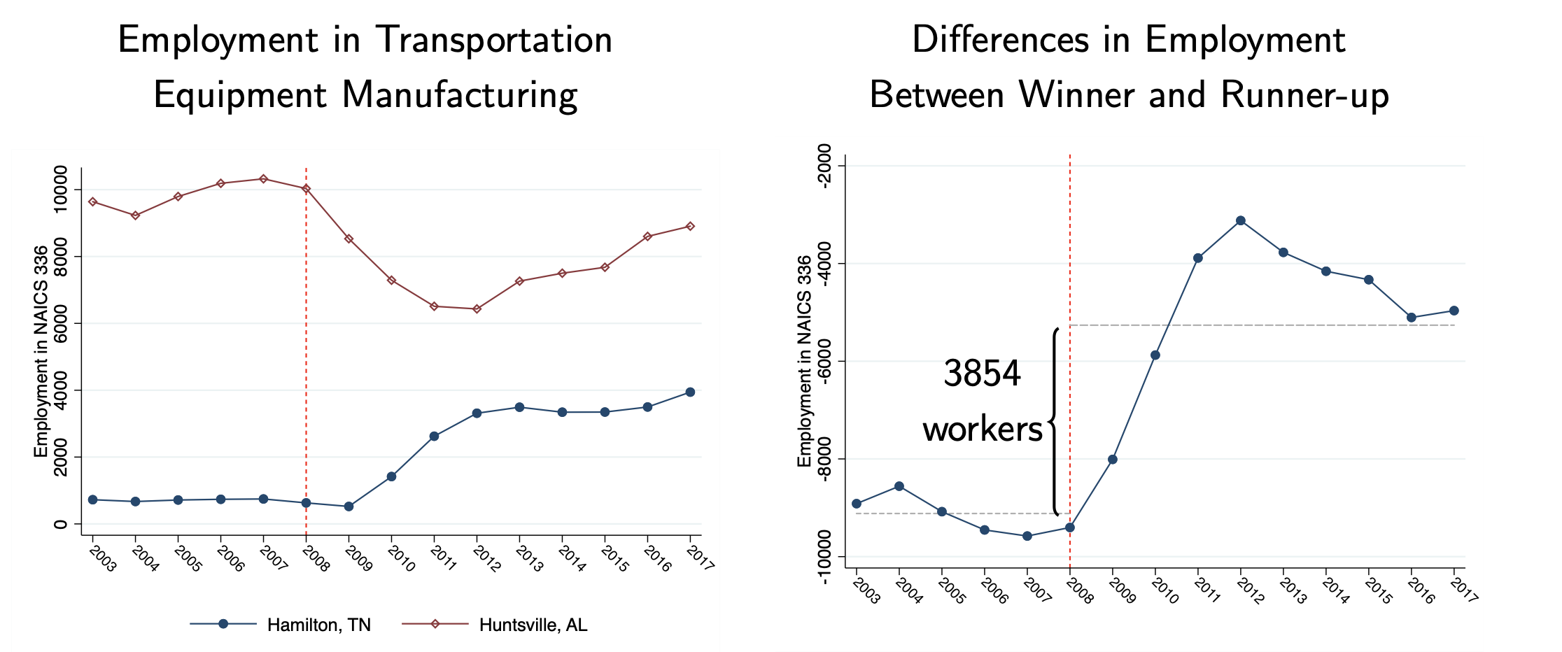
Direct Firm Subsidies

Slide 23
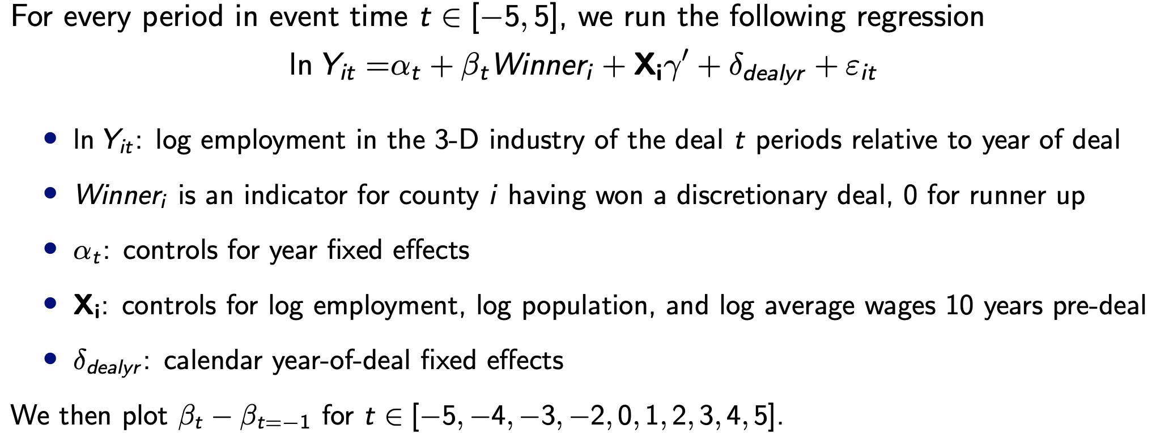
Direct Firm Subsidies
Expand event study design to compare “winner” to “runner-up” counties for deals between 2002-2012

Slide 24
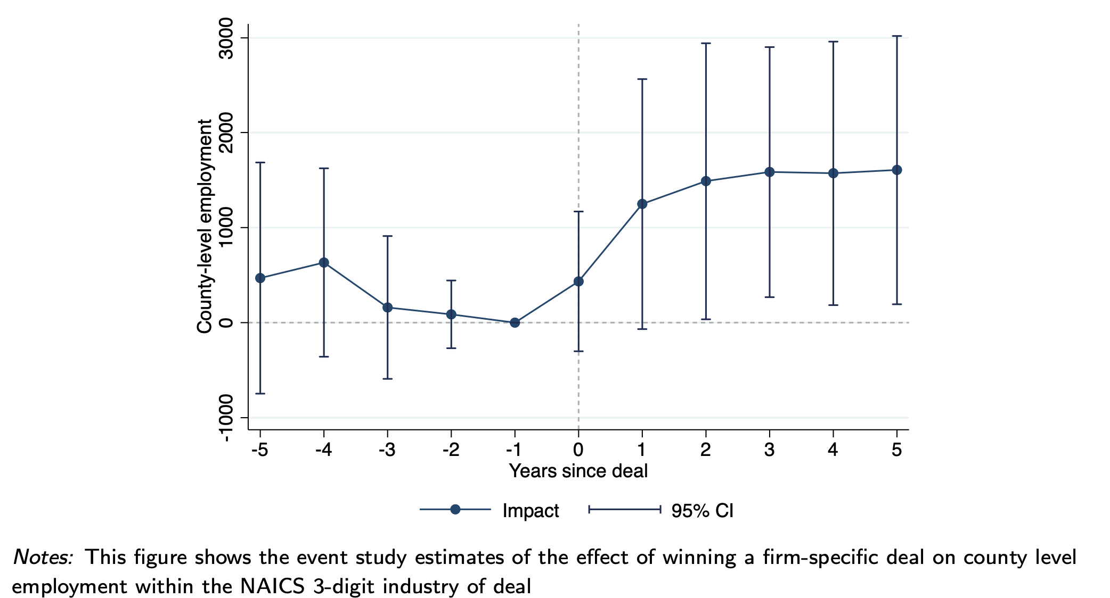
Effect within Industry

Slide 25
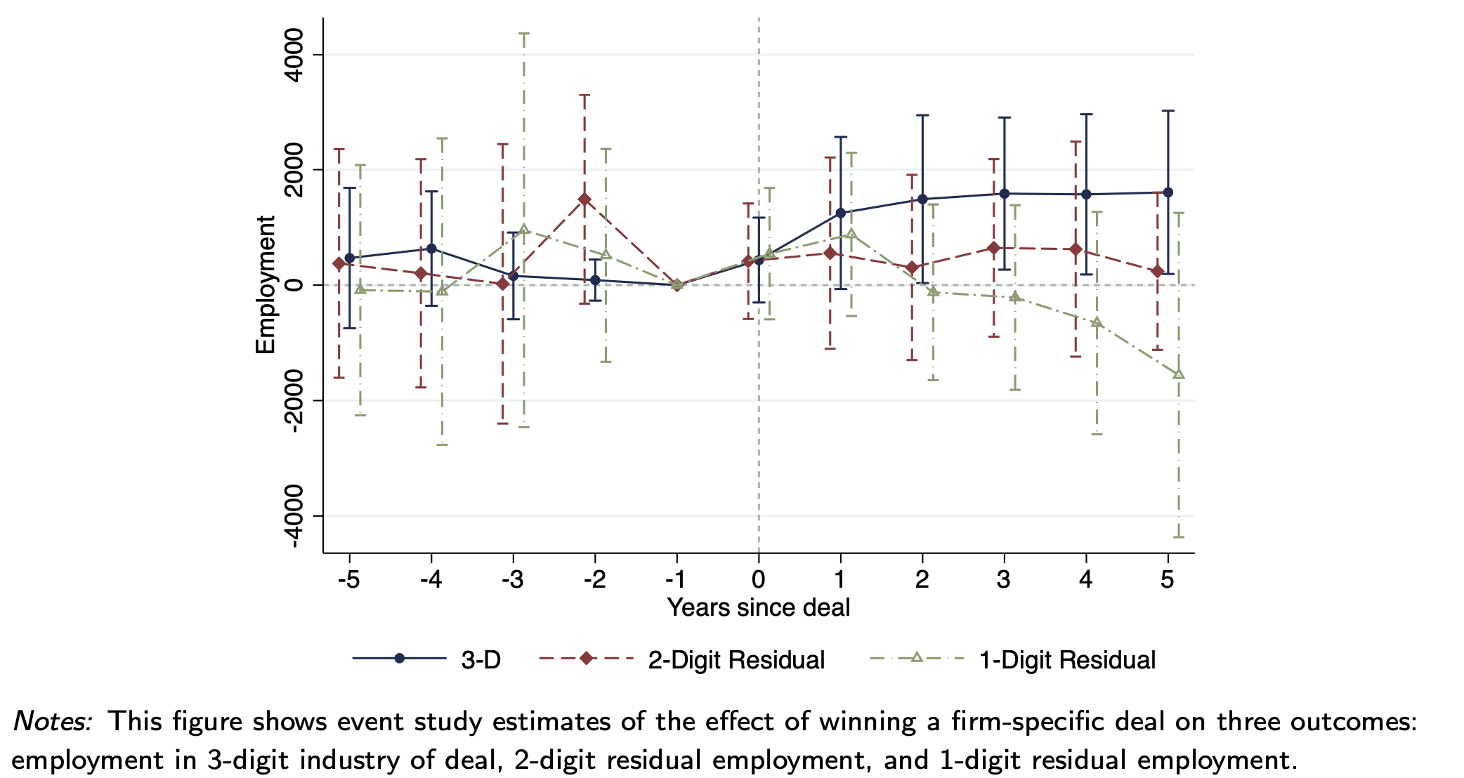
No Evidence of Spillover Effects to Other Industries

Slide 26
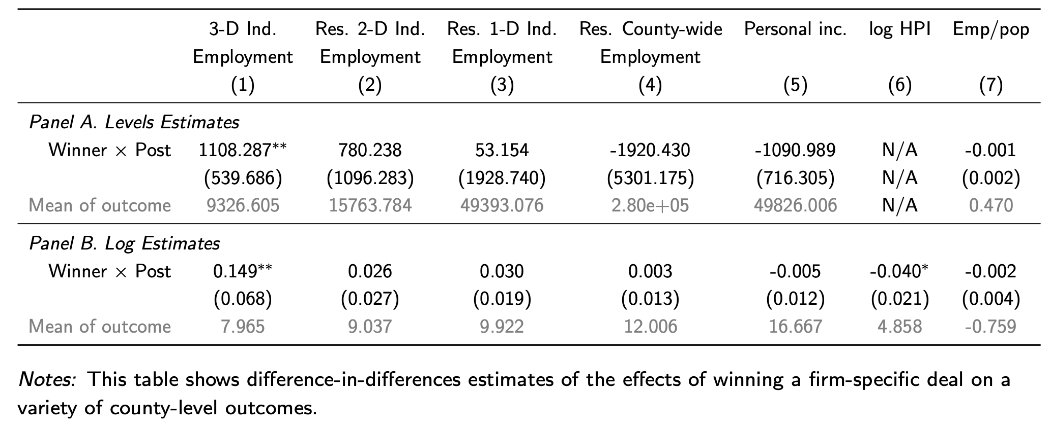
No Evidence of Spillover Effects to Other Industries

Slide 27
Lack of Spillovers Differs from Prior Literature
“Million Dollar Plants” data: 82 subsidy deals from Site Selection Magazine, mostly manufacturing, in 1980s and 90s (Greenstone & Moretti 2003)
Relies on reported location rankings of large firms’ location choices
Compares top to 2nd highest ranked places

Slide 28
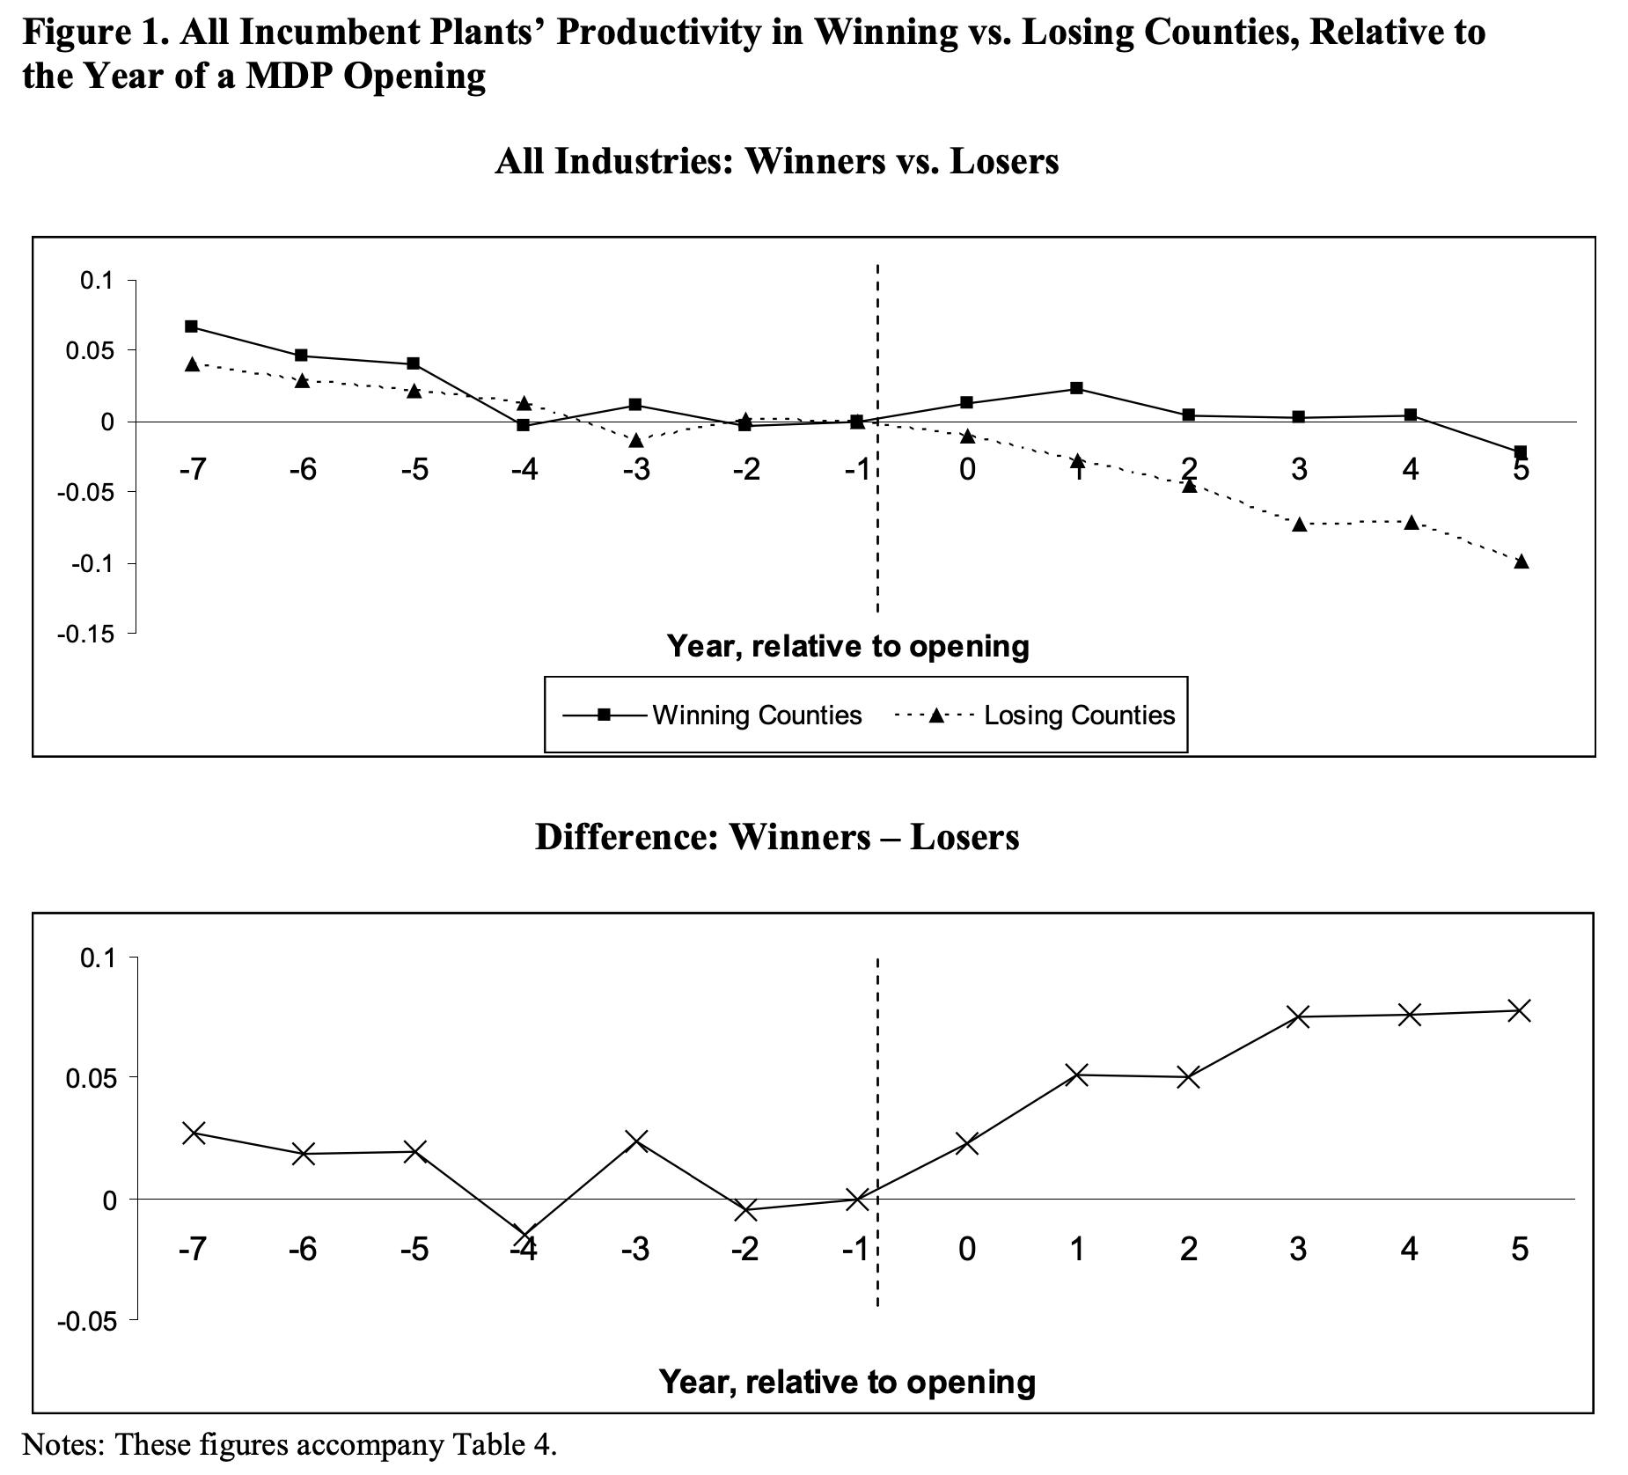
Lack of Spillovers Differs from Prior Literature

Slide 29
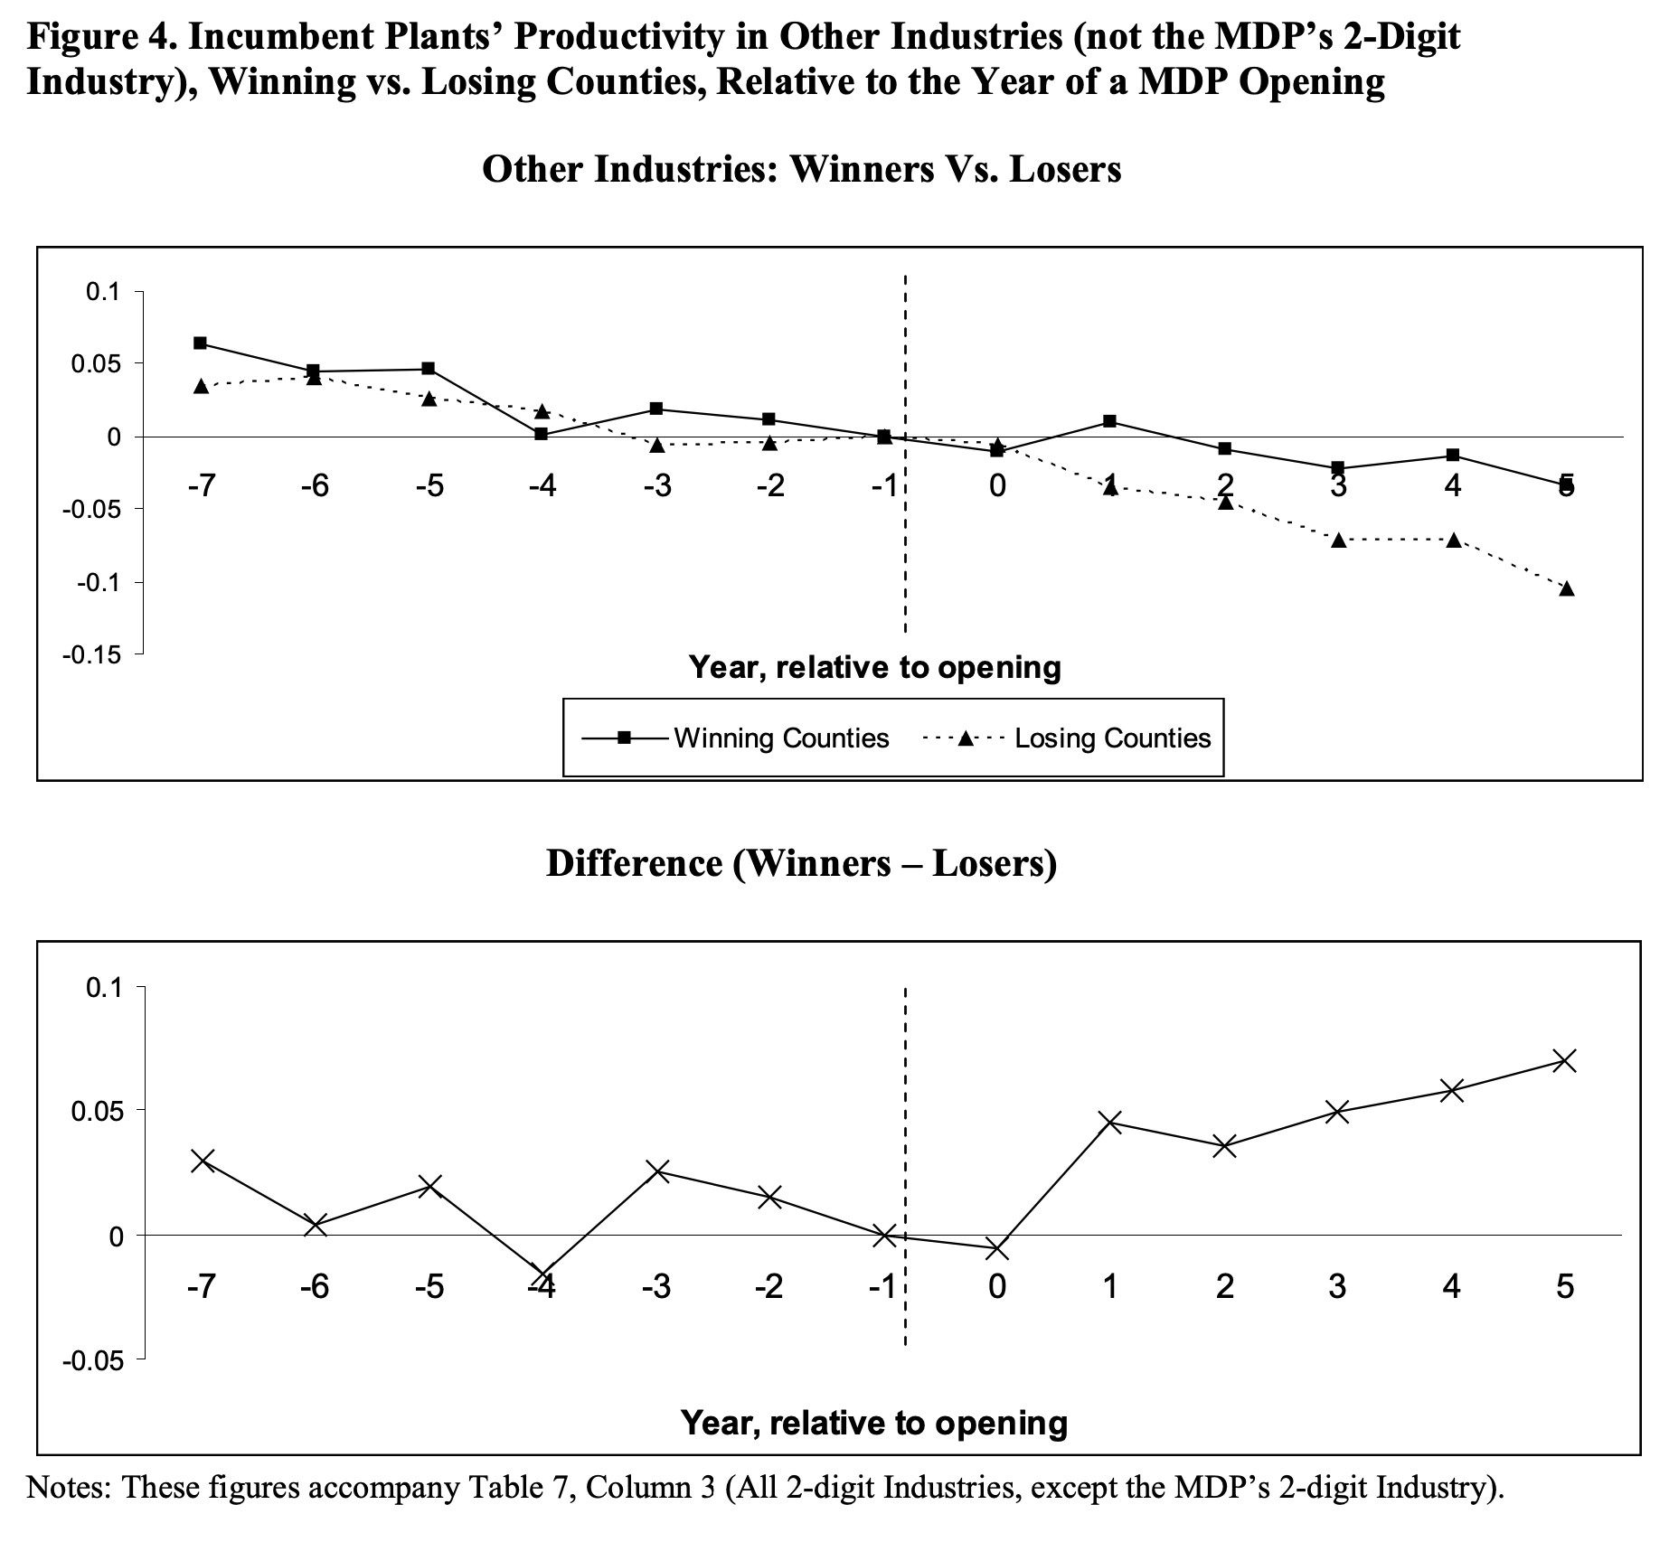
Lack of Spillovers Differs from Prior Literature

Slide 30
Impact of Depreciation Generosity on Local Labor Markets
Federal subsidies can also have heterogeneous local effects (and can help isolate potential spillover effects)
Garnett, Ohrn, and Suarez Serrato (2019) study the impact of accelerated depreciation on local labor markets
Study “bonus depreciation” that allows firms to deduct an additional percentage of capital expenditures in the first year of an asset’s tax life.
Bonus depreciation has larger effects where firms invest in longer-lived assets
Measure a county’s exposure to bonus depreciation by interacting industry-level heterogeneity in the benefit of bonus depreciation with industry location data

Slide 31
Impact of Depreciation Generosity on Local Labor Markets
Exploit 2002 Job Creation and Worker Assistance Act
Enacted 30% bonus depreciation, later increased to 50% in 2003-2004, then canceled in 2005 and re-implemented at 50% in response to 2008 recession for 2008-17 (aside from 100% in 2011).
Large body of work shows increased firm investment in response to bonus depreciation
  House and Shapiro (2008), Edgerton (2010), Cummings et al (2004)
Transition estimates to exposure in local labor markets using shift-share design

Slide 32
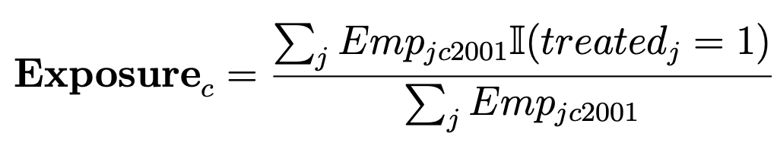
Impact of Depreciation Generosity on Local Labor Markets
Construct local labor market measure of exposure to bonus depreciation
Classify industries by those with long-lived assets
Construct fraction of local employment in 2001 that is in these industries

Slide 33
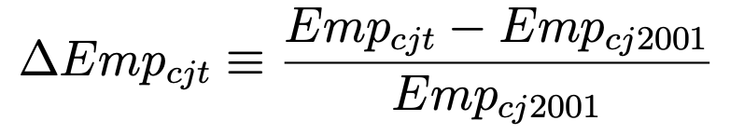
Impact of Depreciation Generosity on Local Labor Markets
Run regression of employment growth in county c industry j in year t:
where

Slide 34
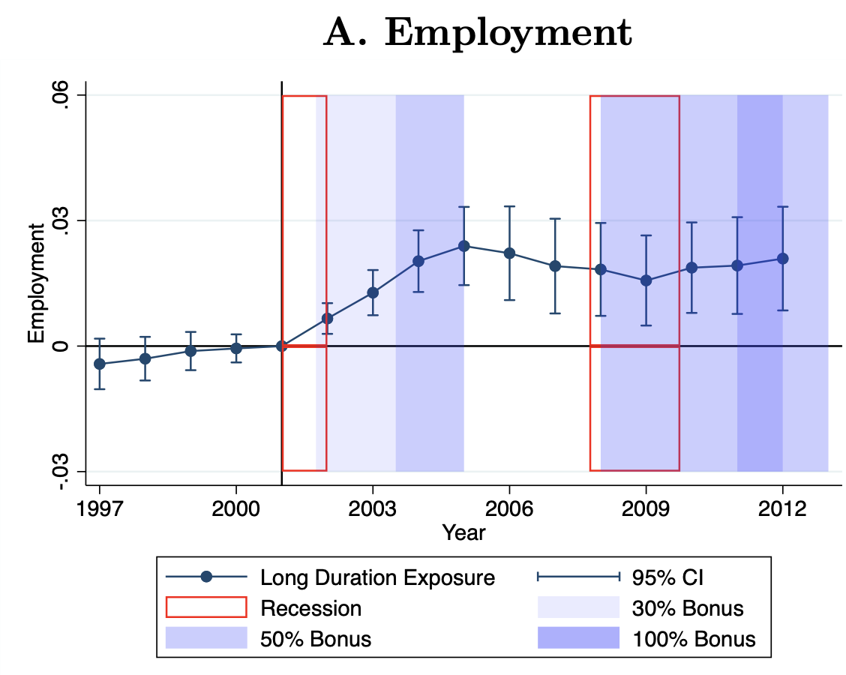
Impact of Depreciation Generosity on Local Labor Markets
Notes:
Author’s calculations using data from QCEW and Zwick and Mahon (2017). This figure shows the annual coefficients from an event study around the implementation of bonus depreciation following the structure of Equation 2. The dependent variable is Employment in Figure 2A, earnings in Figure 2B, earnings-per-worker in Figure 2C, and a placebo for all outcomes in Figure 2D. The variable of interest is the percent of employment that resides in long duration industries normalized to the inter-quartile range (IQR). See Section III for more discussion regarding the interpretation of the event study results. Figure 2D shows the coefficients from regressions of outcomes on exposure to long duration industries that use more than five times more structures and intellectual property products than equipment in 2001. Structures and intellectual property products are not eligible for bonus depreciation. The set of long duration industries that use relatively little equipment includes the following NAICS codes: 2111, 4821, 5311, 7111, 7112, 7211, 7212, and all of 81. The results of Figure 2D give evidence that structures and land investment are not driving the results. All of the results are robust to the exclusion of the local controls as shown in Figures E3, E4, and E5, as well as the definition of a long-duration industry exposure as shown in Figures E6 and E7. Tables E4, E5, and E6 show the annual coefficients for employment, earnings, and earnings-per-worker, respectively, with additional specifications. Standard errors are clustered at the county level.

Slide 35
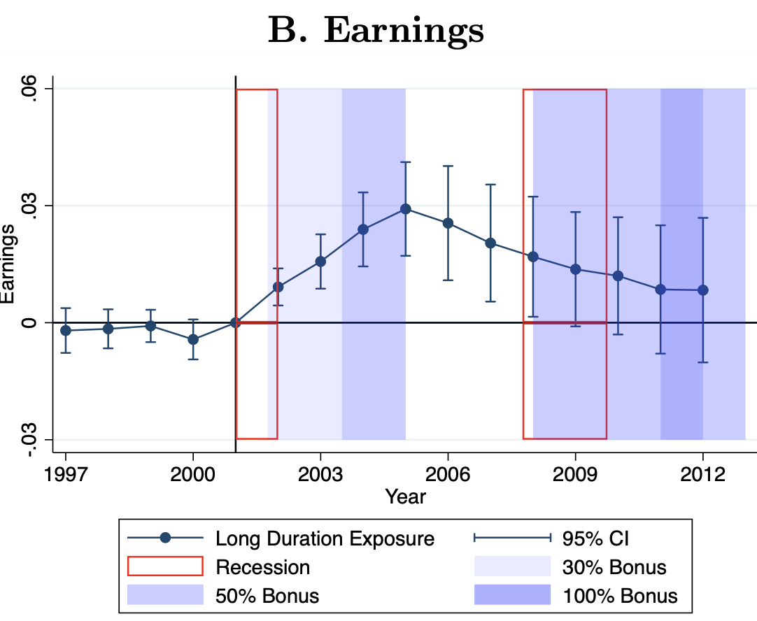
Impact of Depreciation Generosity on Local Labor Markets
Notes:
Author’s calculations using data from QCEW and Zwick and Mahon (2017). This figure shows the annual coefficients from an event study around the implementation of bonus depreciation following the structure of Equation 2. The dependent variable is Employment in Figure 2A, earnings in Figure 2B, earnings-per-worker in Figure 2C, and a placebo for all outcomes in Figure 2D. The variable of interest is the percent of employment that resides in long duration industries normalized to the inter-quartile range (IQR). See Section III for more discussion regarding the interpretation of the event study results. Figure 2D shows the coefficients from regressions of outcomes on exposure to long duration industries that use more than five times more structures and intellectual property products than equipment in 2001. Structures and intellectual property products are not eligible for bonus depreciation. The set of long duration industries that use relatively little equipment includes the following NAICS codes: 2111, 4821, 5311, 7111, 7112, 7211, 7212, and all of 81. The results of Figure 2D give evidence that structures and land investment are not driving the results. All of the results are robust to the exclusion of the local controls as shown in Figures E3, E4, and E5, as well as the definition of a long-duration industry exposure as shown in Figures E6 and E7. Tables E4, E5, and E6 show the annual coefficients for employment, earnings, and earnings-per-worker, respectively, with additional specifications. Standard errors are clustered at the county level.

Slide 36
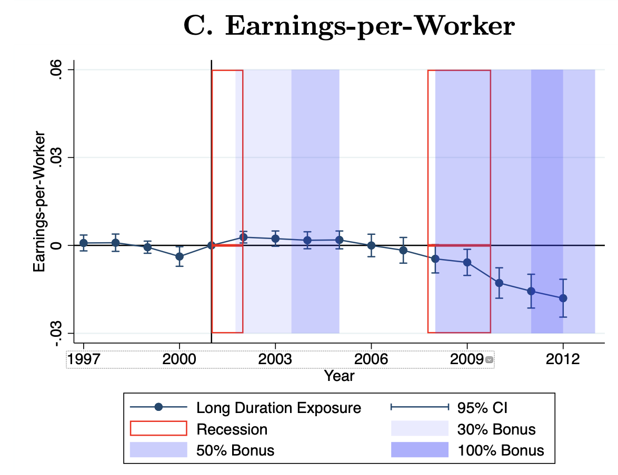
Impact of Depreciation Generosity on Local Labor Markets
Notes:
Author’s calculations using data from QCEW and Zwick and Mahon (2017). This figure shows the annual coefficients from an event study around the implementation of bonus depreciation following the structure of Equation 2. The dependent variable is Employment in Figure 2A, earnings in Figure 2B, earnings-per-worker in Figure 2C, and a placebo for all outcomes in Figure 2D. The variable of interest is the percent of employment that resides in long duration industries normalized to the inter-quartile range (IQR). See Section III for more discussion regarding the interpretation of the event study results. Figure 2D shows the coefficients from regressions of outcomes on exposure to long duration industries that use more than five times more structures and intellectual property products than equipment in 2001. Structures and intellectual property products are not eligible for bonus depreciation. The set of long duration industries that use relatively little equipment includes the following NAICS codes: 2111, 4821, 5311, 7111, 7112, 7211, 7212, and all of 81. The results of Figure 2D give evidence that structures and land investment are not driving the results. All of the results are robust to the exclusion of the local controls as shown in Figures E3, E4, and E5, as well as the definition of a long-duration industry exposure as shown in Figures E6 and E7. Tables E4, E5, and E6 show the annual coefficients for employment, earnings, and earnings-per-worker, respectively, with additional specifications. Standard errors are clustered at the county level.

Slide 37
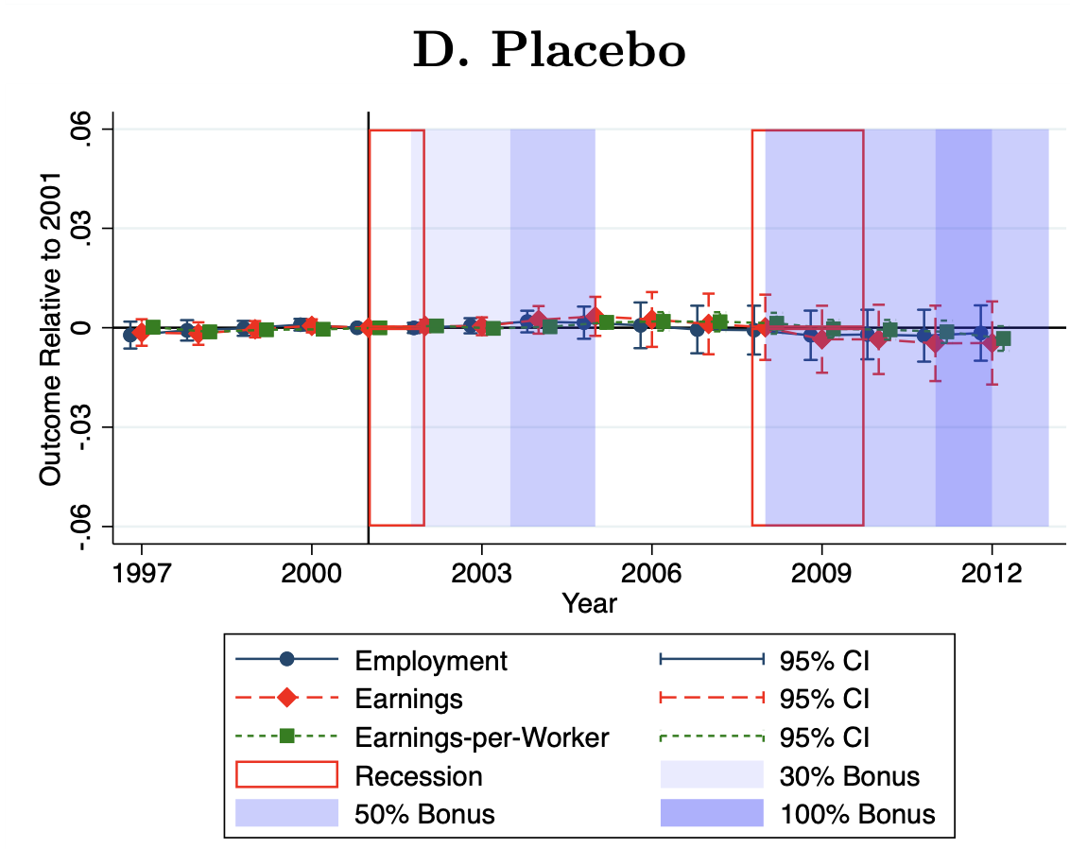
Placebo using “Structures and IP” exposure, which are not subject to bonus depreciation
Notes:
Author’s calculations using data from QCEW and Zwick and Mahon (2017). This figure shows the annual coefficients from an event study around the implementation of bonus depreciation following the structure of Equation 2. The dependent variable is Employment in Figure 2A, earnings in Figure 2B, earnings-per-worker in Figure 2C, and a placebo for all outcomes in Figure 2D. The variable of interest is the percent of employment that resides in long duration industries normalized to the inter-quartile range (IQR). See Section III for more discussion regarding the interpretation of the event study results. Figure 2D shows the coefficients from regressions of outcomes on exposure to long duration industries that use more than five times more structures and intellectual property products than equipment in 2001. Structures and intellectual property products are not eligible for bonus depreciation. The set of long duration industries that use relatively little equipment includes the following NAICS codes: 2111, 4821, 5311, 7111, 7112, 7211, 7212, and all of 81. The results of Figure 2D give evidence that structures and land investment are not driving the results. All of the results are robust to the exclusion of the local controls as shown in Figures E3, E4, and E5, as well as the definition of a long-duration industry exposure as shown in Figures E6 and E7. Tables E4, E5, and E6 show the annual coefficients for employment, earnings, and earnings-per-worker, respectively, with additional specifications. Standard errors are clustered at the county level.

Slide 38
Summary
Results suggest firms local investments leads to positive impacts on employment and local earnings
Paper calculates a “$20,000 cost per job”
  A common welfare metric – is this reasonable?
What does this mean for models of perfect labor sorting? (e.g. Rosen-Roback?)
Does this imply local workers benefit?

Slide 39
Housing Policy
Many government spending and tax credits target housing and local development
Consider two policies here:
  Section 8 / Housing Choice Vouchers (Jacob and Ludwig 2012)
  Hope VI – Laura Tach
FYI there is a large literature on other policies, such as LIHTC (Diamond and McQuade 2017)

Slide 40
Housing Choice Voucher / Section 8 Program
Housing Choice Vouchers provide subsidized rent to eligible families
Family income may not exceed 50% of median income in county (preference given to those below 30%)
No right to voucher – must apply and allocated based on preferential lottery
Voucher holders pay 30% of income on rent
  Leads to additional tax on earnings
Jacob and Ludwig (2012) study impact on labor supply

Slide 41
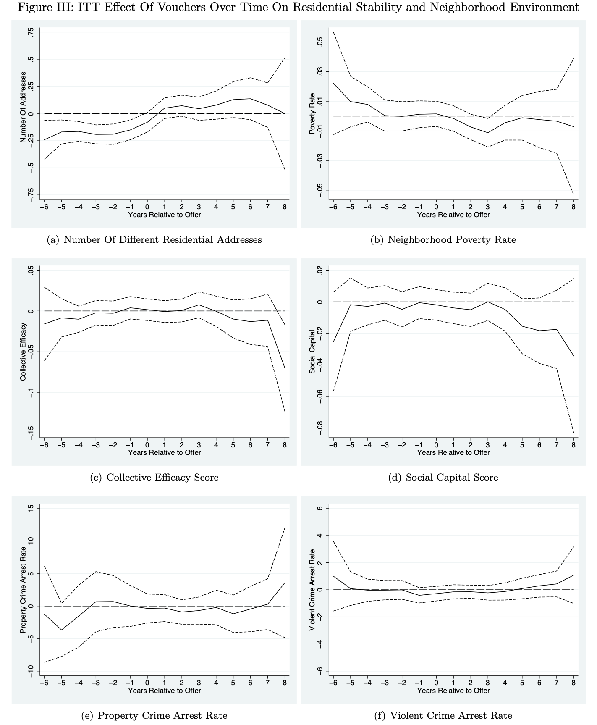
Housing Choice Voucher / Section 8 Program

Slide 42
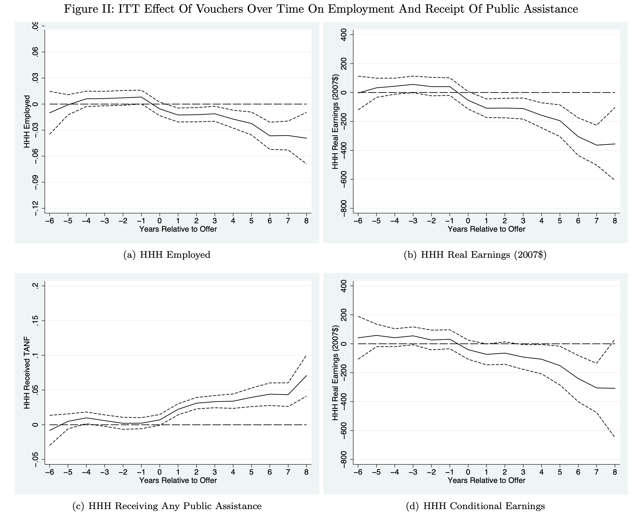
Housing Choice Voucher / Section 8 Program

Slide 43
Housing Choice Voucher / Section 8 Program
Jacob, Kapustin, and Ludwig (2015) study impact on children
No evidence of impacts on test scores, graduation, etc.

Slide 44
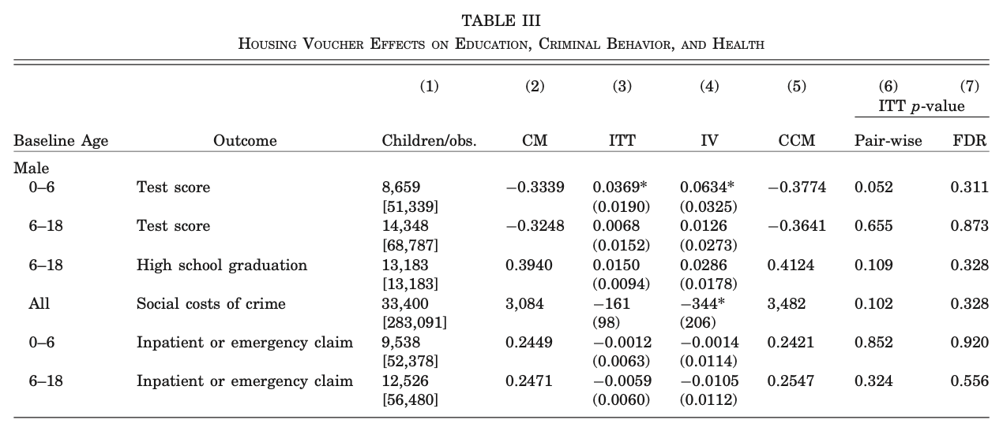
Housing Choice Voucher / Section 8 Program

Slide 45
Place-based investment
Results suggest no impact on “neighborhood quality” from Section 8 vouchers in Chicago
Negative impacts on labor earnings and spillover impacts on public assistance
Hendren and Sprung-Keyser (2020) calculate MVPF of 0.65
No impacts on children (maybe something for youngest 0-6?)
  Consistent with fact that vouchers didn’t change where families moved
  Recall evidence from MTO and CMTO from previous lecture suggests vouchers paired with services will change neighborhood locations

Slide 46
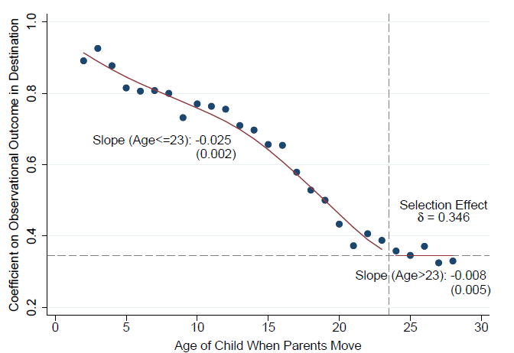
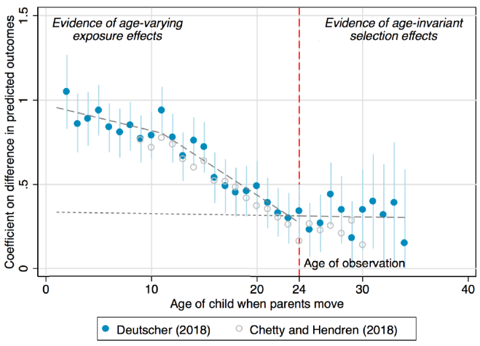
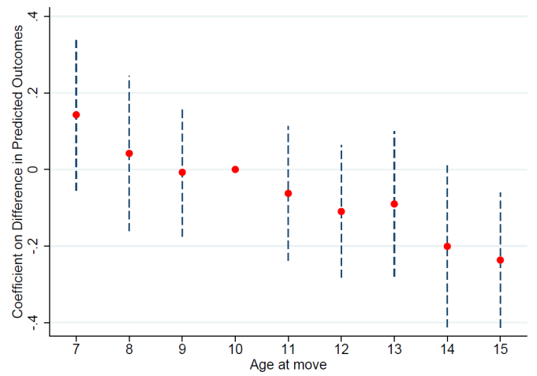
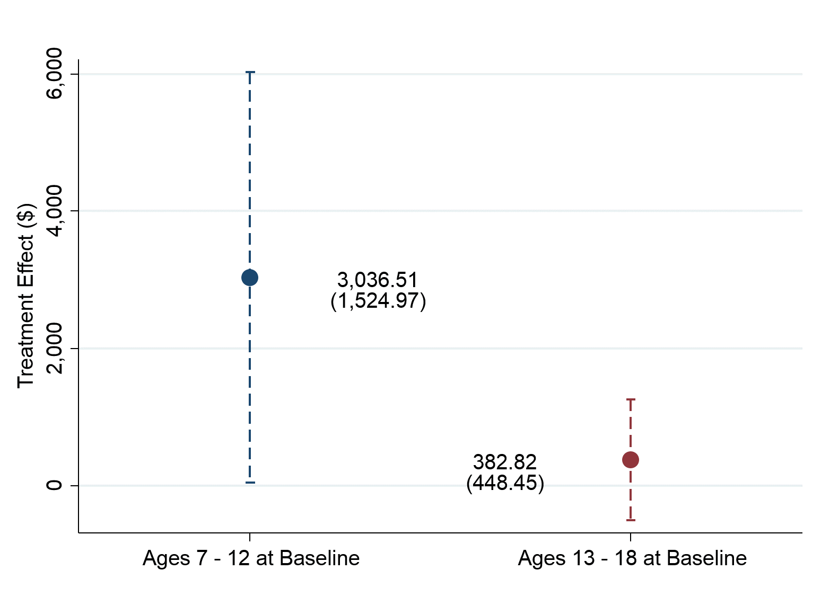
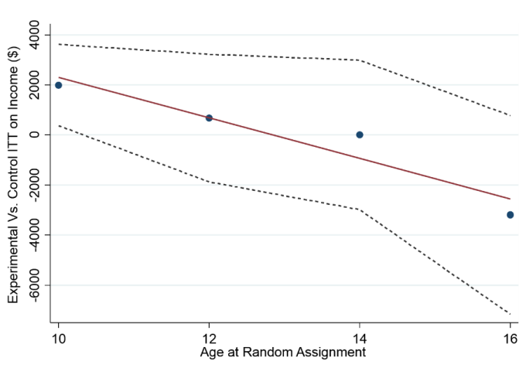
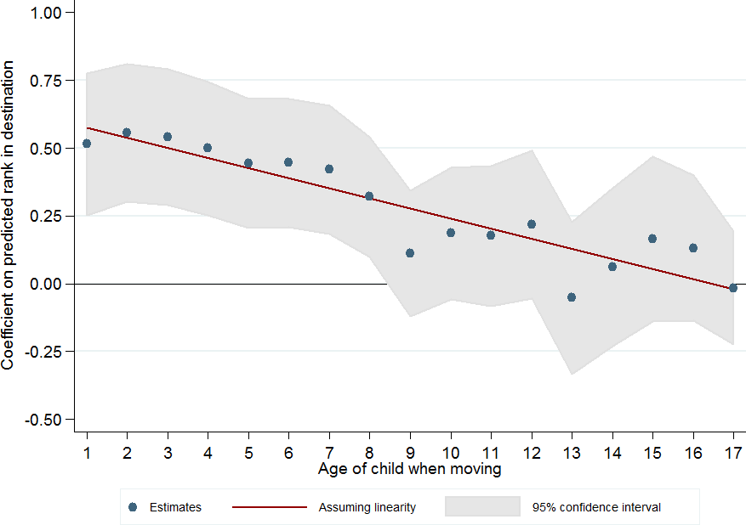
Estimates of Childhood Exposure Effects
United States
Australia
Montreal, Canada
Source: Chetty, Friedman, Hendren, Jones, Porter (2018)
Source: Deutscher (2018)
Source: Laliberté (2018)
MTO: Baltimore, Boston, Chicago, LA, NYC
Chicago Public Housing Demolitions
Denmark
Source: Faurschou (2018)
Source: Chetty, Hendren, Katz (AER 2016)
Source: Chyn (AER 2018)

Slide 47
Place-based investment
Tach and Emory (2017 AJS) study Hope VI, a program to revitalize the most distressed public housing units
Generally involved destruction of existing public housing and building of new buildings
  Existing residents were sometimes given vouchers or alternate locations

Slide 48
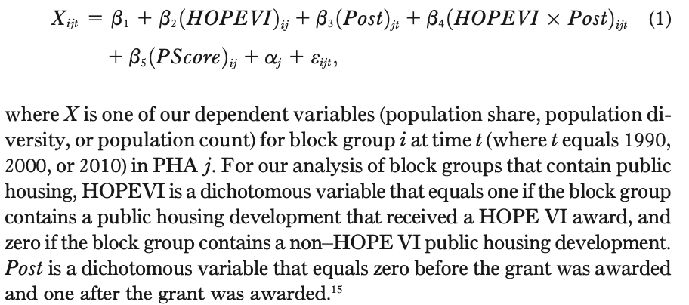
Place-based investment

Slide 49
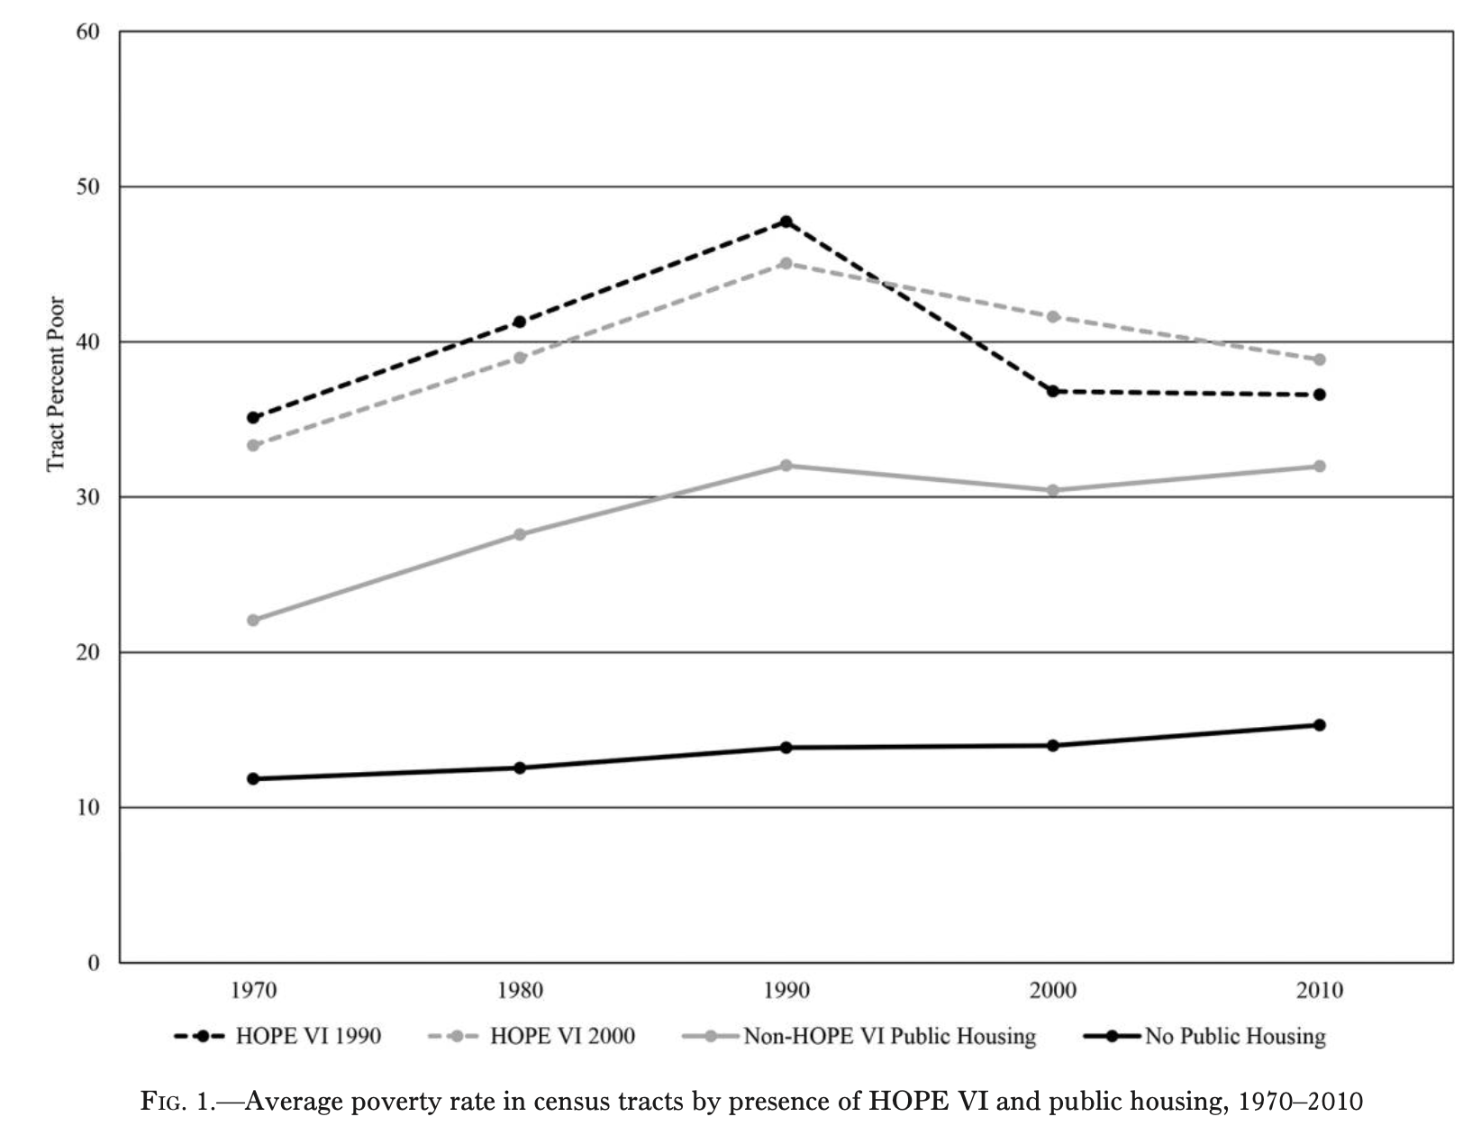
Hope VI: Poverty Rate

Slide 50
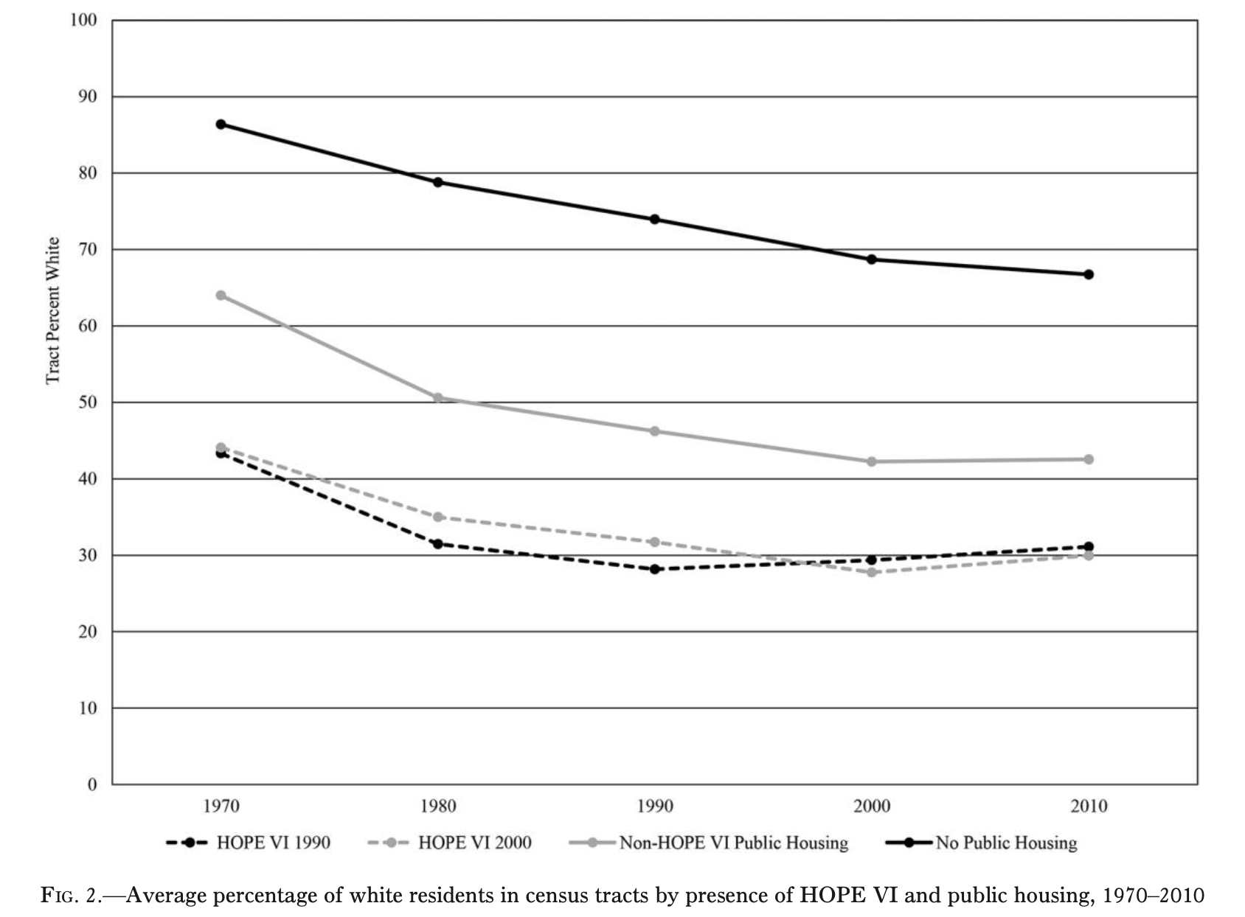
Hope VI: % White

Slide 51
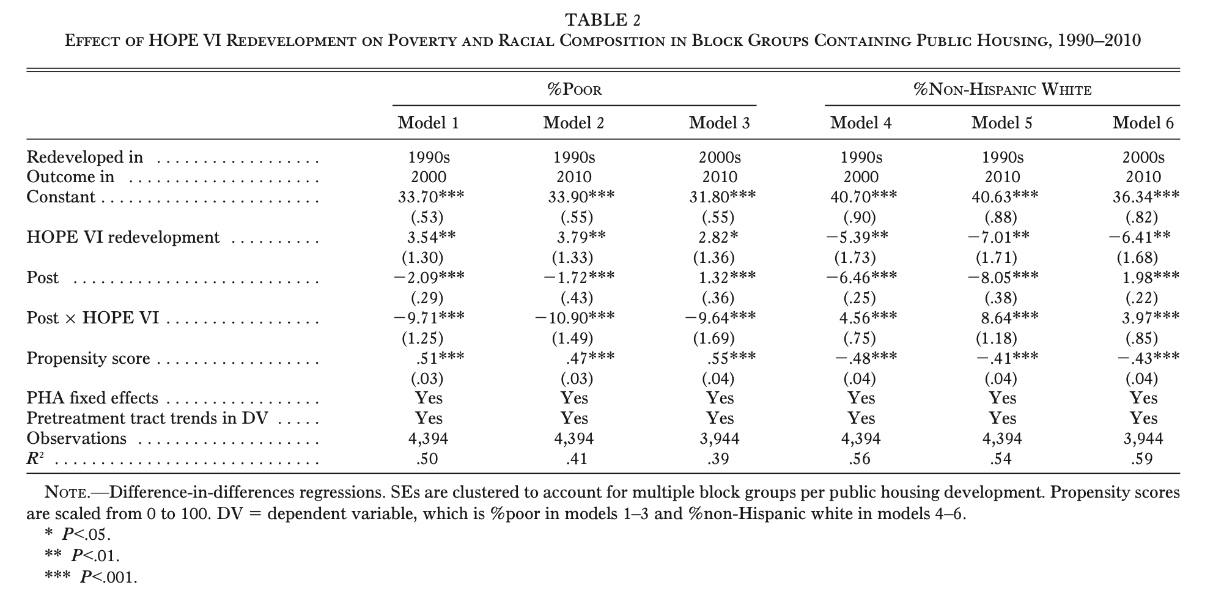
Hope VI

Slide 52
Hope VI Summary
Results suggest Hope VI led to “revitalization” of local neighborhoods but displacement of existing low-income black residents
No existing work has documented impact on pre-existing residents (although work is ongoing)
Recall from earlier lecture that Hope VI displacements led to increases in children’s test scores:
  Jacob (2004) finds impacts on test scores
  Chyn (2018) documents impact of Hope VI demolitions on children
Compare children whose parents’ buildings are demolished vs. those who are not

Slide 53
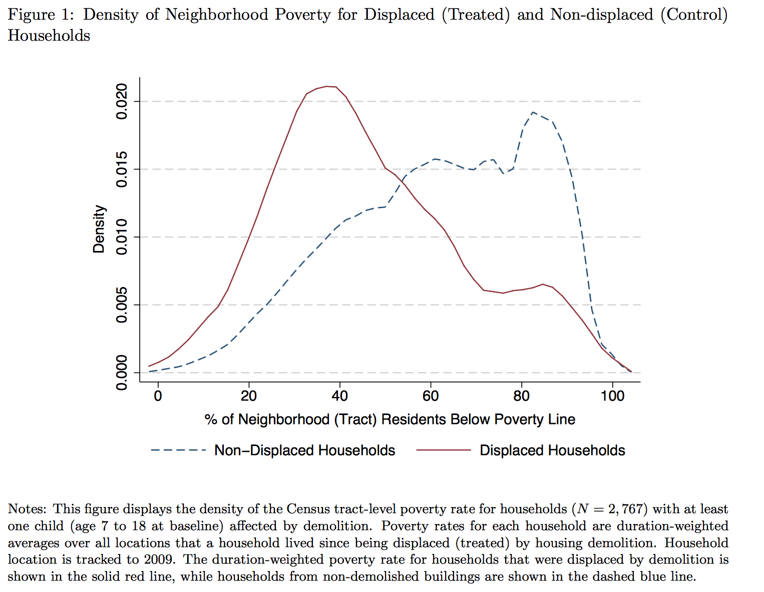

Slide 54
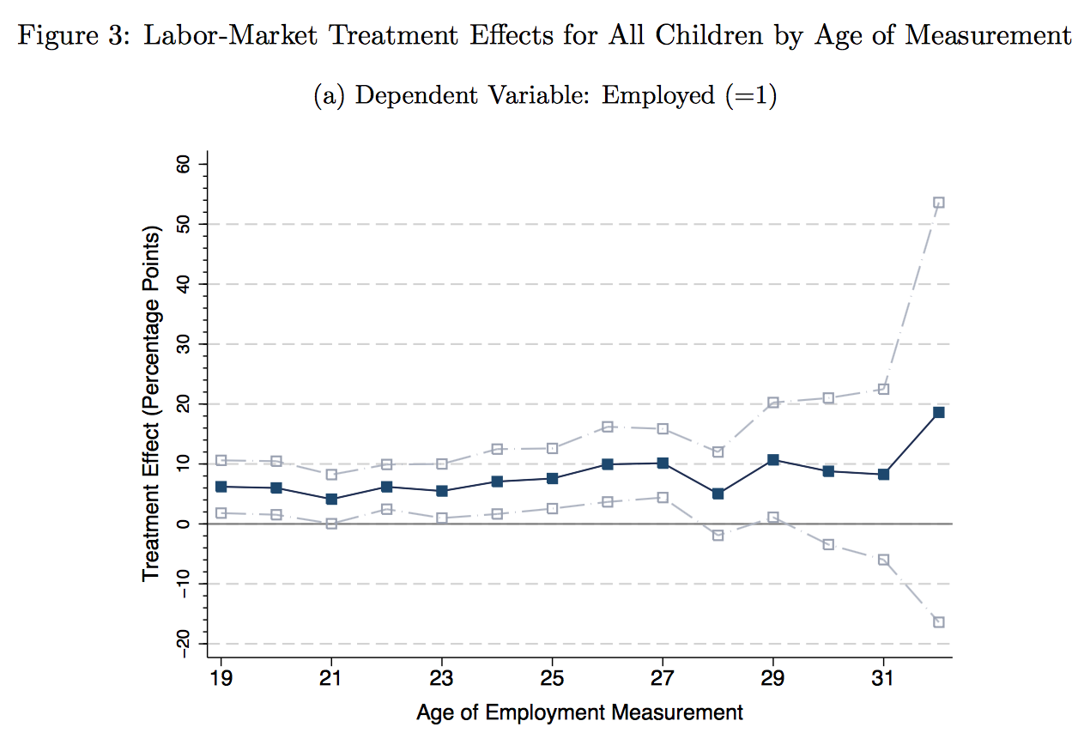

Slide 55
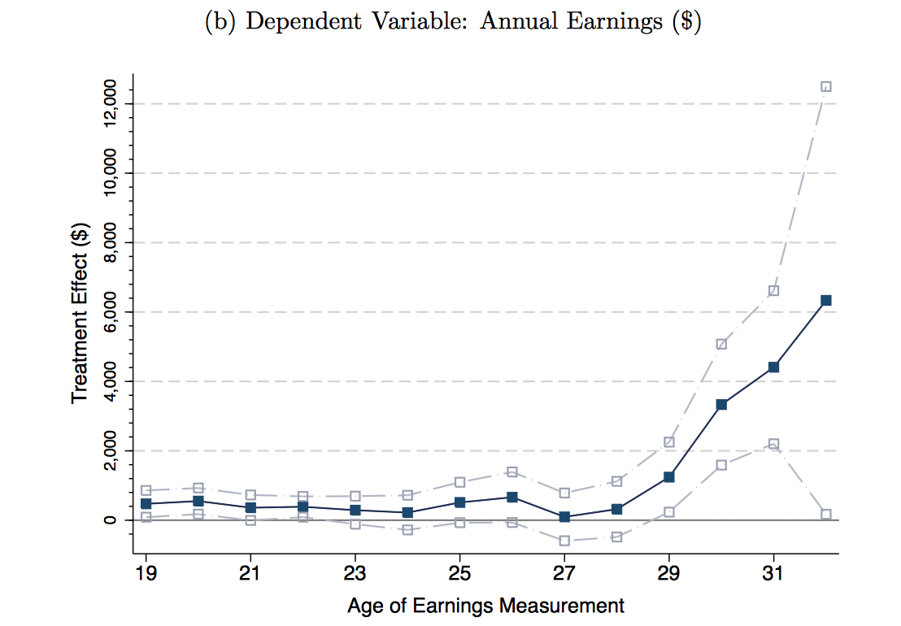

Slide 56
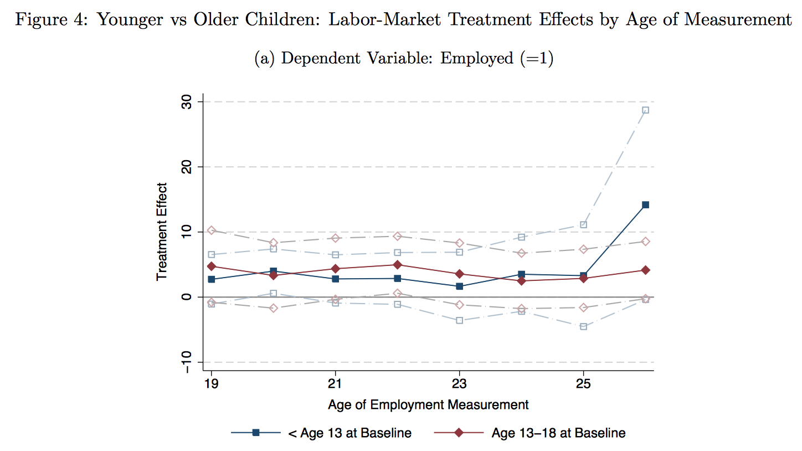

Slide 57
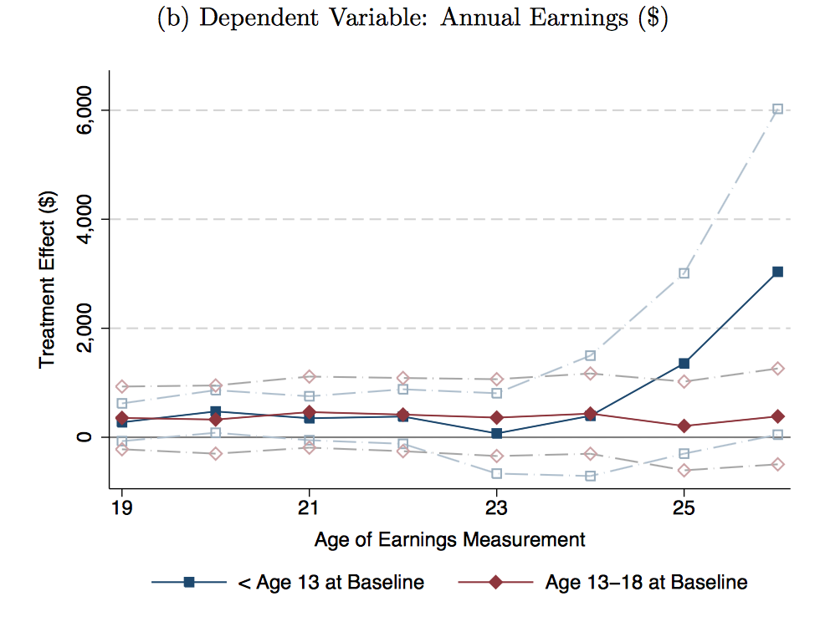

Slide 58
Summary and Gentrification
Summing up, Hope VI led to displacement of pre-existing residents
Results suggest positive effects on children and a “revitalization” or “gentrification” of the neighborhood
Key question: what were the impacts on previous residents

Slide 59
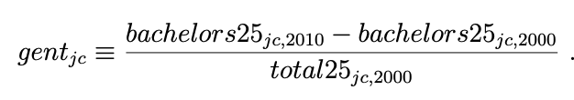
Gentrification
Burgeoning new work studying systematic impact of gentrification
Brummet and Reed (2019) use linked census data to compare changes in outcomes for pre-existing residents to changes in neighborhood composition
Measure “gentrification” as change in over-25 population % with bachelor’s degree

Slide 60
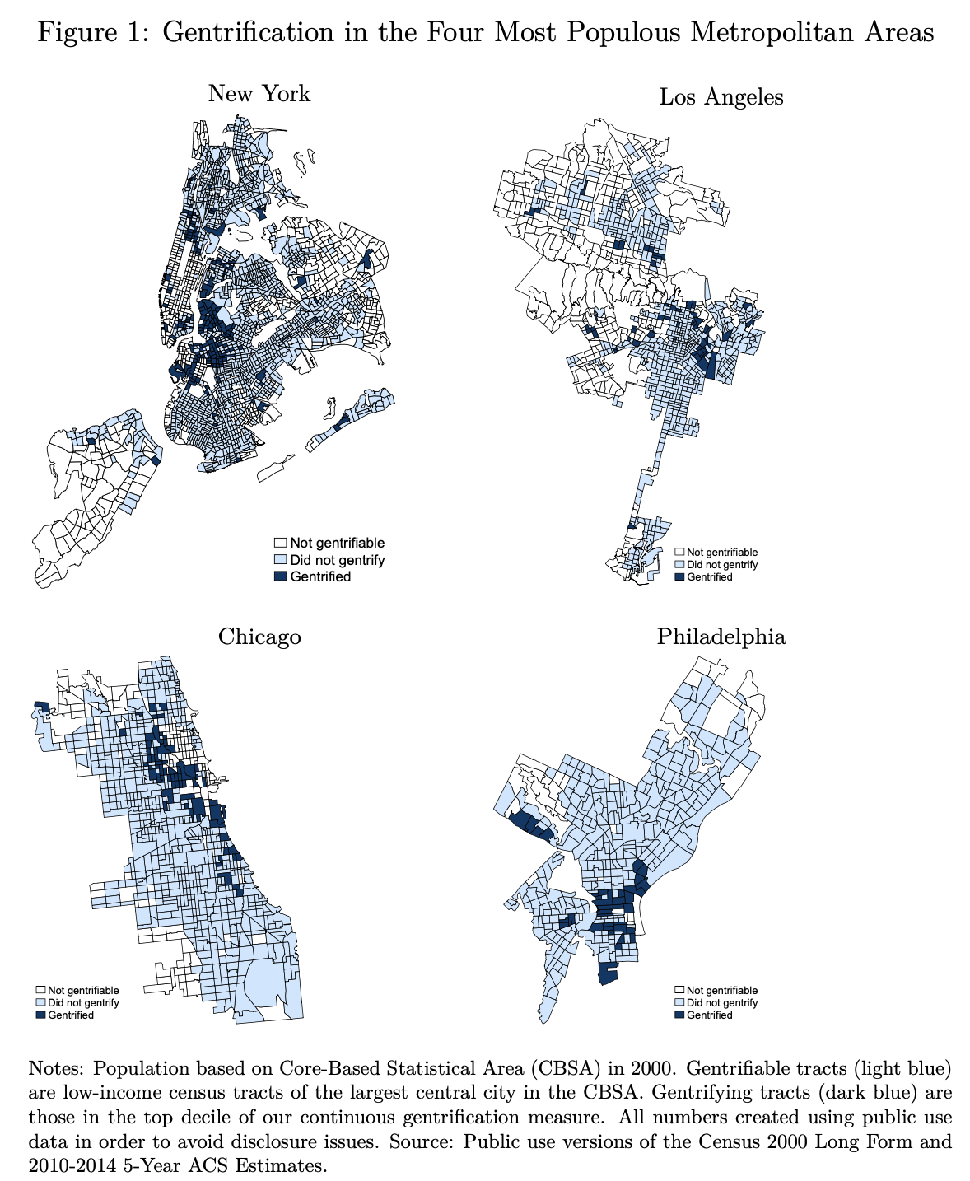
Gentrification

Slide 61
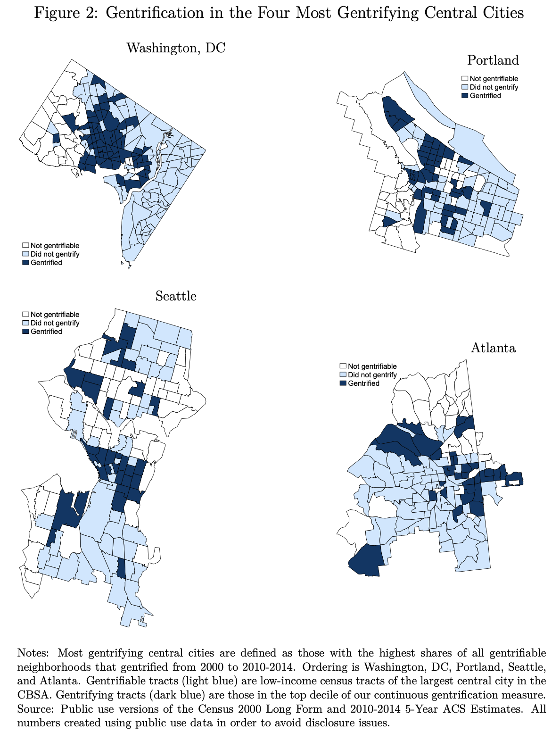
Gentrification

Slide 62
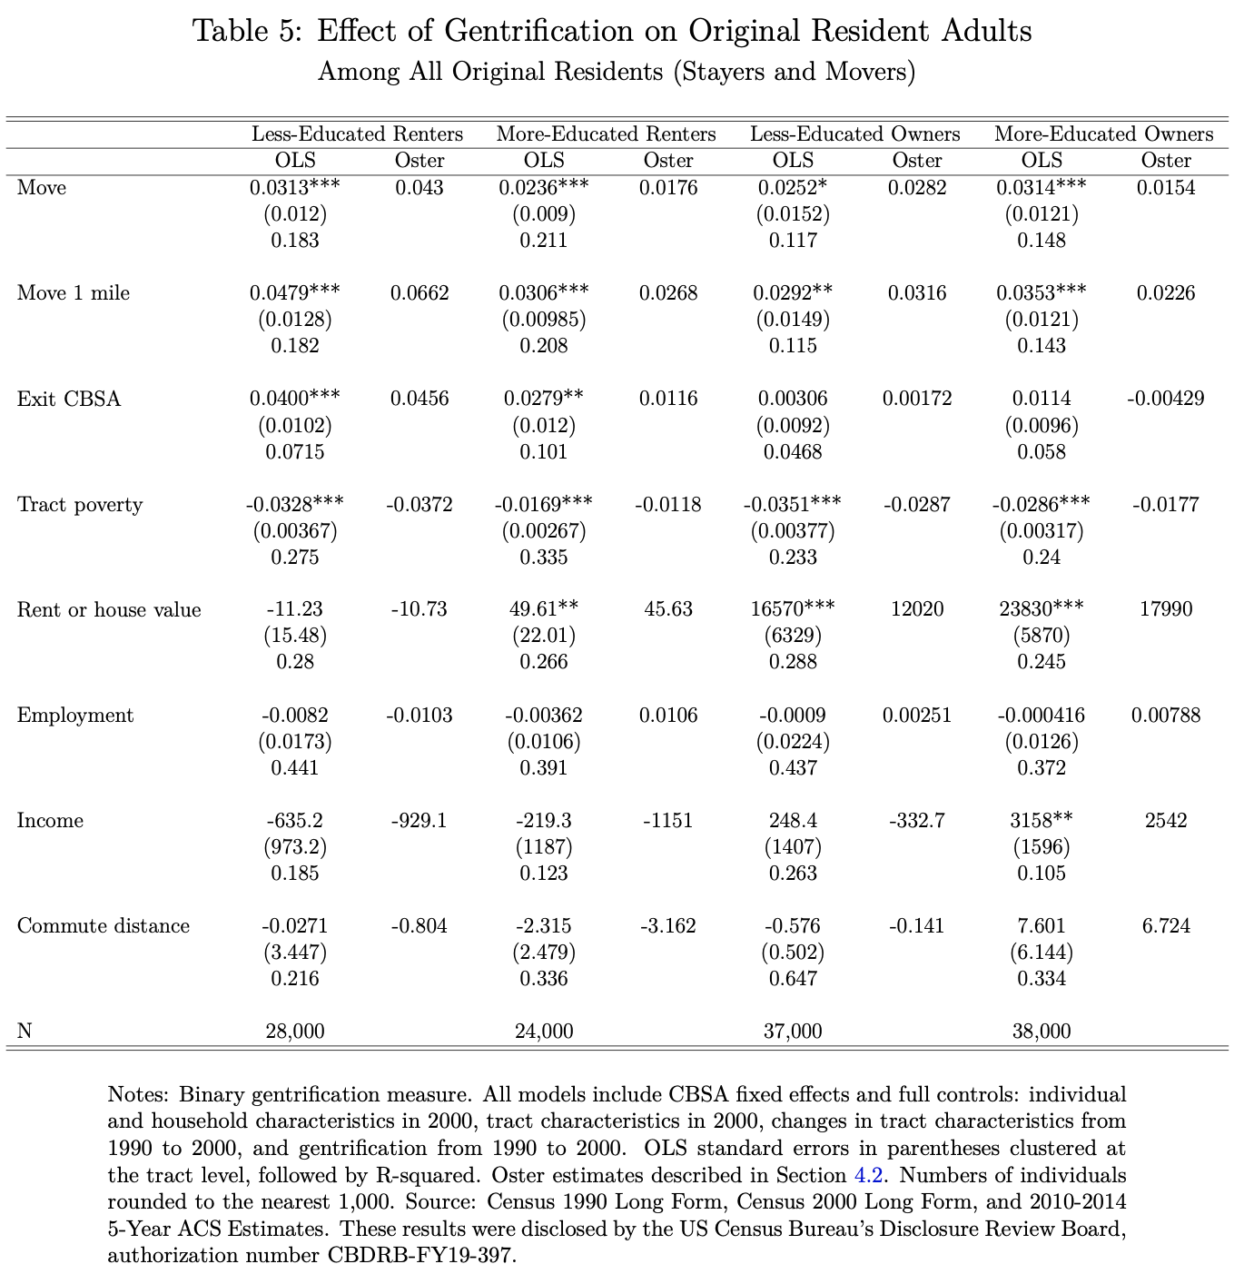
Gentrification

Slide 63
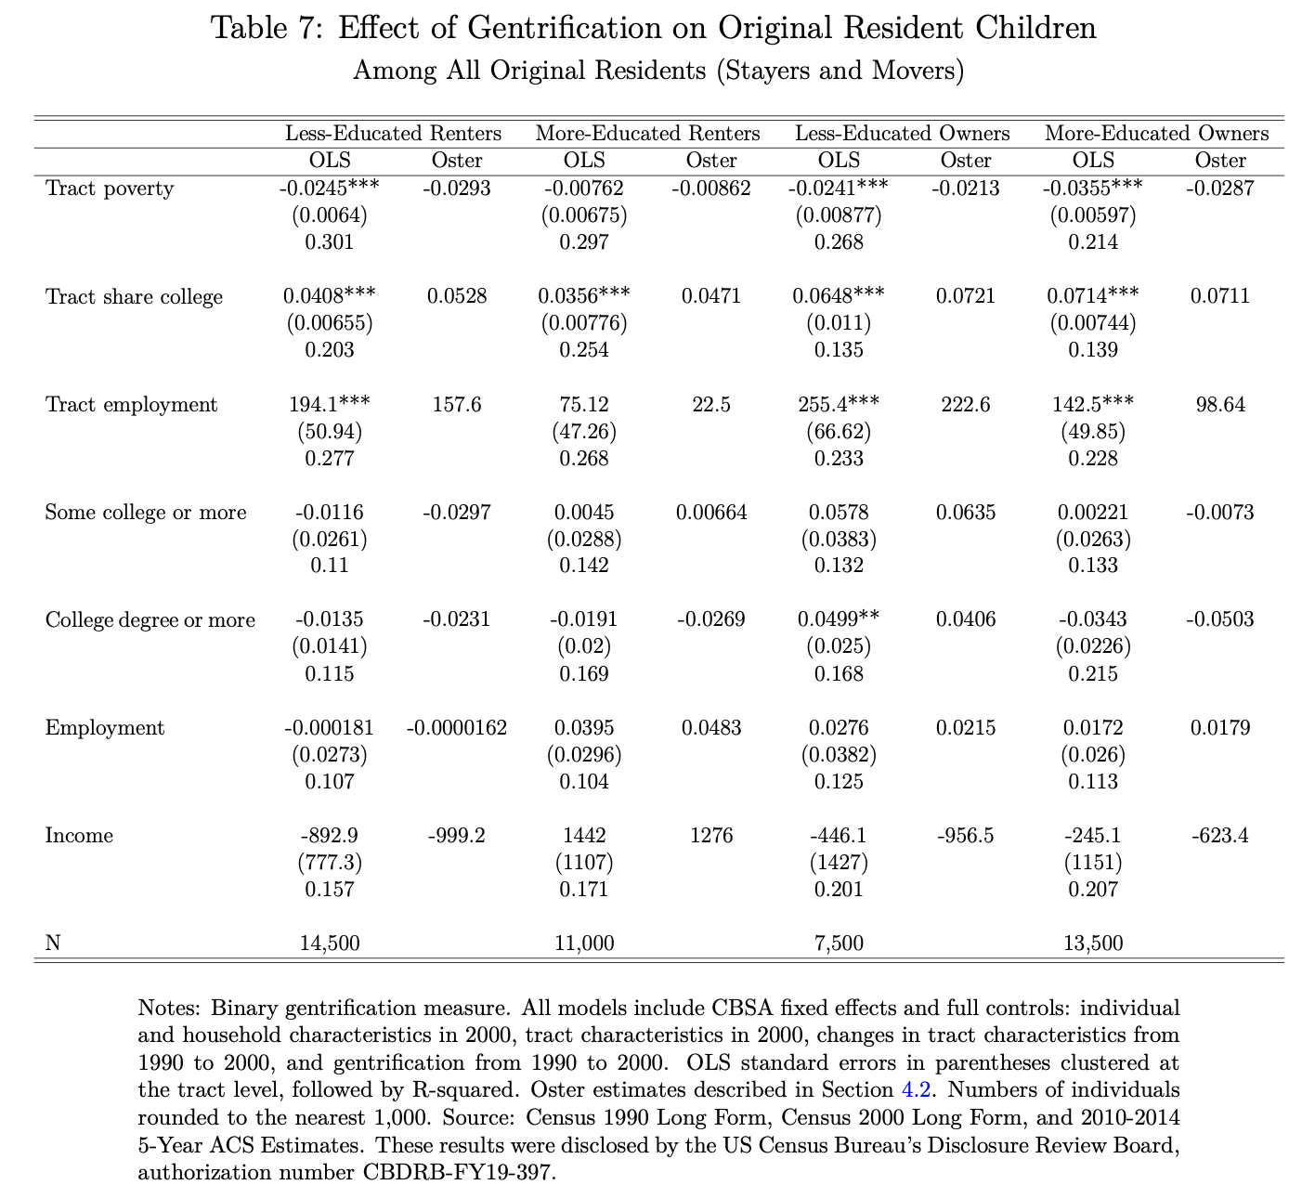
Gentrification

Slide 64
Gentrification
Evidence of:
Displacement especially of low-income renters, statistically insignificant impact on employment and earnings.
Positive impacts on house values for owners
Exposure to poverty decreases for both owners and renters
Some evidence of positive impacts on children, especially among owners

Slide 65
Summary
Many open questions:
Welfare impacts of “gentrification”? What’s the right definition of “gentrification”
Is place-based policy more “efficient” than national-based policy
  Target people vs. places?
  Fiscal externalities from local to national policies?
  Optimal response to place-based “shocks” vs. level differences

