Slide 1
Public Economics (2450B)
Topic 5: Children and Family Policies
Nathaniel Hendren
Spring, 2020

Slide 2
Early Childhood and Family Policies
Last lecture: Role of human capital and education
  Focused on college, job training, K12, etc.
This lecture: focus on child/childhood/family/environment policies:
  Preschool policies
  Family leave
  Environmental policies
Broad themes consistent with the first lecture: Kids matter

Slide 3
Outline
Preschool and Head Start
1
2
Family Leave and Childcare policies
3
Environmental Policies and Early Childhood Impacts

Slide 4
Preschool and Head Start
US Spends ~$10B on head start annually
  States contract with local providers to provide free preschool to low-income children
  Children aged 0-5 with incomes below 100% FPL or in SSI/TANF are eligible
  Funded through federal grants to local public / non-profit organizations providing pre-school
  Generally administered via waitlists (not enough slots)
What is the impact of this spending?
How should we think about the welfare impacts of it?

Slide 5
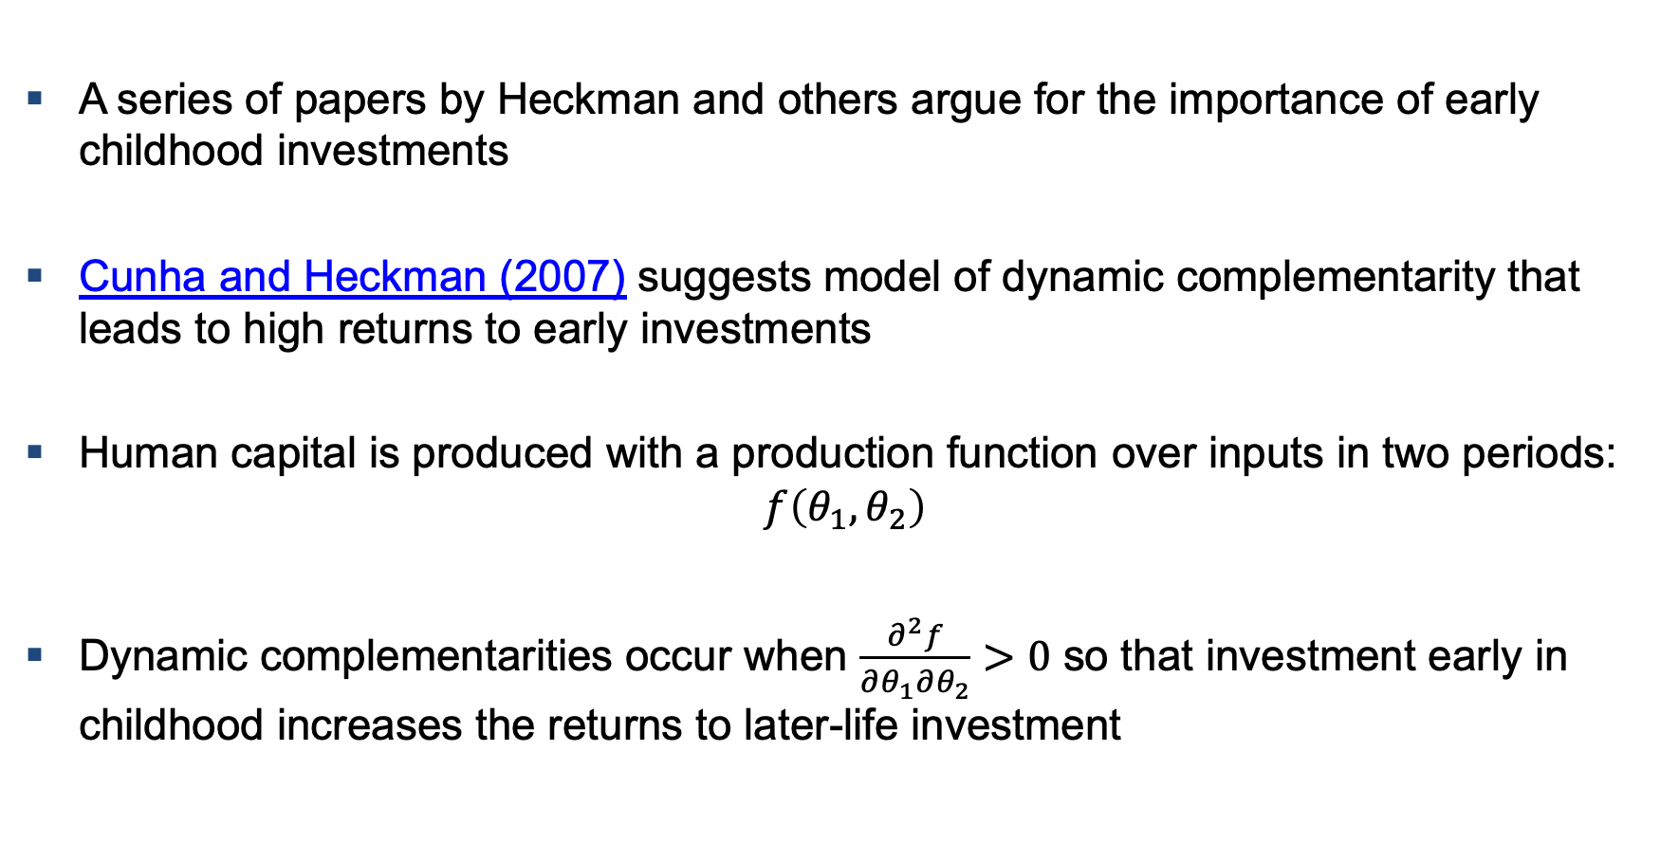
Early Childhood Investment & Dynamic Complementarity
A series of papers by Heckman and others argue for the importance of early childhood investments
Cunha and Heckman (2007) suggests model of dynamic complementarity that leads to high returns to early investments
Human capital is produced with a production function over inputs in two periods:
$$f\left(θ_{1},θ_{2}\right)$$
Dynamic complementarities occur when $\frac{∂^{2}f}{∂θ_{1}∂θ_{2}}>0$ so that investment early in childhood increases the returns to later-life investment

Slide 6
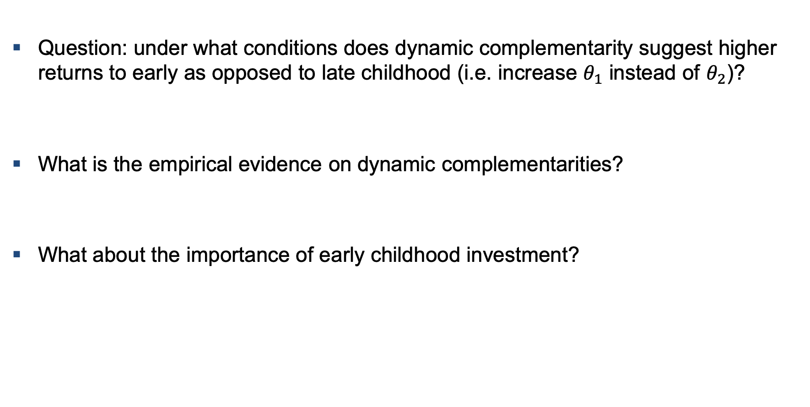
Early Childhood Investment & Dynamic Complementarity
Question: under what conditions does dynamic complementarity suggest higher returns to early as opposed to late childhood (i.e. increase $θ_{1}$ instead of $θ_{2}$)?
What is the empirical evidence on dynamic complementarities?
What about the importance of early childhood investment?
Notes:
Answer: there is a higher stock of investment in later life so that by increasing theta_1 we get a higher mean return.

Slide 7
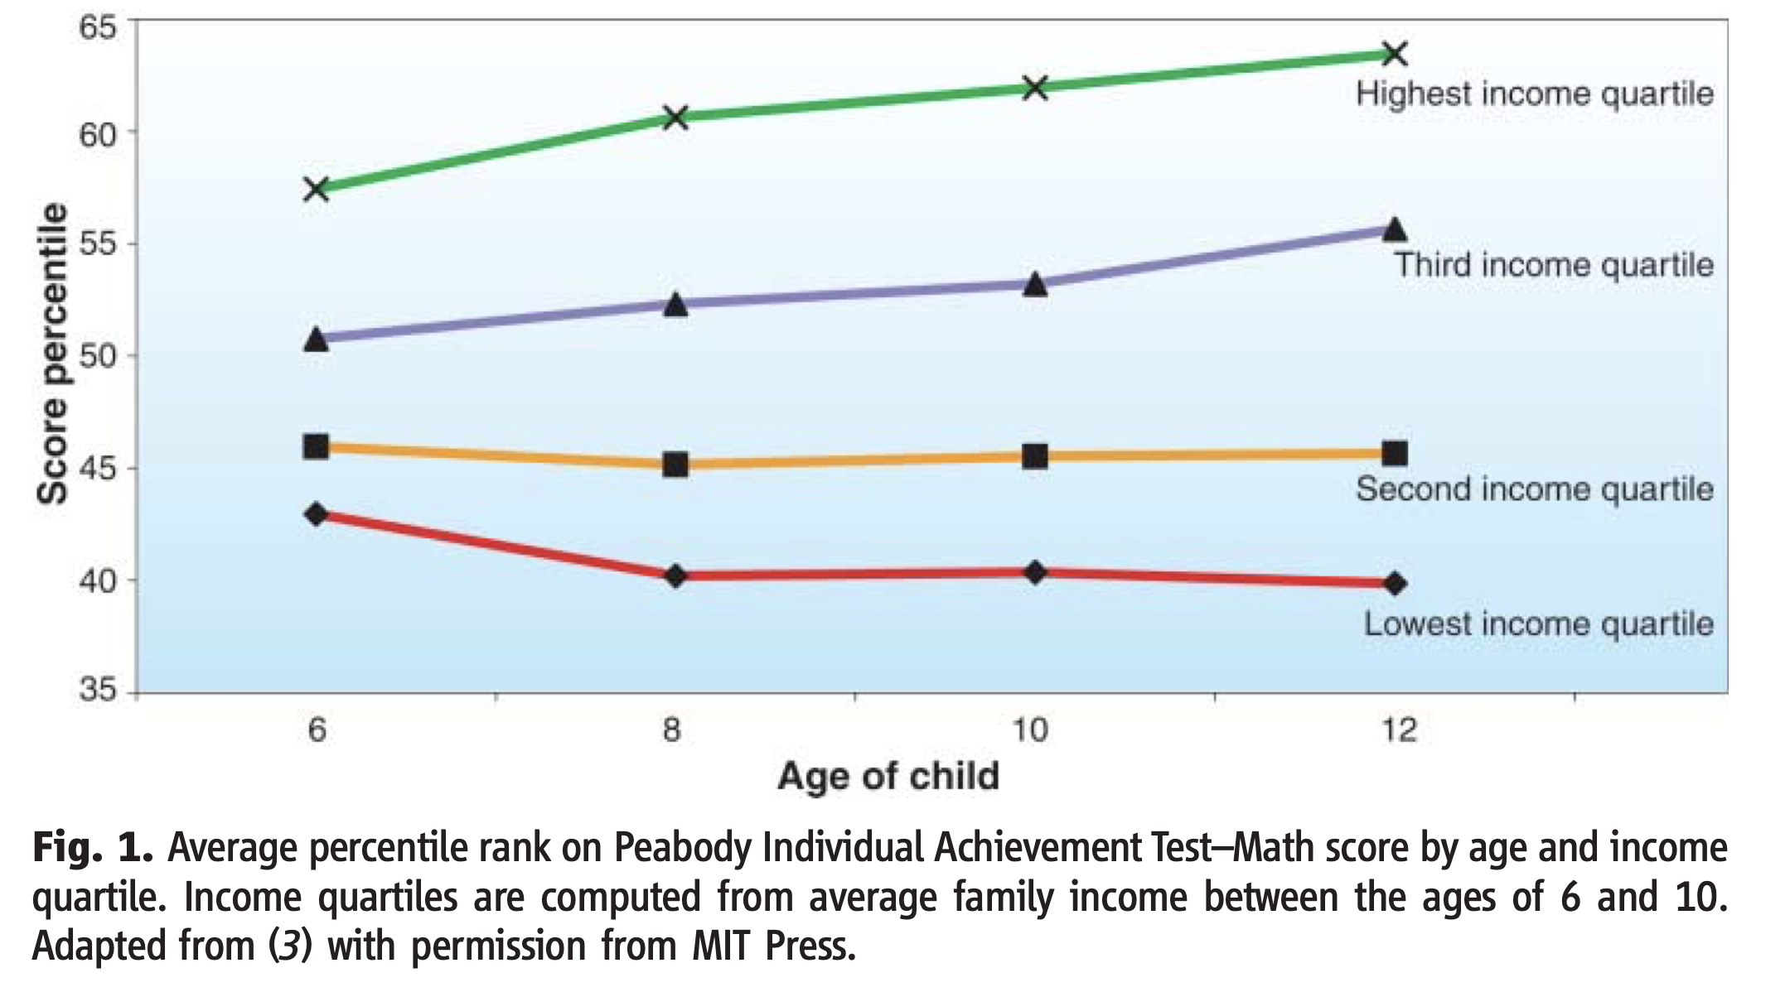
Heckman (2006, Science)

Slide 8
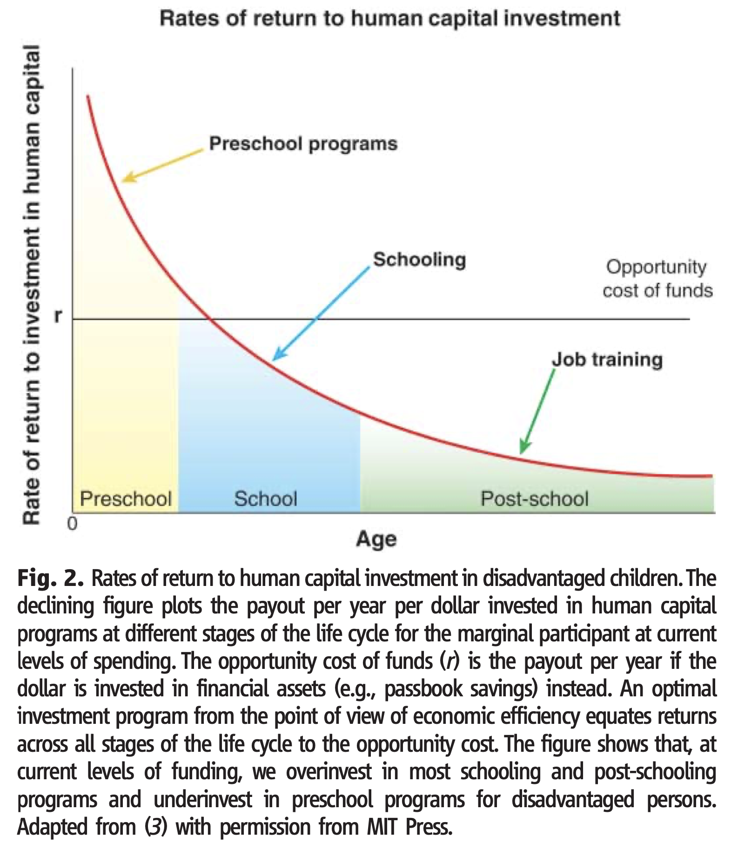
Heckman (2006, Science)

Slide 9
What does the data say? MVPFs by Age (Hendren and Sprung-Keyser 2019)
Child Education
∞
Health Child
College Child
>5
4
3
Top Taxes
MVPF
2
Cash Transfers
Housing Vouchers
Supp. Sec. Inc.
1
Job Training
Unemp. Ins.
Disability Ins.
Health Adult
0
<-1
College Adult
0
20
40
60
80
Age of Beneficiaries

Slide 10
What does the data say? Neighborhood Exposure Effects (CFHJP2019)
1.0
0.8
Slope (Age<=23): -0.025
Coefficient on Observational Outcome in Destination
(0.002)
0.6
Selection Effect
δ = 0.346
0.4
Ident. Assumption: Selection effect constant across ages
Shape before age 23 reflects causal effects of exposure
Slope (Age>23): -0.008
(0.005)
0.2
0
5
10
15
20
25
30
Age of Child When Parents Move

Slide 11
Preschool and Head Start
Nonetheless, there is clear evidence that early childhood programs can have large effects (the debate is about whether they are larger/smaller than other policies)
Generally, evidence on the long-run causal evidence on impact of preschool on children in the US generally comes from three sources:
  Perry Preschool RCT
  Abecedarian RCT
  Introduction of Head Start
Additional studies looks at more short- and medium-run outcomes (e.g. test scores)
  Head Start Impact Study (RCT)
  Sibling designs (Deming 2009)
  Large body of other work looking at test scores

Slide 12
Perry Preschool
Perry Preschool is one of the most widely-cited preschool studies
Studies 123 children randomly assigned to treatment and control groups
Non-random attrition in the follow-up surveys, which is corrected for using a Heckman selection model
Heckman et al. 2009 conduct a cost-benefit analysis of the program

Slide 13
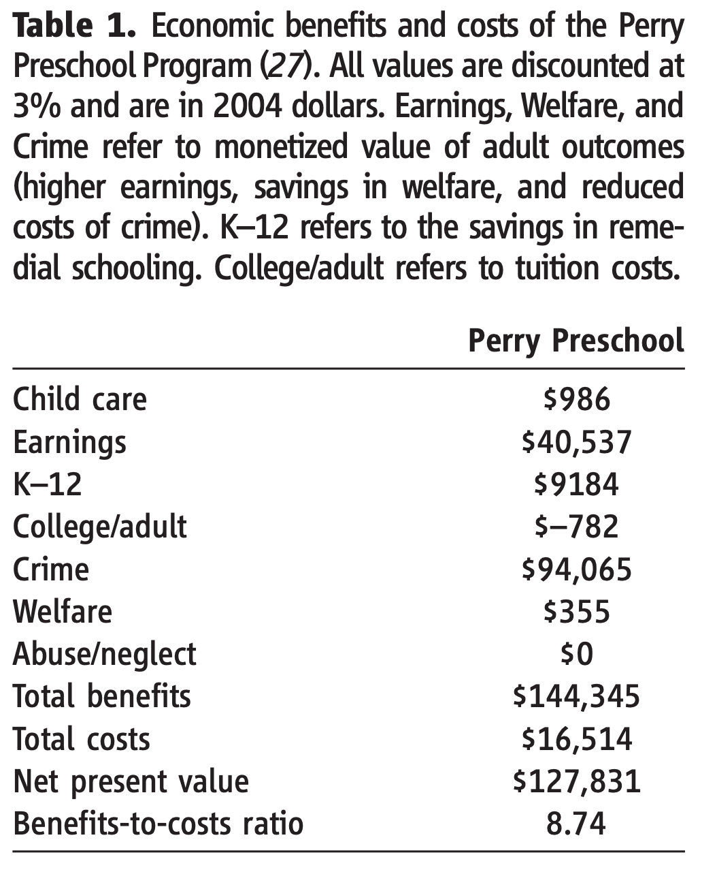
Heckman (2006, Science)

Slide 14
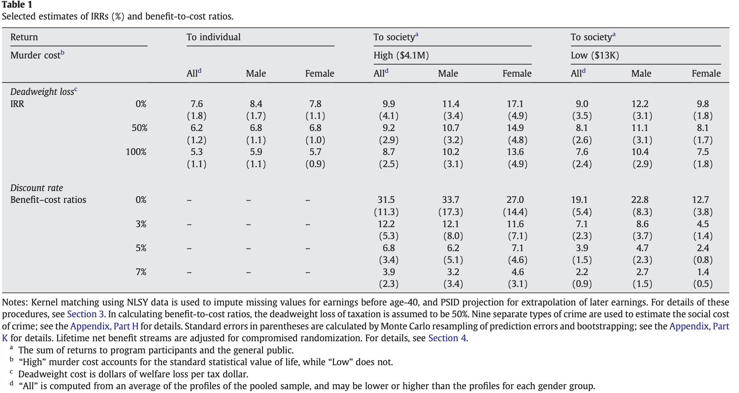
Perry Preschool

Slide 15
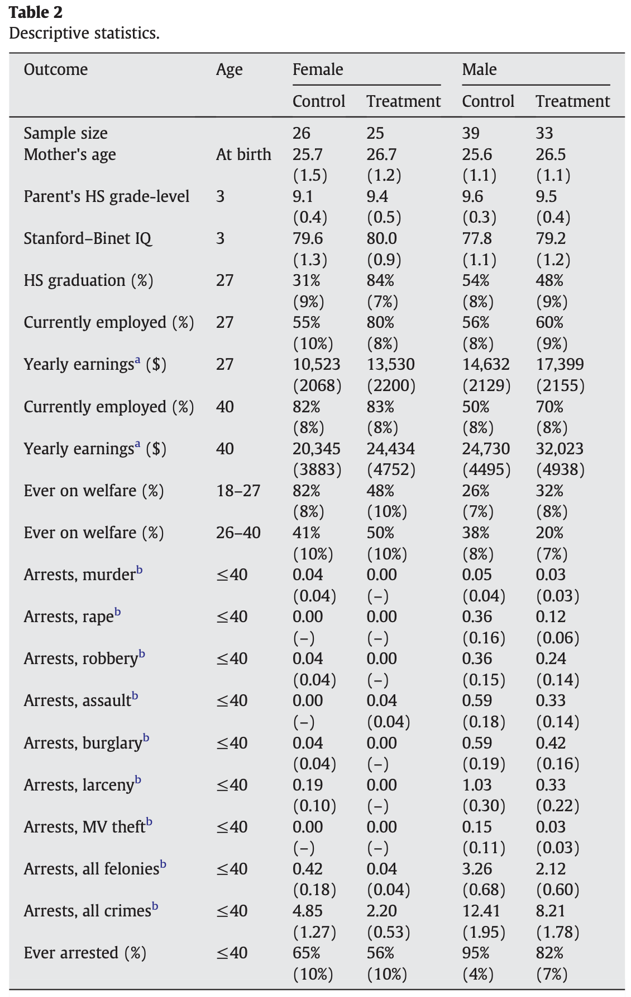
Perry Preschool

Slide 16
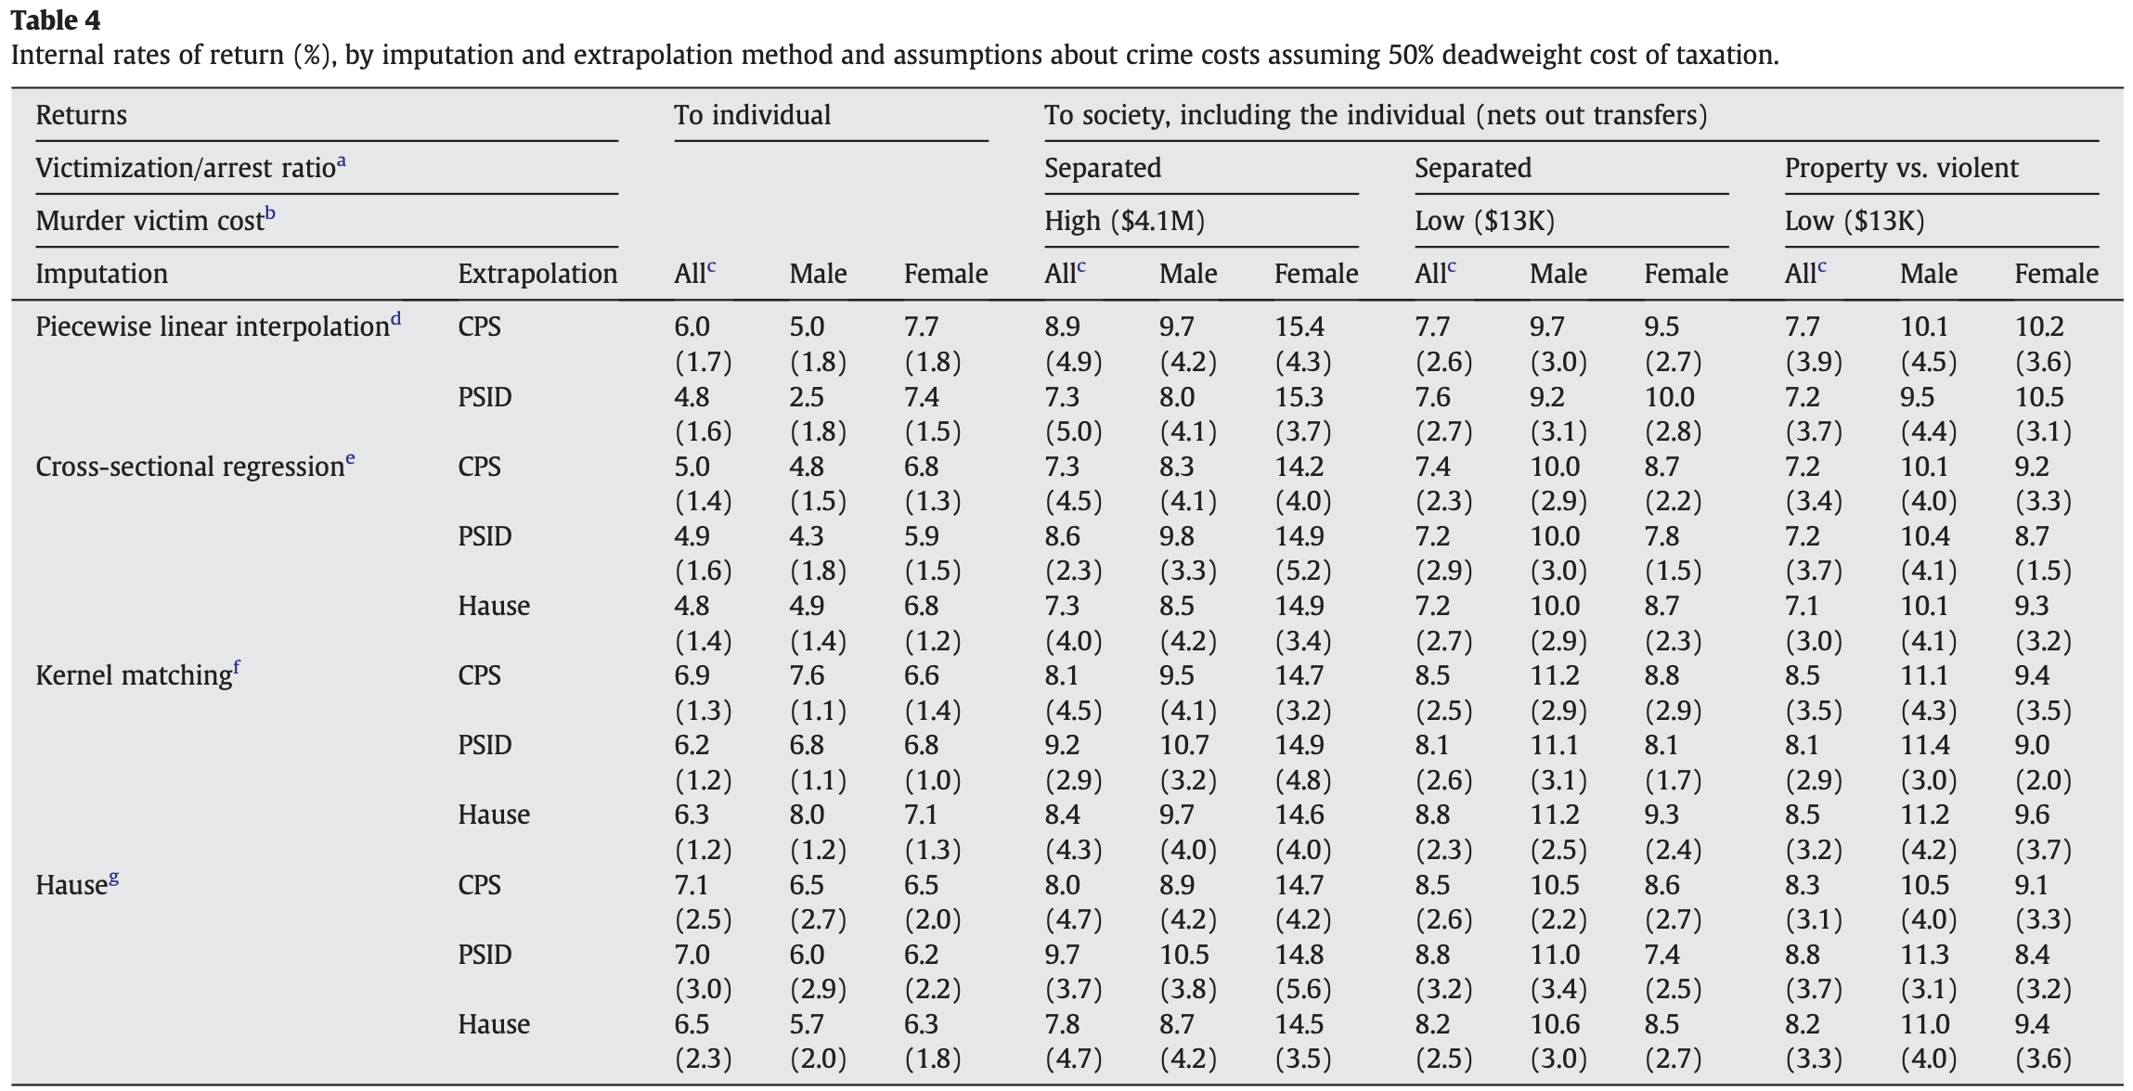
Perry Preschool

Slide 17
Abecedarian Preschool
﻿You just saw more summary statistics of data than there are observations in the dataset ☺
But, there are also strong results from another intervention: Carolina Abecedarian
Carolina Abecedarian randomized 111 children into treatment and control
Campbell et al. (2012) conduct a follow-up analysis looking at long run impacts on earnings in young adulthood

Slide 18
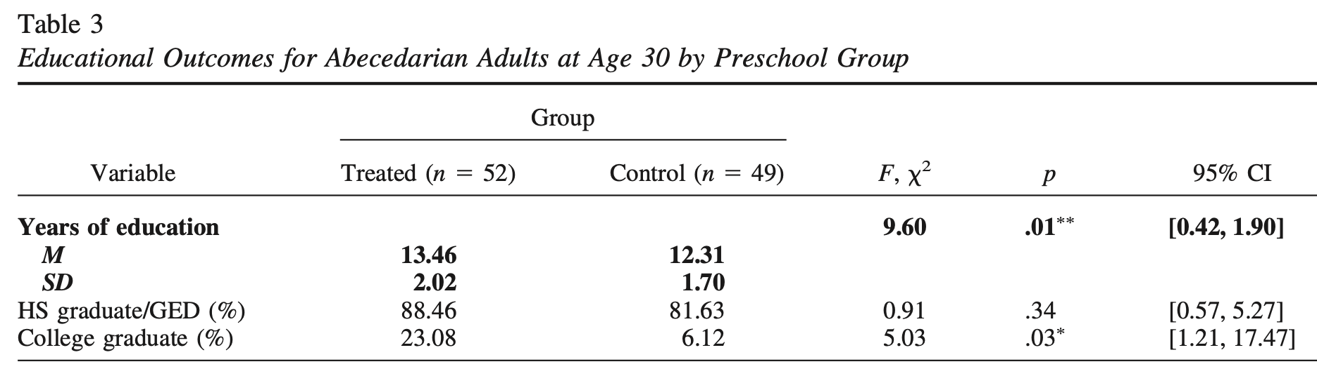
Abecedarian Preschool: Increases in Years of Education

Slide 19
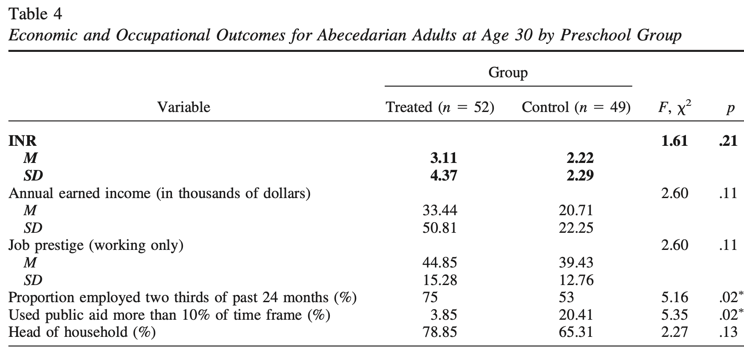
Abecedarian Preschool: Increases in incomes (p=0.11)

Slide 20
Preschool at Scale
Can these results be replicated at scale?
Head Start provides free preschool to low-income families
  Families must be below the poverty line
  Homeless families/TANF/SSI families are eligible (even if above 100% FPL)
Several approaches to analyzing impacts of Head Start
  Sibling Design (e.g. Deming 2009)
  Recent RCT “Head Start Impact Study” but too early for income outcomes (Kline and Walters 2016 forecast with test scores)
  County-level rollout (Jackson et al 2019; Bailey et al 2018)

Slide 21
Deming (2009)
Deming 2009 uses sibling design to estimate impact of head start on outcomes
Key question: What drives differences across siblings in head start participation?
  Head start availability?
  Shocks to the parents?

Slide 22
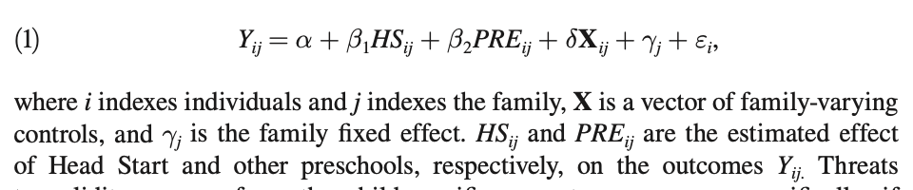
Deming (2009): Sibling Design

Slide 23
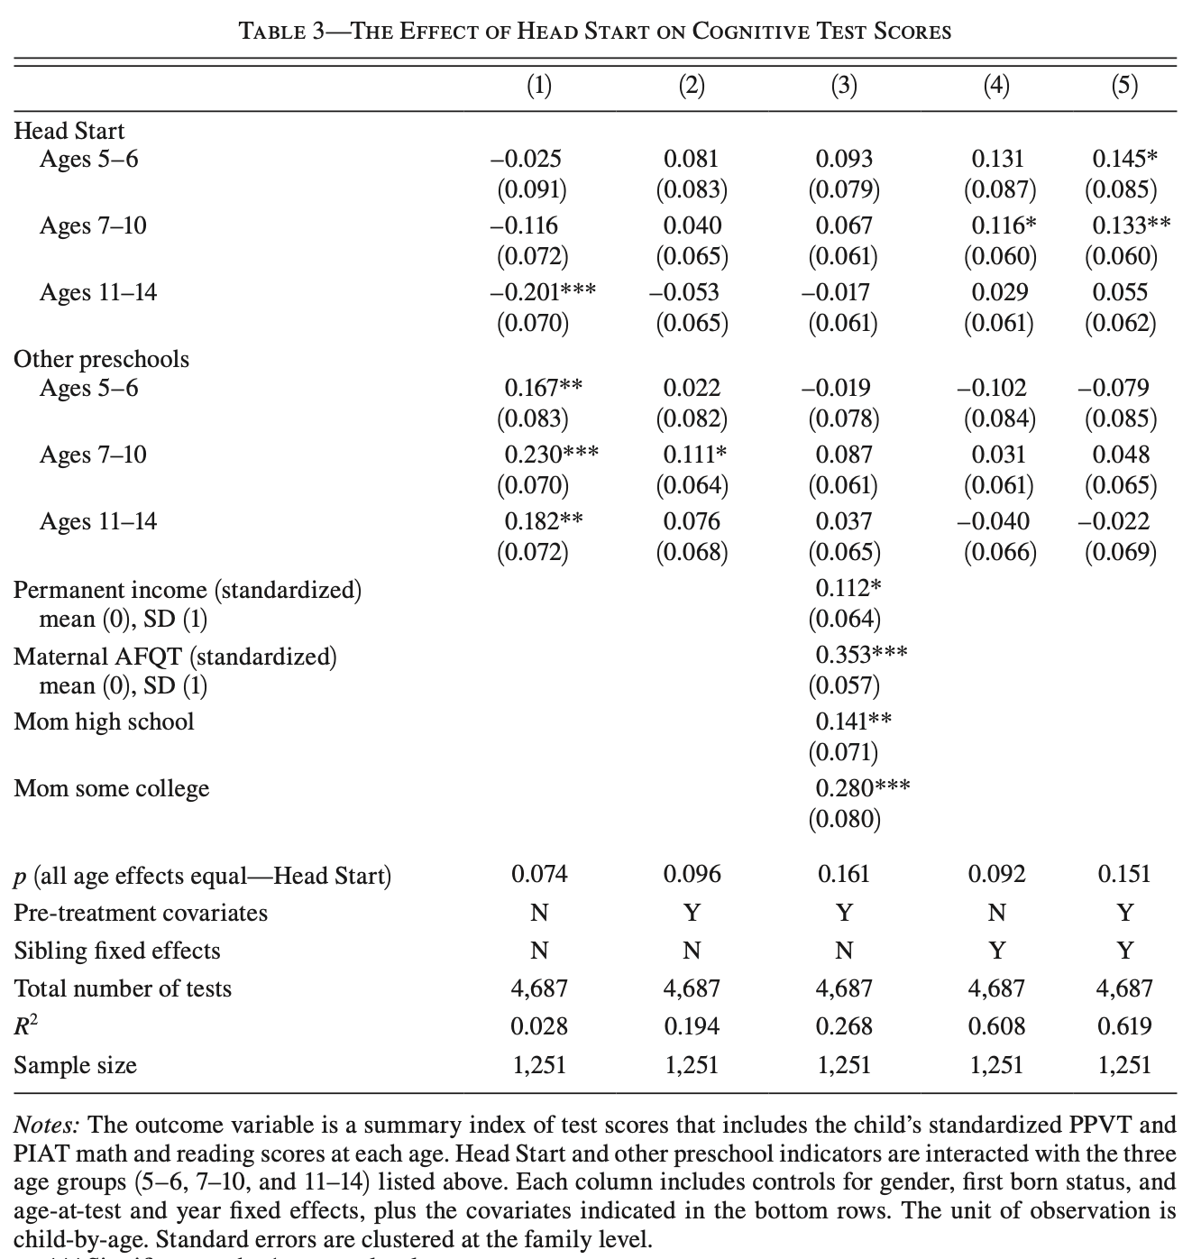
Deming (2009)

Slide 24
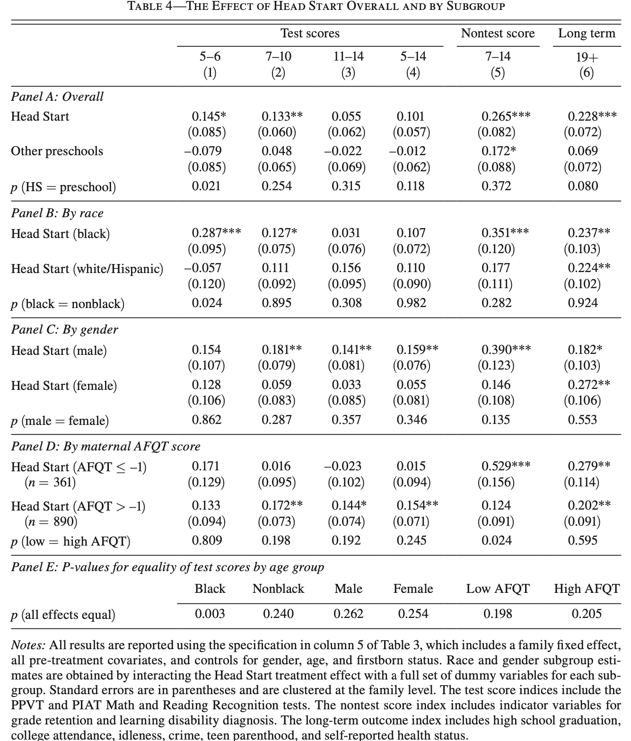
Deming (2009)

Slide 25
Deming (2009)
“Fade out” (but long-run effect)

Slide 26
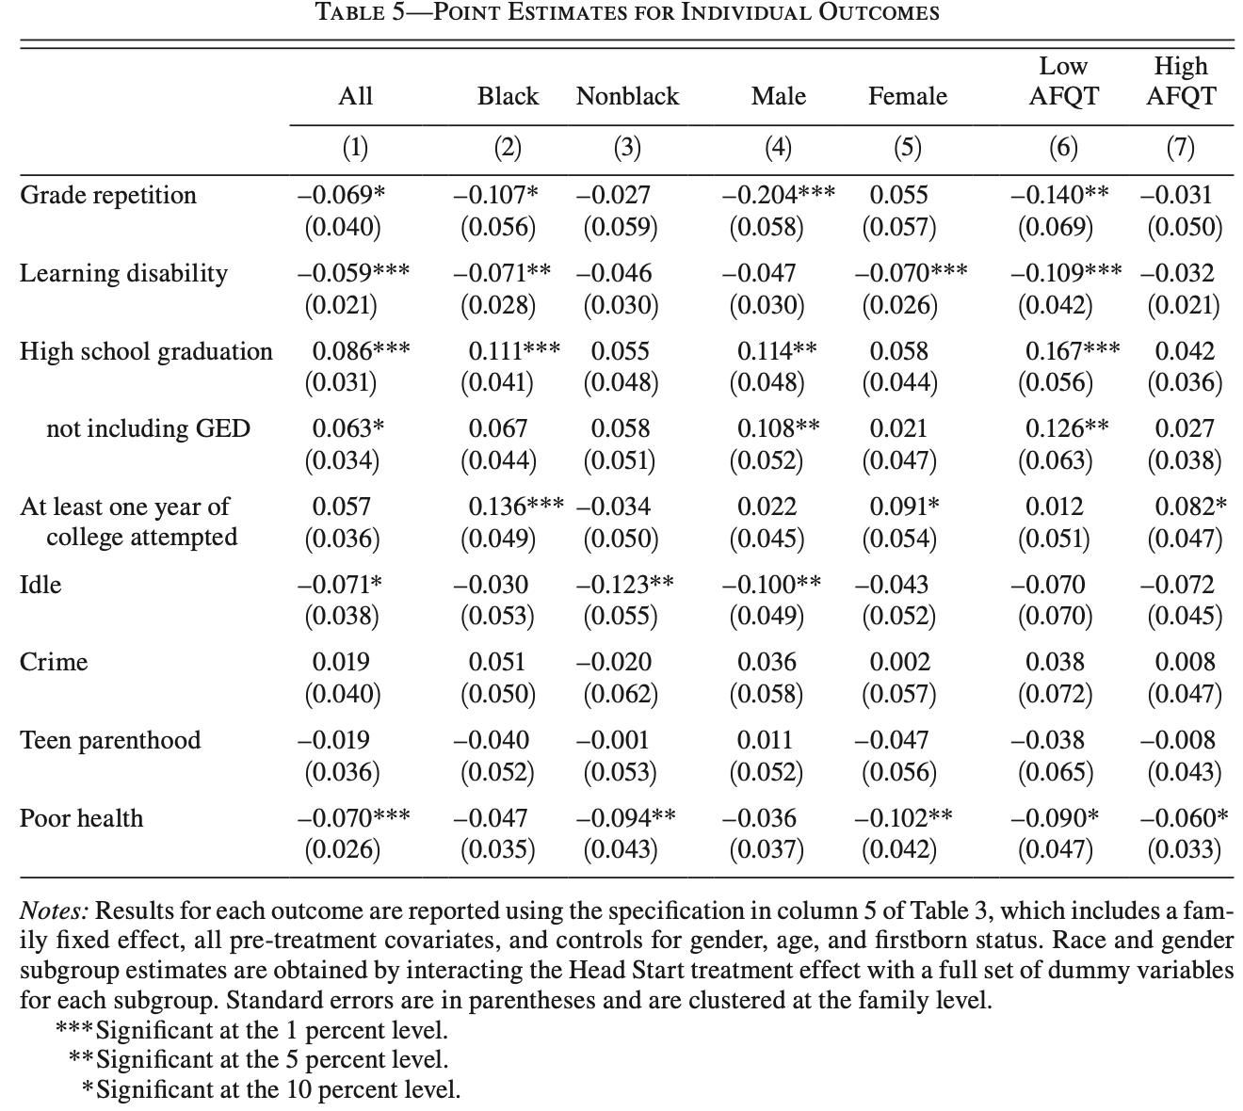
Deming (2009)

Slide 27
Deming (2009)
Large impacts of Head Start participation on outcomes
Roughly 80% of the size of Perry Preschool effects
But, perhaps we’re worried about selection bias?

Slide 28
Head Start Impact Study
Head Start Impact Study conducted large scale RCT of head start
Existing work documents impacts on test scores throughout children’s youth
Generally, results are smaller than those from Deming (2009) and other quasi-experimental studies
Why?
  Selection Bias?
  Other?

Slide 29
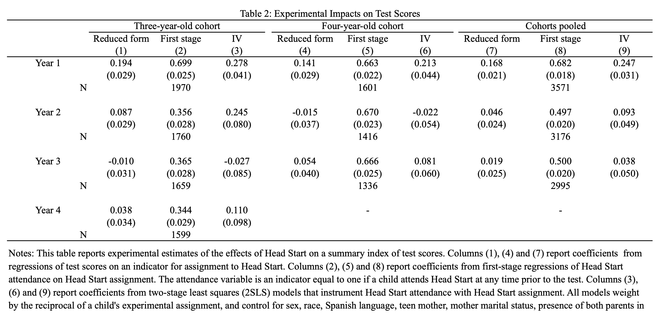
Kline and Walters (2016)

Slide 30
Kline and Walters (2016)
Fade Out

Slide 31
Kline and Walters (2016)
1/3 of control group attended other preschools!
Most of these preschools were publicly funded
Suggests causal effect should be attenuated
And costs would be over-stated in traditional CBA
Aside: What’s implication for the incidence of the policy of providing free preschool?

Slide 32
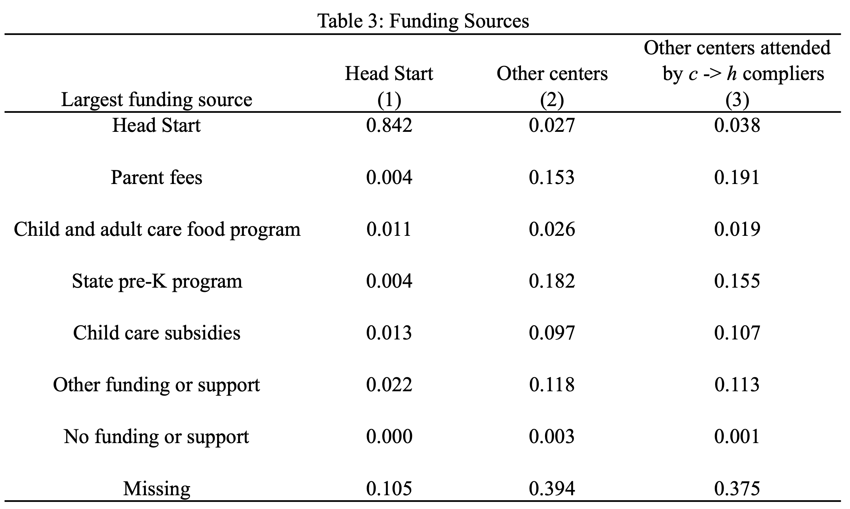
Kline and Walters (2016)

Slide 33
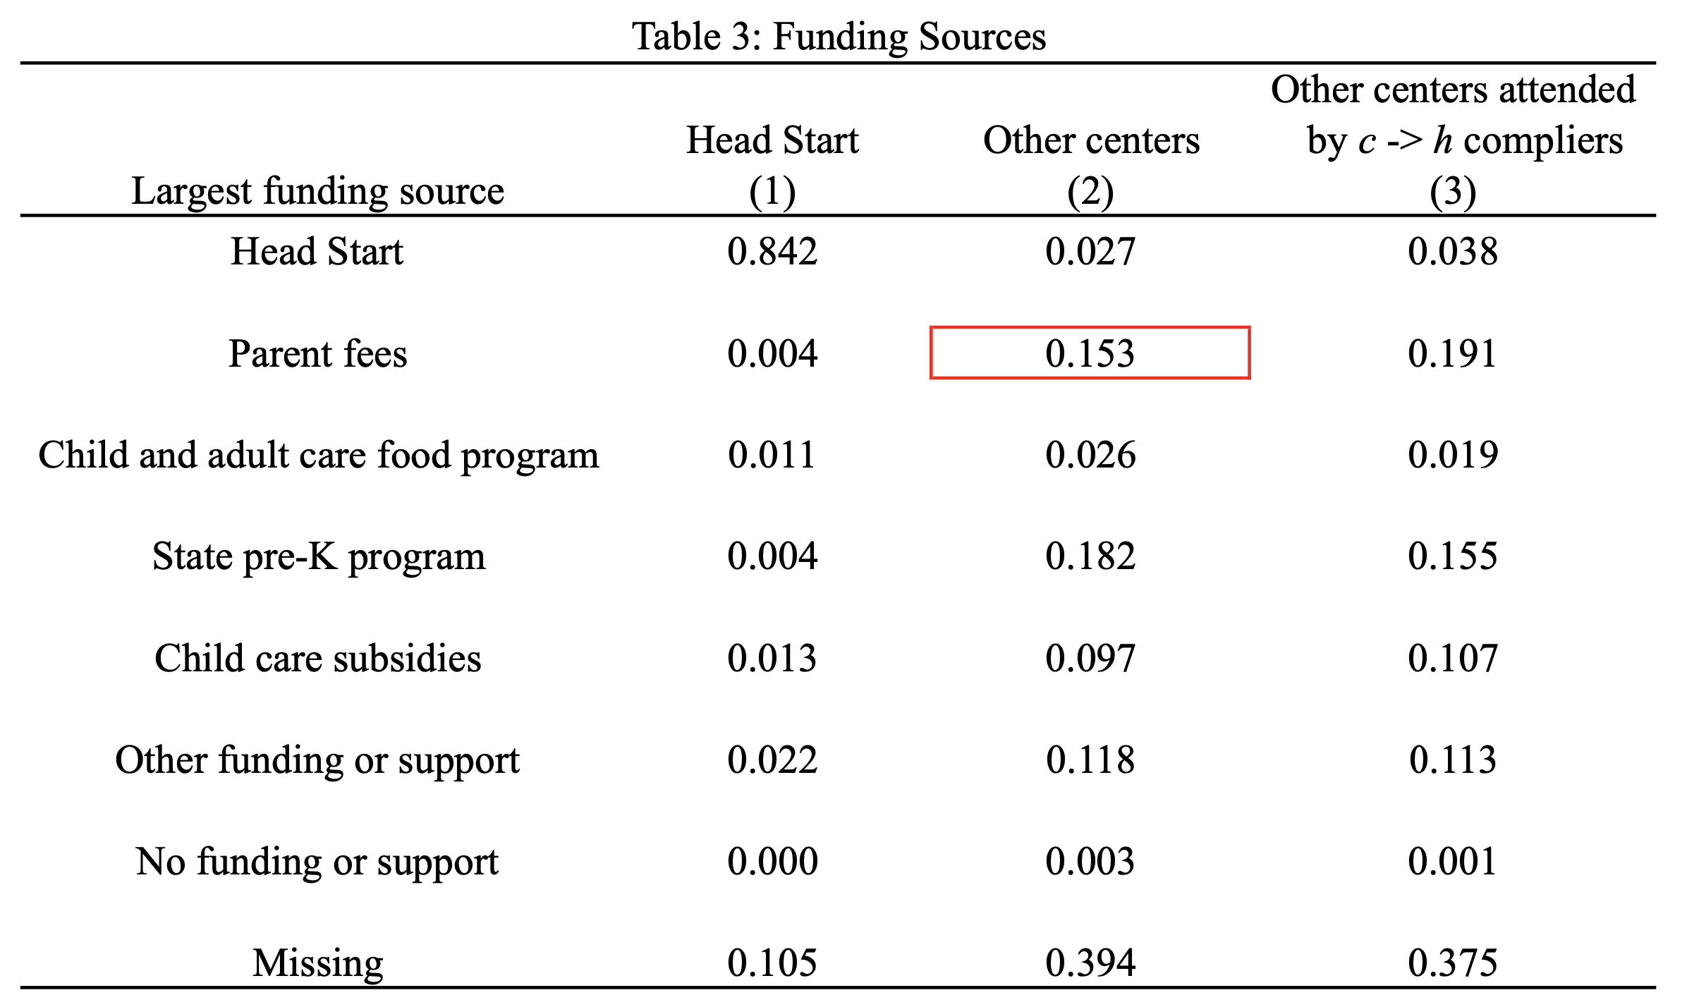
Kline and Walters (2016)

Slide 34
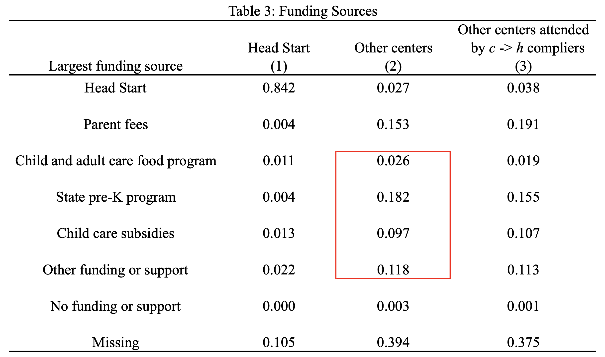
Kline and Walters (2016)

Slide 35
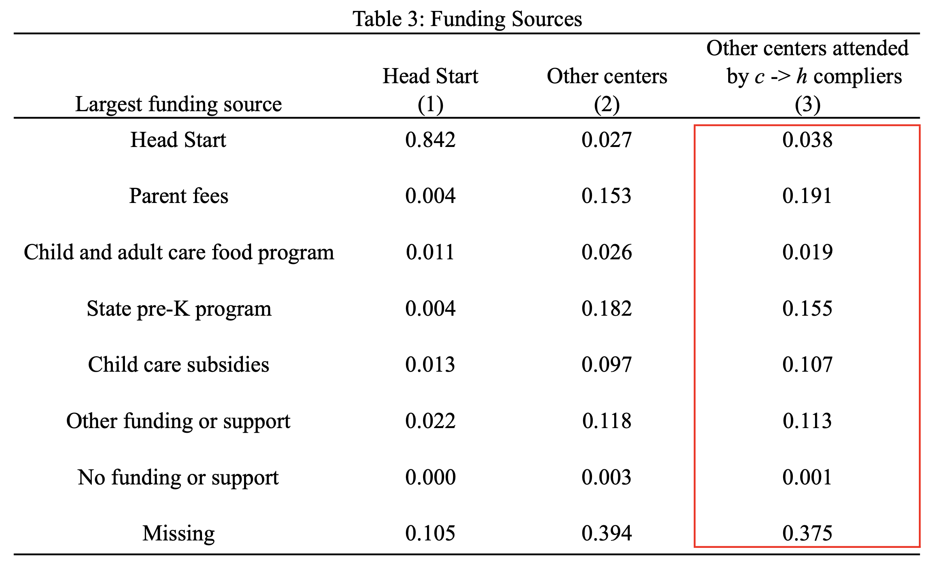
Kline and Walters (2016)

Slide 36
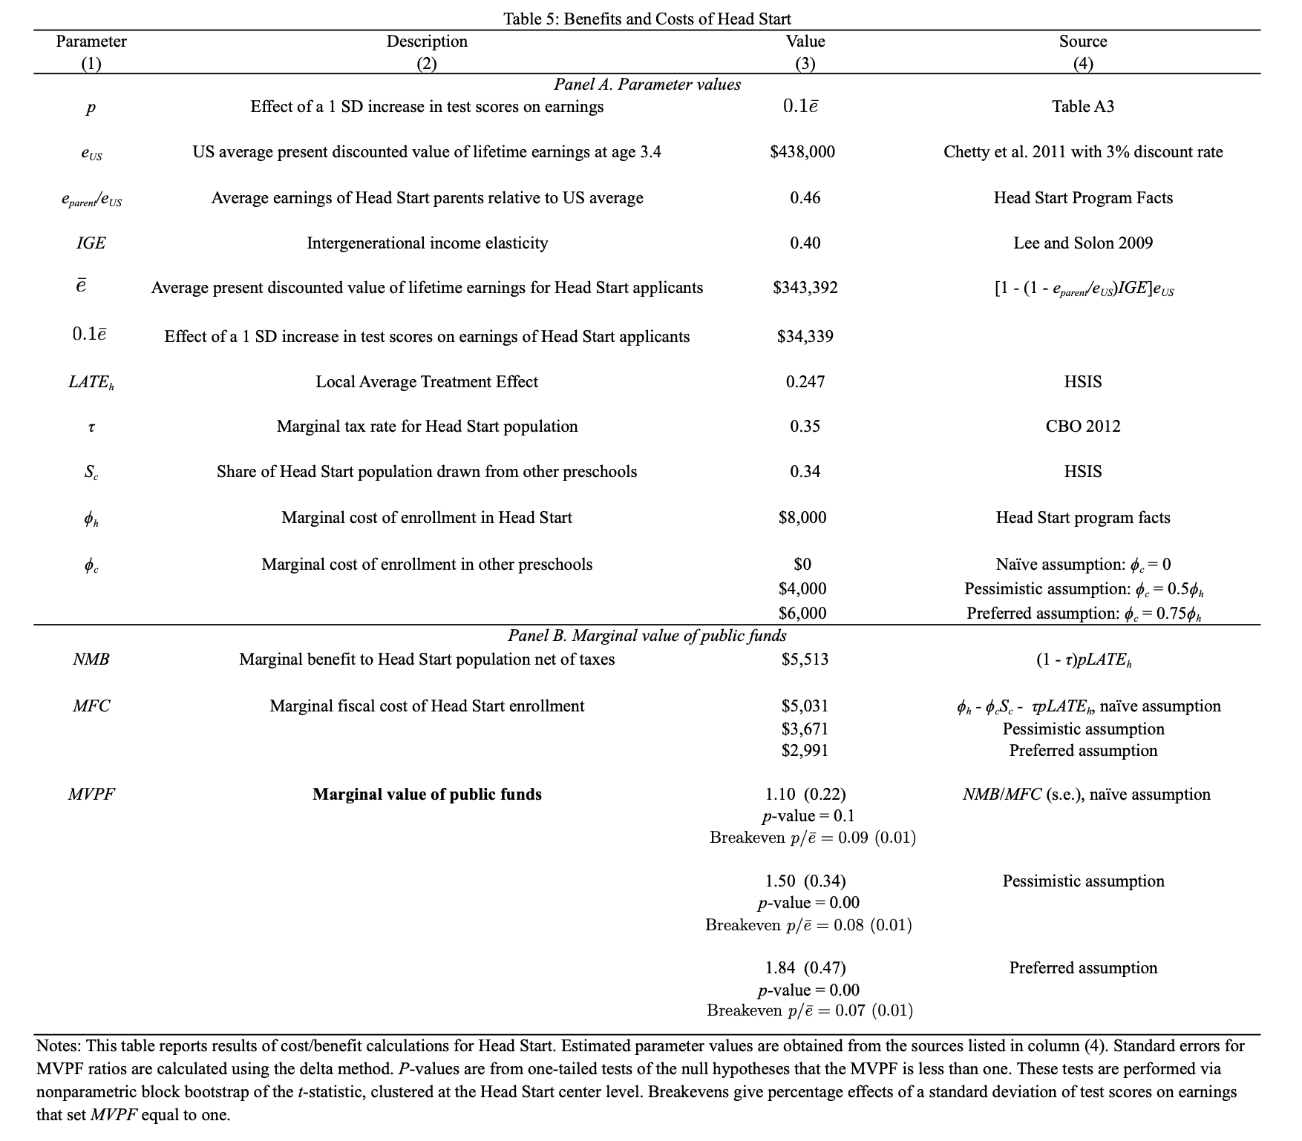
Head Start Impact Study

Slide 37
Kline and Walters
How should we calculate the MVPF?
How might parents time / earnings / payments to preschools affect WTP and Cost?

Slide 38
Head Start Rollout
Other evidence comes from the introduction of Head Start
Idea: Exploit county-by-cohort-variation in introduction of Head Start
Two main papers looking at long-run outcomes directly:
Bailey et al. (2019)
  Use census data to look at long-run outcomes
Jackson et al. (2019)
  Use PSID data to look at long-run outcomes

Slide 39
Johnson and Jackson (2019)
Key advantage of PSID is that it can restrict to low-income parents
Johnson and Jackson (2019) look at impact of head start and also its interaction with K12 spending
Combine:
  Roll out of head start (Preschool)
  School finance equalization rulings (K-12)
Explore the role of “dynamic complementarities”
  Compare effect of head start in places with and without court-mandated school finance reform
Does this test dynamic complementarities? Why or why not?

Slide 40
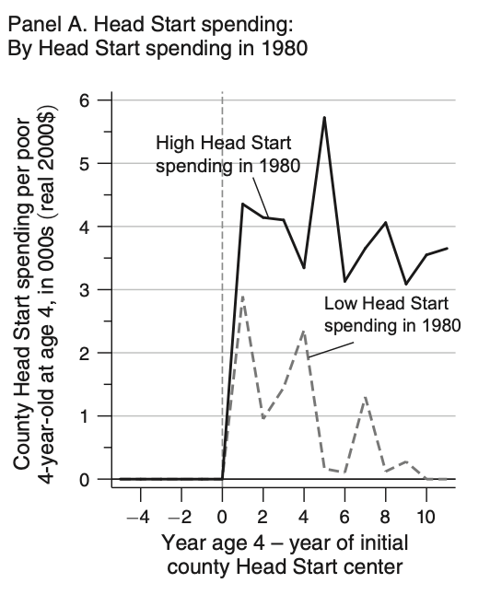
Johnson and Jackson (2019): Increases in Head Start Spending

Slide 41
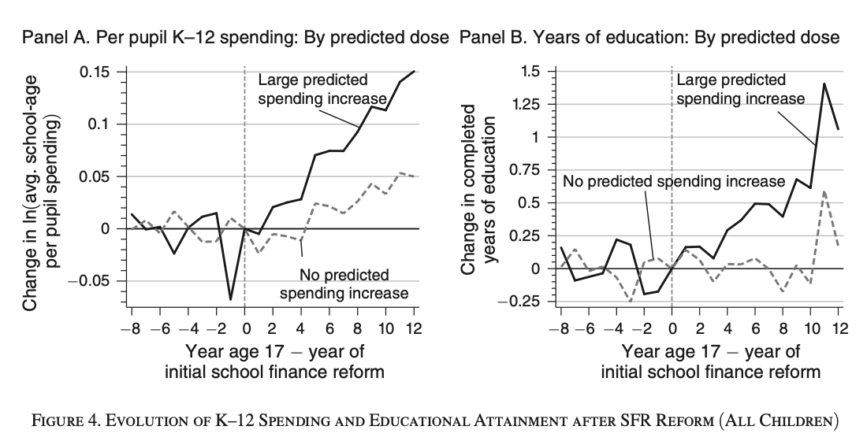
Johnson and Jackson (2019): Increases in K-12 Spending

Slide 42
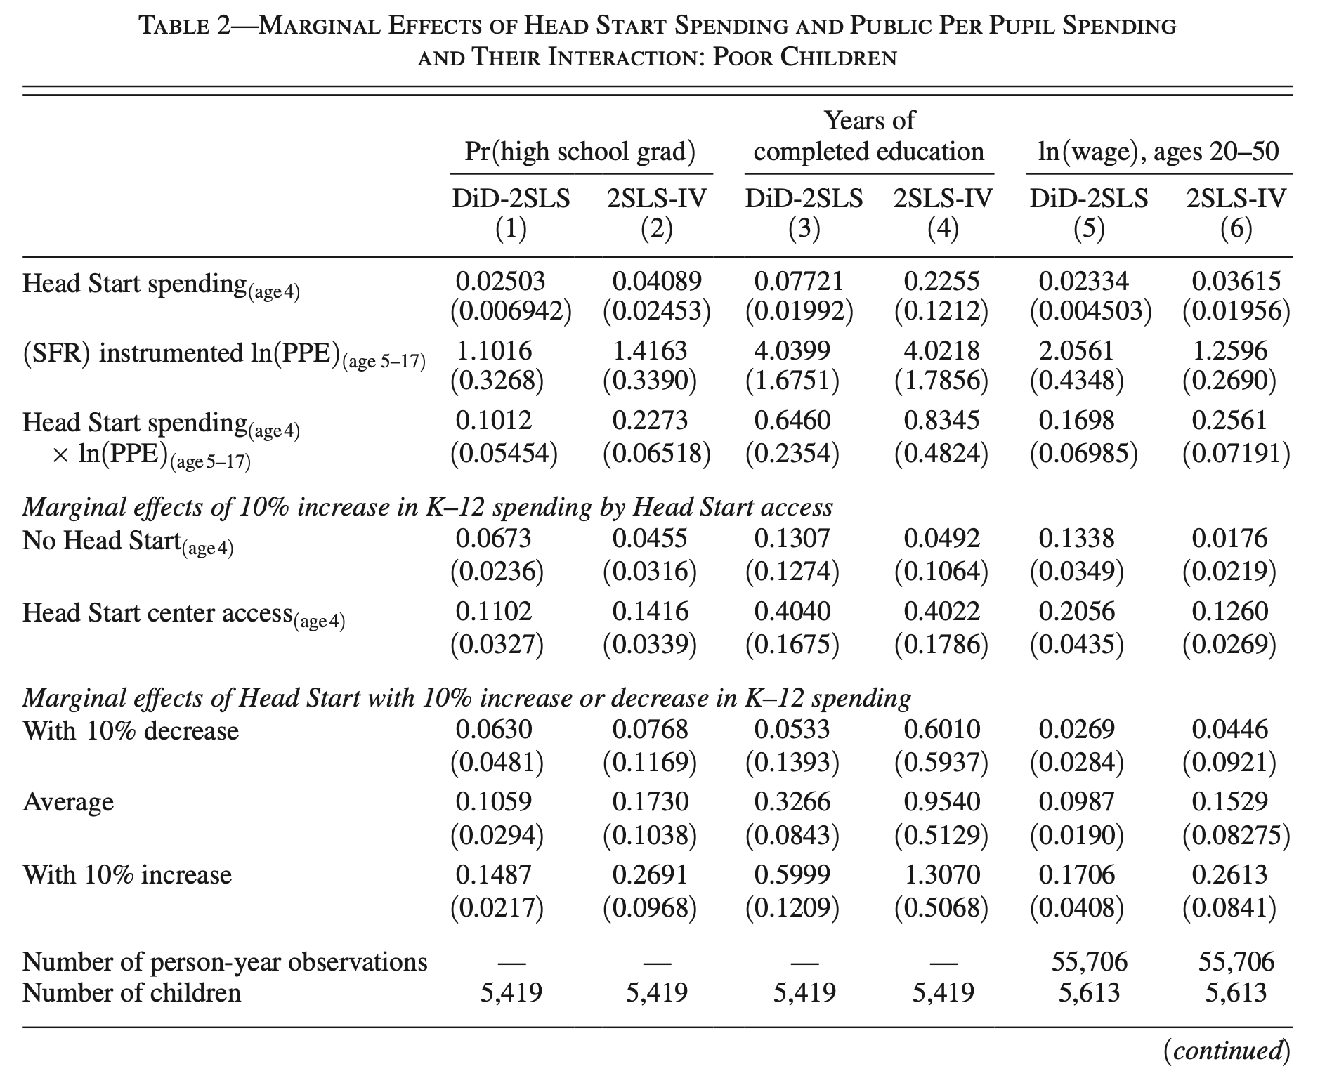
Jackson et al. (2019)

Slide 43
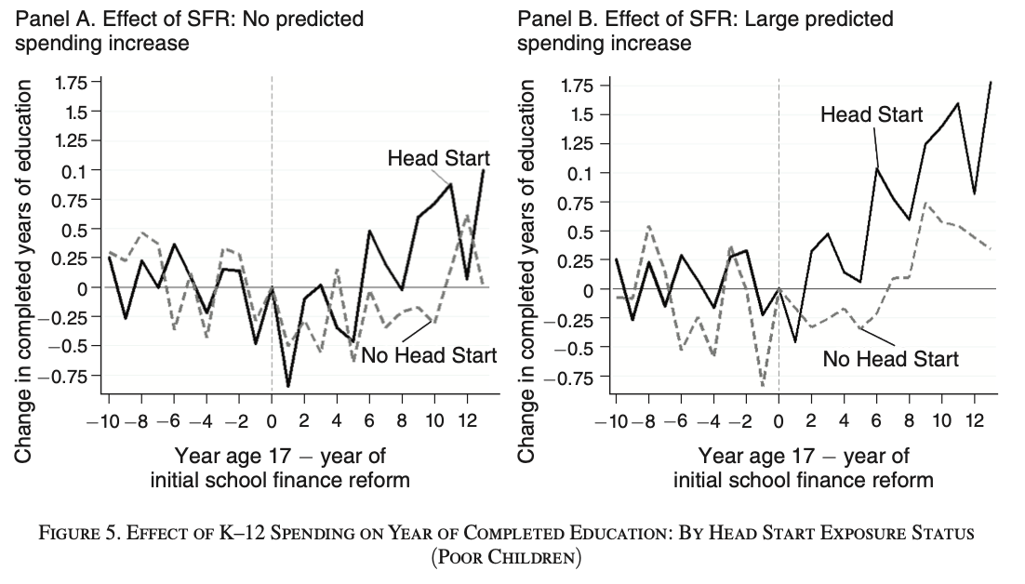
Johnson and Jackson (2019)

Slide 44
Bailey et al. (2019)
Advantage of PSID: Can focus on subpopulation of poor parents most likely to be eligible
Disadvantage: poor follow-up / attrition / measurement of income
Baily et al. (2019) implement same strategy in Census data

Slide 45
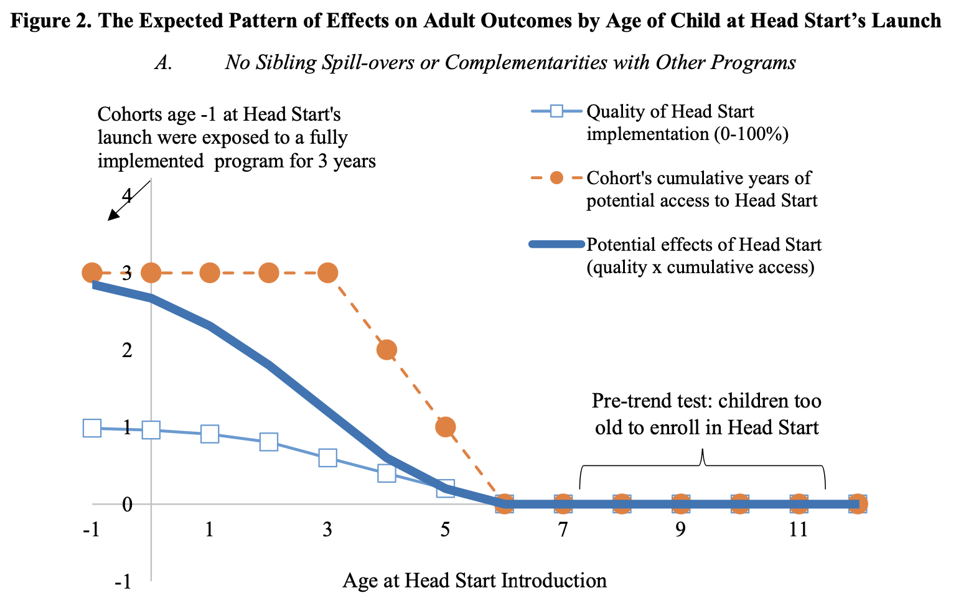
Bailey et al. (2019)

Slide 46
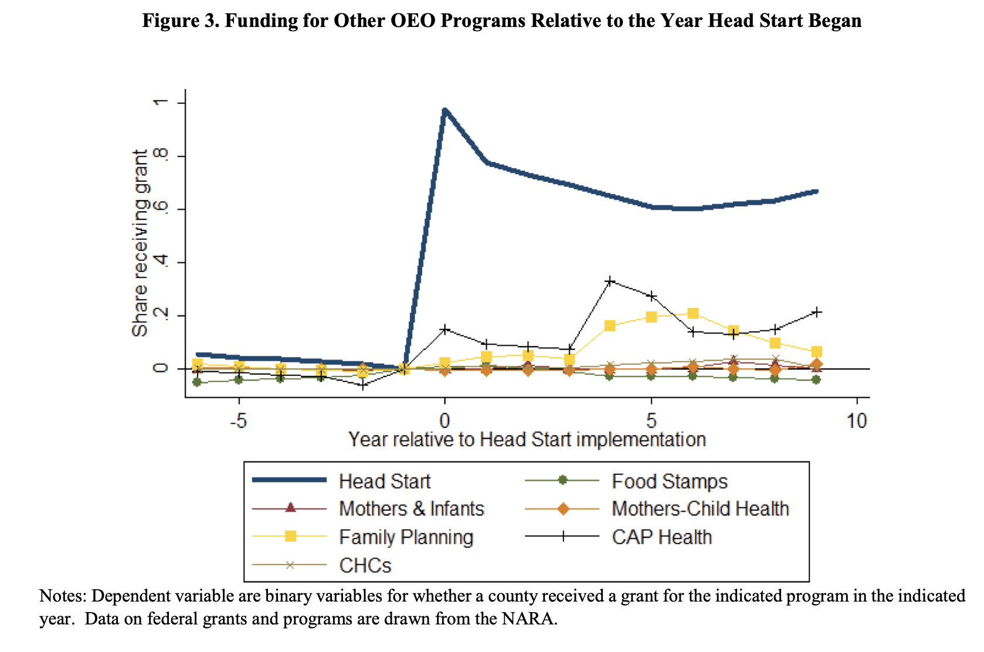
Bailey et al. (2019)

Slide 47
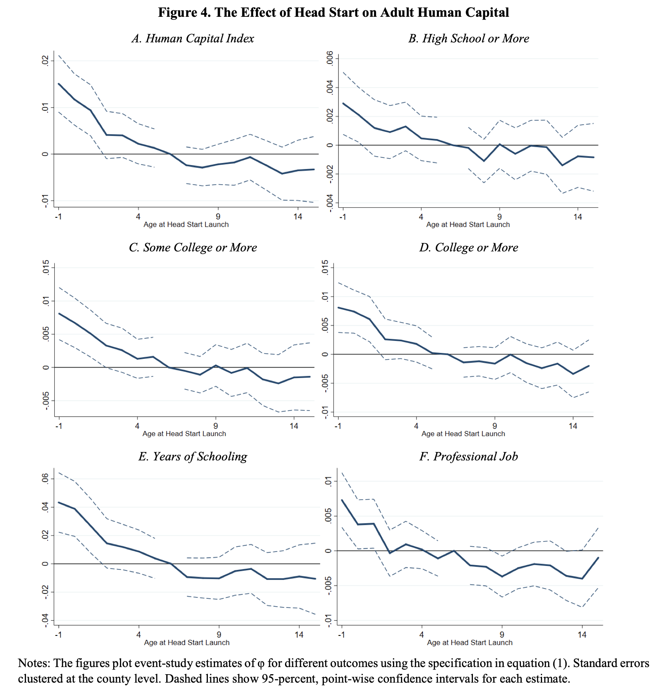
Bailey et al. (2019)

Slide 48
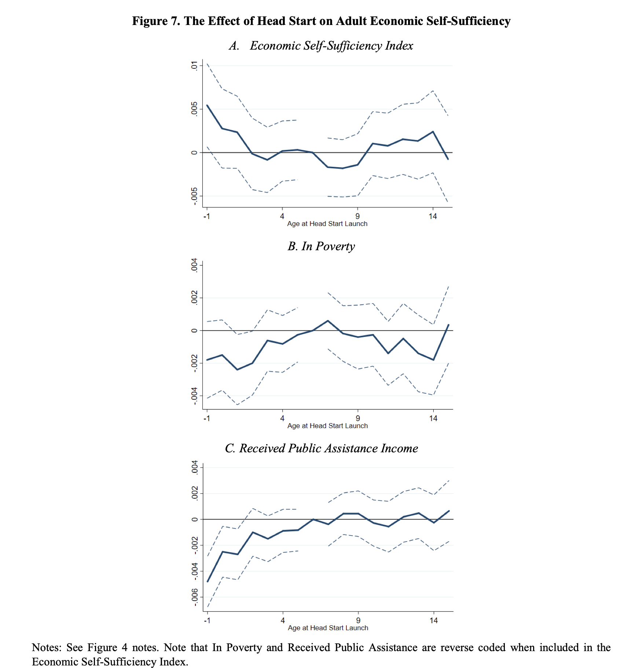
Bailey et al. (2019)

Slide 49
Outline
Preschool and Head Start
1
2
Family Leave and Childcare policies
3
Environmental Policies and Early Childhood Impacts

Slide 50
Child Penalties
Large and growing literature estimating impact of childbirth on maternal labor supply
  Angelov et al. (2016 JOLE), Kleven et al. (2018), Kleven et al. (2019)
Also large literature on child policies on labor supply
  Olivetti and Petrongolo (2017) review the literature
To begin, consider Kleven et al. (2018) and Kleven et al. (2019) ‘s work on impact of childbirth on parental incomes

Slide 51
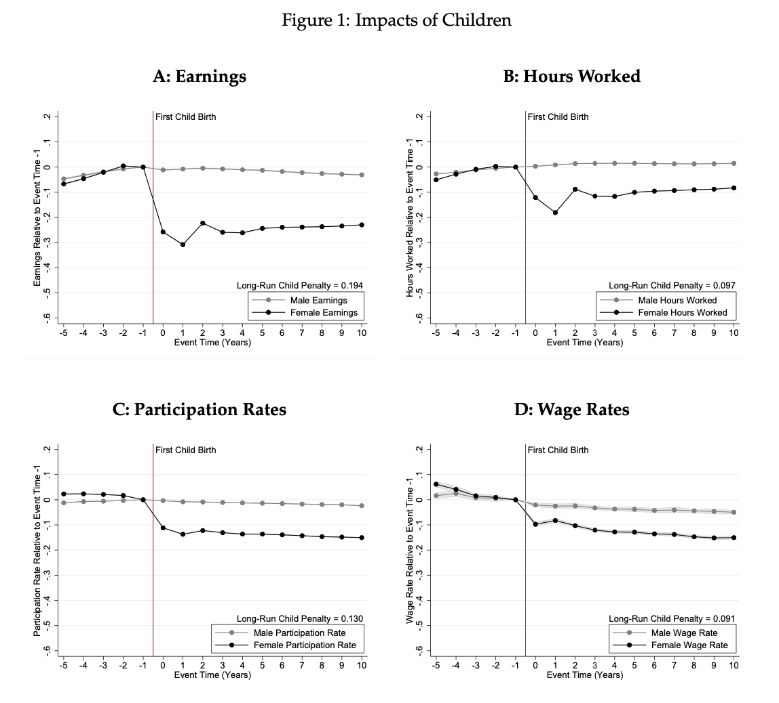
Child Penalties

Slide 52
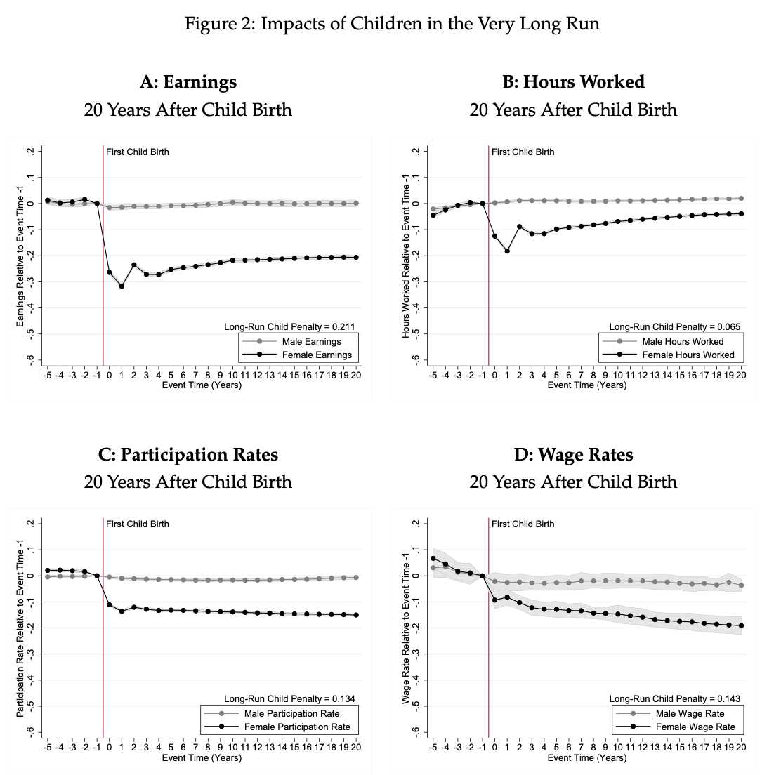
Child Penalties

Slide 53
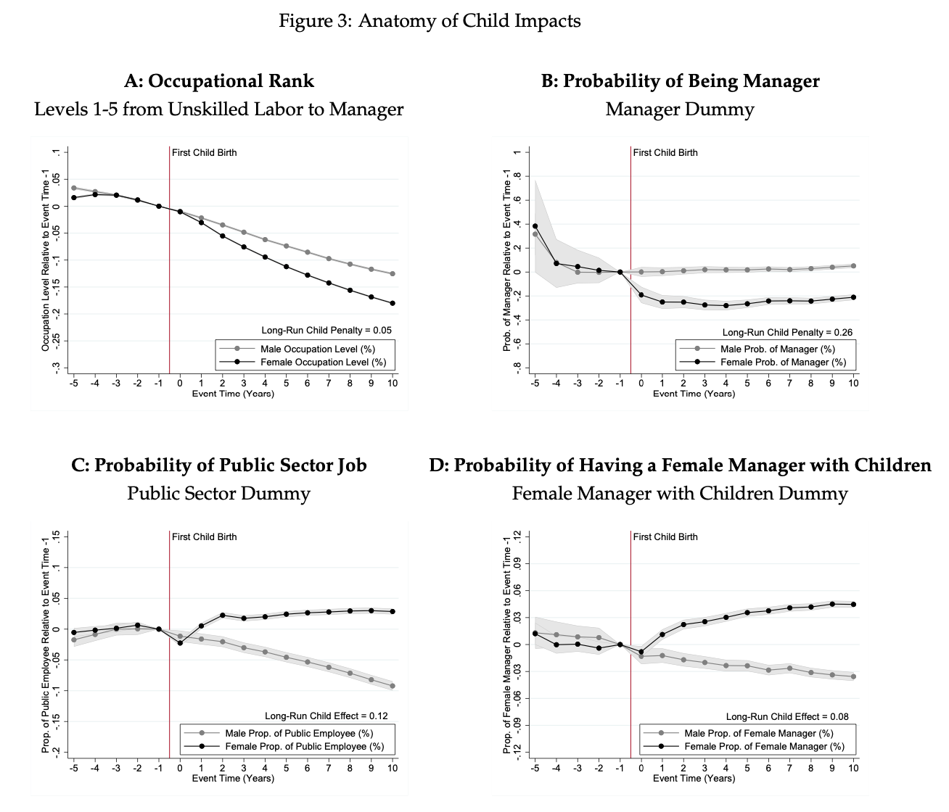
Child Penalties

Slide 54
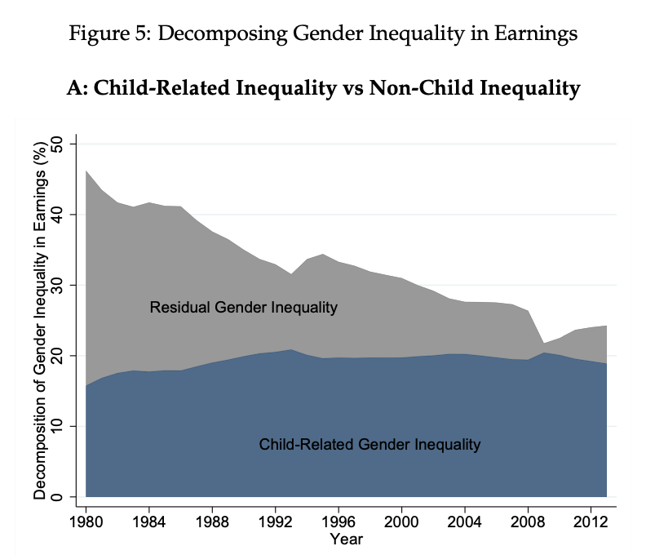
Child Penalties

Slide 55
Kleven et al. (2019) Document Heterogeneity Across Countries

Slide 56
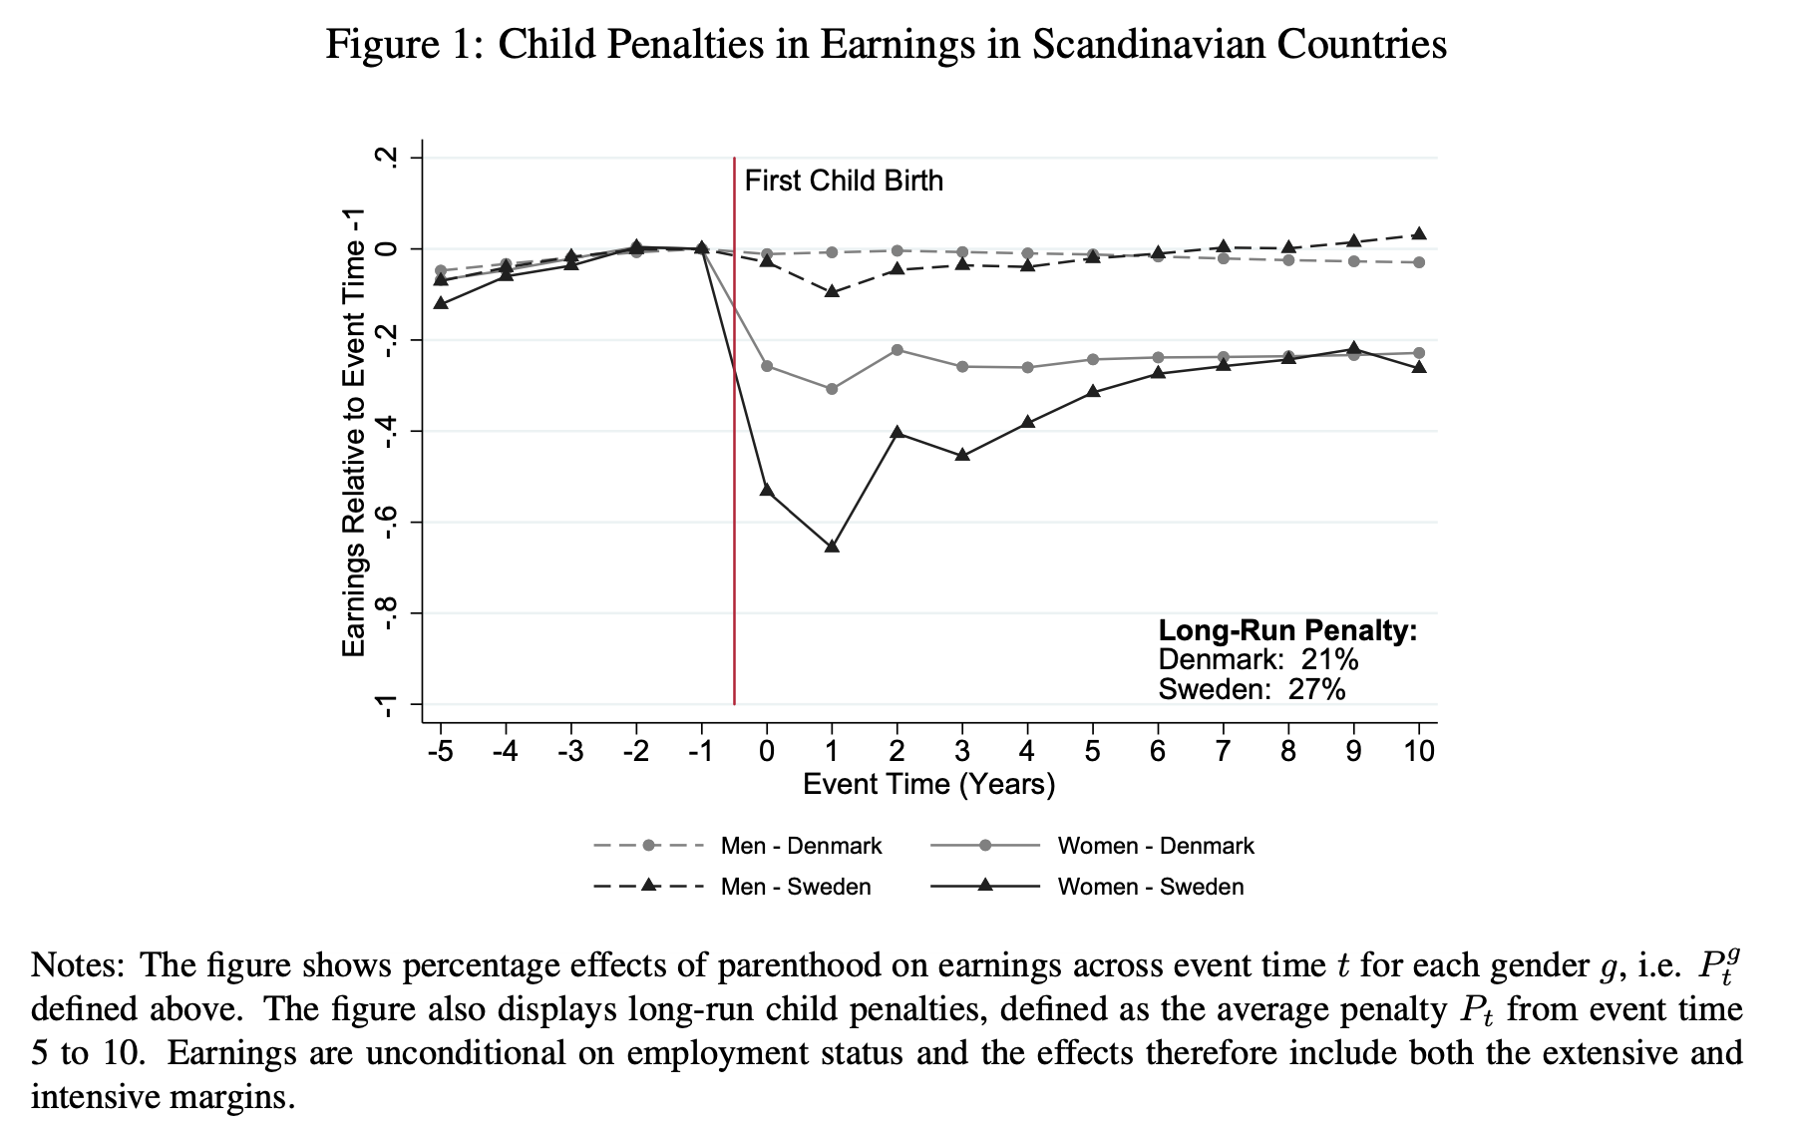
Kleven et al. (2019) Document Heterogeneity Across Countries

Slide 57
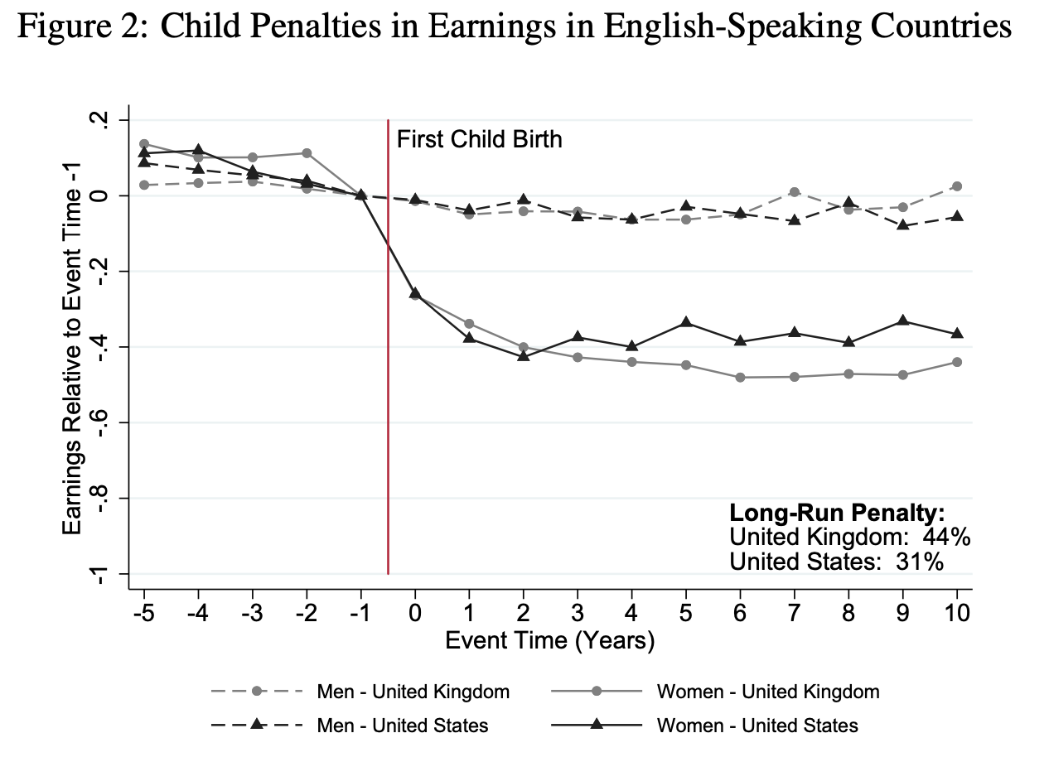

Slide 58
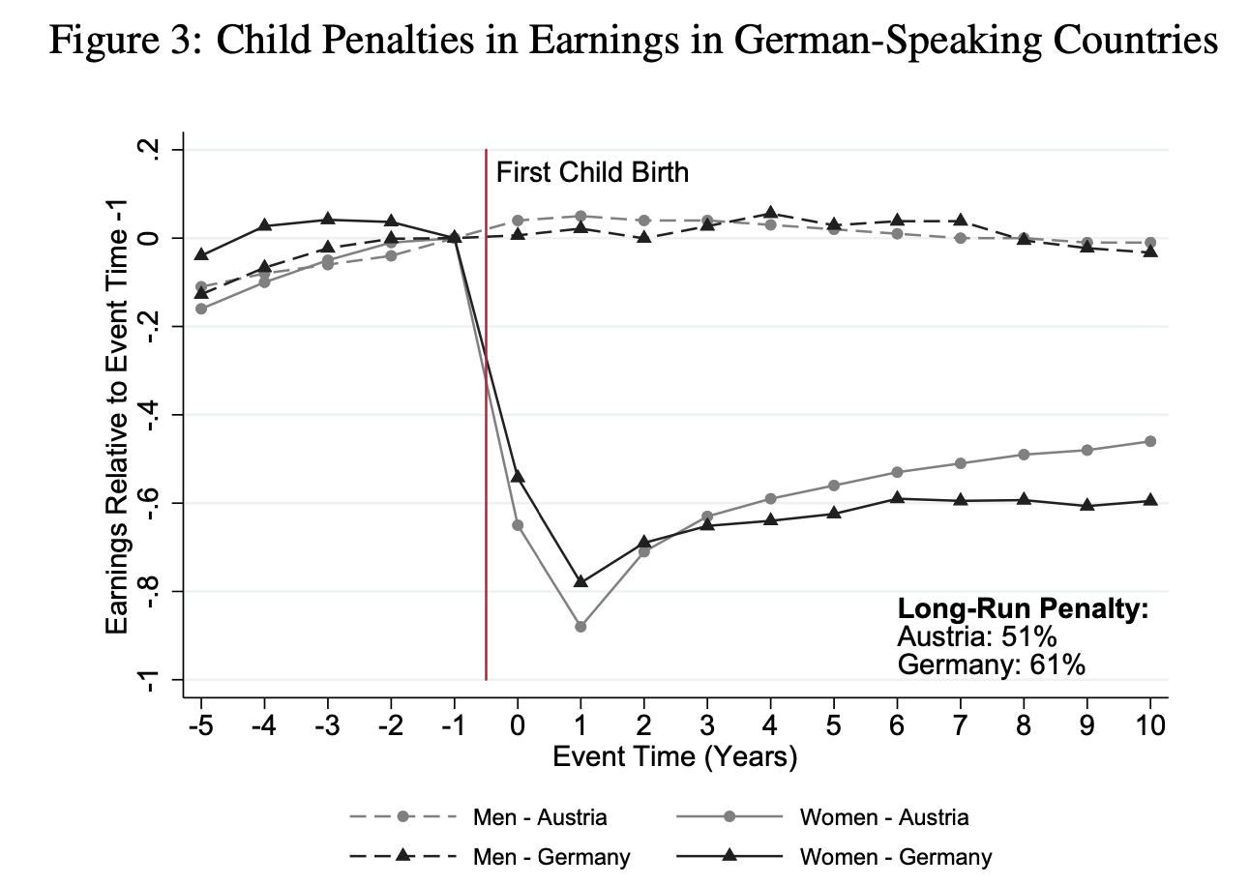

Slide 59
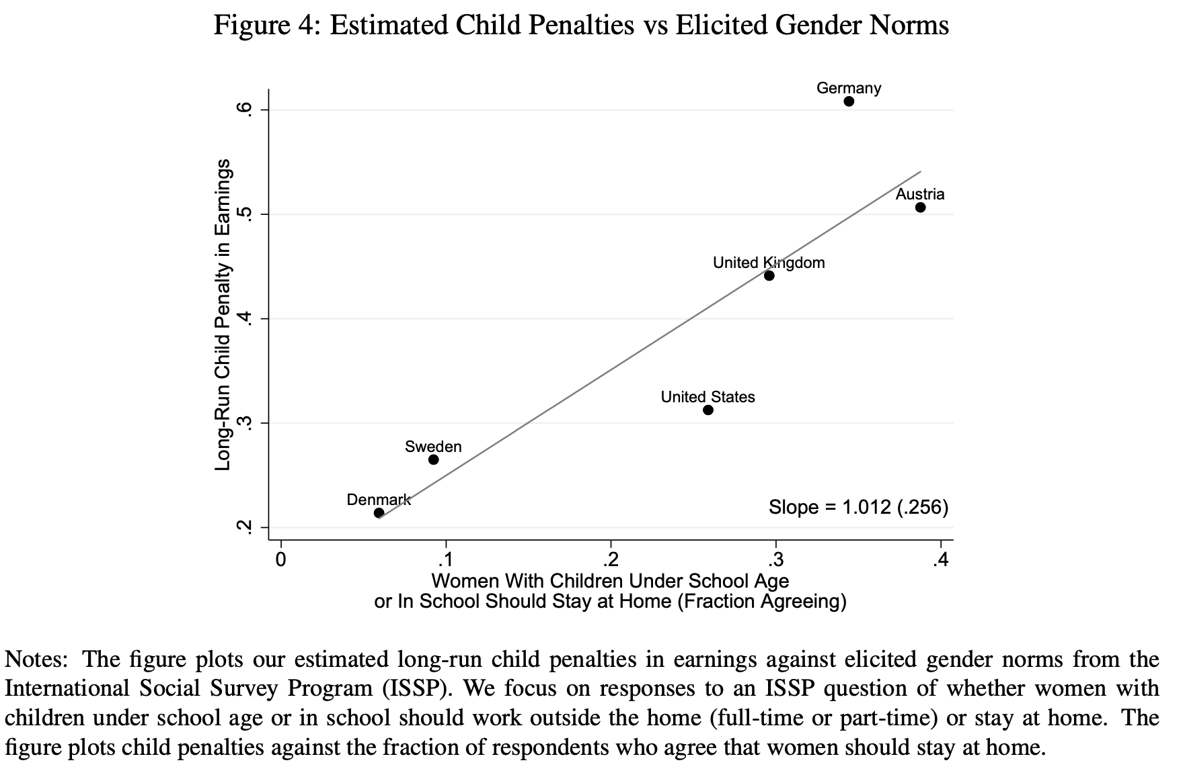

Slide 60
Childcare Subsidies
Bettendorf et al. (2015, Labour Economics) study “Law on Childcare” in 2005 in Netherlands
  Cut fee for childcare cut in half
  Subsidies allowed to be used at small-scale providers
  Treatment group = mothers with a youngest child up to age 12
  Control group = mothers with youngest child 12-18 years old
Problem: some expansion of EITC at the same time
Broad patterns suggest no significant difference in female LFP or hours worked

Slide 61
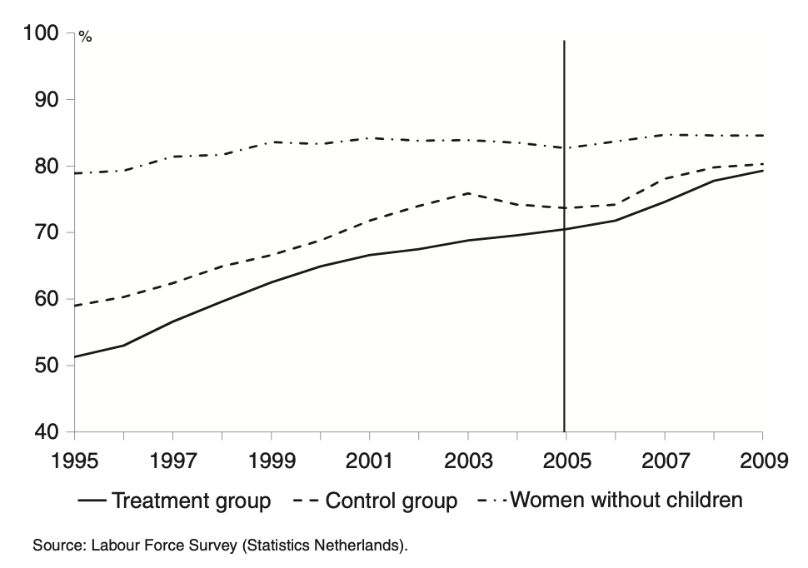
Impact on LFP

Slide 62
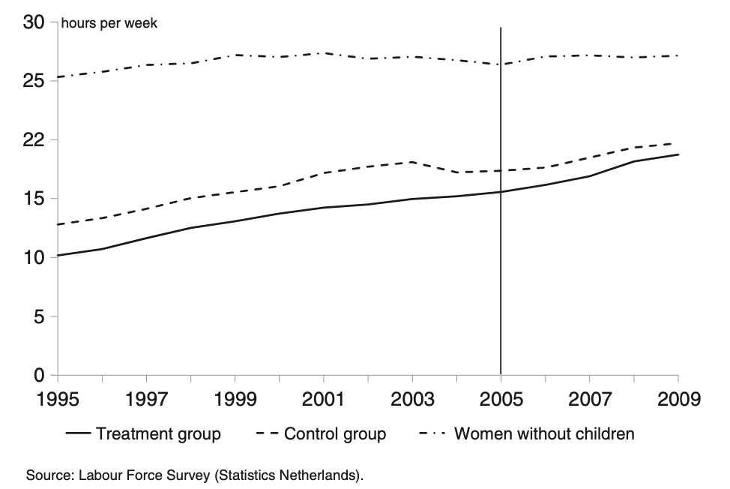
Impact on Hours Worked

Slide 63
Childcare Subsidies
Lefebvre, Merrigan, and Verstraete (2009) study 1997 introduction of subsidized childcare in Quebec for 4 year olds
  On September 1997, a new childcare policy was initiated by the provincial government of Québec. Licensed and regulated providers of childcare services began offering day care spaces at the subsidized fee of $5/day/child for children aged 4.
  Authors argue that policy led to long-run dynamic effects on labor force participation
  Effects on mothers with children below 6, concentrated on less-educated mothers

Slide 64
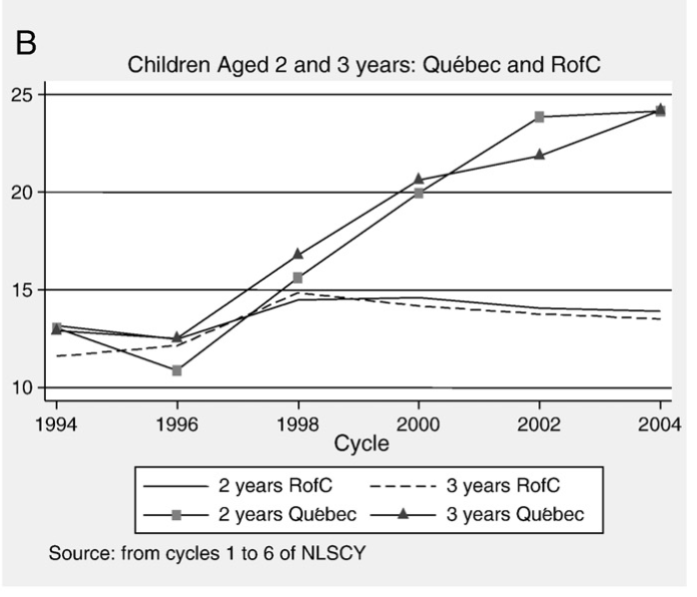
Childcare Participation (Note that age 2 in 1997 is age 7 in 2002)

Slide 65
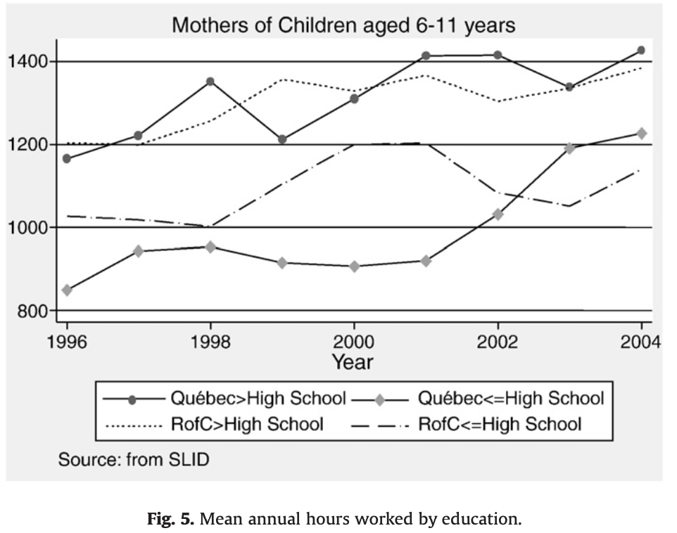
Labor force participation (Note that age 2 in 1997 is age 7 in 2002)

Slide 66
Impacts on Children: Havnes and Mogstad (2011)
Havnes and Mogstad (2011) study impact of a 1975 Norway reform that expanded childcare subsidies
Large long-run positive impact on children’s outcomes at age 30
DD strategy: Compare adult outcomes of 3-6 year olds in places that did versus did not experience large expansions of child care coverage

Slide 67
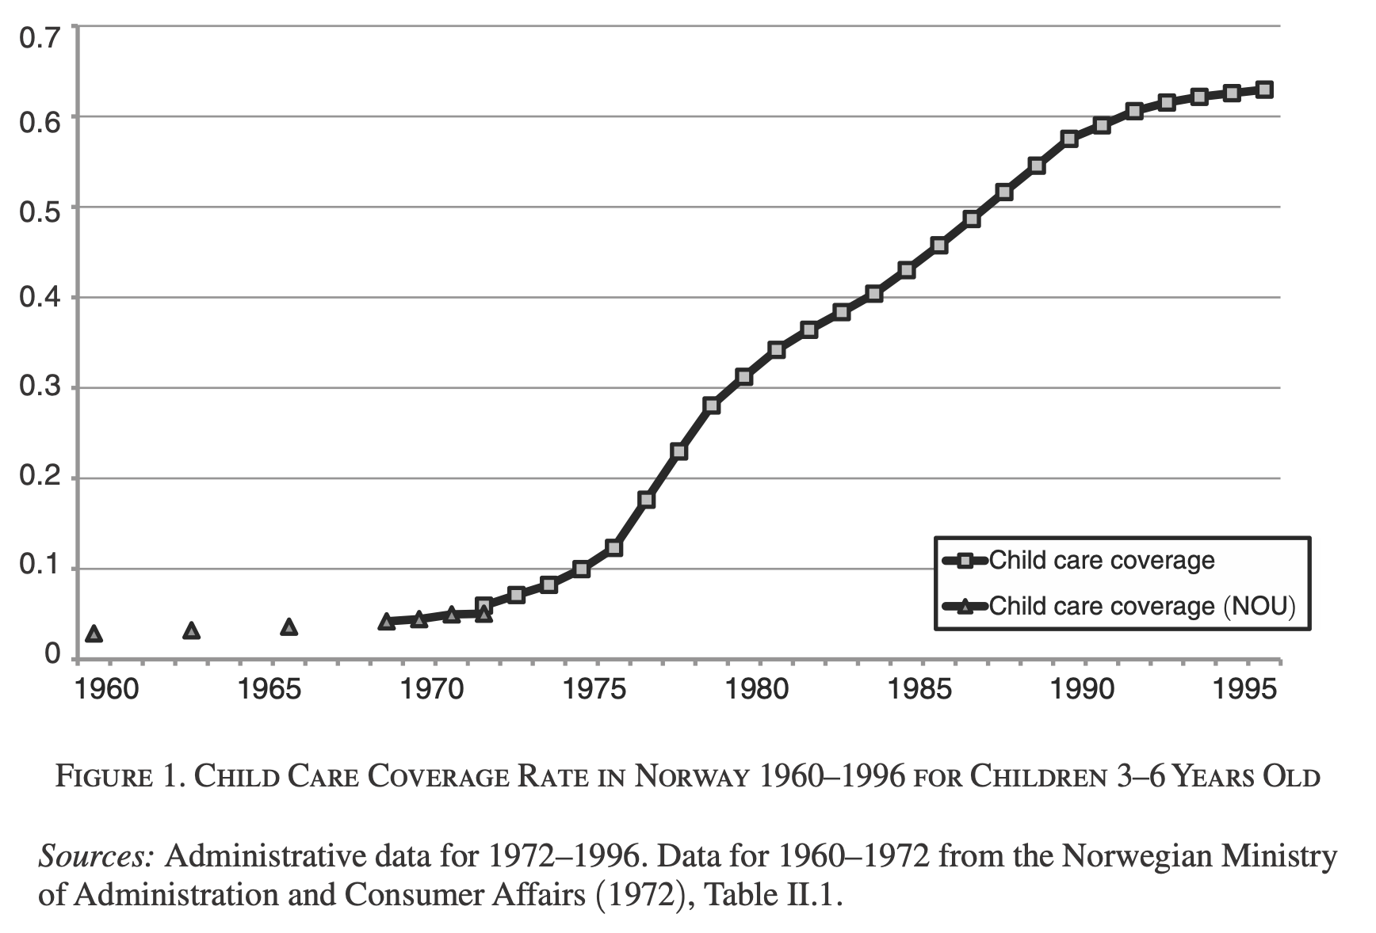
Childcare Coverage Rates (Havnes and Mogstad (2011))

Slide 68
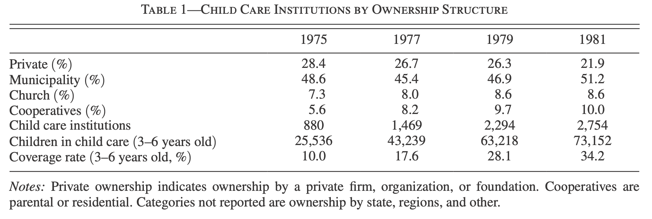
Child Care Structure: Havnes and Mogstad (2011)

Slide 69
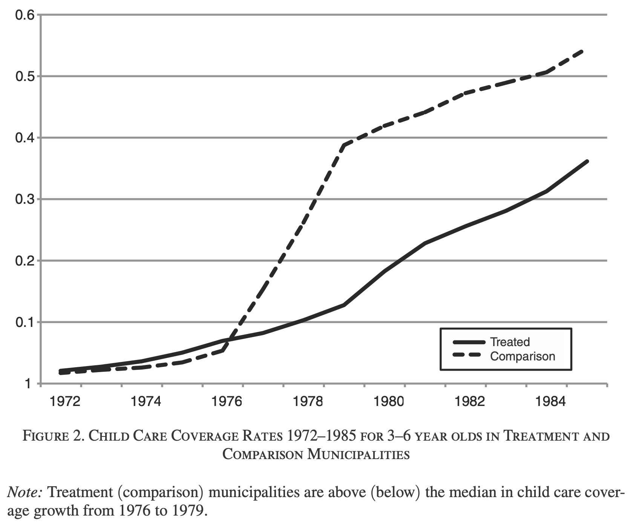
Treatment vs. Control Municipalities Coverage Rates (Havnes and Mogstad (2011))

Slide 70
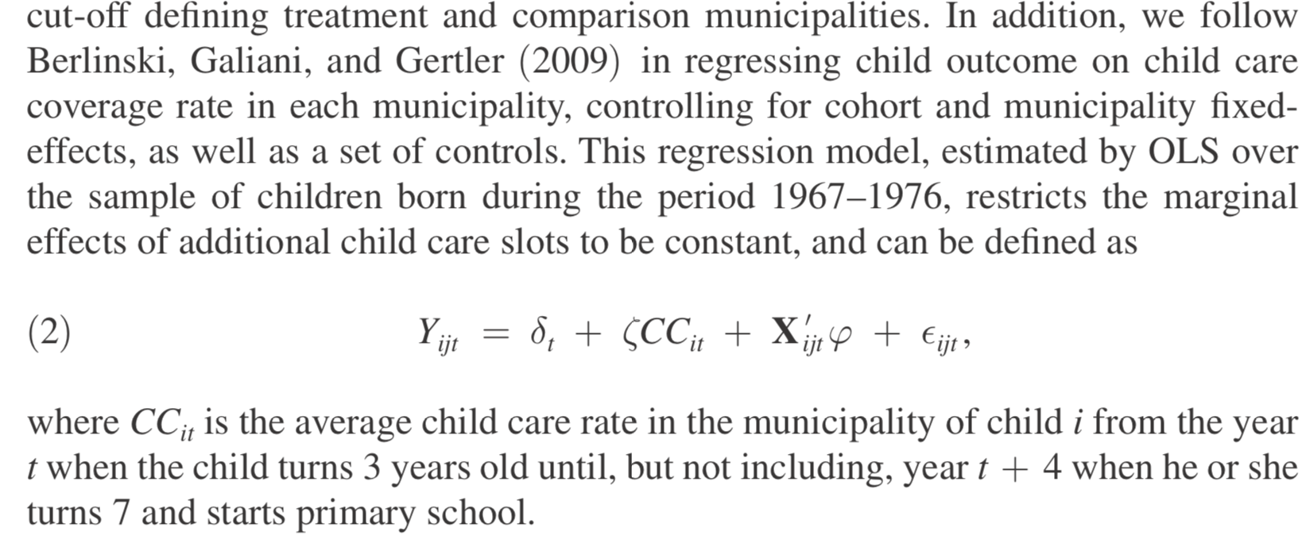
Empirical Specification (Havnes and Mogstad (2011))

Slide 71
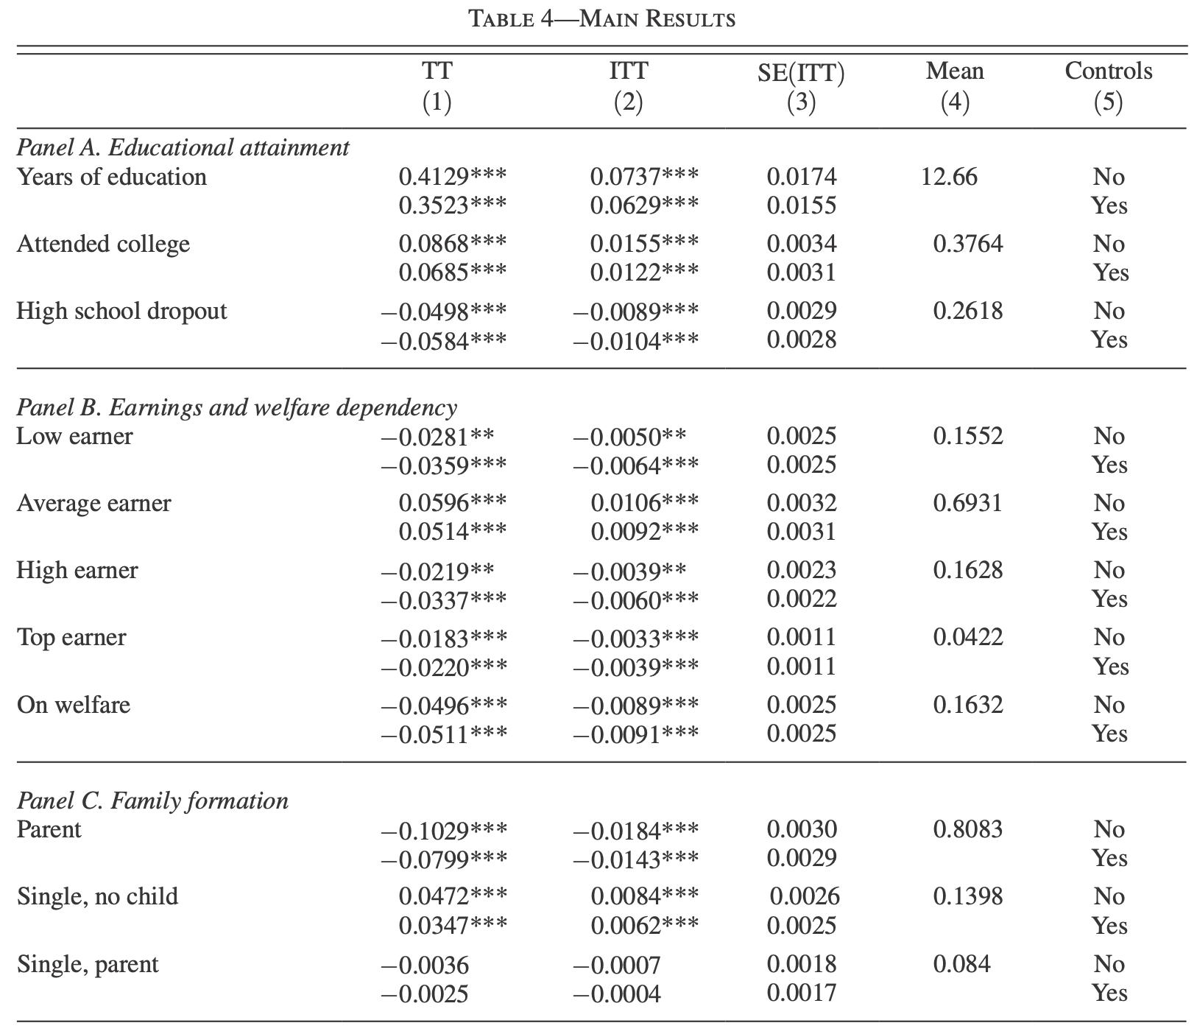
Impacts on Children: Havnes and Mogstad (2011)

Slide 72
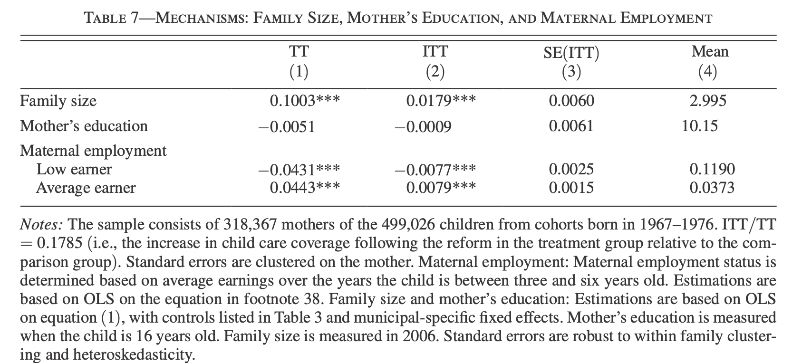
Impacts on Parents: Havnes and Mogstad (2011)

Slide 73
Quantile Treatment Effects: Havnes and Mogstad (2012)
Havnes and Mogstad (2011) find large positive average effects on children
Havnes and Mogstad (2012) study the quantile treatment effects
Find large heterogeneity in the effects – they “leveled the playing field”

Slide 74
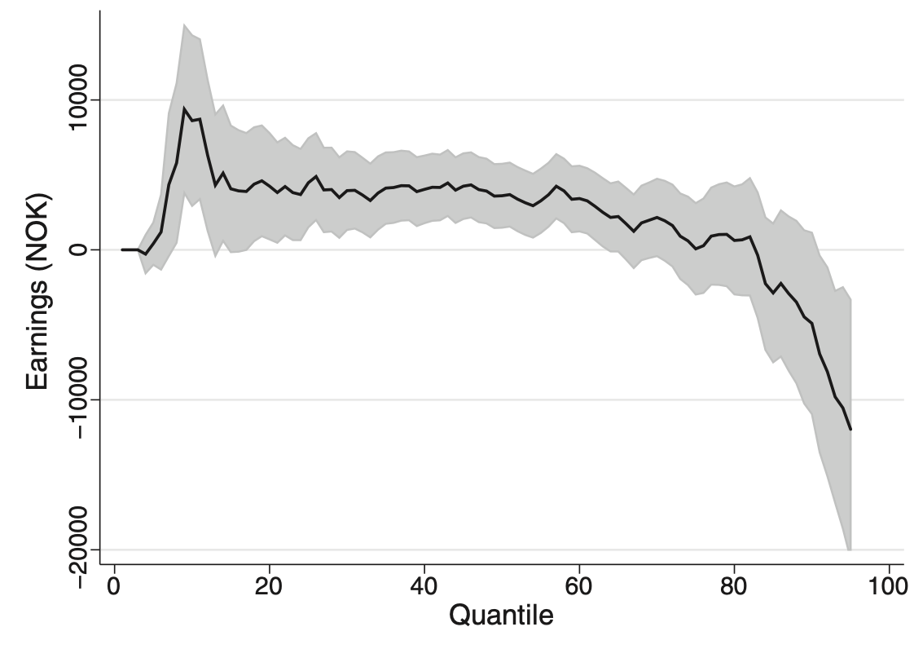
Quantile Treatment Effects: Havnes and Mogstad (2012)

Slide 75
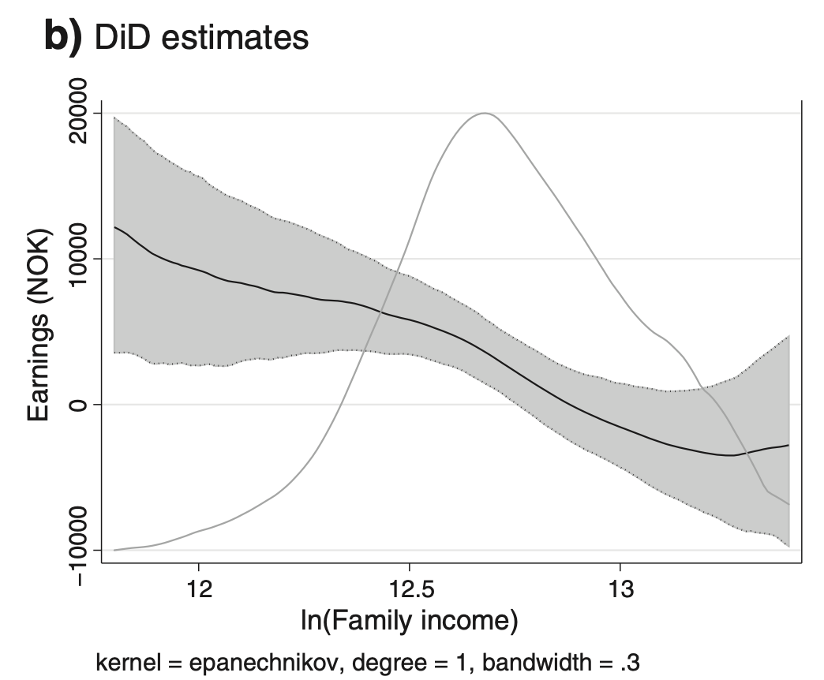
Heterogeneity by Parental Income: Would not have seen sig negative effects

Slide 76
Childcare Subsidies
Overall, mixed evidence on the impact of childcare subsidies
Some evidence of heterogeneous effects – e.g. leveling the playing field
Nathan’s take: This is consistent with the VA literature – teachers matter, which means we should expect to find that subsidies that homogenize child experiences should lead to more equal outcomes for children
Welfare implications?
  Reason to subsidize poor children is impact on children (improves human capital)
    Also, evidence from Abecedarian of increases in parental labor earnings
  Reason to subsidize rich children? Impacts on adults? If anything, Quebec impacts had no effects on rich families labor supply, but maybe this is because those families don’t take up the subsidies? Havnes and Mogstad find increases in labor supply for more affluent families

Slide 77
Paid Parental Leave
Impact of paid parental leave policies
Olivetti and Petrongolo (2017) study cross-sountry variation in family-friendly policies
Find broad cross-country pattern: countries with paid parental leave have smaller LFP gaps between men and women aged 25-54

Slide 78
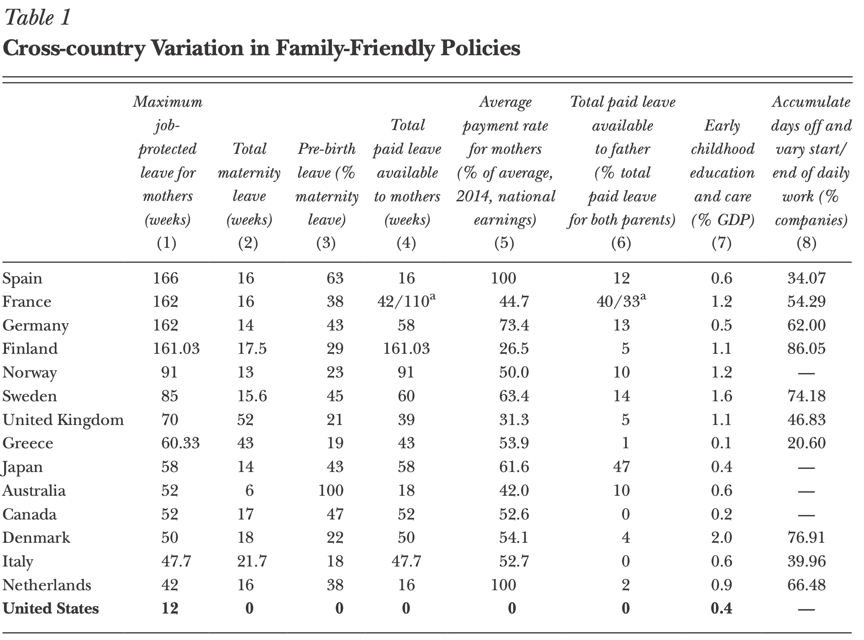
Paid Parental Leave

Slide 79
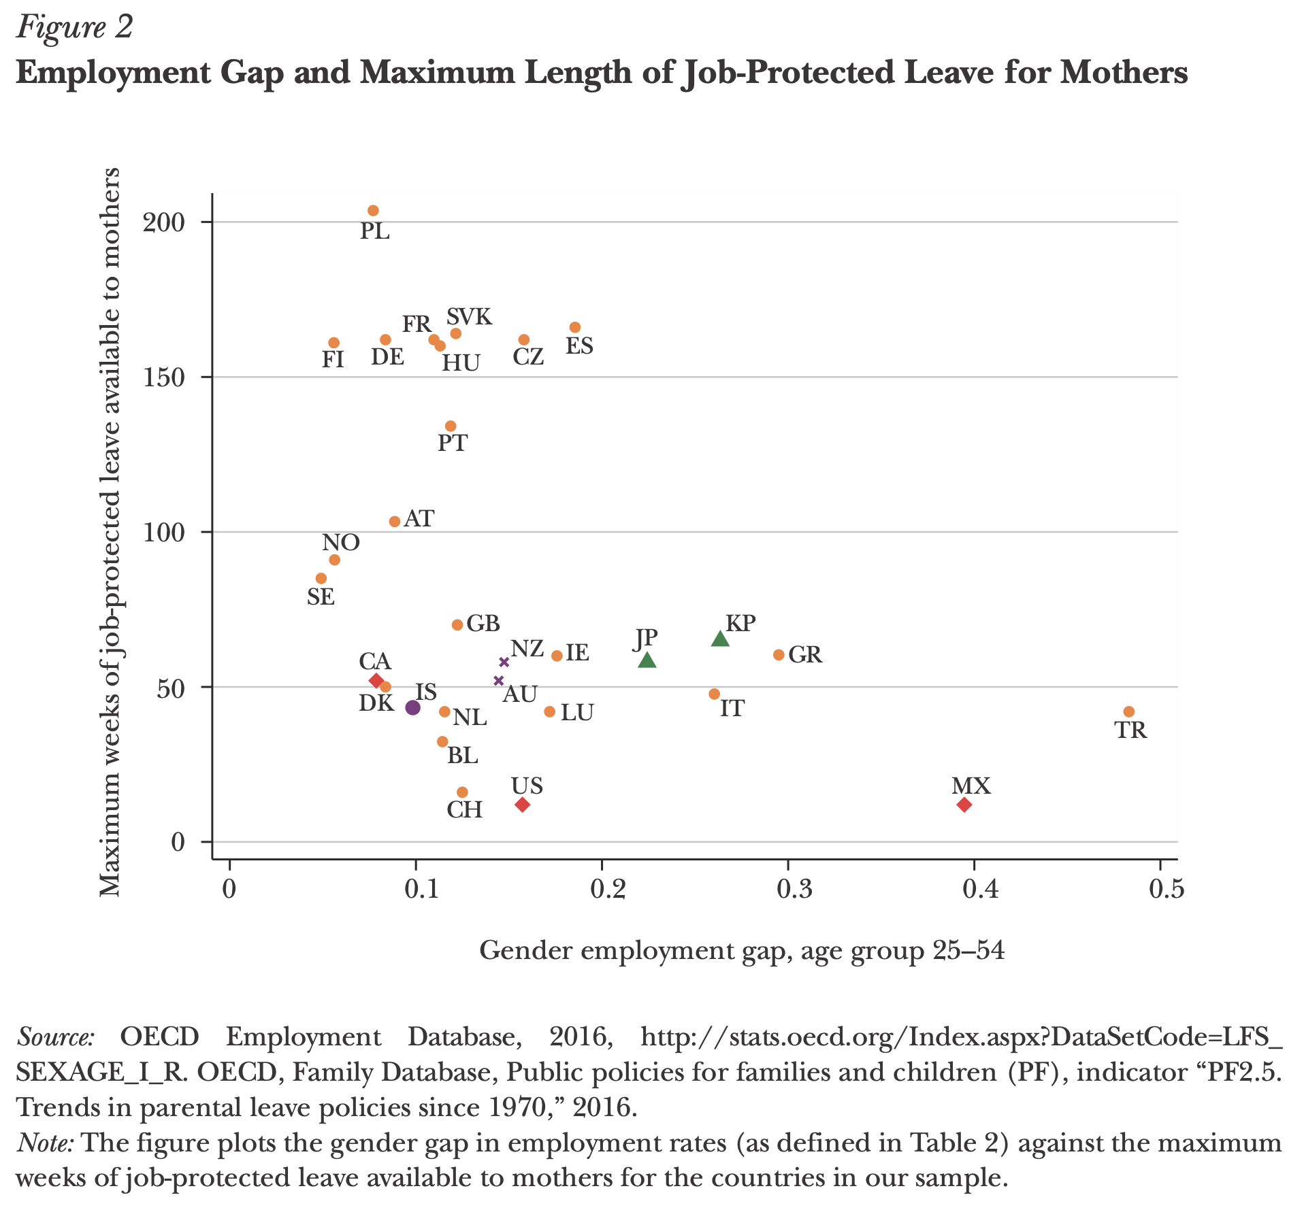
Paid Parental Leave

Slide 80
Paid Parental Leave
Bana et al. (2020) estimate the impact of paid parental leave
RK design in CA state-level paid family leave
Exploit kink in the paid family leave schedule benefit amount in CA
Individuals get 55% earnings up to a max benefit amount
Find no impact on adverse impacts on future labor supply and an increase in likelihood of returning to pre-leave firm

Slide 81

Paid Parental Leave

Slide 82

Paid Parental Leave

Slide 83

Paid Parental Leave

Slide 84

Paid Parental Leave

Slide 85
Parental Leave: What about Paternal Leave?
Persson and Rossin-Slater (2019) study impact of paternal leave on maternal health
  Prior to reform, parents given 16 months paid leave to be shared across both parents
  However parents were not allowed to both be on leave at the same time
  “Double days” reform in Sweden allowed fathers to choose whether to claim paid leave on a day-to-day basis, independent of whether the mother was on leave
Notes:
The “Double Days” reform, implemented on January 1, 2012, relaxed this restriction by allowing both parents to use full-time leave benefits at the same time for up to 30 additional days during the child’s first year of life. Importantly, these “Double Days” could be taken intermittently; thus, fathers were effectively granted more flexibility to choose, on a day-to-day basis, whether to claim paid leave to stay home together with the mother and child.

Slide 86

Parental Leave

Slide 87

Parental Leave

Slide 88

Parental Leave

Slide 89
Outline
Preschool and Head Start
1
2
Family Leave and Childcare policies
3
Environmental Policies and Early Childhood Impacts

Slide 90
Environmental Policies and Early Childhood Impacts
Large body of evidence suggesting environmental hazards have significant impacts on young children in particular
Begin with evidence from the Clean Air Act
Chay and Greenstone (2009) exploit variation from attainment vs. non-attainment counties that exceeded a threshold above which they were subject to higher regulations to limit air pollution.
Policy induced change in 80-82

Slide 91

Chay and Greenstone (2009): First stage reduction in TSPs

Slide 92

Chay and Greenstone (2009): Reduced form impact on infant mortality

Slide 93
Environmental Policies and Early Childhood Impacts
Currie and Walker (2011) exploit variation from the removal of toll booths as a result of EZ-Pass
Exploit variation in timing of rollout of EZ Pass
Compare groups close vs far from toll booths
Also include specifications with mother fixed effects

Slide 94

Environmental Policies and Early Childhood Impacts

Slide 95

Environmental Policies and Early Childhood Impacts

Slide 96

Environmental Policies and Early Childhood Impacts

Slide 97
Environmental Policies and Early Childhood Impacts
Lastly, Almond et al. (2009 QJE) look at impact of prenatal exposure to Chernobyl fallout on school outcomes in Sweden

Slide 98


Environmental Policies and Early Childhood Impacts

Slide 99

Difference in Difference outcomes for Exposed vs Unexposed Regions by Cohort

Slide 100

Difference in Difference outcomes for Exposed vs Unexposed Regions by Cohort

Slide 101
Summary
Childhood matters
Environment matters
Policies promoting childcare have mixed evidence of impacts on parents
But strong evidence they are an efficient method of redistribution to low-income families because of spillover effects on kids
Some evidence promoting labor force attachment for high income families can have large returns (and potentially large FEs)

Slide 102

Implications for Optimal Policy
Let y denote income, x denote consumption of normal goods, c denote childcare
Do we have evidence that:
$$u_{i}\left(c,x,y\right)={\tilde{u}}_{i}(g\left(c,x\right),y)$$
What about:
$$u_{i}\left(c,x,y\right)={\tilde{u}}_{i}(x,g(c,y))$$
How can we test this?

Slide 103
Quantifying the Tradeoffs of Redistribution through the Tax Schedule
∞
Top Tax 1981
>2
Top Tax 1986
Top Tax 1993
MVPF
1.5
Top Tax 2001
EITC 1986
Top Tax 2013
EITC 1993
1
Paycheck+
Alaska UBI
AFDC Generosity
AFDC Term Limits
<0.5
Neg Inc Tax
0
10
20
30
40
>50K
Approximate Income of Beneficiary

Slide 104
Redistribution through Investments in Low-Income Children
FIU GPA
Cal Grant GPA
MC Child (State Exp)
Texas Pell
K12 Spend
MC Pregnant & Infants
∞
MC Child 83+
CC Texas
Ohio Pell
Top Tax 1981
Soc Sec College
Florida Grant
DC Grant
CC Mich
Perry Preschool
Georgia HOPE
>2
College Spend
Top Tax 1986
TN Hope
Kalamazoo
Top Tax 1993
MC Intro
Abecedarian
MVPF
1.5
WI Scholarship
CUNY Pell
Top Tax 2001
EITC 1986
Top Tax 2013
EITC 1993
1
Paycheck+
College Tuition
Alaska UBI
AFDC Generosity
TN Pell
AFDC Term Limits
MA Scholarship
<0.5
Neg Inc Tax
Cal Grant Inc
0
10
20
30
40
>50K
Approximate Income of Beneficiary

Slide 105
Implications for Optimal Policy
Returns to direct investment in children are inconsistent with high MVPFs
What about child care subsidies?
  How do we construct that MVPF?
  Can pre-school subsidies be optimal even if no impacts on kids?
Do we have evidence that environmental policies provide g (e.g. clean air) that is weakly separable in the utility function?
  Or do we have evidence of a violation of weak separability?

Slide 106
EITC OBRA 1993 MVPF Estimates
Incorporating Different Estimates of Spillovers on Children
∞
>5
4
3
MVPF
2
1
0
<-1
No
Bastian and
Bastian and
Michelmore
Manoli and
Dahl and
CFR
Maxfield
Impact
Michelmore
Michelmore
(2018)
Turner (2018)
Lochner
(2011)
(2013)
(2018)
(2018)
[College]
[College]
(2018)
[Test scores]
[Test scores]
[Earnings]
[College]
[Test scores]

