Slide 1
MIT Guest Lecture
Empirical Welfare Analysis
The MVPF
Nathaniel Hendren
Fall, 2021

Slide 2
Goals of Public Economics
What government policies do the most to improve social welfare?
  Should we spend more (or less) on health insurance?
  Should we raise top marginal income tax rates?
  Should we invest more in children? At what age?
Just gave a Nobel Prize for methods to estimate the causal impact of a wide range of these types of policy changes
  Can estimate “Potential Outcomes” with vs without the policy
How do we translate those estimates into a statement about the desirability of the policy change?
  What causal estimates do we need?

Slide 3
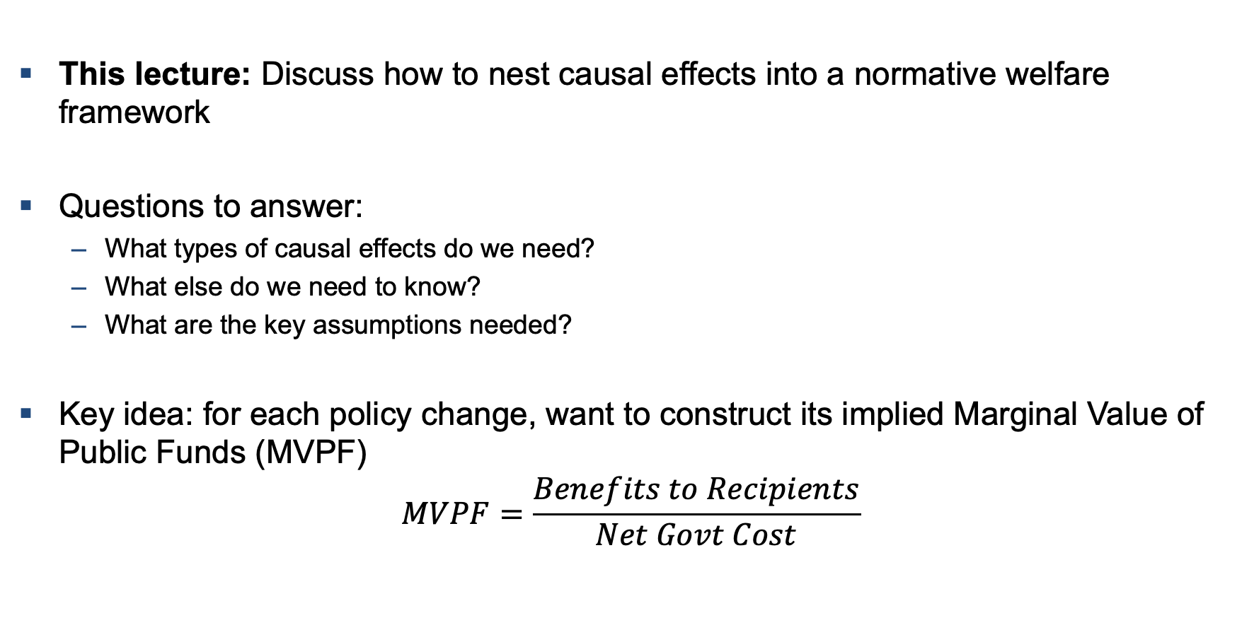
Normative Evaluation of Policy Changes
This lecture: Discuss how to nest causal effects into a normative welfare framework
Questions to answer:
  What types of causal effects do we need?
  What else do we need to know?
  What are the key assumptions needed?
Key idea: for each policy change, want to construct its implied Marginal Value of Public Funds (MVPF)
$$MVPF=\frac{Benefits to Recipients}{Net Govt Cost}$$

Slide 4
Existing Approaches to Empirical Welfare Estimation
﻿MVPF: Mayshar (1990), Slemrod and Yitzhaki (1996, 2001), Kleven and Kreiner (2006), Hendren (2016), Hendren and Sprung-Keyser (2019), Finkelstein (2019 -- You’ll like this one… ☺)
CBA + MCPF: Conduct a benefit-cost ratio and adjust for the DWL from taxation
  Stiglitz and Dasgupta (1971); Atkinson and Stern (1974); many others
  Kaplow (2011) provides a nice discussion
  Boardman (2017) provide a discussion of current methods (not much on distributional incidence)
MEB – Generally applied to taxes, but framework is more general
  Auerbach and Hines (2002) Handbook Chapter provides a nice summary
All rely on different conceptual frameworks
  The MVPF has numerous advantages -- in particular, it is the unique approach that relies on counterfactuals identified by causal effects (as opposed to decomposing those effects into income and substitution effects)

Slide 5
Outline
Theory and Measures of Welfare
1
2
Empirical Estimates of MVPFs for Various Policies
3
Other Welfare Measures: MEB and Cost-Benefit Analysis + MCPF
4
Relation to Optimal Tax Theory

Slide 6
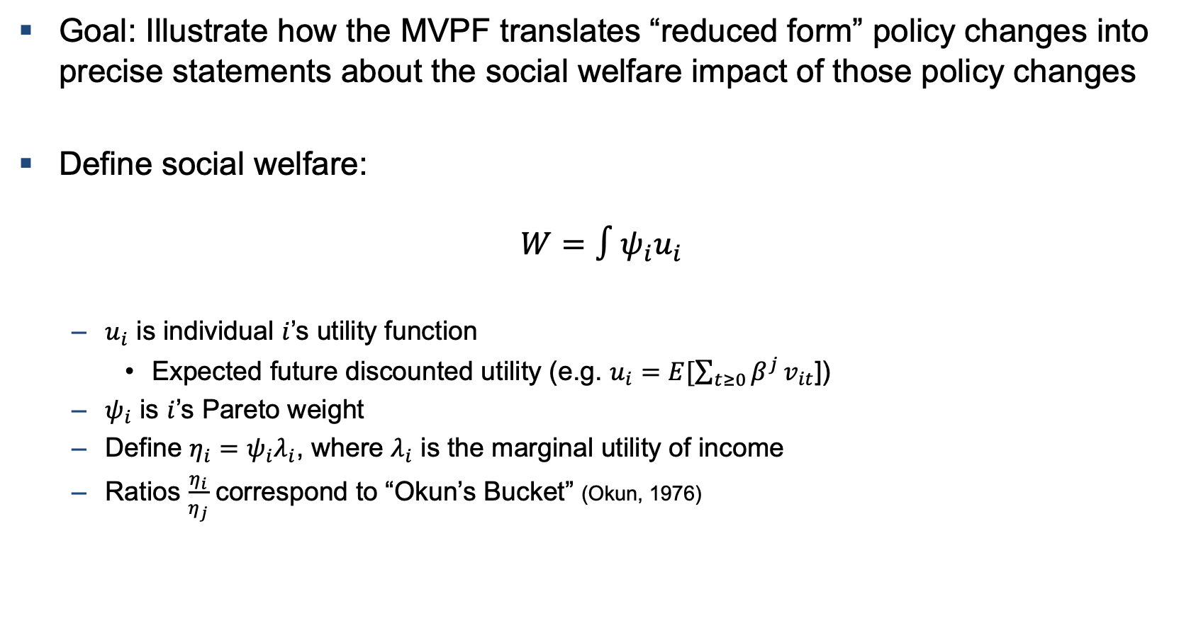
General Welfare Framework
Goal: Illustrate how the MVPF translates “reduced form” policy changes into precise statements about the social welfare impact of those policy changes
Define social welfare:
$$W=∫ψ_{i}u_{i}$$
  $u_{i}$ is individual $i$’s utility function
    Expected future discounted utility (e.g. $u_{i}=E[\sum_{t≥0}{β^{j}}v_{it}$])
  $ψ_{i}$ is $i$’s Pareto weight
  Define $η_{i}=ψ_{i}λ_{i}$, where $λ_{i}$ is the marginal utility of income
  Ratios $\frac{η_{i}}{η_{j}}$ correspond to “Okun’s Bucket” (Okun, 1976)

Slide 7
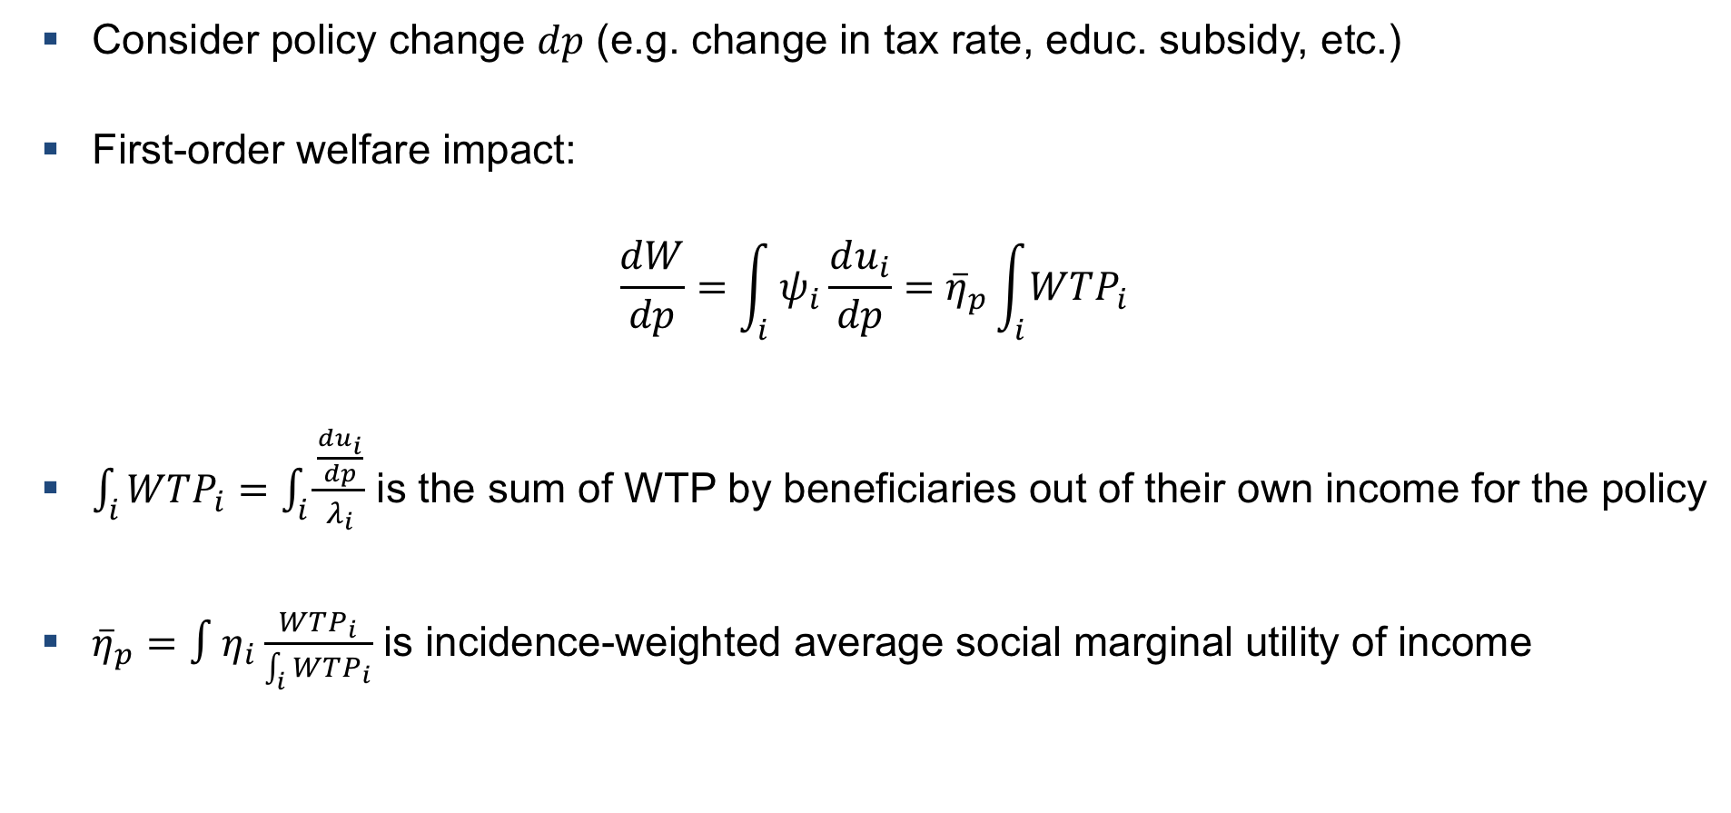
Impact of Policy Change on Social Welfare
Consider policy change $dp$ (e.g. change in tax rate, educ. subsidy, etc.)
First-order welfare impact:
$$\frac{dW}{dp}=\int_{i}{ψ_{i}\frac{du_{i}}{dp}}={\overline{η}}_{p}\int_{i}{WTP_{i}}$$
$\int_{i}{WTP_{i}}=\int_{i}{\frac{\frac{du_{i}}{dp}}{λ_{i}}}$ is the sum of WTP by beneficiaries out of their own income for the policy
${\overline{η}}_{p}=∫η_{i}\frac{WTP_{i}}{\int_{i}{WTP_{i}}}$ is incidence-weighted average social marginal utility of income

Slide 8
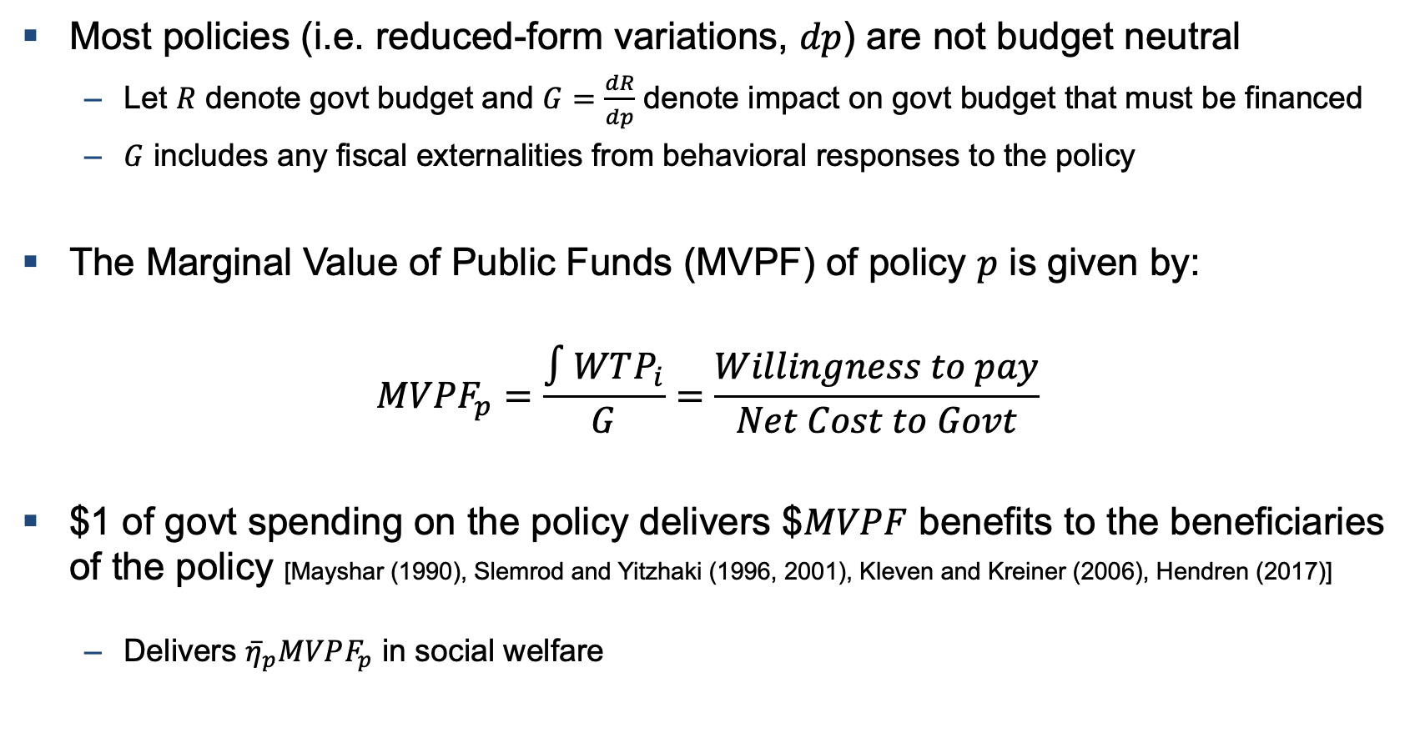
Compare Policies by Normalizing by Cost
Most policies (i.e. reduced-form variations, $dp$) are not budget neutral
  Let $R$ denote govt budget and $G=\frac{dR}{dp}$ denote impact on govt budget that must be financed
  $G$ includes any fiscal externalities from behavioral responses to the policy
The Marginal Value of Public Funds (MVPF) of policy $p$ is given by:
$$MVPF_{p}=\frac{∫WTP_{i}}{G}=\frac{Willingness to pay}{Net Cost to Govt}$$
$1 of govt spending on the policy delivers $$MVPF$ benefits to the beneficiaries of the policy [Mayshar (1990), Slemrod and Yitzhaki (1996, 2001), Kleven and Kreiner (2006), Hendren (2017)]
  Delivers ${\overline{η}}_{p}MVPF_{p}$ in social welfare

Slide 9
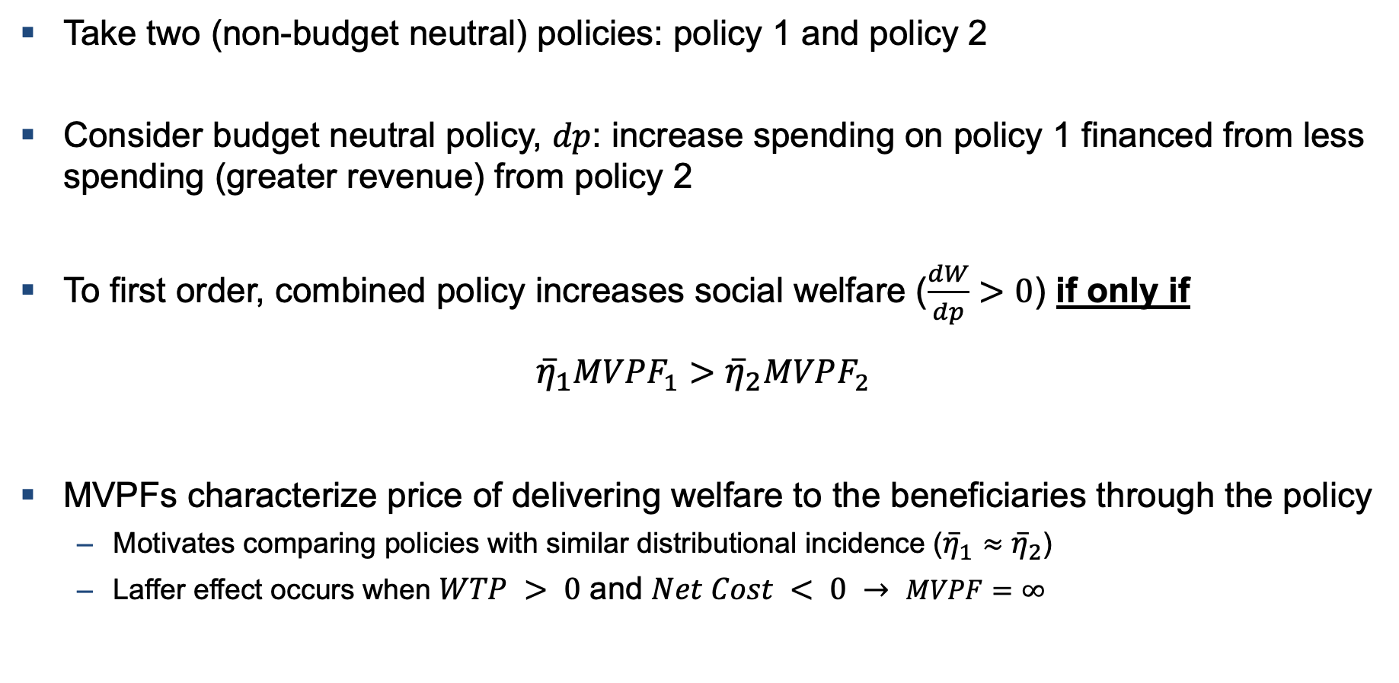
MVPF Facilitates Construction of Policies that Increase Welfare
Take two (non-budget neutral) policies: policy 1 and policy 2
Consider budget neutral policy, $dp$: increase spending on policy 1 financed from less spending (greater revenue) from policy 2
To first order, combined policy increases social welfare ($\frac{dW}{dp}>0$) if only if
$${\overline{η}}_{1}MVPF_{1}>{\overline{η}}_{2}MVPF_{2}$$
MVPFs characterize price of delivering welfare to the beneficiaries through the policy
  Motivates comparing policies with similar distributional incidence (${\overline{η}}_{1}≈{\overline{η}}_{2}$)
  Laffer effect occurs when $WTP > 0$ and $Net Cost < 0 → MVPF=∞$

Slide 10
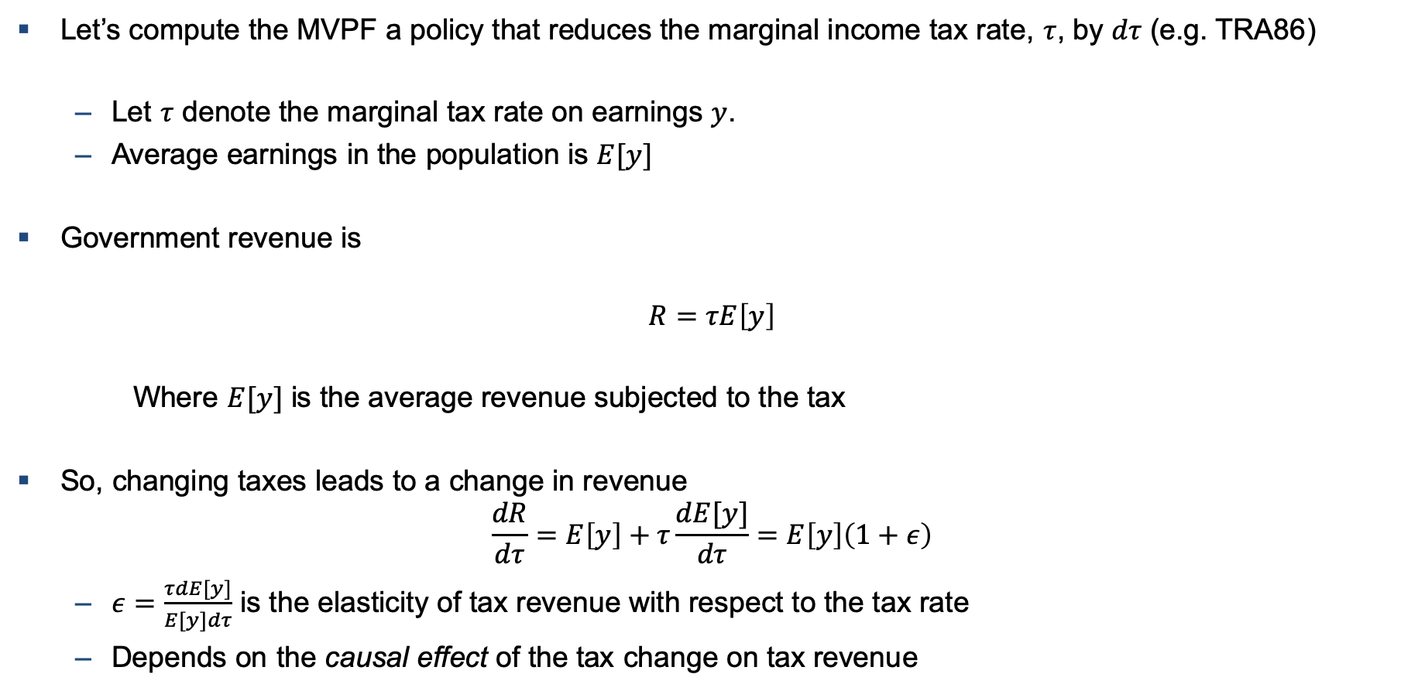
Example MVPF: Tax Rate Change
Let’s compute the MVPF a policy that reduces the marginal income tax rate, $τ$, by $dτ$ (e.g. TRA86)
  Let $τ$ denote the marginal tax rate on earnings $y$.
  Average earnings in the population is $E[y]$
Government revenue is
$$R=τE\left[y\right]$$
Where $E[y]$ is the average revenue subjected to the tax
So, changing taxes leads to a change in revenue
$$\frac{dR}{dτ}=E\left[y\right]+τ\frac{dE[y]}{dτ}=E\left[y\right]\left(1+ε\right)$$
  $ε=\frac{τdE[y]}{E[y]dτ}$ is the elasticity of tax revenue with respect to the tax rate
  Depends on the causal effect of the tax change on tax revenue

Slide 11
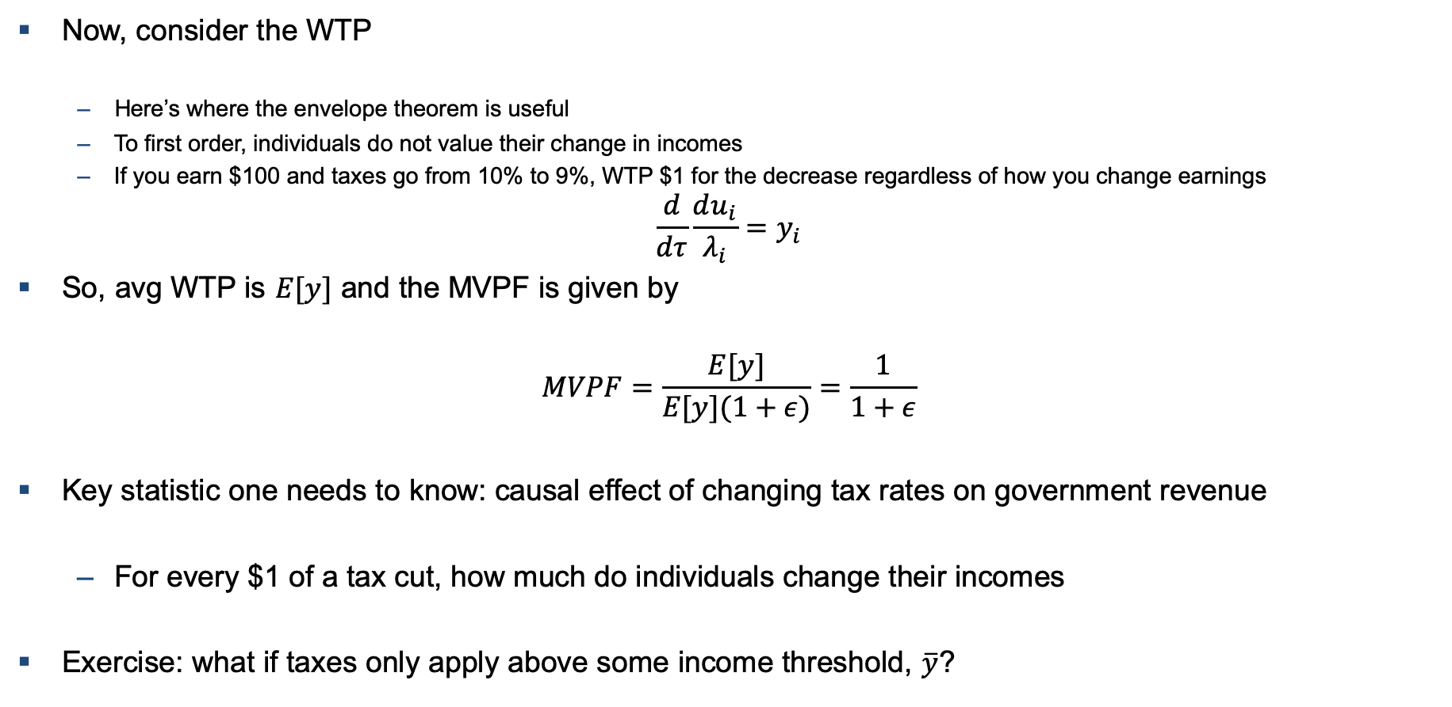
Example MVPF: Tax Rate Change
Now, consider the WTP
  Here’s where the envelope theorem is useful
  To first order, individuals do not value their change in incomes
  If you earn $100 and taxes go from 10% to 9%, WTP $1 for the decrease regardless of how you change earnings
$$\frac{d}{dτ}\frac{du_{i}}{λ_{i}}=y_{i}$$
So, avg WTP is $E[y]$ and the MVPF is given by
$$MVPF=\frac{E[y]}{E[y](1+ε)}=\frac{1}{1+ε}$$
Key statistic one needs to know: causal effect of changing tax rates on government revenue
  For every $1 of a tax cut, how much do individuals change their incomes
Exercise: what if taxes only apply above some income threshold, $\overline{y}$?

Slide 12
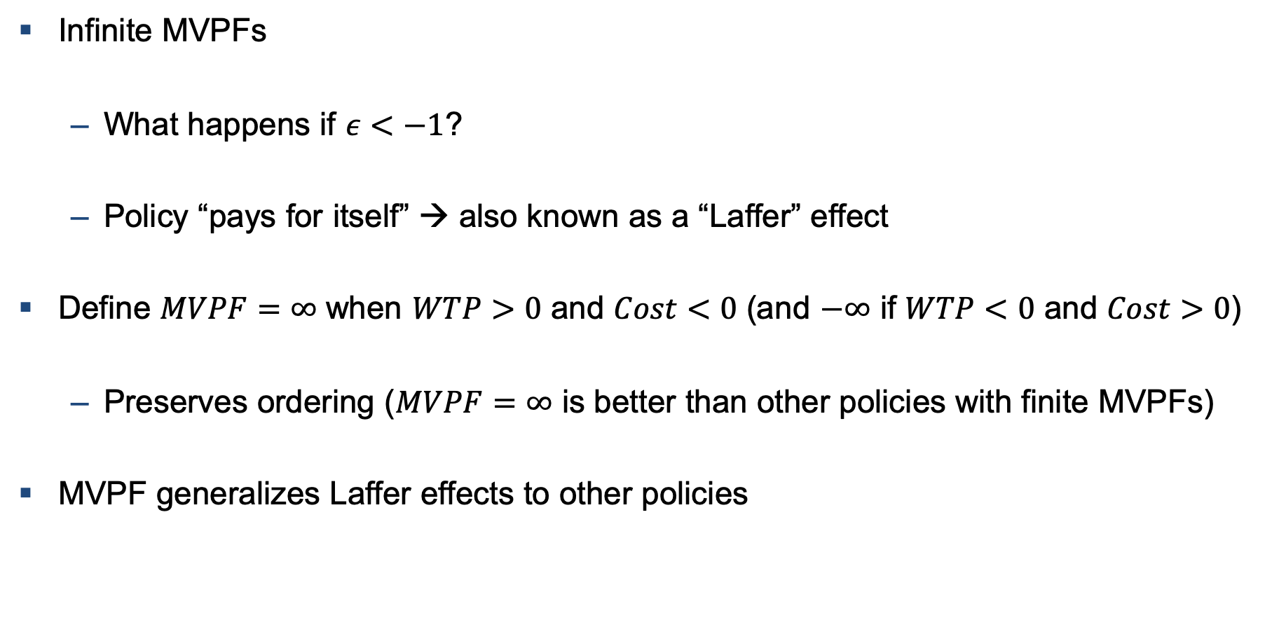
Infinite MVPFs
Infinite MVPFs
  What happens if $ε<−1$?
  Policy “pays for itself” → also known as a “Laffer” effect
Define $MVPF=∞$ when $WTP>0$ and $Cost<0$ (and $−∞$ if $WTP<0$ and $Cost>0$)
  Preserves ordering ($MVPF=∞$ is better than other policies with finite MVPFs)
MVPF generalizes Laffer effects to other policies

Slide 13
Outline
Theory and Measures of Welfare
1
2
Empirical Estimates of MVPFs for Various Policies
3
Other Welfare Measures: MEB and Cost-Benefit Analysis + MCPF
4
Relation to Optimal Tax Theory

Slide 14
Measuring MVPFs: Hendren and Sprung-Keyser (2019)
Hendren and Sprung-Keyser (2019) construct 133 MVPFs for policies in social insurance, education and job training, taxes and cash transfers, and in-kind transfers
  Additional MVPF estimates from other authors available at www.policyimpacts.org
Construct sample from survey and review articles in the four domains
Assess robustness to range of assumptions
  Program Parameters (discount rate, tax rate, etc.)
  Forecasting/Extrapolation of Observed Effects
  Validity of Empirical Designs (RCTs/RDs vs. Diff-in-Diff; Peer Reviewed vs. not; etc.)
  Publication Bias (Andrews and Kasy, 2018)
  Missing Causal Estimates (e.g. restrict to subsets of policies with different sets of observed effects)
Detailed appendices + posted .do files on GitHub for exploration

Slide 15
MVPF Example: Admission to Florida International University
Florida International University (FIU) had a minimum GPA threshold for admission that created a fuzzy discontinuity
Zimmerman (2014) utilizes this discontinuity to examine the impact of FIU admission on earnings for 14 years after admission.

Slide 16
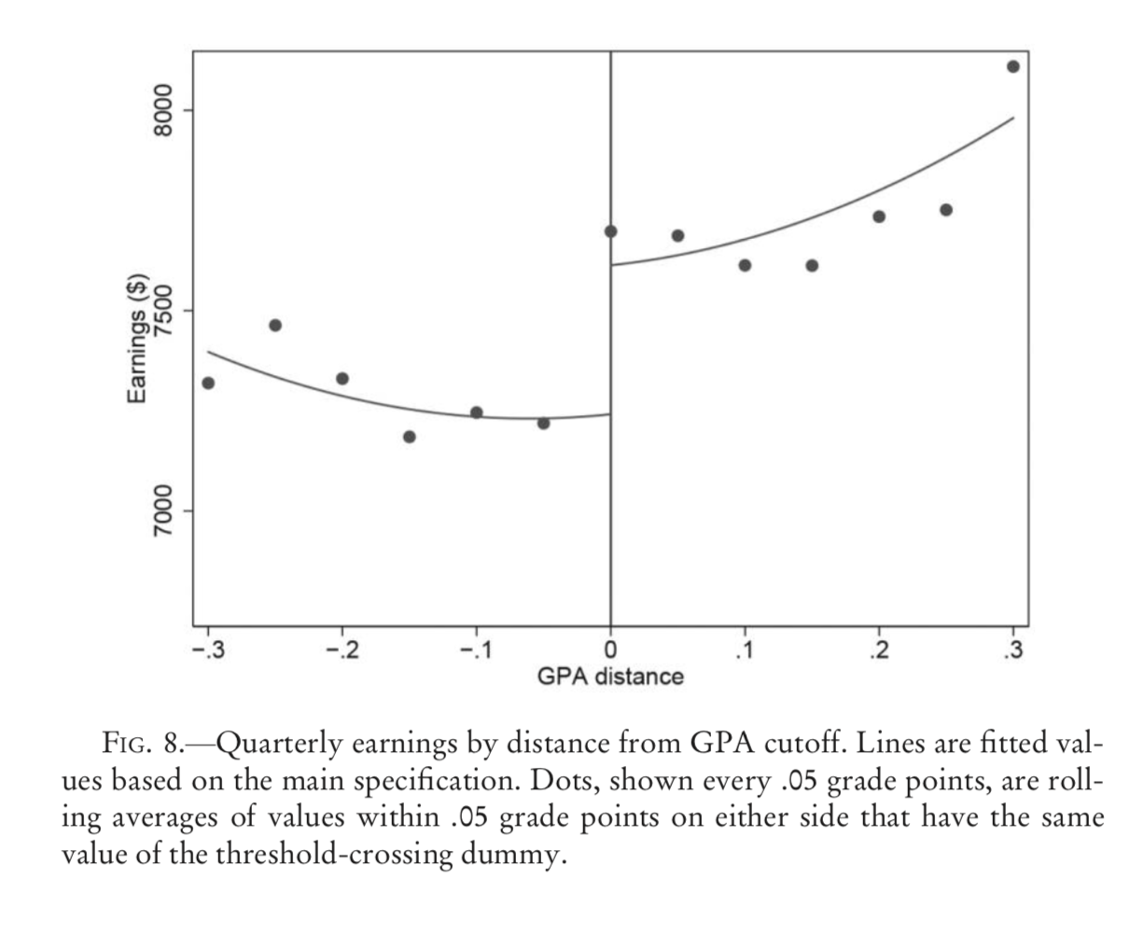
Impact of College Attendance on Earnings: Zimmerman (2014)

Slide 17
Net Cost to Government of Admission to Florida International University
$10K
0
-10K
-20K
-30K
Note: All amounts in 2005 USD, discounted using a 3% real interest rate

Slide 18
Net Cost to Government of Admission to Florida International University
$11.4K
$10K
Cost per admission to FIU (IPEDS/Zimmerman (2014))
0
-10K
-20K
-30K
Total
FIU Cost
Note: All amounts in 2005 USD, discounted using a 3% real interest rate

Slide 19
Net Cost to Government of Admission to Florida International University
$11.4K
$10K
Student payments/loans contribute $3.2K
$-3.2K
0
-10K
-20K
-30K
Total
Student
FIU Cost
Contribution
Note: All amounts in 2012 USD, discounted using CPI-U-RS and 3% real interest rate

Slide 20
Net Cost to Government of Admission to Florida International University
$11.4K
$10K
$-3.2K
5.6K reduction in community college govt spending
$-5.6K
0
-10K
-20K
-30K
Total
Student
Community
FIU Cost
Contribution
College Exp.
Note: All amounts in 2012 USD, discounted using CPI-U-RS and 3% real interest rate

Slide 21
Net Cost to Government of Admission to Florida International University
$11.4K
$10K
$-3.2K
$-5.6K
Net Upfront Gov’t Cost: 2.6K
0
-10K
-20K
-30K
Total
Student
Community
FIU Cost
Contribution
College Exp.
Note: All amounts in 2012 USD, discounted using CPI-U-RS and 3% real interest rate

Slide 22
Net Cost to Government of Admission to Florida International University
$11.4K
$10K
$-3.2K
$2.0K
Lost tax revenue from initial earnings declines from college attendance
$-5.6K
0
-10K
-20K
-30K
Total
Student
Community
Taxes from
age 19-25
earnings
FIU Cost
Contribution
College Exp.
Note: All amounts in 2012 USD, discounted using CPI-U-RS and 3% real interest rate

Slide 23
Net Cost to Government of Admission to Florida International University
$11.4K
$10K
$7.3K increase in tax revenue from ages 26-33 (18.6% tax+transfer, CBO)
$-3.2K
$2.0K
$-5.6K
0
$-7.3K
-10K
-20K
-30K
Total
Student
Community
Taxes from
age 19-25
earnings
Taxes from
age 26-33
earnings
FIU Cost
Contribution
College Exp.
Note: All amounts in 2012 USD, discounted using CPI-U-RS and 3% real interest rate

Slide 24
Net Cost to Government of Admission to Florida International University
$11.4K
$10K
$-3.2K
$2.0K
$-5.6K
0
$-7.3K
$-2.7K
-10K
Net government savings of $2.7K by age 33
-20K
17.2+2.7+11.4
-30K
Total
Student
Community
Taxes from
age 19-25
earnings
Taxes from
age 26-33
earnings
Net Cost To
FIU Cost
Contribution
College Exp.
Government
Note: All amounts in 2012 USD, discounted using CPI-U-RS and 3% real interest rate

Slide 25
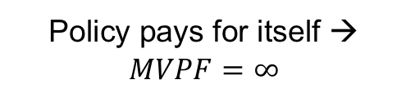
Net Cost to Government of Admission to Florida International University
$11.4K
$10K
$-3.2K
$2.0K
$-5.6K
0
$-7.3K
$-2.7K
-10K
Policy pays for itself → $MVPF=∞$
-20K
-30K
Total
Student
Community
Taxes from
age 19-25
earnings
Taxes from
age 26-33
earnings
Net Cost To
FIU Cost
Contribution
College Exp.
Government
Note: All amounts in 2012 USD, discounted using CPI-U-RS and 3% real interest rate

Slide 26
Net Cost by Age to Government of Admission to Florida International University
40k
20k
0
Cumulative Govt Cost
Observe outcomes through age 33
What about future ages?
Forecast future earnings using cross-section in ACS, following previous literature (e.g. Chetty, Hendren, Katz (2016))
-20k
-40k
0
10
20
30
40
50
60
70
Age

Slide 27
Forecasting Future Earnings using the Cross-sectional Age Distribution
Mean 2015 ACS Earnings by Age with 0.5% Growth
40k
60k
50k
20k
40k
0
Wage
Cumulative Govt Cost
30k
-20k
20k
10k
-40k
0
0
10
20
30
40
50
60
70
Age

Slide 28
Forecasting Future Earnings using the Cross-sectional Age Distribution
Control Group Earnings
40k
60k
50k
20k
40k
0
Wage
Cumulative Govt Cost
30k
-20k
Control group earnings are 97% of mean earnings at age 30
20k
10k
-40k
0
0
10
20
30
40
50
60
70
Age

Slide 29
Forecasting Future Earnings using the Cross-sectional Age Distribution
Control Group Forecast
40k
60k
50k
20k
40k
0
Wage
Cumulative Govt Cost
30k
Assume constant % of mean earnings over life-cycle
-20k
20k
10k
-40k
0
0
10
20
30
40
50
60
70
Age

Slide 30
Forecasting Future Earnings using the Cross-sectional Age Distribution
Control Group Earnings + Treatment Effect
40k
60k
Add Treatment Effect to Control Group Earnings
50k
20k
40k
0
Wage
Cumulative Govt Cost
30k
-20k
20k
10k
-40k
0
0
10
20
30
40
50
60
70
Age

Slide 31
Forecasting Future Earnings using the Cross-sectional Age Distribution
Treatment Group Forecast
40k
Forecast assuming constant % impact on earnings
60k
50k
20k
40k
0
Wage
Cumulative Govt Cost
30k
-20k
20k
10k
-40k
0
0
10
20
30
40
50
60
70
Age

Slide 32

Net Cost by Age to Government of Admission to Florida International University
Forecasting Future Tax/Transfer Revenue
Original $11.4K cost returns $24.4K to the government over the person’s lifetime
$$MVPF=∞$$
40k
(Regardless of WTP)
20k
0
Cumulative Govt Cost
-20k
-40k
0
10
20
30
40
50
60
70
Age

Slide 33
Willingness to Pay for Admission into Florida International University
Baseline WTP
100K
Baseline Estimate: Value WTP using impact on net after-tax income
Valid if no impact on labor effort/disutility and no other impact of education on utility
WTP ($)
50K
0
-25K
Private tuition
Age 19-25
Age 26-33
Age 34+
Baseline
payments
after-tax
after-tax
after-tax
WTP
earnings
earnings
earnings

Slide 34
Willingness to Pay for Admission into Florida International University
Baseline WTP
$95.5K
$112.8K
100K
WTP ($)
50K
$29.1K
0
$-2.9K
$-8.9K
-25K
Private tuition
Age 19-25
Age 26-33
Age 34+
Baseline
payments
after-tax
after-tax
after-tax
WTP
earnings
earnings
earnings

Slide 35
Direct Investments in Children Historically Had Highest MVPFs
FIU GPA
∞
>5
4
3
MVPF
2
1
0
<-1
0
20
40
60
80
Age of Beneficiaries

Slide 36
Cash Transfers
Direct Investments in Children Historically Had Highest MVPFs
Child Education
College Adult
Cal Grant GPA
College Child
MC Pregnant & Infants
MC Child 83+
AOTC (SS)
MTO
FIU GPA
Tuition Deduc (SS)
Disability Ins.
∞
Head Start
Top Tax 1981
Tuition Deduc (SE)
Health Adult
MC Child (State Exp)
Texas Pell
Health Child
K12 Spend
HTC (JS)
Perry Preschool
CC Mich
AOTC (JS)
HTC (SE)
AOTC (IS)
Top Tax 1986
Housing Vouchers
>5
Job Training
Abecedarian
CC Texas
HTC (IS)
MTO
MC Intro
Florida Grant
Soc Sec College
4
DC Grant
AOTC (SI)
HOPE Cred.
Nutrition
Georgia HOPE
College Spend
Supp. Sec. Inc.
NSW Ex-Offender
UI Dur (MO)
HCV RCT to Welfare
NSW Women
Mass HI (150%FPL)
Top Taxes
3
Adult Pell
SNAP Intro
JTPA Adult
Unemp. Ins.
TN Hope
Paycheck+
Mass HI (250%FPL)
MVPF
HTC (JE)
Alaska UBI
Oregon Health
Ohio Pell
UI Ben (RK)
Top Tax 1993
2
Kalamazoo
UI Ben (GA)
Top Tax 2001
WI Scholarship
EITC 1986
Work Advance
Top Tax 2013
CUNY Pell
Mass HI (200%FPL)
Medicare Intro
College Tuition
AFDC Term Limits
DI Generosity
1
SSI Review
TN Pell
DI Veterans
SNAP Assist
MA Scholarship
SNAP Info
NSW Youth
EITC 1993
UI Ben (NY)
DI Examiner
Tuition Deduc (JE)
Medigap Tax
0
Year Up
JobStart
AFDC Generosity
UI Ben (MO Exp)
SSI Judge
Job Corps
HCV Chicago Lottery
UI Ben (MO Rec)
JTPA Youth
UI Ben (DD)
UI Ben (DD w UR)
DI Judge
Tuition Deduc (JS)
Cal Grant Inc
NSW Ex-Addict
UI Ben (State Max)
AOTC (SE)
<-1
UI Dur (DD)
AOTC (JE)
HOPE/LLC
Neg Inc Tax
HTC (SS)
0
20
40
60
80
Age of Beneficiaries

Slide 37
Cash Transfers
Direct Investments in Children Historically Had Highest MVPFs
Child Education
College Adult
Cal Grant GPA
College Child
MC Pregnant & Infants
MC Child 83+
AOTC (SS)
MTO
FIU GPA
Tuition Deduc (SS)
Disability Ins.
∞
Head Start
Top Tax 1981
Tuition Deduc (SE)
Health Adult
MC Child (State Exp)
Texas Pell
Health Child
K12 Spend
HTC (JS)
Perry Preschool
CC Mich
AOTC (JS)
HTC (SE)
AOTC (IS)
Top Tax 1986
Housing Vouchers
>5
Job Training
Abecedarian
CC Texas
HTC (IS)
MTO
MC Intro
Florida Grant
Soc Sec College
4
DC Grant
AOTC (SI)
HOPE Cred.
Nutrition
Georgia HOPE
College Spend
Supp. Sec. Inc.
High MVPFs for policies targeting children
NSW Ex-Offender
UI Dur (MO)
HCV RCT to Welfare
NSW Women
Mass HI (150%FPL)
Top Taxes
3
Adult Pell
SNAP Intro
JTPA Adult
Unemp. Ins.
TN Hope
Paycheck+
Mass HI (250%FPL)
MVPF
HTC (JE)
Alaska UBI
Oregon Health
Ohio Pell
UI Ben (RK)
Top Tax 1993
2
Kalamazoo
UI Ben (GA)
Top Tax 2001
WI Scholarship
EITC 1986
Work Advance
Top Tax 2013
CUNY Pell
Mass HI (200%FPL)
Medicare Intro
College Tuition
AFDC Term Limits
DI Generosity
1
SSI Review
TN Pell
DI Veterans
SNAP Assist
MA Scholarship
SNAP Info
NSW Youth
EITC 1993
UI Ben (NY)
DI Examiner
Tuition Deduc (JE)
Medigap Tax
0
Year Up
JobStart
AFDC Generosity
UI Ben (MO Exp)
SSI Judge
Job Corps
HCV Chicago Lottery
UI Ben (MO Rec)
JTPA Youth
UI Ben (DD)
UI Ben (DD w UR)
DI Judge
Tuition Deduc (JS)
Cal Grant Inc
NSW Ex-Addict
UI Ben (State Max)
AOTC (SE)
<-1
UI Dur (DD)
AOTC (JE)
HOPE/LLC
Neg Inc Tax
HTC (SS)
0
20
40
60
80
Age of Beneficiaries

Slide 38
Cash Transfers
Direct Investments in Children Historically Had Highest MVPFs
Child Education
College Adult
Cal Grant GPA
College Child
MC Pregnant & Infants
MC Child 83+
AOTC (SS)
MTO
FIU GPA
Tuition Deduc (SS)
Disability Ins.
∞
Head Start
Top Tax 1981
Tuition Deduc (SE)
Health Adult
MC Child (State Exp)
Texas Pell
Health Child
K12 Spend
HTC (JS)
Perry Preschool
CC Mich
AOTC (JS)
HTC (SE)
AOTC (IS)
Top Tax 1986
Housing Vouchers
>5
Job Training
Abecedarian
CC Texas
HTC (IS)
MTO
MC Intro
Florida Grant
Soc Sec College
4
DC Grant
AOTC (SI)
HOPE Cred.
Nutrition
Georgia HOPE
College Spend
Supp. Sec. Inc.
NSW Ex-Offender
UI Dur (MO)
HCV RCT to Welfare
NSW Women
Mass HI (150%FPL)
Top Taxes
3
Adult Pell
SNAP Intro
JTPA Adult
Unemp. Ins.
TN Hope
Paycheck+
Mass HI (250%FPL)
Lower MVPFs for policies targeting adults
MVPF
HTC (JE)
Alaska UBI
Oregon Health
Ohio Pell
UI Ben (RK)
Top Tax 1993
2
Kalamazoo
UI Ben (GA)
Top Tax 2001
WI Scholarship
EITC 1986
Work Advance
Top Tax 2013
CUNY Pell
Mass HI (200%FPL)
Medicare Intro
College Tuition
AFDC Term Limits
DI Generosity
1
SSI Review
TN Pell
DI Veterans
SNAP Assist
MA Scholarship
SNAP Info
NSW Youth
EITC 1993
UI Ben (NY)
DI Examiner
Tuition Deduc (JE)
Medigap Tax
0
Year Up
JobStart
AFDC Generosity
UI Ben (MO Exp)
SSI Judge
Job Corps
HCV Chicago Lottery
UI Ben (MO Rec)
JTPA Youth
UI Ben (DD)
UI Ben (DD w UR)
DI Judge
Tuition Deduc (JS)
Cal Grant Inc
NSW Ex-Addict
UI Ben (State Max)
AOTC (SE)
<-1
UI Dur (DD)
AOTC (JE)
HOPE/LLC
Neg Inc Tax
HTC (SS)
0
20
40
60
80
Age of Beneficiaries

Slide 39
Cash Transfers
Direct Investments in Children Historically Had Highest MVPFs
With 95% Confidence Intervals Computed via Modified Bootstrap
Child Education
College Adult
College Child
Disability Ins.
∞
Health Adult
Health Child
Housing Vouchers
>5
Job Training
MTO
4
Nutrition
Supp. Sec. Inc.
Top Taxes
3
Unemp. Ins.
MVPF
2
1
0
<-1
0
20
40
60
80
Age of Beneficiaries

Slide 40
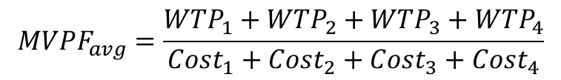
Cash Transfers
Direct Investments in Children Historically Had Highest MVPFs
Child Education
College Adult
College Child
Disability Ins.
∞
Health Adult
Health Child
Housing Vouchers
>5
Job Training
Imagine spending $1 in initial program cost on each domain
MTO
4
Nutrition
$$MVPF_{avg}=\frac{WTP_{1}+WTP_{2}+WTP_{3}+WTP_{4}}{Cost_{1}+Cost_{2}+Cost_{3}+Cost_{4}}$$
Supp. Sec. Inc.
Top Taxes
3
Unemp. Ins.
MVPF
2
1
0
<-1
0
20
40
60
80
Age of Beneficiaries

Slide 41
Direct Investments in Children Historically Had Highest MVPFs
Category Averages
Child Education
∞
Health Child
College Child
>5
4
3
Top Taxes
MVPF
2
Cash Transfers
Housing Vouchers
Supp. Sec. Inc.
1
Job Training
Unemp. Ins.
Disability Ins.
Health Adult
0
<-1
College Adult
0
20
40
60
80
Age of Beneficiaries

Slide 42
Net Costs to Government per $1 of Initial Expenditure
Category Averages
>2
1
1
Cost Over Program Cost
0
0
Child Education
College Child
Health Child
-1
-1
<-2
<-2
0
20
40
60
80
Age of Beneficiaries

Slide 43
Net Costs to Government per $1 of Initial Expenditure
Category Averages
>2
Unemp. Ins.
Health Adult
Supp. Sec. Inc.
Housing Vouchers
Disability Ins.
1
Cash Transfers
Job Training
College Adult
Top Taxes
Cost Over Program Cost
0
Child Education
College Child
Health Child
-1
<-2
0
20
40
60
80
Age of Beneficiaries

Slide 44
Not All Child-Targeted Policies Have High MVPFs
∞
>5
4
3
MVPF
2
1
SSI Review
MA Scholarship
0
Job Corps
<-1
0
20
40
60
80
Age of Beneficiaries

Slide 45
Infinite MVPF for 1981 Top Tax Rate…
∞
Top Tax 1981
>5
4
3
MVPF
2
1
0
<-1
0
20
40
60
80
Age of Beneficiaries

Slide 46
Infinite MVPF for 1981 Top Tax Rate…
∞
Top Tax 1981
>5
4
3
MVPF
2
1
0
<-1
0
20
40
60
80
Age of Beneficiaries

Slide 47
Policies with Spillovers onto Children Have High MVPFs (e.g. MTO)
MTO
∞
>5
4
3
MVPF
2
1
0
<-1
0
20
40
60
80
Age of Beneficiaries

Slide 48
MVPF Robustness to Alternative Discount Rates
3% discount rate
Child Education
College Child
∞
Health Child
>5
4
3
Top Taxes
MVPF
Cash Transfers
2
Supp. Sec. Inc.
Housing Vouchers
1
Health Adult
Unemp. Ins.
Disability Ins.
0
Job Training
College Adult
<-1
0
20
40
60
80
Age of Beneficiaries

Slide 49
MVPF Robustness to Alternative Discount Rates
7% discount rate
∞
>5
College Adult
Health Child
College Child
4
3
Child Education
Top Taxes
MVPF
Cash Transfers
2
Supp. Sec. Inc.
1
Housing Vouchers
Health Adult
Disability Ins.
Job Training
Unemp. Ins.
0
<-1
0
20
40
60
80
Age of Beneficiaries

Slide 50
MVPF Robustness to Alternative Tax and Transfer Rates
10% Tax and Transfer Rate
∞
Health Child
>5
College Adult
College Child
Child Education
4
3
Top Taxes
MVPF
Cash Transfers
2
Housing Vouchers
Supp. Sec. Inc.
1
Disability Ins.
Health Adult
Unemp. Ins.
0
Job Training
<-1
0
20
40
60
80
Age of Beneficiaries

Slide 51
MVPF Robustness to Alternative Tax and Transfer Rates
30% Tax and Transfer Rate
Child Education
College Child
∞
Health Child
>5
4
3
Top Taxes
MVPF
Cash Transfers
2
Housing Vouchers
Supp. Sec. Inc.
1
Health Adult
Disability Ins.
Unemp. Ins.
0
Job Training
<-1
College Adult
0
20
40
60
80
Age of Beneficiaries

Slide 52
MVPF Robustness to WTP
Conservative Willingness to Pay
Health Child
College Child
∞
Child Education
>5
4
3
Top Taxes
MVPF
College Adult
2
Housing Vouchers
Cash Transfers
Supp. Sec. Inc.
1
Disability Ins.
Health Adult
Unemp. Ins.
0
Job Training
<-1
0
20
40
60
80
Age of Beneficiaries
WTP/Prog. cost

Slide 53
MVPF by Year of Policy
Averages by Decade
∞
Child Policies
>5
4
3
MVPF
2
1
Adult Policies
0
<-1
1960
1970
1980
1990
2000
2010
Year

Slide 54
Publication Bias
Estimates are constrained by the existence of previous literature
Would Perry Preschool have been published if the effects were an (imprecise) zero?
Andrews and Kasy (2018) provide a method to test for and correct publication bias
Child Policies: 3-4 times more likely to be published if they find a repayment effect
Adult Policies: up to 12 times more likely to be published if they find a distortionary effect
Table

Slide 55
MVPF Robustness to Publication Bias
Adjusting for Observed Publication Bias
Child Education
College Child
∞
Health Child
>5
4
3
MVPF
Top Taxes
2
Cash Transfers
Supp. Sec. Inc.
1
Housing Vouchers
Health Adult
Unemp. Ins.
Disability Ins.
Job Training
0
<-1
College Adult
0
20
40
60
80
Age of Beneficiaries

Slide 56
MVPF Robustness to Publication Bias
Adjusting for 35X Bias in Experimental Economics Studies [Camerer (2016)]
∞
Child Education
>5
Health Child
College Child
4
3
Top Taxes
MVPF
2
Cash Transfers
Supp. Sec. Inc.
1
Housing Vouchers
Health Adult
Disability Ins.
Unemp. Ins.
0
Job Training
<-1
College Adult
0
20
40
60
80
Age of Beneficiaries

Slide 57
Outline
Theory and Measures of Welfare
1
2
Empirical Estimates of MVPFs for Various Policies
3
Other Welfare Measures: MEB and Cost-Benefit Analysis + MCPF
4
Relation to Optimal Tax Theory

Slide 58
Other Welfare Approaches: MEB
Marginal excess burden (MEB) corresponds to another conceptual policy experiment
Imagine doing the policy but closing the budget constraint through individual-specific lump-sum taxation ( Auerbach and Hines (2002))
Requires compensated not causal effect to calculate MEB
Assumes budget constraint is closed with a technologically-infeasible policy
  Key insight of Mirrlees (1971) is that individual-specific lump-sum taxation isn’t feasible – can only tax based on outcomes such as earnings

Slide 59
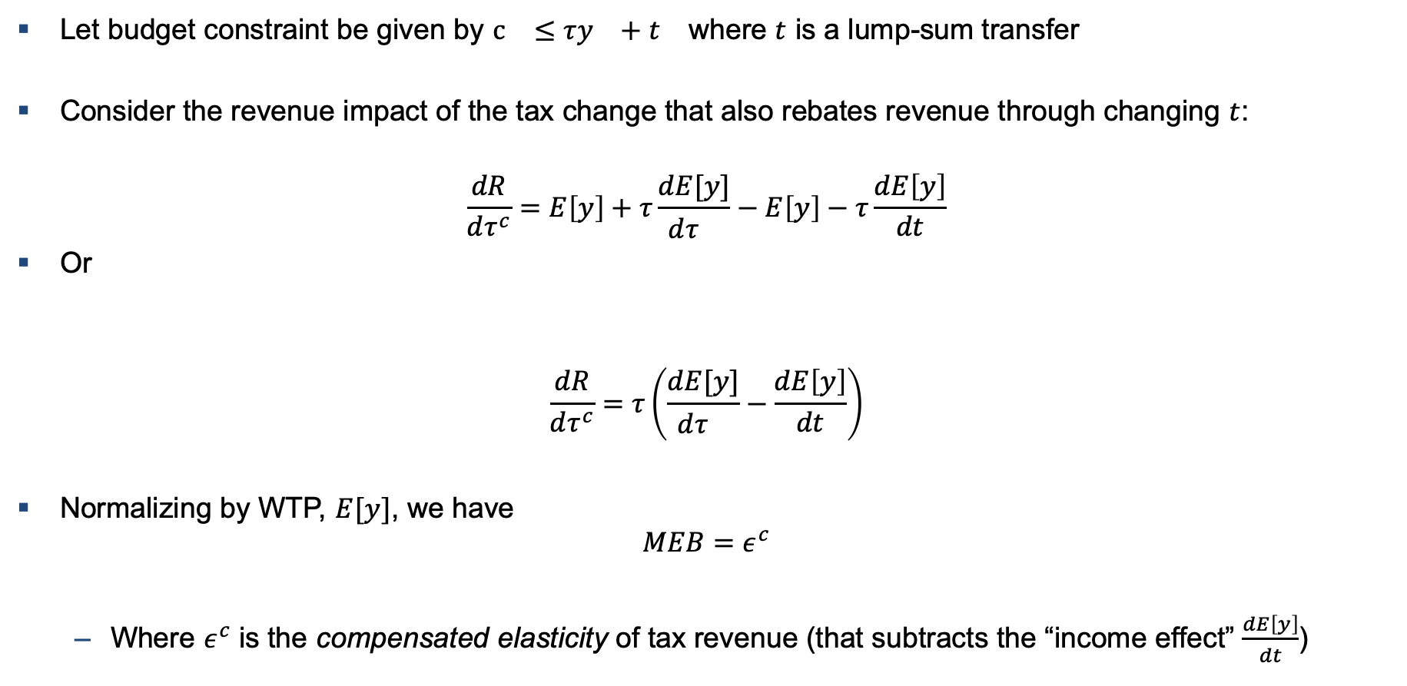
MEB of Tax Rate Change
Let budget constraint be given by $c_{}≤τy_{}+t_{}$ where $t$ is a lump-sum transfer
Consider the revenue impact of the tax change that also rebates revenue through changing $t$:
$$\frac{dR}{dτ^{c}}=E\left[y\right]+τ\frac{dE[y]}{dτ^{}}−E\left[y\right]−τ\frac{dE\left[y\right]}{dt}$$
Or
$$\frac{dR}{dτ^{c}}=τ\left(\frac{dE[y]}{dτ^{}}−\frac{dE\left[y\right]}{dt}\right)$$
Normalizing by WTP, $E[y]$, we have
$$MEB=ε^{c}$$
  Where $ε^{c}$ is the compensated elasticity of tax revenue (that subtracts the “income effect” $\frac{dE\left[y\right]}{dt}$)
Tax Cut
Lump-Sum

Slide 60
Issues with the MEB Approach
Two fundamental problems with MEB
  Requires compensated, not causal effects
    Income effects are hard to measure (especially if they are not invariant across environments)
  Individual specific transfers are not feasible (this is the core idea behind Mirrlees’ optimal income tax work).
    E.g. distortionary taxes will always look “bad”
It is still possible to compare MEBs across policies
  Appropriately defined, this will characterize changes in social welfare
  But, requires compensated effects bc both policy changes need to add in, then subtract the income effects

Slide 61
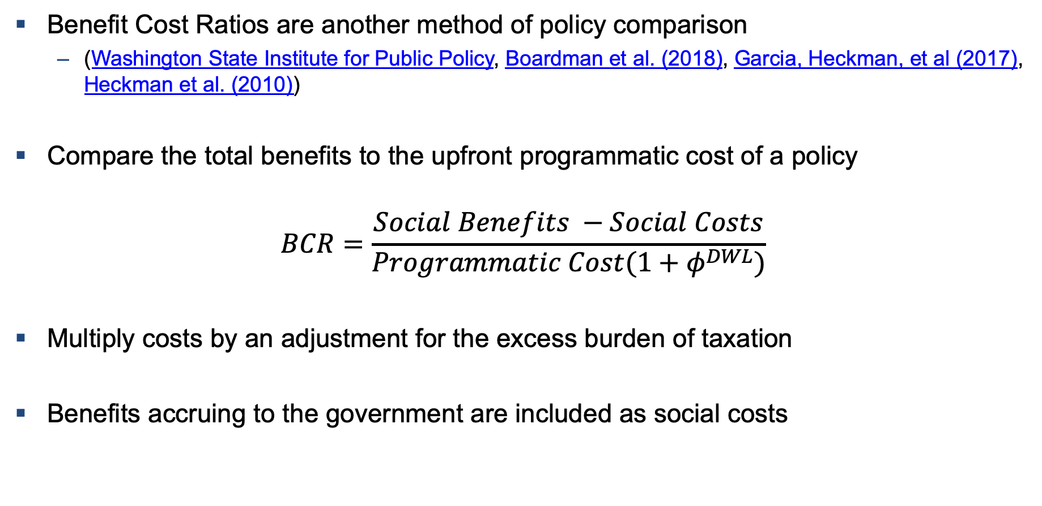
Other Welfare Approaches: Cost-Benefit Analysis
Benefit Cost Ratios are another method of policy comparison
  (Washington State Institute for Public Policy, Boardman et al. (2018), Garcia, Heckman, et al (2017), Heckman et al. (2010))
Compare the total benefits to the upfront programmatic cost of a policy
$$BCR=\frac{Social Benefits −Social Costs}{Programmatic Cost(1+φ^{DWL})}$$
Multiply costs by an adjustment for the excess burden of taxation
Benefits accruing to the government are included as social costs

Slide 62

MVPF vs Benefit/Cost Ratio [Heckman et al., 2010; Zimmerman 2014]
Benefit Cost Ratio by Age of Beneficiaries
>10
8
College Child
6
Health Child
BCR, $φ^{DWL}=50\%$
4
Child Education
2
Cash Transfers
Supp. Sec. Inc.
Housing Vouchers
Disability Ins.
Health Adult
0
Job Training
Unemp. Ins.
<-1
College Adult
0
20
40
60
80
Age of Beneficiaries

Slide 63

MVPF vs Benefit/Cost Ratio [Heckman et al., 2010; Zimmerman 2014]
Tax Revenue Impacts Counted as Social Benefits, not Government Cost Reductions
>5
FIU GPA
4
3
Perry Preschool
BCR, $φ^{DWL}=50\%$
2
Top Tax 1981
MC Child 83+
1
EITC 1993
Top Tax 1993
0
Job Corps
<-1
<-1
0
1
2
3
4
>5
∞
MVPF

Slide 64
Key Problem with Cost-Benefit Analysis
Benefit-Cost analysis tends to suffer from three related conceptual problems
  Revenue impacts are included in numerator but they reduce the need to raise revenue and thus the excess burden of taxation!
    But the excess burden only multiplies the upfront cost
  They force a particular method of closing the budget constraint (linear taxation)
  They don’t (generally) account for differential distributional incidence of the policy relative to the method used to raise revenue (but it is well known one can incorporate distributional weights)
In contrast, the MVPF would put the net government cost in the denominator, allow the researcher to compare the MVPF to other policies, and use Okun’s bucket

Slide 65
Outline
Theory and Measures of Welfare
1
2
Empirical Estimates of MVPFs for Various Policies
3
Other Welfare Measures: MEB and Cost-Benefit Analysis + MCPF
4
Relation to Optimal Tax Theory

Slide 66
Quantifying the Tradeoffs of Redistribution through the Tax Schedule (Mirrlees 1976)
∞
Top Tax 1981
>2
Prefer 1993 OBRA tax change iff prefer $1.12 to low-income EITC beneficiaries to $1.85 to top earners
Top Tax 1986
Top Tax 1993
MVPF
1.5
Top Tax 2001
EITC 1986
Top Tax 2013
EITC 1993
1
Paycheck+
Alaska UBI
AFDC Generosity
AFDC Term Limits
<0.5
Neg Inc Tax
0
10
20
30
40
>50K
Approximate Income of Beneficiary
Spillovers on Children

Slide 67
In-Kind versus Cash Transfers (“Atkinson-Stiglitz” Theorem)
∞
MTO
Top Tax 1981
>2
Top Tax 1986
Top Tax 1993
MVPF
1.5
Food stamps vs. housing vouchers
Top Tax 2001
EITC 1986
Top Tax 2013
SNAP Intro
EITC 1993
1
Paycheck+
HCV RCT to Welfare
SNAP Assist
Alaska UBI
AFDC Generosity
SNAP Info
AFDC Term Limits
HCV Chicago Lottery
<0.5
Neg Inc Tax
0
10
20
30
40
>50K
Approximate Income of Beneficiary

Slide 68
“Tagging” Based on Age in MTO
∞
MTO Young
MTO
Top Tax 1981
>2
Top Tax 1986
Top Tax 1993
MVPF
1.5
Top Tax 2001
EITC 1986
Top Tax 2013
SNAP Intro
EITC 1993
1
Paycheck+
HCV RCT to Welfare
SNAP Assist
Alaska UBI
AFDC Generosity
SNAP Info
AFDC Term Limits
HCV Chicago Lottery
<0.5
MTO Teens
Neg Inc Tax
0
10
20
30
40
>50K
Approximate Income of Beneficiary

Slide 69
Efficient Redistribution through Investments in Low-Income Children
Child Health, College and Education Programs
FIU GPA
Cal Grant GPA
MC Child (State Exp)
Texas Pell
K12 Spend
MC Pregnant & Infants
∞
MC Child 83+
CC Texas
Ohio Pell
Top Tax 1981
Soc Sec College
Florida Grant
DC Grant
CC Mich
Perry Preschool
Georgia HOPE
>2
College Spend
Top Tax 1986
TN Hope
Kalamazoo
Top Tax 1993
MC Intro
Abecedarian
MVPF
1.5
WI Scholarship
CUNY Pell
Top Tax 2001
EITC 1986
Top Tax 2013
EITC 1993
1
Paycheck+
College Tuition
Alaska UBI
AFDC Generosity
TN Pell
AFDC Term Limits
MA Scholarship
<0.5
Neg Inc Tax
Cal Grant Inc
0
10
20
30
40
>50K
Approximate Income of Beneficiary

Slide 70
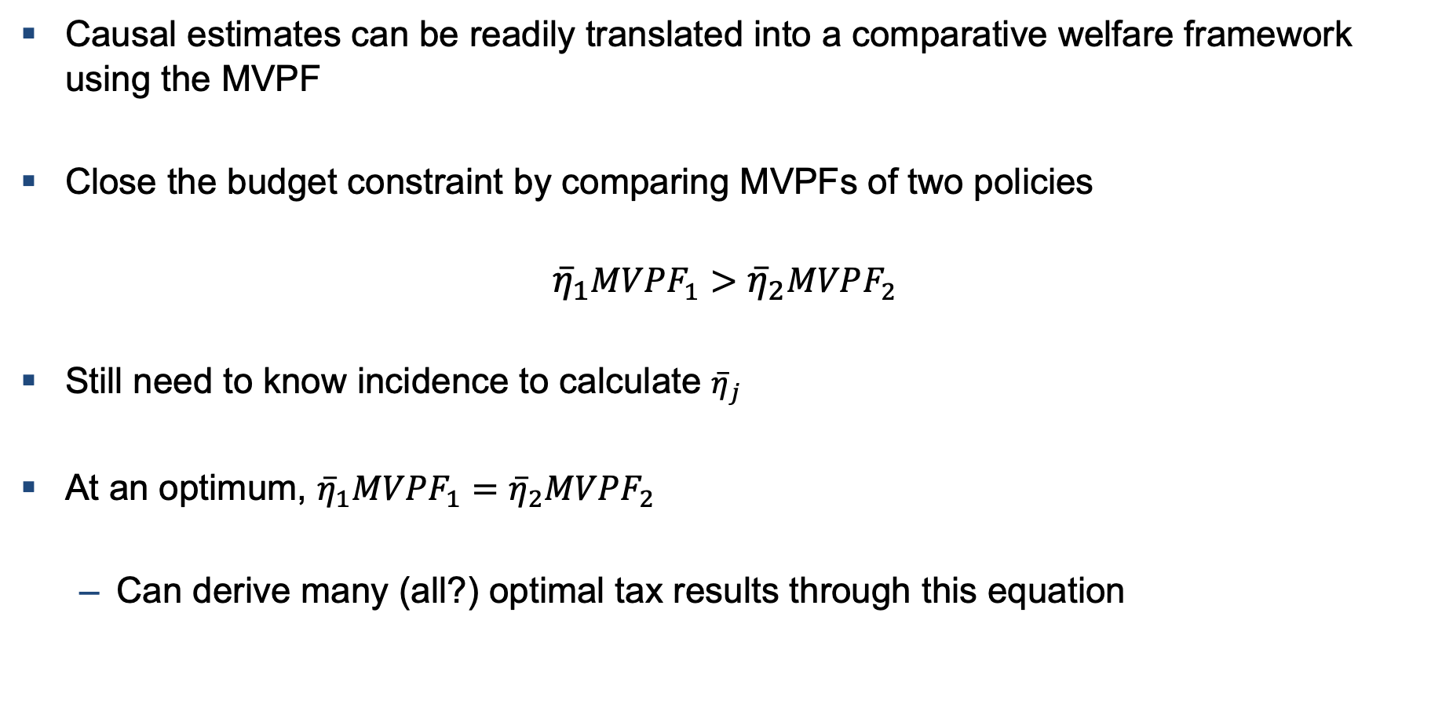
Summary
Causal estimates can be readily translated into a comparative welfare framework using the MVPF
Close the budget constraint by comparing MVPFs of two policies
$${\overline{η}}_{1}MVPF_{1}>{\overline{η}}_{2}MVPF_{2}$$
Still need to know incidence to calculate ${\overline{η}}_{j}$
At an optimum, ${\overline{η}}_{1}MVPF_{1}={\overline{η}}_{2}MVPF_{2}$
  Can derive many (all?) optimal tax results through this equation

Slide 71
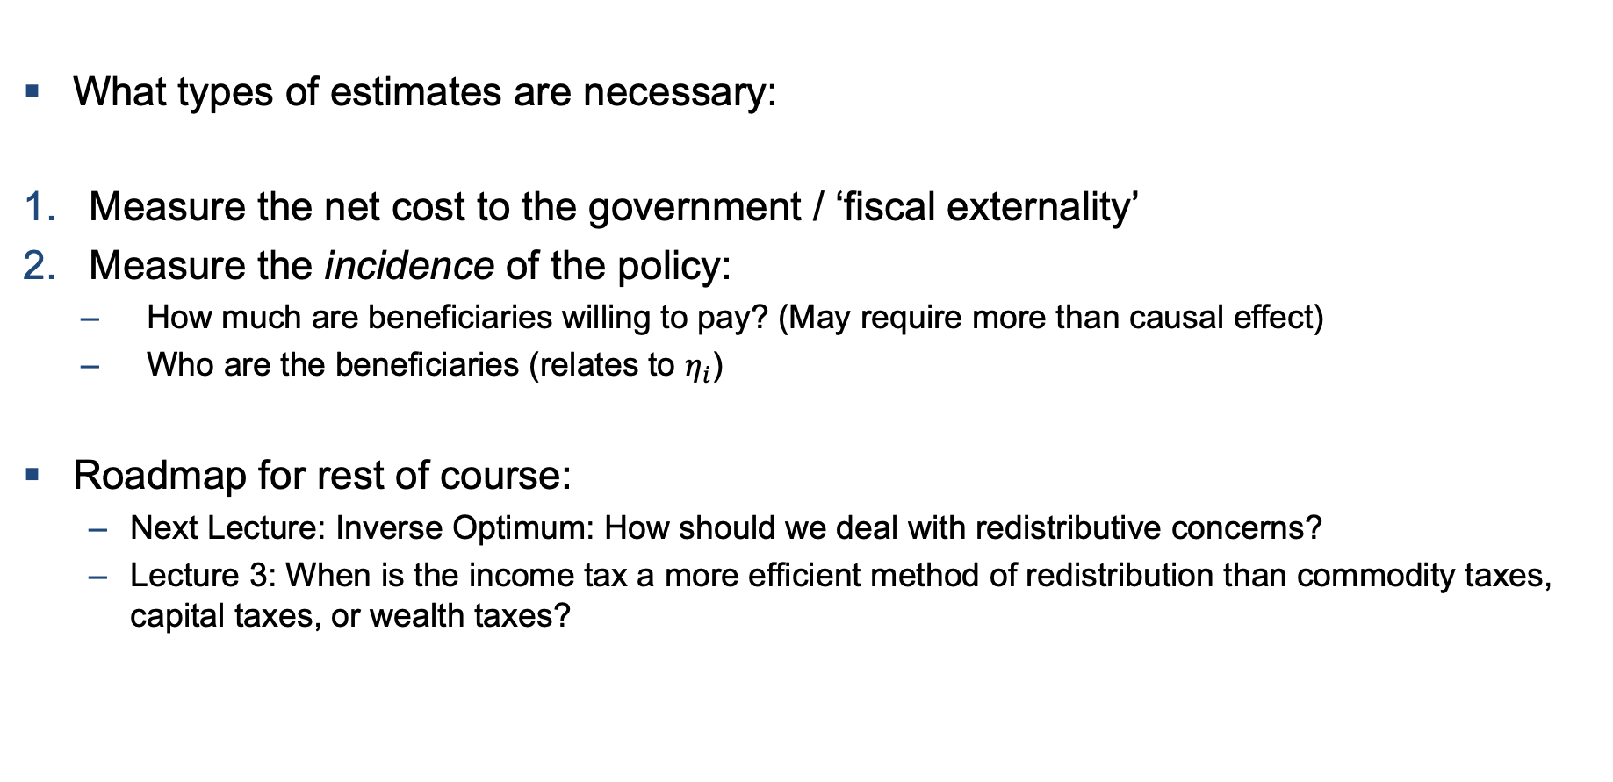
Summary
What types of estimates are necessary:
Measure the net cost to the government / ‘fiscal externality’
Measure the incidence of the policy:
  How much are beneficiaries willing to pay? (May require more than causal effect)
  Who are the beneficiaries (relates to $η_{i}$)
Roadmap for rest of course:
  Next Lecture: Inverse Optimum: How should we deal with redistributive concerns?
  Lecture 3: When is the income tax a more efficient method of redistribution than commodity taxes, capital taxes, or wealth taxes?

