Slide 1

Place and Kids
Nathaniel Hendren
Spring 2023

Slide 2

The Public Economics of “Place”
Last Lecture: Impact of Place on adults and models of sorting across place
This lecture: What about impacts on kids?
Notes:
2

Slide 3
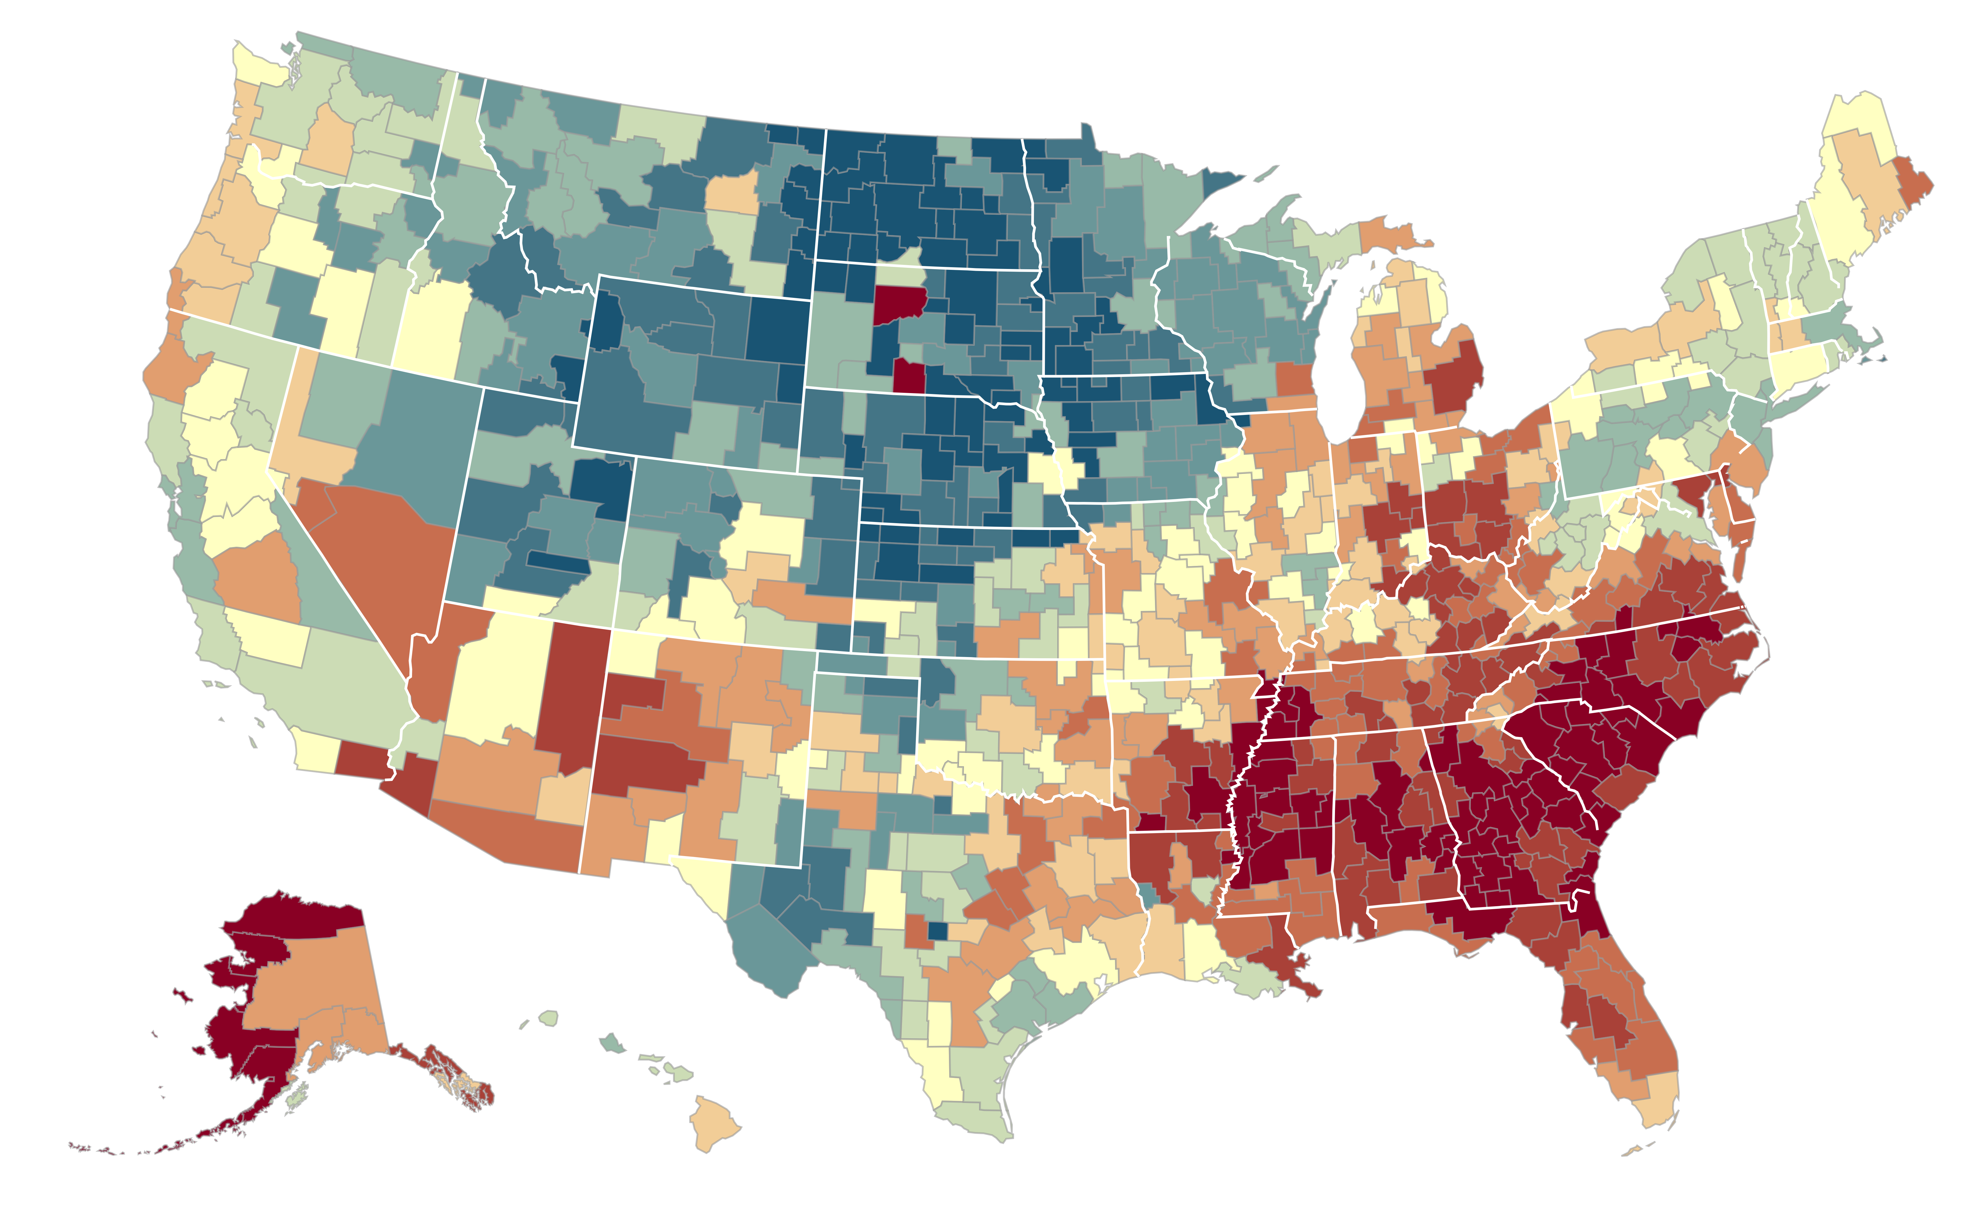

The Geography of Upward Mobility in the United States
Average Household Income for Children with Parents Earning $27,000 (25th percentile)
Seattle
$35.2k
Salt Lake City $37.2k
Chicago
$30.7k
Cleveland
$29.4k
Boston $36.8k
San Francisco
Bay Area
$37.2k
Baltimore $28.2k
Washington DC
$33.9k
> $44.8k
Los Angeles
$34.3k
Atlanta
$26.6k
$33.7k
Note: Blue = More Upward Mobility, Red = Less Upward Mobility
< $26.8k
Notes:
-720 metro and rural areas
-tremendous range of outcomes across the US. E.g. Baltimore and Seattle.

Slide 4
“People versus Place”
Is the variation in economic outcomes ”people vs. places”?
  A.k.a. Selection versus causal effect
Growing approach: Use people who move across places to infer causal effect of place
  Healthcare utilization – Finkelstein, Gentzkow, Williams (QJE 2016)
  Mortality - Finkelstein, Gentzkow, Williams (AER 2021)
  Intergenerational Mobility – Chetty and Hendren (QJE 2018)
Notes:
4

Slide 5
“People versus Place”
Is the variation in economic outcomes ”people vs. places”?
  A.k.a. Selection versus causal effect
Growing approach: Use people who move across places to infer causal effect of place
  Healthcare utilization – Finkelstein, Gentzkow, Williams (QJE 2016)
  Mortality - Finkelstein, Gentzkow, Williams (AER 2021)
  Intergenerational Mobility – Chetty and Hendren (QJE 2018)
    Use US tax records from 1996-2012 to study causal effect of childhood exposure to different areas of the US
Notes:
5

Slide 6
Mean Child Income Rank at Age 26 vs. Parent Income Rank
for Children Born in 1985 and Raised in Chicago
70
60
50
Mean Child Rank in National Income Distribution
40
30
20
0
10
20
30
40
50
60
70
80
90
100
Parent Rank in National Income Distribution

Slide 7

Mean Child Income Rank at Age 26 vs. Parent Income Rank
for Children Born in 1985 and Raised in Chicago
70
60
50
Mean Child Rank in National Income Distribution
40
$\overline{y}$_{p,Chicago,1985} = $\overline{y}$_{0,Chicago,1985}
+ (Rank-Rank Slope) $×$ $p$
30
Predict outcome for child in CZ c using slope + intercept of rank-rank relationship
20
0
10
20
30
40
50
60
70
80
90
100
Parent Rank in National Income Distribution

Slide 8
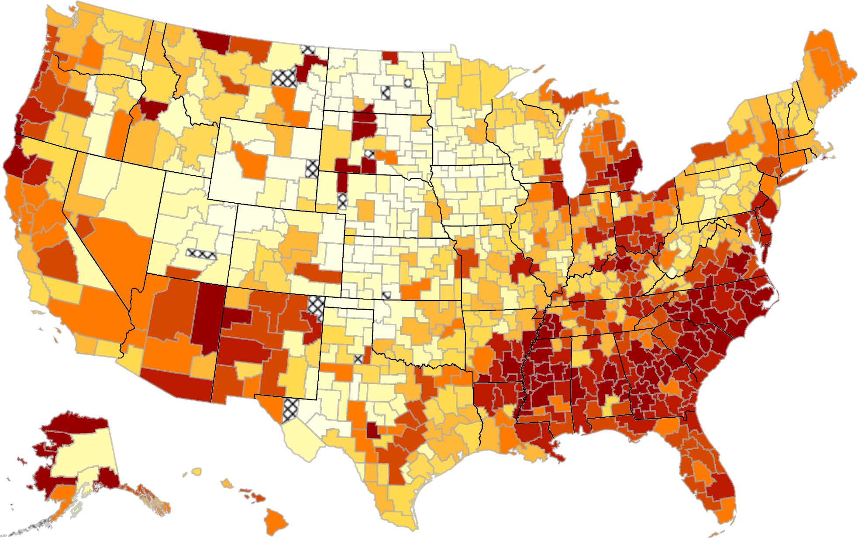
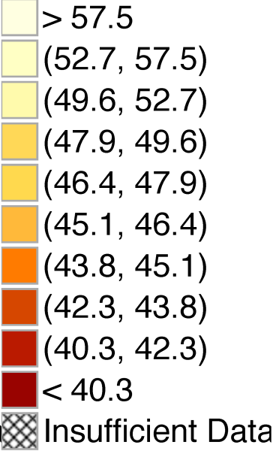
The Geography of Intergenerational Mobility in the United States (Permanent Residents)
Predicted Income Rank at Age 26 for Children with Parents at 25th Percentile
Is this variation "Causal”?

Slide 9
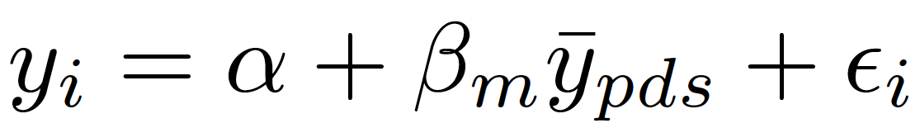
Childhood Exposure Effects
Does growing up in a “more red” CZ cause a child to grow up to have lower incomes?
Exposure effect at age m: impact of spending year m of childhood in an area where permanent residents’ outcomes are 1 percentile higher
Ideal experiment: randomly assign children to new neighborhoods d starting at age m for the rest of childhood
  Regress income in adulthood (y_{i}) on mean outcomes of prior residents:
  Exposure effect at age m is
(1)

Slide 10
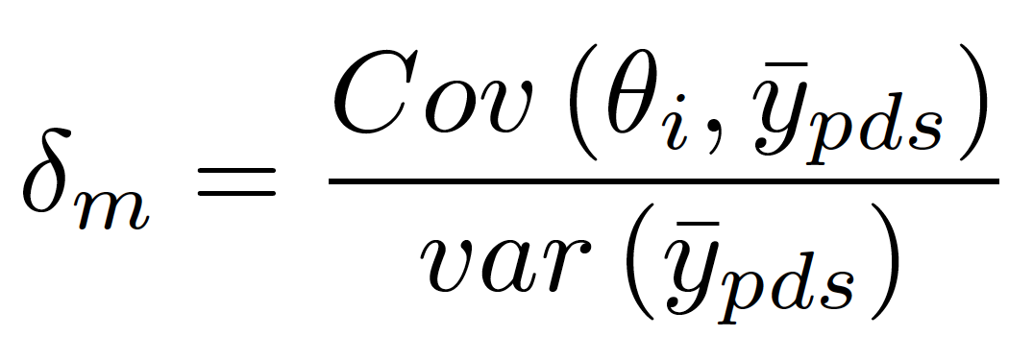
Estimating Exposure Effects in Observational Data
Chetty and Hendren (2016) estimate exposure effects by studying families that move across CZ’s with children at different ages in observational data
Key problem: choice of neighborhood is likely to be correlated with children’s potential outcomes
  Ex: parents who move to a good area may have latent ability or wealth (θ_{i}) that produces better child outcomes
Estimating (1) in observational data yields a coefficient
where is a standard selection effect

Slide 11
Estimating Exposure Effects in Observational Data
But identification of exposure effects does not require that where people move is orthogonal to child’s potential outcomes
Instead, requires that timing of move to better vs. worse area is orthogonal to child’s potential outcomes (DD on timing and geography)
Assumption 1. Selection effects do not vary with child’s age at move:
δ_{m} = δ for all m
Certainly plausible that this assumption could be violated
  Ex: parents who move to better areas when kids are young may have better unobservables
  I’ll be curious if you find the following arguments convincing ☺

Slide 12
Estimating Exposure Effects in Observational Data
To begin, consider subset of families who move with a child who is exactly 13 years old
Regress child’s income rank at a given age (e.g. age 24, 26, or 30) y_{i} on predicted outcome of permanent residents in destination:
Include parent decile (q) by origin (o) by birth cohort (s) fixed effects to identify b_{m} purely from differences in destinations

Slide 13
Movers’ Outcomes vs. Predicted Outcomes Based on Residents in Destination
Child Age 13 at Time of Move, Income Measured at Age 24
4
2
0
Mean (Residual) Child Rank in National Income Distribution
Slope: b₁₃ = 0.628
(0.048)
-2
-4
-6
-4
-2
0
2
4
6
Predicted Diff. in Child Rank Based on Permanent Residents in Dest. vs. Orig.

Slide 14
Movers’ Outcomes vs. Predicted Outcomes Based on Residents in Destination
By Child’s Age at Move, Income Measured at Age $=$ 24
0.8
0.6
δ: 0.226
Coefficient on Predicted Rank in Destination
Slope: -0.038
Slope: -0.002
(0.002)
(0.011)
0.4
0.2
10
15
20
25
30
Age of Child when Parents Move
Spec

Slide 15
Movers’ Outcomes vs. Predicted Outcomes Based on Residents in Destination
By Child’s Age at Move, Income Measured at Age $=$ 24
0.8
0.6
δ: 0.226
Coefficient on Predicted Rank in Destination
Slope: -0.038
Slope: -0.002
(0.002)
(0.011)
0.4
0.2
Assumption 1: δ_{m} = δ for all m
→ Causal effect of moving at age m is β_{m} = b_{m} – δ
10
15
20
25
30
Age of Child when Parents Move

Slide 16
Identifying Causal Exposure Effect
Key identification assumption: timing of moves to better/worse areas uncorrelated with child’s potential outcomes
Two main concerns (Jencks and Mayer, 1990)
  Sorting of families to different areas
  Time-varying shocks driving movement to different areas
Easy solution: control for family fixed effects and time-varying observables such as marital status and income changes

Slide 17
Family Fixed Effects: Sibling Comparisons
0.8
0.6
Coefficient on Predicted Rank in Destination (b_{m})
0.4
δ (Age > 23): 0.008
Slope (Age ≤ 23): -0.043
Slope (Age > 23): -0.003
(0.003)
(0.013)
0.2
0
10
15
20
25
30
Age of Child when Parents Move (m)

Slide 18
Family Fixed Effects: Sibling Comparisons
with Controls for Change in Income and Marital Status at Move
0.8
0.6
Coefficient on Predicted Rank in Destination (b_{m})
0.4
δ (Age > 23): 0.015
Slope (Age ≤ 23): -0.042
Slope (Age > 23): -0.003
(0.003)
(0.013)
0.2
0
10
15
20
25
30
Age of Child when Parents Move (m)

Slide 19
Time-Varying Unobservables
Family fixed effects do not rule out time-varying unobservables that affect children in proportion to exposure time
  Wealth shocks
  “Parental capital” shocks correlated with where you move
Paper presents results from “outcome-based placebo tests”
  Exploit heterogeneity in place effects across subgroups to obtain overidentification tests of exposure effect model

Slide 20
Outcome-Based Placebo Tests
General idea: exploit heterogeneity in place effects across subgroups to obtain overidentification tests of exposure effect model
Start with variation in place effects across birth cohorts
  Some areas are getting better over time, others are getting worse
  Causal effect of neighborhood on a child who moves in to an area should depend on properties of that area while he is growing up

Slide 21
Outcome-Based Placebo Tests
Example: variation in place effects across birth cohorts
  Some areas are getting better over time, others are getting worse
  Causal effect of neighborhood on a child who moves in to an area should depend on properties of that area while he is growing up
Parents choose neighborhoods based on their preferences and information set at time of move
  Difficult to predict high-frequency differences for outcomes 15 years later
  Unlikely unobs. shock θ_{i} replicates cohort variation perfectly
Notes:
XX Raj: See edit

Slide 22
Estimates of Exposure Effects Based on Cross-Cohort Variation
0.04
0.03
0.02
Exposure Effect Estimate (β)
0.01
0
-0.01
-4
-2
0
2
4
Years Relative to Own Cohort
Separate

Slide 23
Estimates of Exposure Effects Based on Cross-Cohort Variation
0.04
0.03
0.02
Exposure Effect Estimate (β)
0.01
0
-0.01
-4
-2
0
2
4
Years Relative to Own Cohort
Simultaneous
Separate

Slide 24
Identification of Exposure Effects: Summary
Chetty and Hendren (2018) argument: families making their moves based on time-varying unobservables would not perfectly know the 15-year-later-realized high frequency variation in cohort-level outcomes
  Would suggest you should see loading onto neighboring cohorts in predicting outcomes for own cohort
Summing up: If you believe their results, roughly 2/3 of the variation in intergenerational mobility is the causal effect of childhood exposure
Chetty and Hendren (2018B) constructs causal estimates for each county and provides rankings for each county in the US
  Bayesian shrinkage methods increasingly used in many contexts
  Discuss methods at the end if time
Notes:
XX see edit in 3

Slide 25
RCT Evidence: Moving to Opportunity Experiment
HUD Moving to Opportunity Experiment implemented from 1994-1998
4,600 families at 5 sites: Baltimore, Boston, Chicago, LA, New York
Families randomly assigned to one of three groups:
  Experimental: housing vouchers restricted to low-poverty (<10%) Census tracts
  Section 8: conventional housing vouchers, no restrictions
  Control: public housing in high-poverty (50% at baseline) areas
48% of eligible households in experimental voucher group “complied” and took up voucher

Slide 26
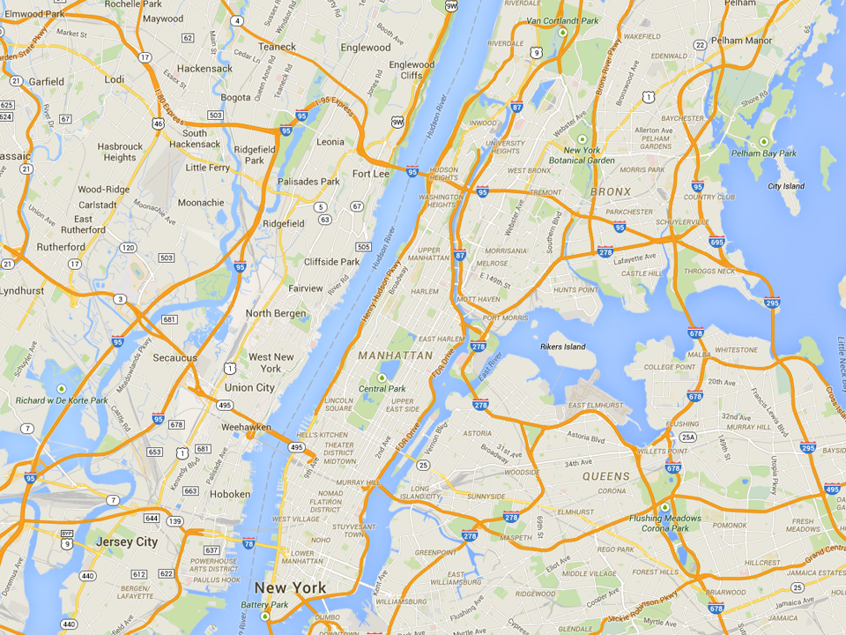
Most Common MTO Residential Locations in New York
Experimental
Wakefield Bronx
Section 8
Soundview Bronx
Control
King Towers
Harlem

Slide 27
MTO Experiment: Exposure Effects?
Prior research on MTO:
  Little impact of moving to a better area on earnings and other economic outcomes
    Rejects “Spatial Mismatch Hypothesis” of Kain (1968)
  But work has focused on adults and older youth at point of move
  [e.g., Kling, Liebman, and Katz 2007]
What about the young kids?
Chetty, Hendren, Katz. “The Effects of Exposure to Better Neighborhoods on Children: New Evidence from the Moving to Opportunity Experiment”
Does MTO improve outcomes for children who moved when young?

Slide 28
Impacts of MTO on Children Below Age 13 at Random Assignment
(a) Individual Earnings (ITT)
(b) Individual Earnings (TOT)
17000
17000
15000
15000
13000
13000
Individual Income at Age ≥ 24 ($)
Individual Income at Age ≥ 24 ($)
11000
11000
9000
9000
$11,270
$12,380
$12,894
$11,270
$12,994
$14,747
7000
p = 0.101
p = 0.014
7000
p = 0.101
p = 0.014
5000
5000
Control
Section 8
Experimental
Voucher
Control
Section 8
Experimental
Voucher

Slide 29
Impacts of Experimental Voucher by Age of Earnings Measurement
For Children Below Age 13 at Random Assignment
3000
2000
Experimental Vs. Control ITT on Earnings ($)
1000
0
-1000
20
21
22
23
24
25
26
27
28
Age of Income Measurement

Slide 30
Impacts of Experimental Voucher by Age of Earnings Measurement
3000
2000
Below 13 at RA
Experimental Vs. Control ITT on Earnings ($)
1000
0
Above 13 at RA
-1000
20
21
22
23
24
25
26
27
28
Age of Income Measurement

Slide 31
Impacts of MTO on Children Below Age 13 at Random Assignment
(a) College Attendance (ITT)
(b) College Quality (ITT)
22000
20
21000
15
College Attendance, Ages 18-20 (%)
Mean College Quality, Ages 18-20 ($)
20000
10
5
16.5%
17.5%
19.0%
19000
$20,915
$21,547
$21,601
p = 0.435
p = 0.028
p = 0.014
p = 0.003
0
18000
Control
Section 8
Experimental
Voucher
Control
Section 8
Experimental
Voucher

Slide 32
Impacts of MTO on Children Below Age 13 at Random Assignment
(a) ZIP Poverty Share in Adulthood (ITT)
(b) Birth with no Father Present (ITT)
Females Only
25
50
23
37.5
21
Zip Poverty Share (%)
Birth with no Father on Birth Certificate (%)
25
19
17
23.8%
22.4%
22.2%
12.5
33.0%
31.7%
28.2%
p = 0.047
p = 0.008
p = 0.610
p = 0.042
15
0
Control
Section 8
Experimental
Voucher
Control
Section 8
Experimental
Voucher

Slide 33
Chyn (2018): Public Housing Demolitions
Past 50+ years saw a dramatic rise and fall of public housing in the US
  Watch the “Pruett Igoe Myth” on YouTube
Eric Chyn’s JMP (AER 2018) studies the causal effect of public housing demolitions in Chicago on children’s long run outcomes
  Exploits long sequencing of Hope VI demolitions
  Compare neighboring buildings (demolished vs. not demolished)

Slide 34
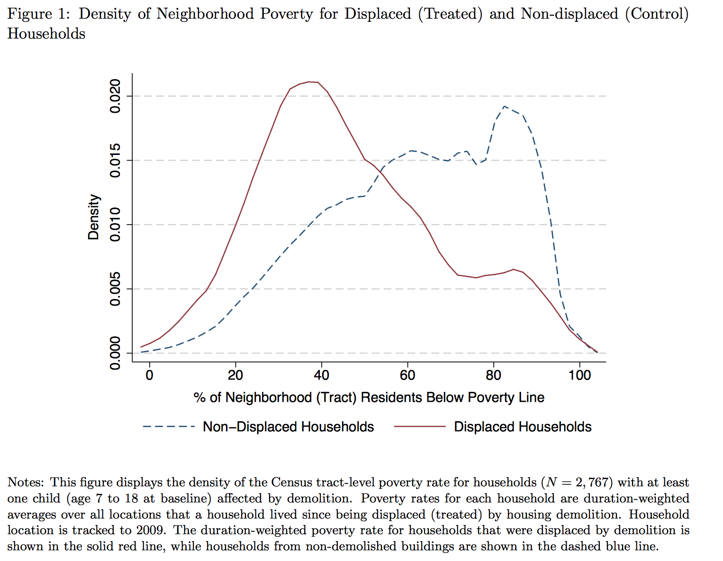

Slide 35
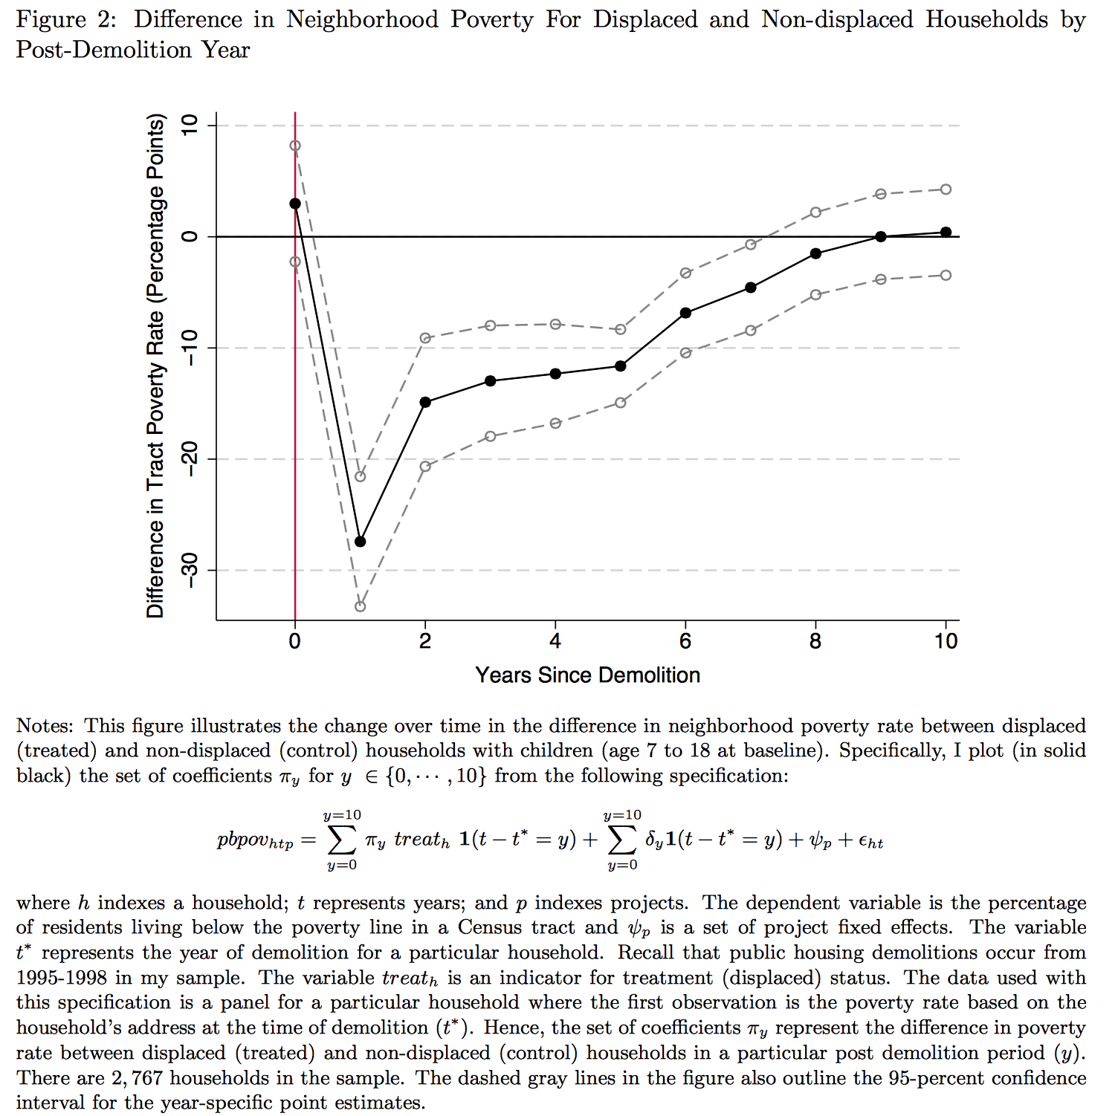

Slide 36
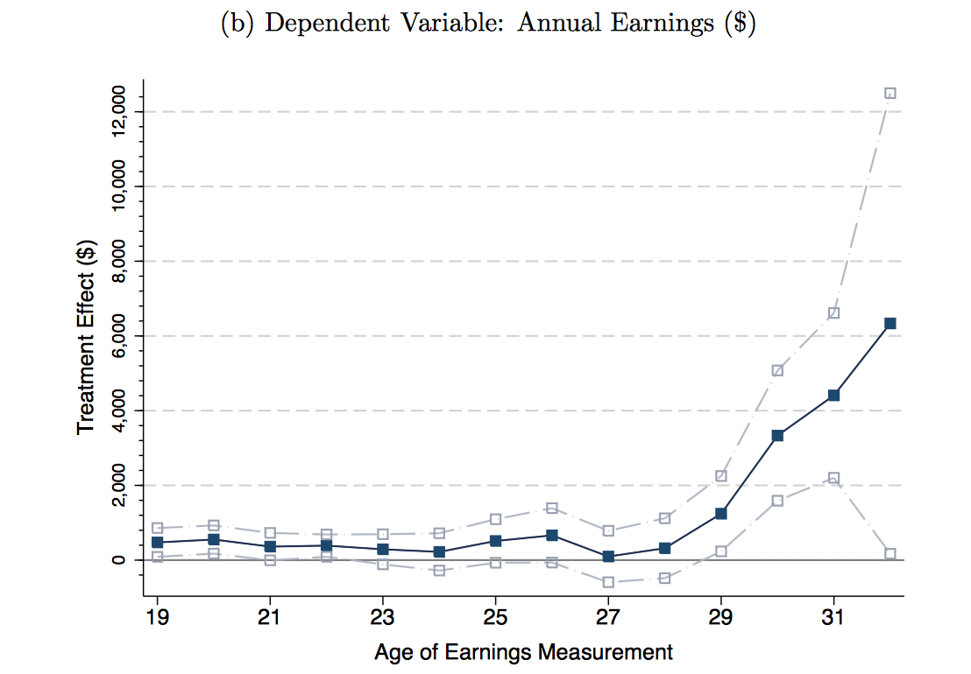

Slide 37
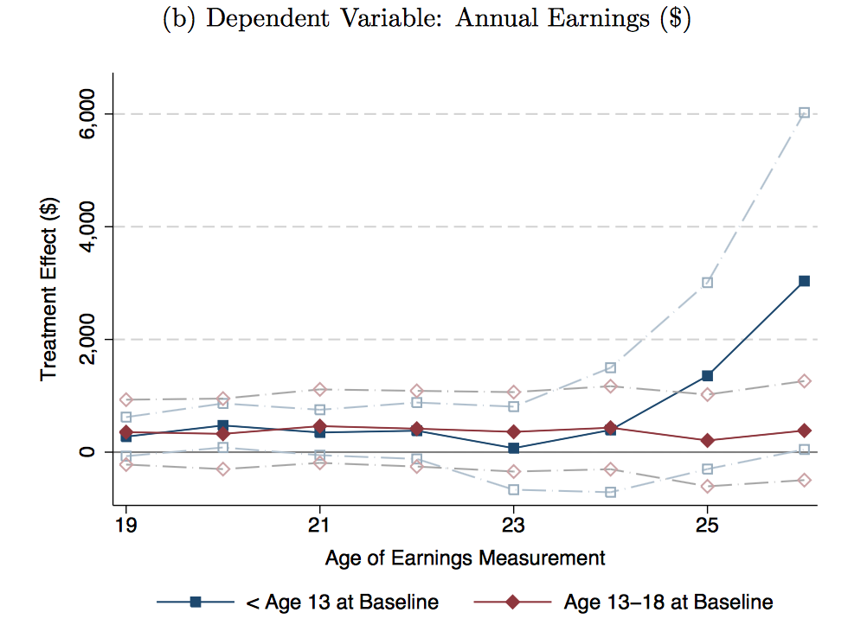

Slide 38
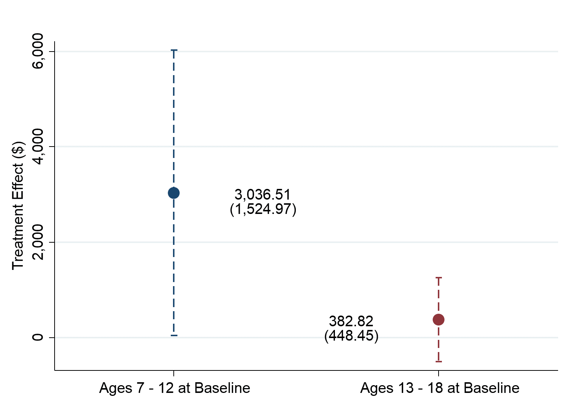
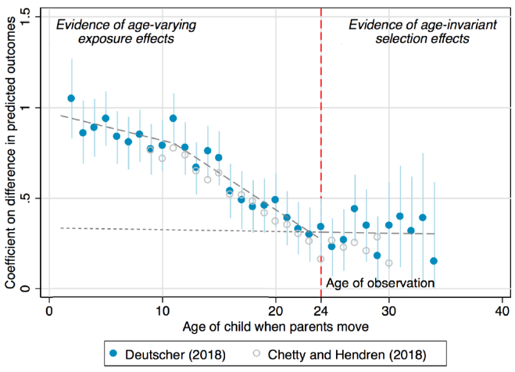
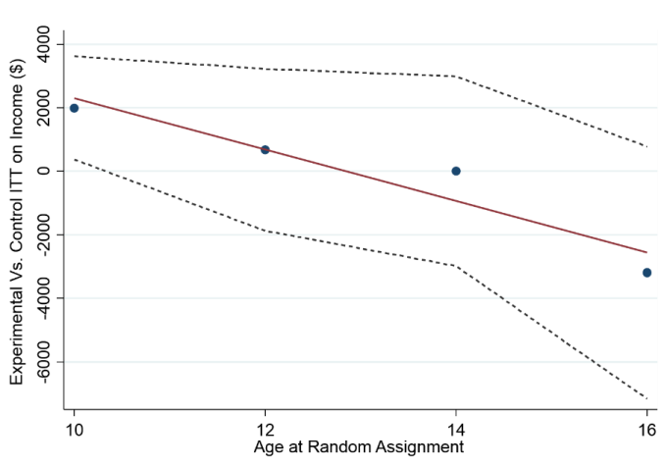
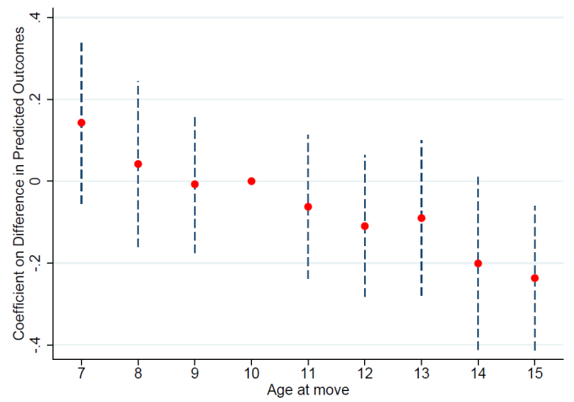
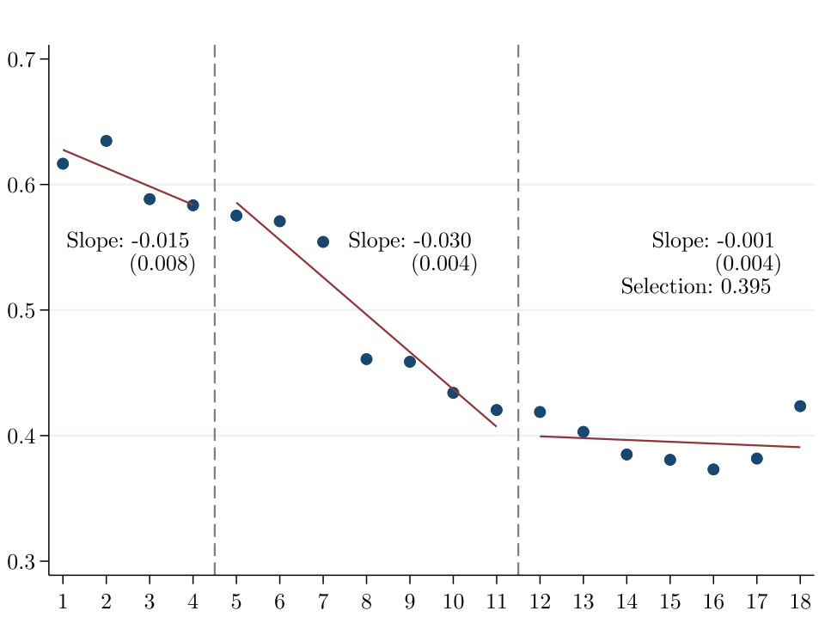
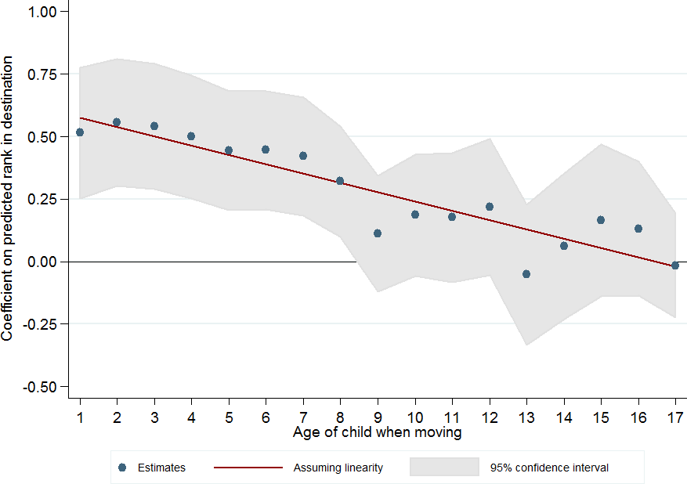
Childhood Exposure Effects Around the World
MTO Experiment
Baltimore, Boston, Chicago, LA, NYC
Public Housing Demolitions
Chicago
Australia
Age at Random Assignment
Age at Move
Source: Chetty, Hendren, Katz (AER 2016)
Source: Chyn (AER 2018)
Source: Deutscher (AEJ Applied 2019)
Denmark
Canada
Africa
Exposure Effect, Average IM-Difference
Age at Move
Age at Move
Age at Move
Source: Faurschou (2018)
Source: Laliberté (AEJ: Econ Policy 2021)
Source: Alesina, Hohmann, Michalopoulos, Papaioannou (Econometrica 2020)

Slide 39
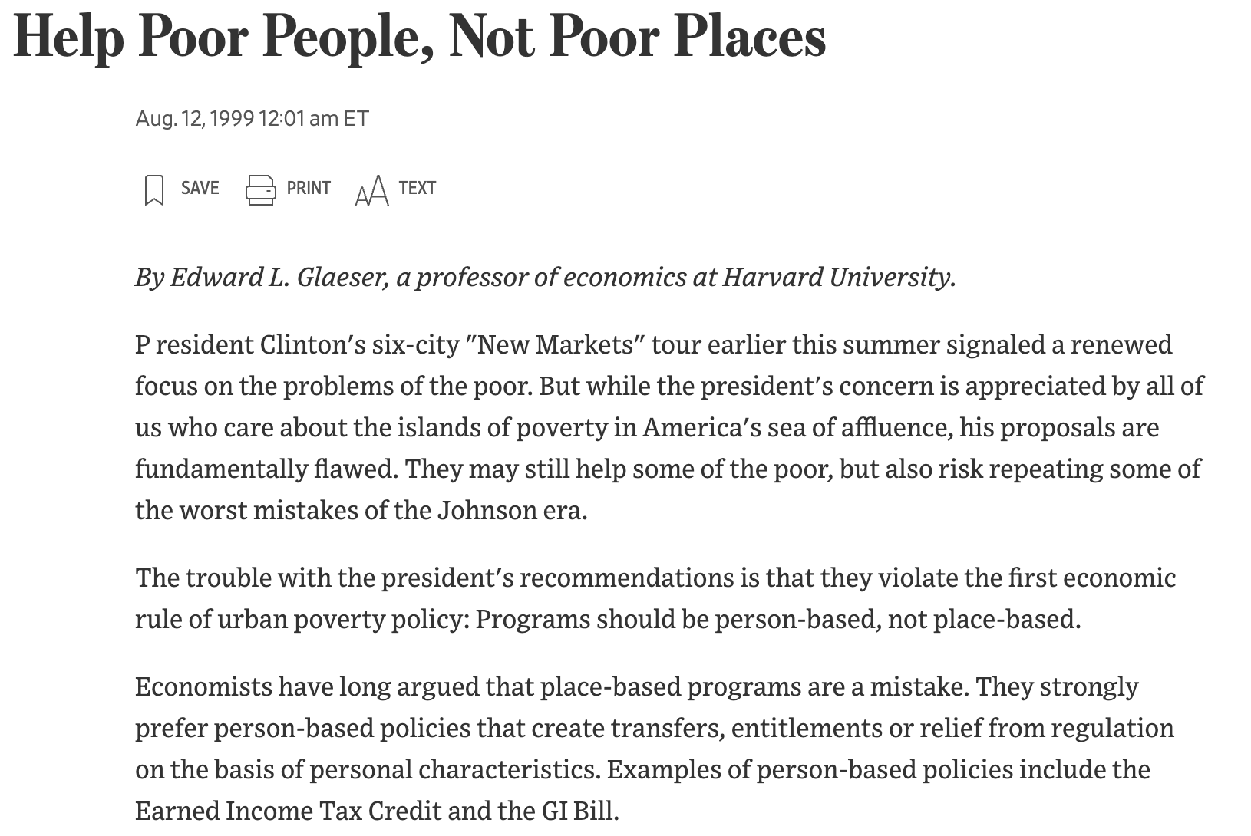
Part 2: If Place Matters, What Should We Do About It?
https://www.wsj.com/articles/SB934404174689915612
Notes:
XX Raj: See edit

Slide 40
If Place Matters, What Should We Do About It?
Incidence: Place based policy may not have the desired incidence
  Rosen-Roback model shows that if people are sufficiently mobile, then place-based policies have incidence on landowners, not workers
  See the rest of Owen Zidar’s 14.472 MIT lecture slides
Efficiency: Is place-based policy more vs. less efficient than giving (the same or similar) people cash?
Same questions arise for other policies:
  Healthcare/Medicaid
  Food stamps
  Disability Insurance
Notes:
XX Raj: See edit

Slide 41
If Place Matters, What Should We Do About It?
Kaplow (1996, 2004, 2006, 2008, …) provides the general argument for why income tax based redistribution can be the most efficient
  If location is like any other choice of a good, then tax schedule is generally efficient
  Are there externalities or frictions in choice?
Bergmann et al. (2019) study search “frictions” in choosing where to live
Focused on housing vouchers and the broad fact that 80% of housing vouchers are used in high poverty neighborhoods
Notes:
XX Raj: See edit

Slide 42
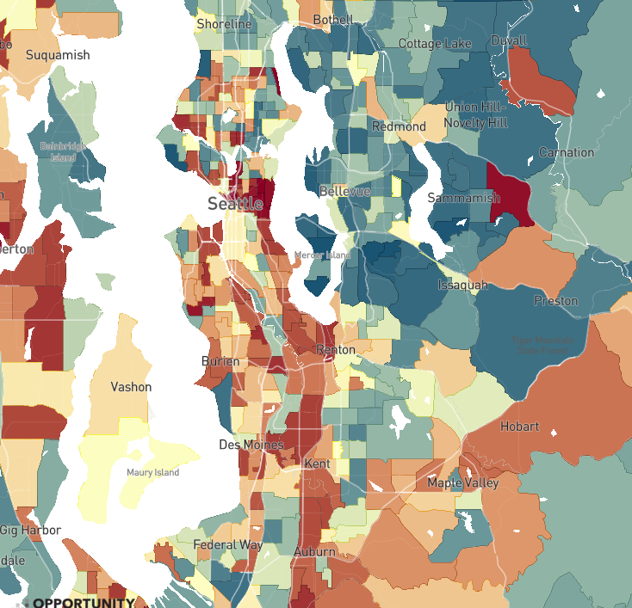
The Geography of Upward Mobility in Seattle
Average Income at Age 35 for Children with Parents Earning $27,000 (25th percentile)
North Queen Anne
$44k
Percentile Rank in Adulthood
> 60 ($55k)
Eastgate
$43k
Central District
$26K
48 ($39k)
< 30 ($20k)
Source: Chetty, Friedman, Hendren,
Jones, Porter (2018)
Notes:
--So I’ll just highlight the local variation. This is a map of Seattle, which is the site of our study. And you can see areas in red where kids from low-income families grow up to have relatively low earnings, such as here in Central District. But there are areas nearby, shaded in blue, where kids grow up to have higher incomes, such as North Queen Anne.
Notes: ~5 miles between each other

Slide 43
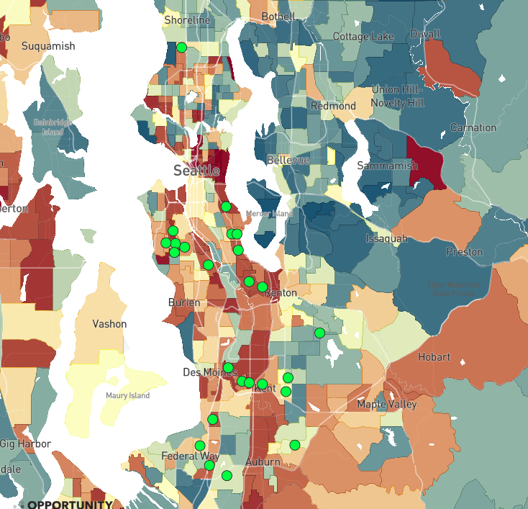
Most Common Locations of Families Receiving Housing Vouchers
25 most common tracts where voucher holders lived before the CMTO experiment
Percentile Rank in Adulthood
> 60 ($55k)
48 ($39k)
< 30 ($20k)
Notes:
-Despite this goal, you can see here that most families cluster in low-opportunity areas. Each of these dots marks one of the 25 most common areas voucher recipients live. 76% of voucher families live in below median upward mobility neighborhoods.
-So this raises the question of why do we see this segregation of low-income families into low-opportunity neighborhoods?

Slide 44
The Price of Opportunity in Seattle and King County
Upward Mobility versus Median Rent by Neighborhood
60
50
with Low-Income Parents ($1000)
Average Incomes of Children
40
30
20
500
1000
1500
2000
2500
Median 2-Bedroom Rent in 2015
Notes:
Correlation of rents and upward mobility only 0.25 in King County

Slide 45
The Price of Opportunity in Seattle and King County
Upward Mobility versus Median Rent by Neighborhood
60
Opportunity Bargains
50
North Queen Anne
with Low-Income Parents ($1000)
Average Incomes of Children
40
30
Central District
20
500
1000
1500
2000
2500
Median 2-Bedroom Rent in 2015
Notes:
Here we see the two neighborhoods I showed you earlier, and we can see the median rent is the same, despite their drastic difference in economic mobility.

Slide 46
Question: Why Don’t Low-Income Families Move to Opportunity?
Two classes of explanations:
  Preferences: families may prefer to stay in current neighborhoods because of other amenities (e.g., commute time, proximity to family)
  Barriers: families may be unable to find housing in high-opportunity areas because of lack of information, search frictions, or landlords’ tastes
If barriers are what is driving segregation, can we reduce them through changes in affordable housing policy?
Notes:
-- To test between these two explanations, we worked with the Seattle and King County Housing Authorities to design Creating Moves to Opportunity, or CMTO, which aims to reduce the constraints and frictions that prevent families from moving to opportunity areas

Slide 47



Creating Moves
to Opportunity in Seattle and King County
Randomized trial to develop and test policy-scalable strategies to reduce barriers housing choice voucher recipients face in moving to high-opportunity areas in Seattle and King County

Slide 48
Definition of Opportunity Areas
Intervention focuses on families with young children (1+ child below age 15)
Therefore, use Opportunity Atlas to define “opportunity areas” as places where historically children from low income families have had the highest upward mobility
Starting point: Census tracts in top third of distribution within Seattle (SHA) and King County (KCHA)
Adjust definitions in collaboration with housing authorities to account for two issues:
  Neighborhood change (using test score data to assess stability)
  Creating contiguous areas

Slide 49
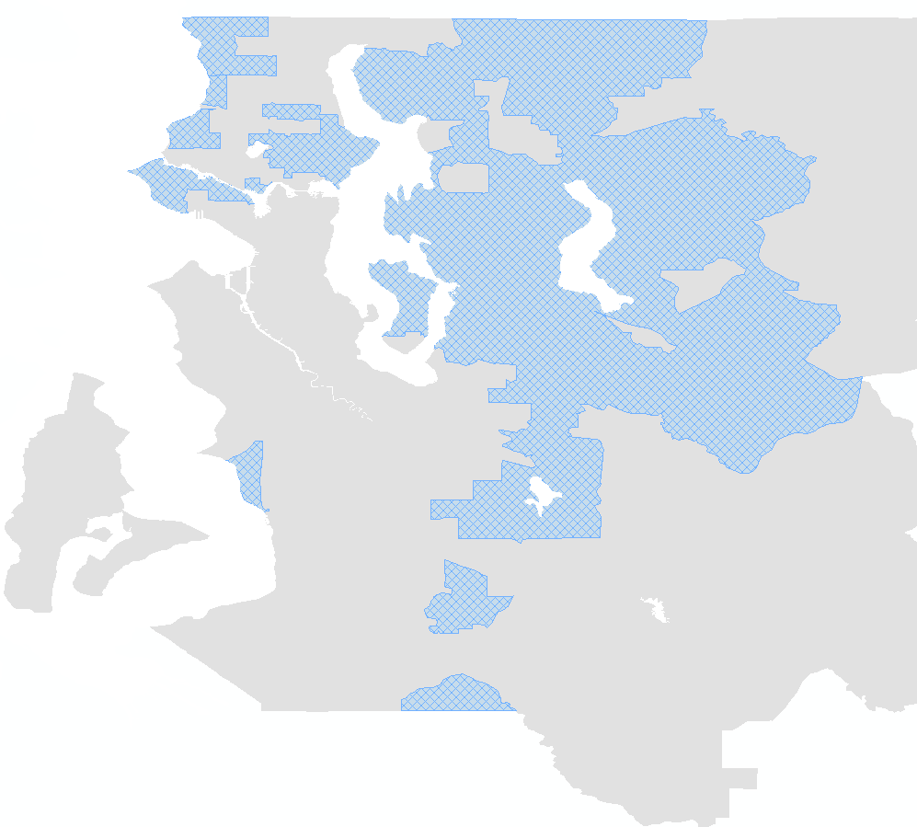
Designation of High-Opportunity Neighborhods
Shoreline
Cottage Lake
Lake City
Inglewood
High-Opportunity
Area
Seattle City Boundary
Northeast Seattle
Redmond
Magnolia
Central District
Bellevue
West Seattle
Rainier
Valley
Newport
Cougar
Mountain
Issaquah
Burien
Tukwila
East Hill
Des Moines
Kent
Lea Hill, Auburn

Slide 50
Treatment Interventions
CUSTOMIZED
SEARCH
ASSISTANCE
DIRECT
LANDLORD
ENGAGEMENT
SHORT-TERM FINANCIAL ASSISTANCE
On average, non-profit staff spend 6.3 hours with each household
52% of rentals in high-opportunity areas made through links via non-profit staff
Average financial assistance of $1,100 for security deposits, application fees, etc.
Program Cost: $2,600 per family issued a voucher
(2.2% of average voucher payments over 7 years)
Note: Families not required to move to high-opportunity areas

Slide 51
Fraction of Families Who Leased Units in High Opportunity Areas
60
50
40
30
to High Opportunity Areas
Share of Households Who Have Moved
20
10
0
Control
Treatment

Slide 52
Fraction of Families Who Leased Units in High Opportunity Areas
60
50
40
30
to High Opportunity Areas
Share of Households Who Have Moved
20
Historical mean
rate: 11.6%
10
0
Control
Treatment

Slide 53
Fraction of Families Who Leased Units in High Opportunity Areas
60
50
40
30
to High Opportunity Areas
Share of Households Who Have Moved
20
14.3%
Historical mean
rate: 11.6%
10
0
Control
Treatment

Slide 54
Fraction of Families Who Leased Units in High Opportunity Areas
60
54.3%
50
40
30
to High Opportunity Areas
Share of Households Who Have Moved
20
14.3%
Historical mean
rate: 11.6%
10
0
Control
Treatment
Difference:
40.0 pp
SE: (5.2)

Slide 55
Fraction Who Has Leased Any Unit within Six Months of Voucher Issuance
Notes:
Contrast to MTO mandatory program where Experimental group had much lower lease-up rate (47%) than Section 8 group (62%) --- voluntary program with assistance hugely increases opportunity moves without reducing lease-up rate

Slide 56
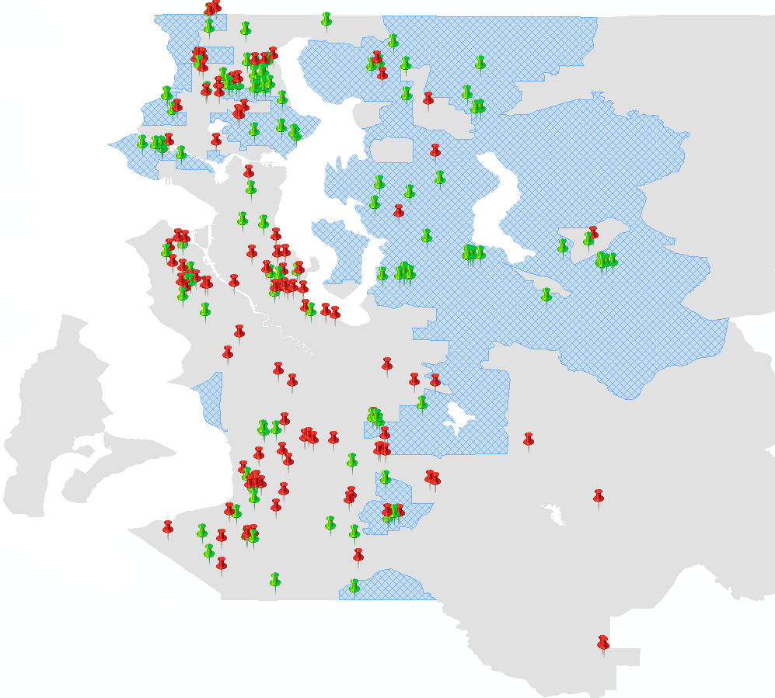


Destination Locations for Families that Leased Units Using Housing Vouchers
Lake City
Inglewood
High-Opportunity
Area
Northeast Seattle
Magnolia
Central District
Control
Bellevue
CMTO
Treatment
West Seattle
Cougar
Mountain
Issaquah
Rainier
Valley
Newport
Burien
Tukwila
East Hill
Des Moines
Kent
Lea Hill, Auburn
Notes:
CMTO treatment families not bunched at cut-off or in same neighborhoods spread out in high opportunity areas 77 treatment movers in 35 distinct Census tracts

Slide 57
Satisfaction with New Neighborhoods
Based on Surveys Six Months Post-Move
Satisfaction with
New Neighborhood
Certainty about Wanting
to Stay in New Neighborhood
Notes:
Can’t see persistence in new neighborhoods yet but follow-up survey after moves shows huge increase in neighborhood satisfaction and desire to stay in new neighborhood for treatment group

Slide 58
Persistence in Opportunity Neighborhoods

Slide 59
Phase 2 Treatment: Fraction who Move to Opportunity
Control
Financial+Info.
Partial Services
CMTO

Slide 60
Summary
Dosage of navigator services affects moves to opportunity, not information and financial help
Segregation Largely Driven by Barriers, not Preferences
  Vouchers / income transfers do not lead to moves to opportunity
  Argument for mobility services? How about place-based investments?
  Similar frictions observed in other contexts such as health insurance, take up of govt benefits, etc?

Slide 61
Politics / Endogeneity of Policies / GE Effects
Lastly, we’ve ignored the political history for where we got to today
Some people don’t like low-income / minorities living nearby
Are the “barriers” to moving to opportunity the result of an intentional historical policy response? What does this mean for future policy?

Slide 62
Derenoncourt (2021)
Derenoncourt 2021 AER studies the causal effect of in-migration of black residents on the upward mobility of those destination locations
Background: Large variation in upward mobility, but also large race gaps within every metro area in the US

Slide 63
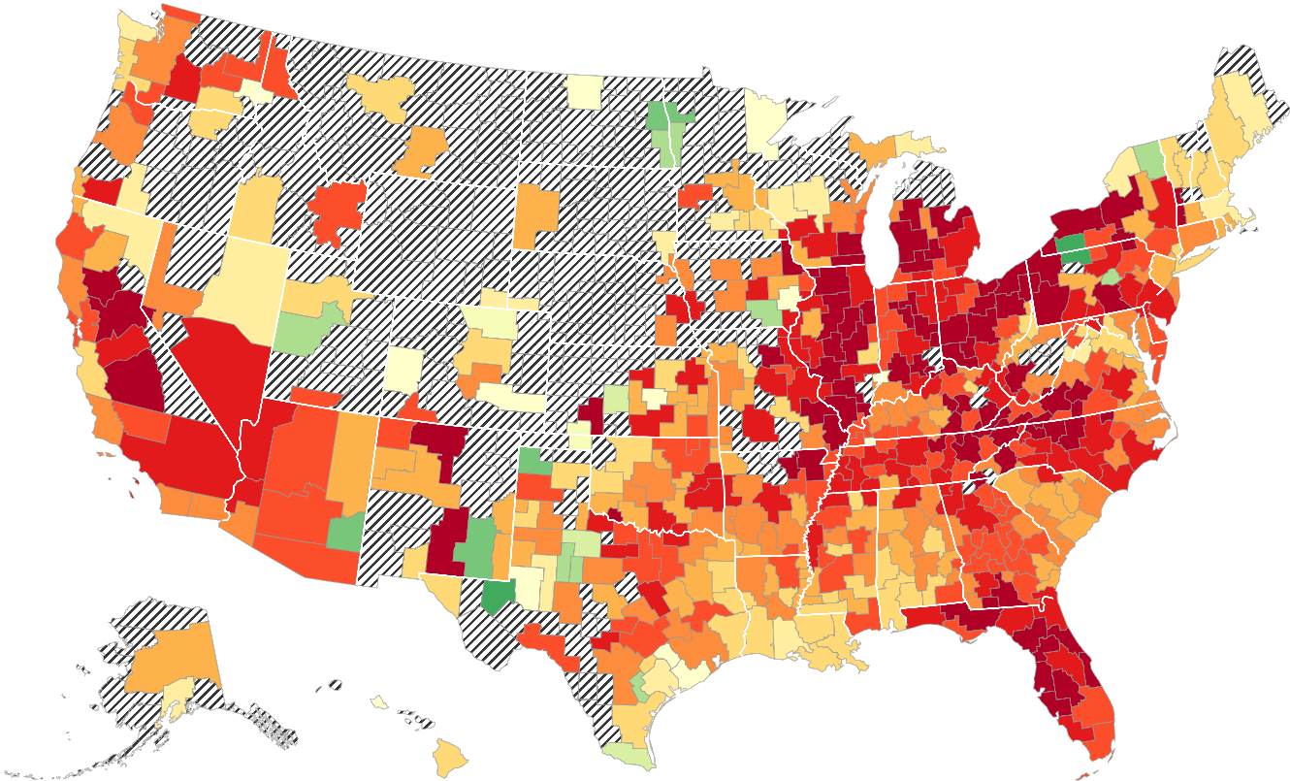
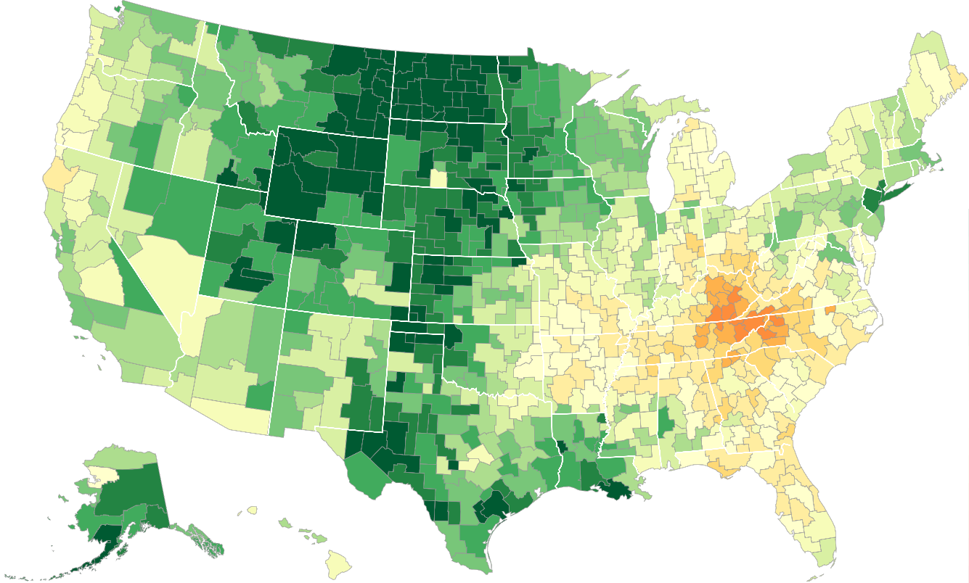
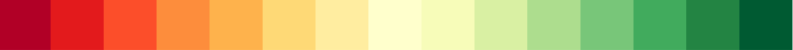
Chetty Hendren Jones Porter 2020: The Geography of Upward Mobility by Race
Average Individual Income for Boys with Parents Earning $25,000 (25th percentile)
Black Men
White Men
Boston
$31k
Boston
$24k
Newark
$20k
Newark
$32k
San
Francisco
$19k
San
Francisco
$31k
Atlanta
$18k
Atlanta
$26k
<36.5
($17k)
45.8
($25k)
>56.9
($35k)
Note: Green = More Upward Mobility, Red = Less Upward Mobility; Grey = Insufficient Data

Slide 64
Endogenous Place Effects on the Race Gap
Are these race gaps the result of policy responses within those places?
If people move to a new place, is there an endogenous response in that destination that changes the upward mobility of the place?
Derenoncourt (2021): Local policies and mobility outcomes are endogenous to historical shifts in racial composition generated through the Great Migration
Source: Derenoncourt (2021)

Slide 65
The Great Migration
Source: Derenoncourt (2021)

Slide 66
What Happened in the Destination Locations?

Slide 67
Source: Derenoncourt (2021)

Slide 68
Places with Greater Black Migration Have Lower Upward Mobility Today
Source: Derenoncourt (2021)

Slide 69
Endogenous Place Effects on the Race Gap
Need exogenous variation in inflow of black migrants
Shift-share instrument:
  Predict black population using interaction of migration shares from each origin to each destination multiplied by predicted migration from each origin
Source: Derenoncourt (2021)

Slide 70
Places with Higher Predicted In-Migration Have Lower Up. Mobility Today
Source: Derenoncourt (2021)

Slide 71
Two Channels for Results
Greater in-migration in the 1940-70s caused lower upward mobility today
Broadly, there are two potential explanations:
  Causal effect on Selection: In-migrants were persistently less upwardly mobile regardless of where they live
  Causal effect on the Causal Effect: In-migration led to structural changes in the destination locations that caused the place to have lower mobility for everyone
Two tests:
  Race-specific effects
  Effect on causal effect of place from Chetty and Hendren (2018B)
Source: Derenoncourt (2021)

Slide 72
Inflow of Black Migration led to Lower Migration for Black Residents
Source: Derenoncourt (2021)

Slide 73
Inflow of Black Migration led to Lower Migration for Black Residents
Source: Derenoncourt (2021)

Slide 74
Inflow of Black Migration Expanded Black-White Race Gap in Up. Mobility
Source: Derenoncourt (2021)

Slide 75
Inflow of Black Migration led to Lower
Causal Exposure Effects from Chetty and Hendren (2018)
Source: Derenoncourt (2021)

Slide 76
Impact on Local Government Spending
Source: Derenoncourt (2021)

Slide 77
Impact on Private School Enrollment
Source: Derenoncourt (2021)

Slide 78
Impact on Police Expenditure
Source: Derenoncourt (2021)

Slide 79
Impact on Incarceration Rates
Source: Derenoncourt (2021)

Slide 80
Conclusion
Places have causal effects on children’s long-term outcomes
  Also evidence place has causal effects on health outcomes
Rationale for policy intervention rests on place being different from other consumption goods
  Evidence of significant barriers in choosing where to live
  And endogenous policy responses in destination locations
Areas for future work:
  Welfare impacts of place-based investments (as opposed to choice-based policies)
  Relative welfare impact of place-based vs. person-based policies
  Endogenous policy responses / political economy of place and location choices
  Implications for federal vs. local policymaking / fiscal federalism

Slide 81
Appendix: Causal Fixed Effects and Optimal Shrinkage
What neighborhoods have the highest causal effect on children’s outcomes?
Note the observed variation across places contains both sorting and causal components
  2/3 may be causal, but 1/3 is still sorting
Objectives:
Can we construct unbiased estimates of the true causal effect?
Can we construct optimal forecasts of the place with the highest causal effect?
Key question: Why are these objectives different?

Slide 82
Causal Effects of Each County
Chetty and Hendren (2018b) estimate causal effects of each county and CZ in the U.S. on children’s earnings in adulthood
  Estimate ~3,000 treatment effects (one per county) instead of one average exposure effect
Notes:
that each year of childhood exposure to a 1 percentile better CZ/county raises earnings by about 0.035 percentiles
Extrapolating over 20 years of childhood, implies that causal effects of place account for 70% of variance in intergen. mobility across areas
This analysis shows

Slide 83
Estimating County Fixed Effects
Begin by estimating effect of each county using a fixed effects model that is identified using variation in timing of moves between areas
Intuition for identification: suppose children who move from Manhattan to Queens at younger ages earn more as adults
  Can infer that Queens has positive exposure effects relative to Manhattan

Slide 84
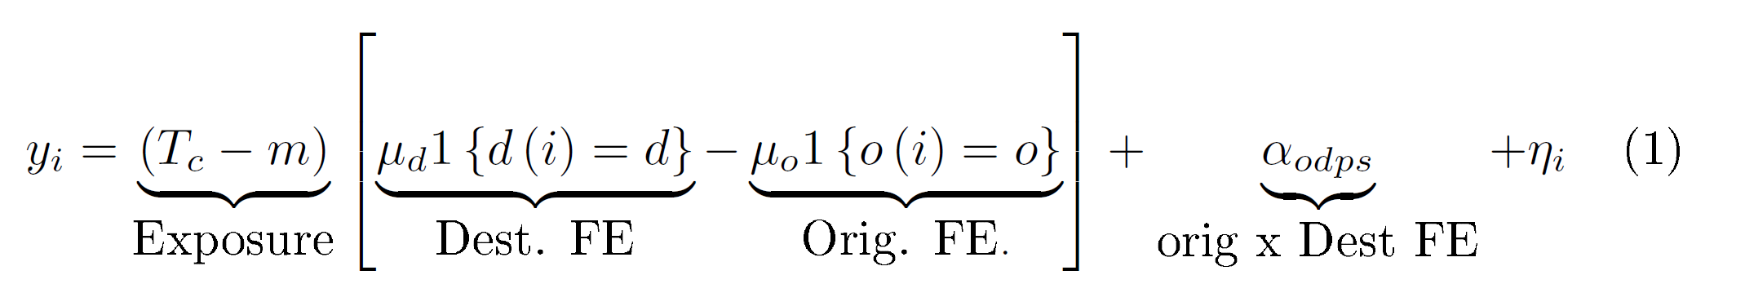
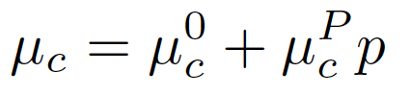
Estimating County Fixed Effects
Estimate place effects μ = (μ₁,…,μ_{N}) using fixed effects for origin and destination interacted with exposure time:
Place effects are allowed to vary linearly with parent income rank:
Include origin-by-destination fixed effects to isolate variation in exposure
What is the identification condition?

Slide 85
Causal Effect Estimates vs. Permanent Resident Outcomes
Income Rank at Age 26 for Children with Parents at 25th Percentile
0.5
Seattle
Washington DC
Minneapolis
Cleveland
San Diego
Philadelphia
Newark
Boston
0
Miami
Phoenix
San Francisco
Causal Effect of 1 Year of Exposure on Child’s Rank
Sacramento
Baltimore
Dallas
Pittsburgh
Houston
Detroit
Bridgeport
Atlanta
New York
Chicago
Los Angeles
-0.5
38
40
42
44
46
48
Mean Percentile Rank of Children of Permanent Residents

Slide 86
Causal Effect Estimates vs. Permanent Resident Outcomes
Income Rank at Age 26 for Children with Parents at 25th Percentile
0.5
Seattle
Washington DC
Minneapolis
Cleveland
San Diego
Philadelphia
Newark
Boston
0
Miami
Phoenix
San Francisco
Causal Effect of 1 Year of Exposure on Child’s Rank
Sacramento
Baltimore
Dallas
Pittsburgh
Houston
Detroit
Bridgeport
Atlanta
New York
Chicago
Los Angeles
-0.5
38
40
42
44
46
48
Mean Percentile Rank of Children of Permanent Residents

Slide 87
Causal Effect Estimates vs. Permanent Resident Outcomes
Income Rank at Age 26 for Children with Parents at 25th Percentile
0.5
Seattle
Washington DC
Minneapolis
Cleveland
San Diego
Philadelphia
Newark
Boston
0
Miami
Phoenix
San Francisco
Causal Effect of 1 Year of Exposure on Child’s Rank
Sacramento
Baltimore
Dallas
Pittsburgh
Houston
Detroit
Bridgeport
Atlanta
New York
Chicago
Los Angeles
-0.5
38
40
42
44
46
48
Mean Percentile Rank of Children of Permanent Residents

Slide 88
Causal Effect Estimates vs. Permanent Resident Outcomes
Income Rank at Age 26 for Children with Parents at 25th Percentile
0.5
Movers in Cleveland do better than would be predicted based on permanent resident outcomes
Seattle
Washington DC
Minneapolis
Cleveland
San Diego
Philadelphia
Newark
Boston
0
Miami
Phoenix
San Francisco
Causal Effect of 1 Year of Exposure on Child’s Rank
Sacramento
Baltimore
Dallas
Pittsburgh
Houston
Detroit
Bridgeport
Atlanta
New York
Chicago
Los Angeles
-0.5
38
40
42
44
46
48
Mean Percentile Rank of Children of Permanent Residents

Slide 89
Causal Effect Estimates vs. Permanent Resident Outcomes
Income Rank at Age 26 for Children with Parents at 25th Percentile
0.5
Two explanations:
Seattle
Washington DC
Minneapolis
Cleveland
San Diego
Philadelphia
Newark
Boston
0
Miami
Phoenix
San Francisco
Causal Effect of 1 Year of Exposure on Child’s Rank
Sacramento
Baltimore
Dallas
Pittsburgh
Houston
Detroit
Bridgeport
Atlanta
New York
Chicago
Los Angeles
-0.5
38
40
42
44
46
48
Mean Percentile Rank of Children of Permanent Residents

Slide 90
Causal Effect Estimates vs. Permanent Resident Outcomes
Income Rank at Age 26 for Children with Parents at 25th Percentile
0.5
Two explanations:
Causal effects are noisy,
Seattle
Washington DC
Minneapolis
Cleveland
San Diego
Philadelphia
Newark
Boston
0
Miami
Phoenix
San Francisco
Causal Effect of 1 Year of Exposure on Child’s Rank
Sacramento
Baltimore
Dallas
Pittsburgh
Houston
Detroit
Bridgeport
Atlanta
New York
Chicago
Los Angeles
-0.5
38
40
42
44
46
48
Mean Percentile Rank of Children of Permanent Residents

Slide 91
Causal Effect Estimates vs. Permanent Resident Outcomes
Income Rank at Age 26 for Children with Parents at 25th Percentile
0.5
Two explanations:
Causal effects are noisy
Permanent residents are biased
Seattle
Washington DC
Minneapolis
Cleveland
San Diego
Philadelphia
Newark
Boston
0
Miami
Phoenix
San Francisco
Causal Effect of 1 Year of Exposure on Child’s Rank
Sacramento
Baltimore
Dallas
Pittsburgh
Houston
Detroit
Bridgeport
Atlanta
New York
Chicago
Los Angeles
-0.5
38
40
42
44
46
48
Mean Percentile Rank of Children of Permanent Residents

Slide 92
Causal Effect Estimates vs. Permanent Resident Outcomes
Income Rank at Age 26 for Children with Parents at 25th Percentile
0.5
Seattle
Washington DC
Minneapolis
Cleveland
San Diego
Philadelphia
Newark
Boston
0
Miami
Phoenix
San Francisco
Causal Effect of 1 Year of Exposure on Child’s Rank
Sacramento
Baltimore
Dallas
Pittsburgh
Houston
Detroit
Bridgeport
Atlanta
New York
Chicago
Los Angeles
-0.5
38
40
42
44
46
48
Mean Percentile Rank of Children of Permanent Residents

Slide 93
Causal Effect Estimates vs. Permanent Resident Outcomes
Income Rank at Age 26 for Children with Parents at 25th Percentile
0.5
Classic bias-variance tradeoff: noisy causal effect estimates but biased (precise) predictions based on permanent residents
Seattle
Washington DC
Minneapolis
Cleveland
San Diego
Philadelphia
Newark
Boston
0
Miami
Phoenix
San Francisco
Causal Effect of 1 Year of Exposure on Child’s Rank
Sacramento
Baltimore
Dallas
Pittsburgh
Houston
Detroit
Bridgeport
Atlanta
New York
Chicago
Los Angeles
-0.5
38
40
42
44
46
48
Mean Percentile Rank of Children of Permanent Residents

Slide 94
Three Objectives
Use fixed effect estimates for three purposes:
Quantify the size of place effects: how much do places matter?
Construct forecasts that can be used to guide families seeking to “move to opportunity”
Characterize which types of areas produce better outcomes to provide guidance for place-based policies
Notes:
XX Nathan – put this slide back here so Katz and others can clearly see plan of paper; otherwise I worry they won’t be able to remember the takeaways. I think we should keep this one.
XX Nathan – also slightly rephrased bullet 3; I know we don’t want to overclaim here but I think this is a bit shorter and ok for intro…feel free to rephrase if you want

Slide 95
Objective 1: Magnitude of Place Effects
Can we just look at the variance of fixed effect estimates, ?
No….we can write: where is orthogonal sampling error
Total variance has two components:
Let s_{c} be the std error of the causal effect in place c,
So,
Variance of true place effects is given by
Notes:
XX Nathan see addition of bullet 1 – thought it was clearer to describe what we do here in one bullet – and addition of sub-bullet under 1, which I think is necessary b/c we switch between percentiles and percentages in many places (e.g. Chicago map) and it’s confusing without this

Slide 96
Objective 1: Magnitude of Place Effects
Chetty and Hendren (2016) estimate across counties for parents at 25th percentile:
So, or
1 year of exposure to a 1SD better place increases earnings by 0.18 percentiles
  To interpret units, note that 1 percentile ~= 3% change in earnings
For children with parents at 25th percentile: 1 SD better county from birth (20 years) → 3.6 percentiles → 10% earnings gain
Notes:
XX Nathan see addition of bullet 1 – thought it was clearer to describe what we do here in one bullet – and addition of sub-bullet under 1, which I think is necessary b/c we switch between percentiles and percentages in many places (e.g. Chicago map) and it’s confusing without this

Slide 97
Objective 2: Forecasts of Best and Worst Areas
What are the best and worst places to grow up?
Construct forecasts that minimize mean-squared-error of predicted impact for a family moving to a new area
Raw fixed effect estimates have high MSE because of sampling error
Reduce MSE by combining fixed effects (unbiased, but imprecise) with permanent resident outcomes (biased, but precise)
Common approach in recent literature:
  E.g. School effects combining causal effects from lotteries with school value-added estimates [Angrist, et al. 2016, QJE: “Leveraging Lotteries for School Value-Added: Testing and Estimation]
Notes:
XX Nathan note edit in language in last bullet
In largest counties, signal accounts for 75% of variance
But in most counties, more than half of the variance is due to noise

Slide 98
Optimal Forecasts Combining Fixed Effects and Permanent Resident Outcomes
0.4
0.2
Cleveland
Causal Effect of 1 Year of Exposure on Child's Rank
0.0
Santa Barbara
New York
-0.2
Chicago
-0.4
38
40
42
44
46
48
Mean Percentile Rank of Childen of Permanent Residents

Slide 99
Optimal Forecasts Combining Fixed Effects and Permanent Resident Outcomes
0.4
Causal effect point estimates, , are noisy
0.2
Cleveland
Causal Effect of 1 Year of Exposure on Child's Rank
0.0
Santa Barbara
New York
-0.2
Chicago
-0.4
38
40
42
44
46
48
Mean Percentile Rank of Childen of Permanent Residents

Slide 100
Optimal Forecasts Combining Fixed Effects and Permanent Resident Outcomes
0.4
0.2
Use forecasts based on
permanent residents,
Cleveland
Causal Effect of 1 Year of Exposure on Child's Rank
0.0
Santa Barbara
New York
-0.2
Chicago
-0.4
38
40
42
44
46
48
Mean Percentile Rank of Childen of Permanent Residents
Notes:
XX Nathan note change in language in text box

Slide 101
Optimal Forecasts of Place Effects
To derive optimal forecast, consider hypothetical experiment of randomly assigning children from an average place to new places
Regress outcomes on fixed-effect estimate, , and stayers prediction, where is de-meaned across places
Part 1 shows that , so that the regression coeffs are:
where:
  is residual variance of fixed effects
  is the noise variance of the fixed effects (=square of std error)

Slide 102
Optimal Forecasts Combining Fixed Effects and Permanent Resident Outcomes
0.4
Optimal forecast is weighted avg. of fixed effect estimate and permanent resident outcome, with weight proportional to precision of fixed effect
0.2
Cleveland
Causal Effect of 1 Year of Exposure on Child's Rank
0.0
Santa Barbara
New York
-0.2
Chicago
-0.4
38
40
42
44
46
48
Mean Percentile Rank of Childen of Permanent Residents
Notes:
XX Nathan note change in language in text box
Note: 1. new york is not affected much relative to causal effects, but large diff relative to perm res (make immigrants point)
2. Santa barbara goes towards perm res effect

Slide 103
Optimal Forecasts Combining Fixed Effects and Permanent Resident Outcomes
0.4
0.2
Predictions are forecast unbiased: 1pp higher predictions → 1pp higher causal effect on average
Cleveland
Causal Effect of 1 Year of Exposure on Child's Rank
0.0
Santa Barbara
New York
-0.2
Chicago
-0.4
38
40
42
44
46
48
Mean Percentile Rank of Childen of Permanent Residents
Notes:
Note: 1. new york is not affected much relative to causal effects, but large diff relative to perm res (make immigrants point)
2. Santa barbara goes towards perm res effect

Slide 104
Optimal Forecasts of Place Effects
To derive optimal forecast, consider hypothetical experiment of randomly assigning children from an average place to new places
Regress outcomes on fixed-effect estimate, , and stayers prediction, where is de-meaned across places
Part 1 shows that , so that the regression coeffs are:
where:
  is residual variance of fixed effects (constant across places)
  is the noise variance of the fixed effects (varies across places)

Slide 105
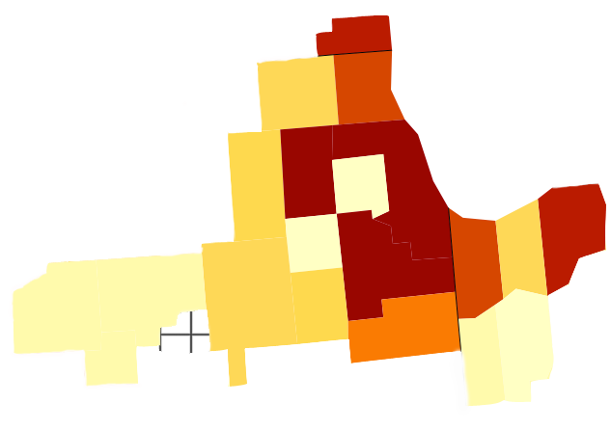
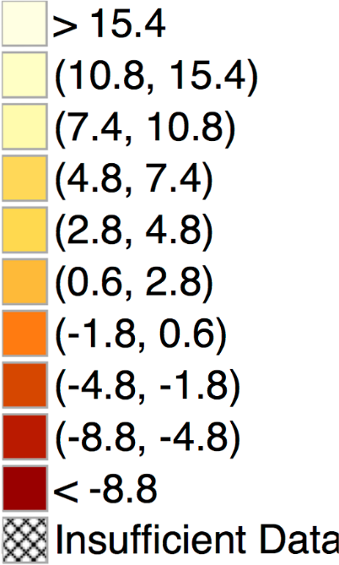
Causal Effects of Growing up in Different Counties on Earnings in Adulthood
For Children in Low-Income (25th Percentile) Families in the Chicago Metro Area
McHenry
DeKalb
Kane
Du
Page
Cook
LaPorte
> 0.77%
(0.54, 0.77)
(0.37, 0.54)
(0.24, 0.37)
(0.14, 0.24)
(0.03, 0.14
(-0.09, 0.03)
(-0.24, -0.09)
(-0.44, -0.24)
< -0.44%
Insufficient Data
Will
Lake
Porter
La Salle
Bureau
Grundy
DuPage: +0.76% per year
Cook: -0.67% per year
Notes:
XX Nathan – flag change to % units here
Note: mention Gatreaux here
Note: Raw fixed effect impact is actually larger: Cook is -0.16% (s.e. 0.10) for Cook and 1.7% (0.38) for DuPage; So, the difference is around 1.8, implying 20 years of exposure is about a 36% increase in earnings.

Slide 106
Causal Effects of Growing up in Different Counties on Earnings in Adulthood
For Children in Low-Income (25th Percentile) Families in the Chicago Metro Area
McHenry
DeKalb
Kane
Du
Page
Cook
LaPorte
> 0.77%
(0.54, 0.77)
(0.37, 0.54)
(0.24, 0.37)
(0.14, 0.24)
(0.03, 0.14
(-0.09, 0.03)
(-0.24, -0.09)
(-0.44, -0.24)
< -0.44%
Insufficient Data
Will
Lake
Porter
La Salle
Bureau
Grundy
DuPage: +0.76% per year
Cook: -0.67% per year
20 Years of Exposure to DuPage vs. Cook County generates ~30% increase in earnings
Notes:
Raw fixed effect impact is actually larger: Cook is -0.16% (s.e. 0.10) for Cook and 1.7% (0.38) for DuPage; So, the difference is around 1.8, implying 20 years of exposure is about a 36% increase in earnings.

Slide 107
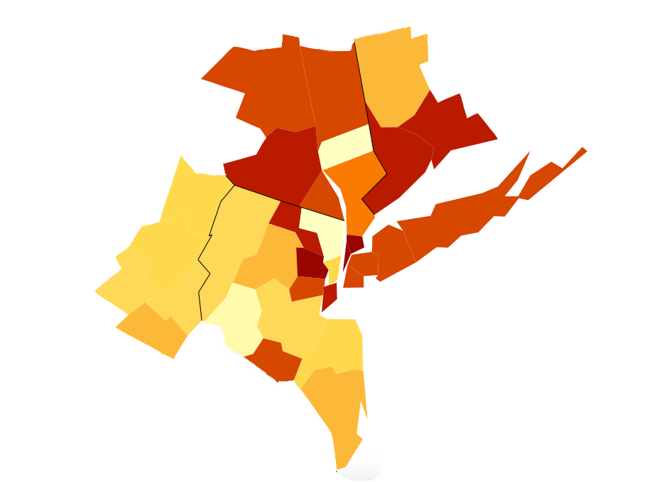
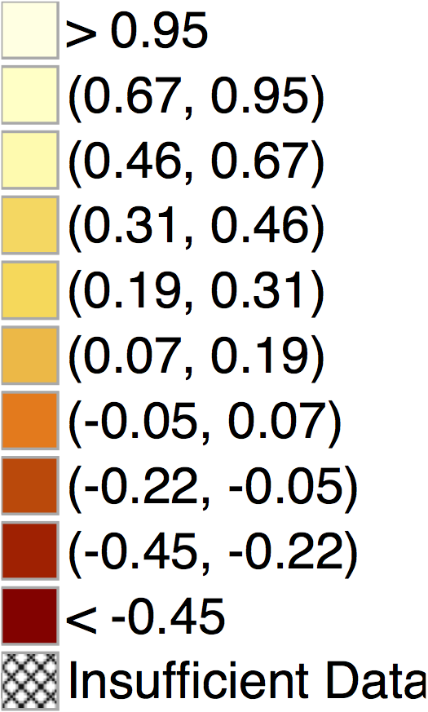
Exposure Effects on Income in the New York CSA
For Children with Parents at 25th Percentile of Income Distribution
Ulster
New Haven
Bergen
Suffolk
Bronx
Monroe
Queens
Brooklyn
Hudson
Ocean
Causal Exposure Effects Per Year:
Bronx NY: - 0.54 %
Bergen NJ: + 0.69 %

Slide 108
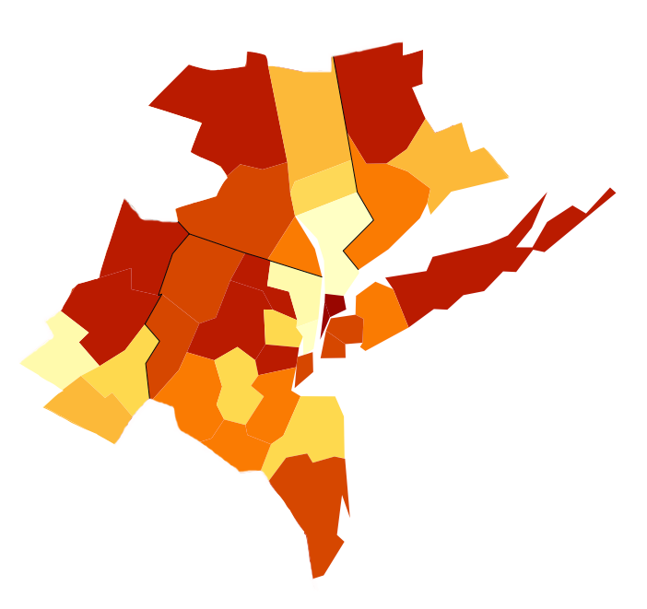
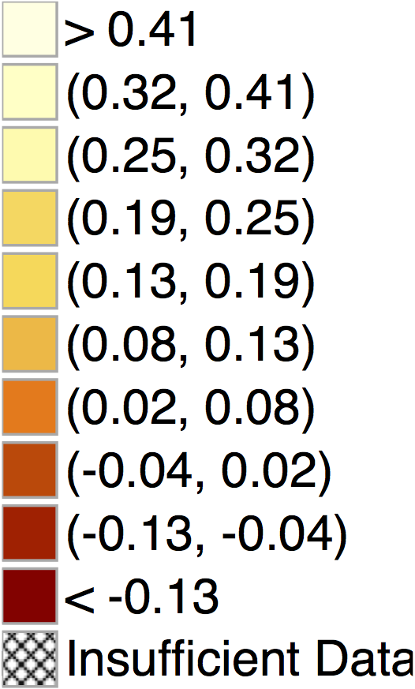
Exposure Effects on Income in the New York CSA
For Children with Parents at 75th Percentile of Income Distribution
Ulster
New Haven
Bergen
Suffolk
Bronx
Monroe
Queens
Brooklyn
Hudson
Ocean
Causal Exposure Effects Per Year:
Bronx NY: - 0.42 %
Bergen NJ: + 0.31 %

Slide 109
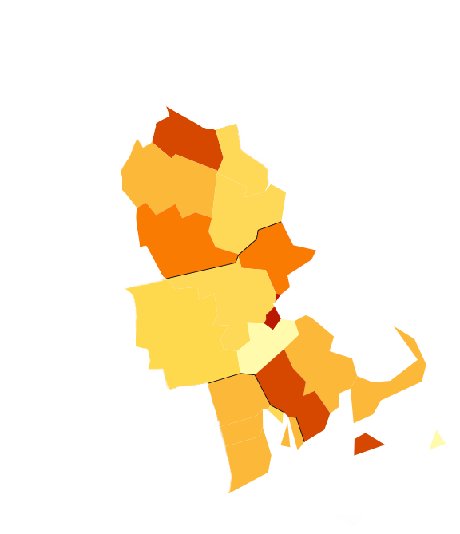
Exposure Effects on Income in the Boston CSA
For Children with Parents at 25th Percentile of Income Distribution
Belknap
Merrimack
Essex
Middlesex
Suffolk
Worcester
Norfolk
Plymouth
Provi-
dence
Barnstable
Causal Exposure Effects Per Year:
Suffolk MA: - 0.31 %
Middlesex MA: + 0.39 %
Newport

Slide 110
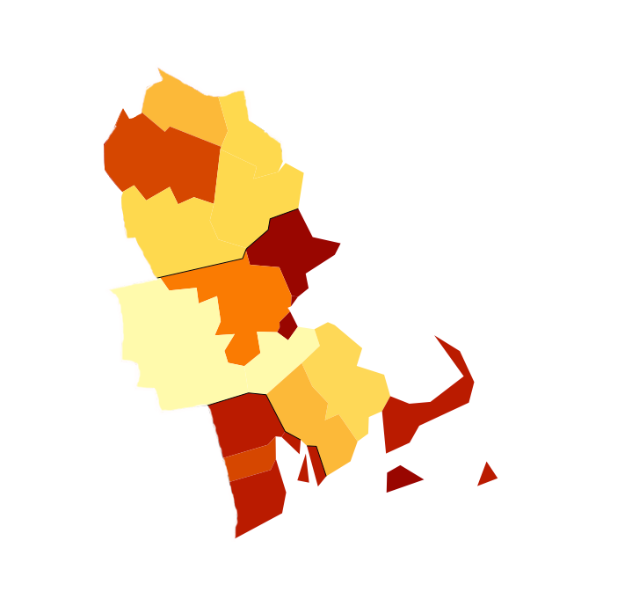
Exposure Effects on Income in the Boston CSA
For Children with Parents at 75th Percentile of Income Distribution
Belknap
Merrimack
Essex
Middlesex
Suffolk
Worcester
Norfolk
Plymouth
Provi-
dence
Barnstable
Causal Exposure Effects Per Year:
Suffolk MA: - 0.18 %
Middlesex MA: + 0.03 %
Newport

Slide 111
Annual Exposure Effects on Income for Children in Low-Income Families (p25)
Top 10 and Bottom 10 Among the 100 Largest Counties in the U.S.
Top 10 Counties |  |  |  | Bottom 10 Counties
Rank | County | Annual Exposure Effect (%) |  | Rank | County | Annual Exposure Effect (%)
1 | Dupage, IL | 0.80 |  | 91 | Wayne, MI | -0.57
2 | Fairfax, VA | 0.75 |  | 92 | Orange, FL | -0.61
3 | Snohomish, WA | 0.70 |  | 93 | Cook, IL | -0.64
4 | Bergen, NJ | 0.69 |  | 94 | Palm Beach, FL | -0.65
5 | Bucks, PA | 0.62 |  | 95 | Marion, IN | -0.65
6 | Norfolk, MA | 0.57 |  | 96 | Shelby, TN | -0.66
7 | Montgomery, PA | 0.49 |  | 97 | Fresno, CA | -0.67
8 | Montgomery, MD | 0.47 |  | 98 | Hillsborough, FL | -0.69
9 | King, WA | 0.47 |  | 99 | Baltimore City, MD | -0.70
10 | Middlesex, NJ | 0.46 |  | 100 | Mecklenburg, NC | -0.72
Exposure effects represent % change in adult earnings per year of childhood spent in county

Slide 112
Annual Exposure Effects on Income for Children in High-Income Families (p75)
Top 10 and Bottom 10 Among the 100 Largest Counties in the U.S.
Top 10 Counties |  |  |  | Bottom 10 Counties
Rank | County | Annual Exposure Effect (%) |  | Rank | County | Annual Exposure Effect (%)
1 | Fairfax, VA | 0.55 |  | 91 | Hillsborough, FL | -0.40
2 | Westchester, NY | 0.34 |  | 92 | Bronx, NY | -0.42
3 | Hudson, NJ | 0.33 |  | 93 | Broward, FL | -0.46
4 | Hamilton, OH | 0.32 |  | 94 | Dist. of Columbia, DC | -0.48
5 | Bergen, NJ | 0.31 |  | 95 | Orange, CA | -0.49
6 | Gwinnett, GA | 0.31 |  | 96 | San Bernardino, CA | -0.51
7 | Norfolk, MA | 0.31 |  | 97 | Riverside, CA | -0.51
8 | Worcester, MA | 0.27 |  | 98 | Los Angeles, CA | -0.52
9 | Franklin, OH | 0.24 |  | 99 | New York, NY | -0.57
10 | Kent, MI | 0.23 |  | 100 | Palm Beach, FL | -0.65
Exposure effects represent % change in adult earnings per year of childhood spent in county

Slide 113
Annual Exposure Effects on Income for Children in Low-Income Families (p25)
Male Children
Top 10 Counties |  |  |  | Bottom 10 Counties
Rank | County | Annual Exposure Effect (%) |  | Rank | County | Annual Exposure Effect (%)
1 | Bucks, PA | 0.84 |  | 91 | Milwaukee, WI | -0.74
2 | Bergen, NJ | 0.83 |  | 92 | New Haven, CT | -0.75
3 | Contra Costa, CA | 0.72 |  | 93 | Bronx, NY | -0.76
4 | Snohomish, WA | 0.70 |  | 94 | Hillsborough, FL | -0.81
5 | Norfolk, MA | 0.62 |  | 95 | Palm Beach, FL | -0.82
6 | Dupage, IL | 0.61 |  | 96 | Fresno, CA | -0.84
7 | King, WA | 0.56 |  | 97 | Riverside, CA | -0.85
8 | Ventura, CA | 0.55 |  | 98 | Wayne, MI | -0.87
9 | Hudson, NJ | 0.52 |  | 99 | Pima, AZ | -1.15
10 | Fairfax, VA | 0.46 |  | 100 | Baltimore City, MD | -1.39
Exposure effects represent % change in adult earnings per year of childhood spent in county

Slide 114
Annual Exposure Effects on Income for Children in Low-Income Families (p25)
Female Children
Top 10 Counties |  |  |  | Bottom 10 Counties
Rank | County | Annual Exposure Effect (%) |  | Rank | County | Annual Exposure Effect (%)
1 | Dupage, IL | 0.91 |  | 91 | Hillsborough, FL | -0.51
2 | Fairfax, VA | 0.76 |  | 92 | Fulton, GA | -0.58
3 | Snohomish, WA | 0.73 |  | 93 | Suffolk, MA | -0.58
4 | Montgomery, MD | 0.68 |  | 94 | Orange, FL | -0.60
5 | Montgomery, PA | 0.58 |  | 95 | Essex, NJ | -0.64
6 | King, WA | 0.57 |  | 96 | Cook, IL | -0.64
7 | Bergen, NJ | 0.56 |  | 97 | Franklin, OH | -0.64
8 | Salt Lake, UT | 0.51 |  | 98 | Mecklenburg, NC | -0.74
9 | Contra Costa, CA | 0.47 |  | 99 | New York, NY | -0.75
10 | Middlesex, NJ | 0.47 |  | 100 | Marion, IN | -0.77
Exposure effects represent % change in adult earnings per year of childhood spent in county

